Slide 1
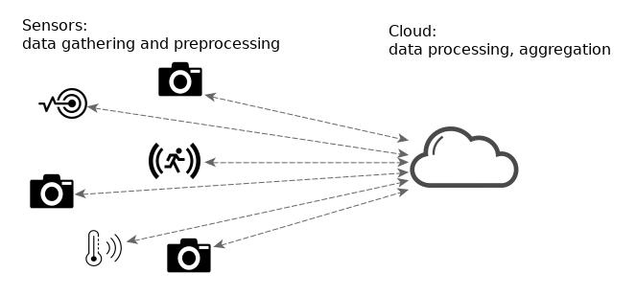
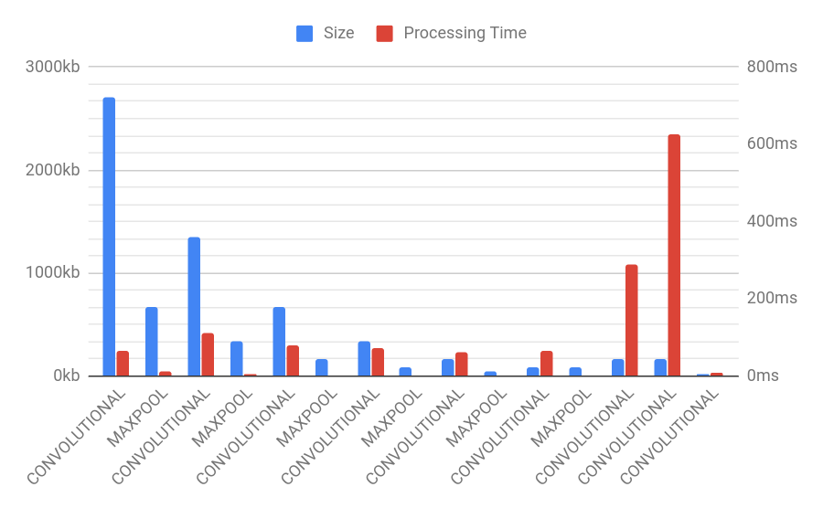
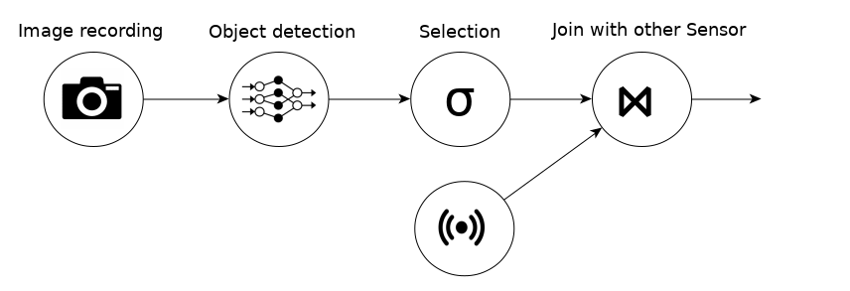




Collaborative Edge and Cloud Neural Networks for
Real-Time Video Processing
44th International Conference on Very Large Data Bases 2018 (VLDB), August 27-31, 2018, Rio de Janeiro
Philipp M. Grulich Technische Universität Berlin philipp.grulich@campus.tu-berlin.de | Faisal Nawab UC Santa Cruz nawab@ucsc.edu
Scenario
Splitting processing of Neuronal Networks
c
Example Processing Pipeline
Performance analysis of Yolo Light Neronal Network, Redmon et al. 2016
Proposed by Kang et al., ASPLOS 2017
Collaborative processing Neural Networks between Edge and Cloud nodes.
Edge processes first N-Layers and Cloud the rest.
Extendable for processing over multiple hops.
Trades latency vs. bandwidth consumption
Is it beneficial on its own?
Observation: Object Detection is in the most cases the most computational intensive operation
1) Lossy Compression
2) Differential communication
On the raw data: We can apply lossy image compression like JPEG.
Combined with Splitting: We compress the weight vector with ZFP. It supports lossy float compression, by a fixed number of bits.
Lossy Compression affects Accuracy.
Two sequential frames typically overlap -> transfer only difference
Inspired by Video Encoding and WANalytics, Vulimiri et. al, CIDR 2015
On the raw data: We applied … to calculate the difference between two frames.
Combined with Splitting: We compress the weight vector with ZFP. It supports lossy float compression, by a fixed number of bits.
Open Source Repositories
Evaluation
Demonstration repository:
github.com/philippgrulich/collaborative

