Slide 1
BPMN
(Business Process Model and Notation)

Slide 2
BPMN Elemente
3 Basiselemente
Flow Objects
Connectiong Objects
Swimlanes
Artifacts

Slide 3


Flow Objects
Events
Start
Intermediate
End
Activities
Task
Subprocess

Slide 4

Flow Objects
Gateways
XOR
OR
AND
eventbasiert

Slide 5



Connecting Objects
Sequence Flow
Message Flow
Association

Slide 6
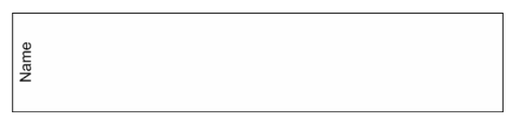
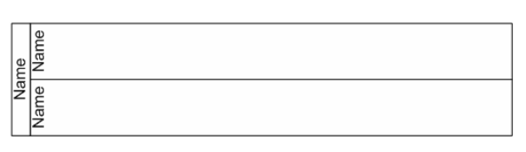
Swimlanes
Pool
Lane

Slide 7
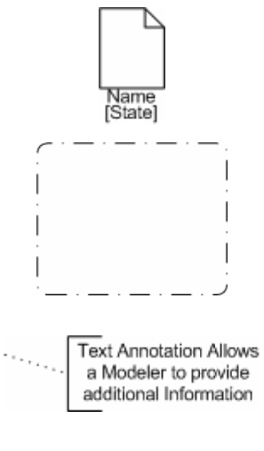
Artifacts
Data Object
Group
Annotation

Slide 8
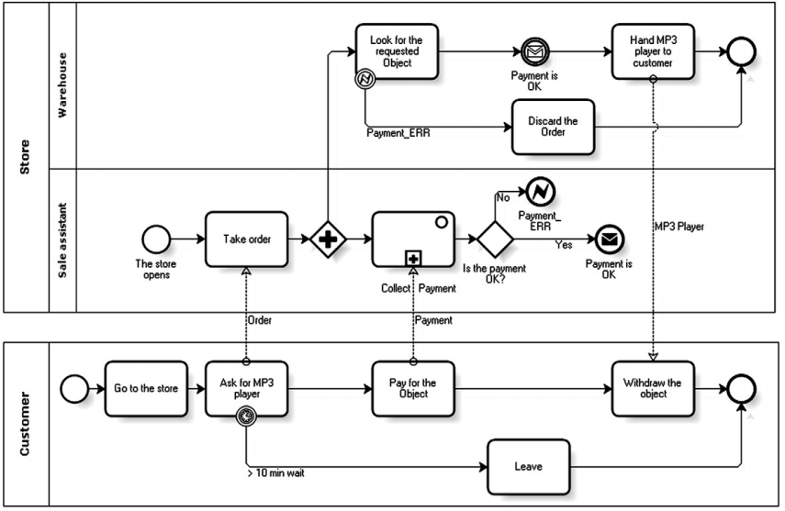

Slide 9
Verwendungszweck
Speziel of Businessprozesse ausgelegt
Exportierbar nach BPEL
Keine Businessregeln

