Slide 1
2nd Bibliometric-enhanced Information Retrieval (BIR) workshop
Philipp Mayr, Ingo Frommholz, Peter Mutschke, Andreas Scharnhorst
ECIR 2015, Vienna (Austria) 2015-03-29
http://www.gesis.org/en/events/conferences/ecirworkshop2015/
http://ceur-ws.org/Vol-1344/

Slide 2
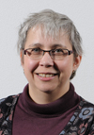
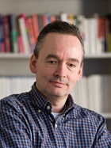
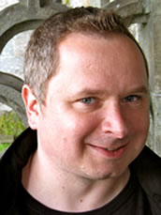
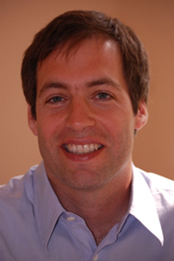
Who we are
Andrea Scharnhorst Peter Mutschke Ingo Frommholz Philipp Mayr
Successful workshop at ISSI 2013 „Combining Bibliometrics and Information Retrieval“ and ECIR 2014, the 1st BIR workshop
Our interests include information retrieval, information seeking, science modeling, network analysis, information visualization, and digital libraries…
Notes:
We are from the Digital Library field
We use bibliometric techniques to enhance/enrich live search systems (e.g. sowiport)
We have evaluated value-added effects in retrieval e.g. in bibliometric-enhanced browsing, ranking, visualization
We do IR evaluations

Slide 3
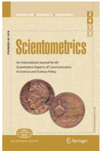
News
Special Issue on „Combining bibliometrics and information retrieval“ appeared
Editorial + 8 papers
Volume 102, Issue 3, March 2015
http://link.springer.com/journal/11192/102/3/page/2

Slide 4
Why is the workshop at ECIR? Workshop ideas
We aim to raise awareness of the missing link and to create a common ground for the incorporation of bibliometrics/science modeling and retrieval in digital libraries.
After ISSI, moving to the core-IR community
The goal is to
explore how statistical modelling of scholarship, such as Bradfordizing or network analysis of co-authorship network, can improve retrieval services
apply insights from bibliometrics, scientometrics, and informetrics to practical problems of retrieval and browsing in Digital Libraries

Slide 5
Workshop Agenda
Introduction
Keynote by Guillaume Cabanac
Paper Session Block 1: Citation Contexts
Anna Dabrowska and Birger Larsen: Exploiting Citation Contexts for Physics Retrieval
Marc Bertin and Iana Atanassova: Factorial Correspondence Analysis Applied to Citation Contexts
Group discussion
Break
10 min for each paper!
30 min group discussions!

Slide 6
Workshop Agenda
Paper Session Block 2: Applications and Evaluation
Ian Wesley-Smith, Ralph Dandrea and Jevin West: An Experimental Platform for Scholarly Article Recommendation
Zeljko Carevic and Philipp Mayr: Extending search facilities via bibliometric-enhanced stratagems
Muhammad Kamran Abbasi and Ingo Frommholz: Polyrepresentative Clustering: A Study of Simulated User Strategies and Representations
Group discussion
Summary
Welcome Reception (Foyer) (starts at 5:30 pm)

Slide 7
Group discussions
Take notes while discussing the papers, somebody should summarize results for each paper block
Group A - Bibliometrics ++
Group AB - Bibliometrics +
Group B - Bibliom. + IR
Group BC – IR +
Group C – IR ++
Notes:
http://tinyurl.com/BIR2015-Group-A
http://tinyurl.com/BIR2015-Group-B
http://tinyurl.com/BIR2015-Group-C

Slide 8
Group discussions
Who are the clients for “Bibliometrics-meets-IR”?
Could “Bibliometrics-meets-IR” reach out to information visualization? If yes, how?
Where do you see open research question? How can these be addressed?
How can we stabilize the link between Bibliometrics and Information Retrieval?

Slide 9
Outlook
We will share all resources on the workshop website
Special issue in IJDL (Ingo Frommholz)
What did you like?
Follow-up workshop next year? SIGIR? Hackathon?

Slide 10
Thank you
Contact:
Dr Philipp Mayr
GESIS - Leibniz Institute for the Social Sciences, Germany
Email: philipp.mayr@gesis.org
Twitter: @philipp_mayr
Workshop website http://www.gesis.org/en/events/conferences/ecirworkshop2015
CEUR Workshop Proceedings http://ceur-ws.org/Vol-1344/

