Slide 1
3rd Bibliometric-enhanced Information Retrieval (BIR) workshop
Philipp Mayr, Ingo Frommholz, Guillaume Cabanac
ECIR 2016, Padua (Italy) 2016-03-20
http://www.gesis.org/en/events/events-archive/conferences/ecirworkshop2016/
Proceedings: http://ceur-ws.org/Vol-1567/

Slide 2
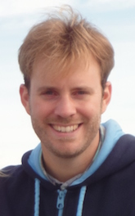
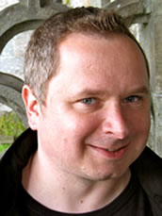
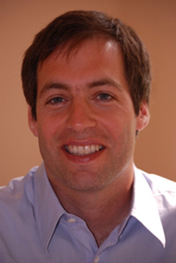
Who we are
Guillaume Cabanac Ingo Frommholz Philipp Mayr
Successful workshop at ISSI 2013 „Combining Bibliometrics and Information Retrieval“ and ECIR 2014, 2015, Computational Linguistics and Bibliometrics 2015 (ISSI 2015)
Our interests include information retrieval, information seeking, science modeling, network analysis, information visualization, and digital libraries…
Notes:
We are from the Digital Library field
We use bibliometric techniques to enhance/enrich live search systems (e.g. sowiport)
We have evaluated value-added effects in retrieval e.g. in bibliometric-enhanced browsing, ranking, visualization
We do IR evaluations

Slide 3
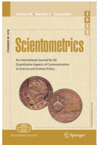
News
Special Issue on „Combining bibliometrics and information retrieval“ published
Editorial + 8 papers
Scientometrics Volume 102, Issue 3, March 2015
http://link.springer.com/journal/11192/102/3/page/2

Slide 4
Why is the workshop at ECIR? Workshop ideas …
The goal is to
explore how statistical modelling of scholarship, such as Bradfordizing or network analysis of co-authorship network, can improve retrieval services
apply insights from bibliometrics, scientometrics, and informetrics to practical problems of retrieval and browsing in Digital Libraries

Slide 5
Workshop Agenda I
Keynote by Marijn Koolen: Bibliometrics in Online Book Discussions: Lessons for Complex Search Tasks
Paper Session Block 1: Text and Reference Mining
Marc Bertin and Iana Atanassova. Weak Links and Strong Meaning: The Complex Phenomenon of Negational Citations
Andi Rexha, Stefan Klampfl, Mark Kröll and Roman Kern. Towards a more fine grained analysis of scientific authorship: Predicting the number of authors using stylometric features
Giovanni Colavizza, Matteo Romanello and Frederic Kaplan. The References of References: Enriching Library Catalogs via Domain-Specific Reference Mining
group discussion
Break

Slide 6
Workshop Agenda II
Paper Session Block 2: Bibliometrics - IR-Tools
Rosa Padrós-Cuxart and Francesc March-Mir. Bibliometrics: a Publication Analysis Tool
Nguyen Minh Tien and Cyril Labbe. Engineering a Tool to Detect Automatically Generated Papers
Group discussion
Summary

Slide 7
Workshop Agenda III
Paper Session Block 3:
Howard White. Bag of Works Retrieval: TF*IDF Weighting of Co-cited Works
Birger Larsen and Christina Lioma. On the Need for and Provision for an ‘IDEAL’ Scientific Information Retrieval Test Collection
Group discussion
Conclusions, feedback and further steps
Welcome Reception (starts at 6:30 pm)

Slide 8
Questions for group discussions by Marijn Koolen
What task types can be supported by bibliometric techniques?
What is the value of different types of citations for (co-)citation analysis and for various steps in complex search tasks?
How can (multistage) interfaces support such complex search tasks?
How can information need be effectively represented through … ?

Slide 9
Outlook
Call for BIRNDL workshop at JCDL 2016 http://wing.comp.nus.edu.sg/birndl-jcdl2016/
Deadline: 15 April 2016
We will share all resources on the workshop website
Special issue in IJDL (Ingo Frommholz)
What did you like?
Suggestions …

Slide 10
Thank you
Contact:
Dr Philipp Mayr
GESIS - Leibniz Institute for the Social Sciences, Germany
Email: philipp.mayr@gesis.org
Twitter: @philipp_mayr
Workshop website http://www.gesis.org/en/events/events-archive/conferences/ecirworkshop2016/
CEUR Workshop Proceedings http://ceur-ws.org/Vol-1567/

