Slide 1

AgriSense BW
Early warnings for crops and livestock in Botswana
Data Science Club · Botho University, Gaborone
Notes:
Hi, we are the Data Science Club of Botho University. This is AgriSense BW: early warnings for crops and livestock in Botswana.

Slide 2

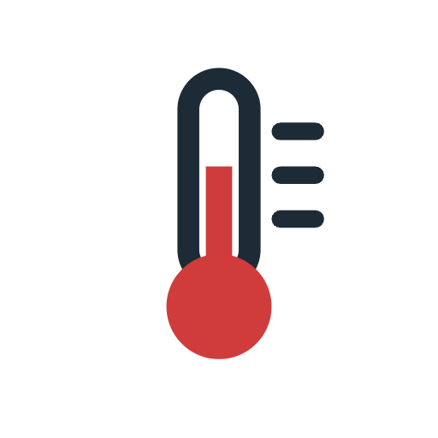
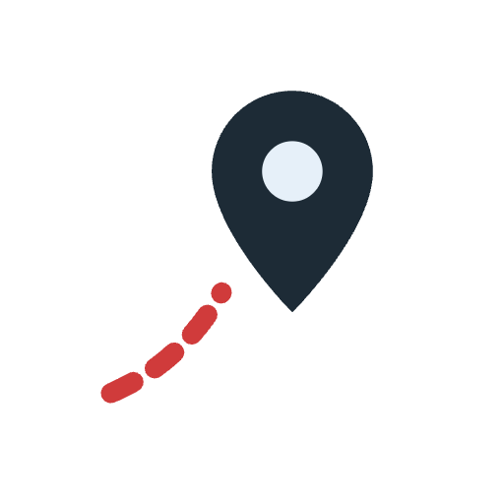

Farmers often find out too late
Dry seasons
Sick animals
Lost or stolen cattle
A poor harvest often shows only at the end of the season.
Illness can spread through a herd before anyone notices.
An animal can be kilometres away before it is missed.
AgriSense BW raises the alarm while there is still time to act.
AgriSense BW
2
Notes:
Farmers often find out too late: a poor harvest shows only at the end of the season, a sick animal can infect the herd, and a lost cow can be far away before anyone notices. We want to raise the alarm while there is still time to act.

Slide 3


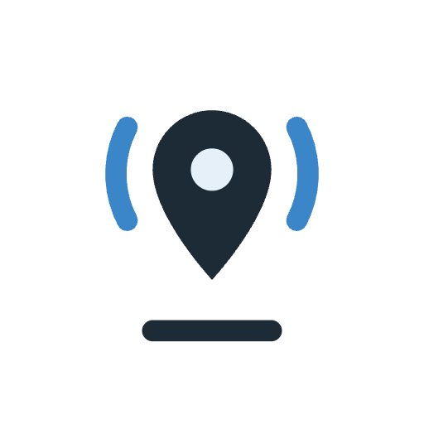
Two monitoring modules, one early-warning engine
Crop module
Rain, temperature and plant greenness → harvest forecast
Clear alerts
Risk level, reason and advice in English and Setswana, for farmers and vets
Early-warning engine
merges, ranks and explains every alert
Livestock module
GPS, activity and body temperature → unusual behaviour
AgriSense BW
3
Notes:
AgriSense BW has two modules: the crop module forecasts the harvest from rain, temperature and plant greenness, and the livestock module spots animals that behave unusually. Our early-warning engine turns both into one list of clear alerts.

Slide 4
Every alert says what, why and what to do
1
Risk level
High, Medium or Low, visible at a glance
▲ High
Animal H3-05 · herd H3
H3-05 may be lost or stolen
It has moved away from its herd on 5 days in a row and is now about 29 km from it.
2
Plain reason
no jargon, the numbers stay in the details
What to do
Look for it today and report it to the police if it is missing.
3
Next step
concrete advice, also in Setswana
AgriSense BW
4
Notes:
Here is a real alert from our prototype: animal H3-05 has left its herd for five days and is now about 29 kilometres away, so it may be lost or stolen. Every alert gives a risk level, a plain reason and a concrete next step, also in Setswana.

Slide 5
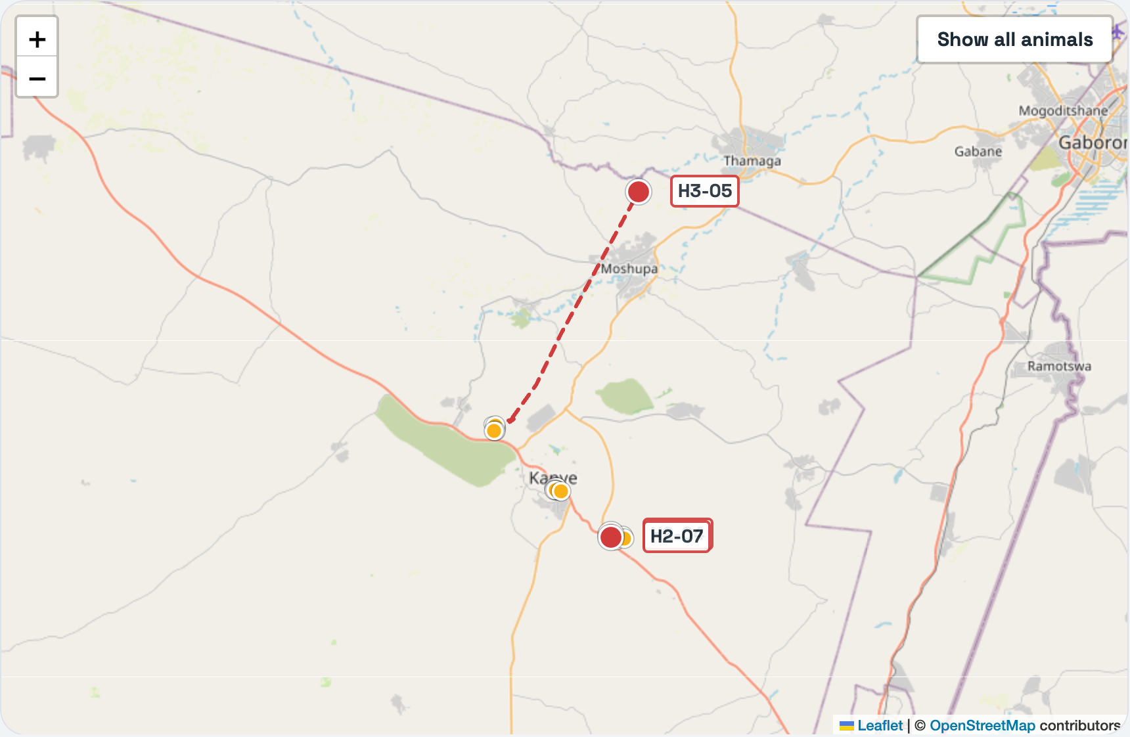
One dashboard for the whole district
Livestock map
every animal, coloured by risk; the dashed line is H3-05's path
Alert list
most urgent first, each with a status: open, acknowledged, resolved
Crops
yield history per site and the forecast for the season
Runs in any web browser
AgriSense BW
5
Notes:
Everything comes together in one web dashboard: a map of every animal coloured by risk, here with the straying animal's path, an alert list sorted by urgency, and the crop forecasts. You can try it on our laptop.

Slide 6

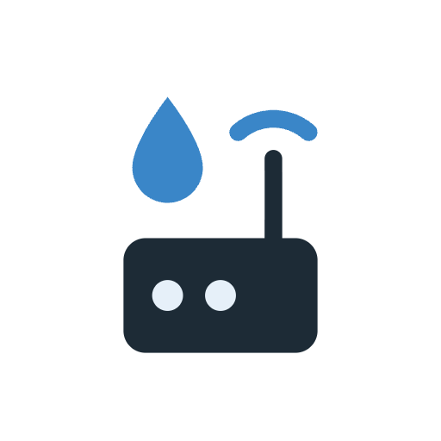

Our first hardware prototype
Collar
Gateway
Dashboard
Bluetooth
Wi-Fi
skin temperature and activity
Arduino UNO, GY‑906 infrared thermometer and accelerometer
collects collars and rain
Arduino UNO and Flying Fish rain sensor, at the kraal or field
high temperature, not seen, raining
Live Sensors tab with alerts
For real herds: a GPS module, long-range radio (LoRa or the mobile network), solar power and a real rain gauge. Skin temperature must be calibrated against a vet thermometer.
AgriSense BW
6
Notes:
We also built a first hardware prototype from our own parts: a collar with an infrared thermometer and a gateway with a rain sensor, which send live data to the dashboard. For real herds it still needs GPS, long-range radio and solar power.

Slide 7
Our prototype for the Southern district
6
30
3
46
crop sites forecast
2 of them at risk
of a poor harvest
animals tracked
for 30 days
in 3 herds
high-risk animals
2 possibly ill
1 possibly lost
alerts
ranked by urgency
each with advice
Note: All numbers come from simulated sample data, so the next step is real farms.
AgriSense BW
7
Notes:
Our prototype covers the Southern district: six crop sites, two at risk, and 30 animals tracked for a month, with three high-risk animals found. We built it in three days with simulated data.

Slide 8
Next: real farms, real data, and partners
Our next steps
We are looking for
GPS collars on a pilot farm
Livestock-tracking and sensor partners
Live weather and satellite data
Access to farm, weather and yield data
Leaf-photo disease detection for crops
Farms and vets to test it with us
Talk to us at the booth · github.com/PhilippSchoeneberg/AgriSenseBW
Abel Lefika Molefhi · Edward Gabathusi · Philipp Schöneberg · Thapelo Segosebe
AgriSense BW
8
Notes:
Next, we want real farms and real data: GPS collars on a pilot farm, live weather and satellite data, and later leaf-photo disease detection. For that we are looking for partners. Come and talk to us.

