Slide 1
AgriSense BW
Early-warning engine, database and dashboard
Philipp Schöneberg
Data Science Club, Botho University · Gaborone · October 2026
Notes:
My part of AgriSense BW is the early-warning engine: it takes the crop alerts from Thapelo and the livestock alerts from Abel and turns them into one list that farmers can understand. I also took over the dashboard, and added a small database behind it.

Slide 2
Two alert files, one list farmers can read
crop_alerts.csv
6 rows · Thapelo
alert_engine.py
merge · rules · advice
final_alerts.csv
31 alerts
SQLite + dashboard
status · map · charts
livestock_alerts.csv
30 rows · Abel
The six shared columns stay first, so everyone's format still fits.
AgriSense BW · Early-warning engine · demo with sample data
2
Notes:
The two input files had different shapes: the crop file has six rows in exactly the shared format, the livestock file has thirty daily rows with extra columns. The engine reads both, applies the rules, adds advice and writes final_alerts.csv. That file keeps the team's six shared columns first, then adds an ID, a category, dates, details and the position. The database and dashboard read from it.

Slide 3
Four rules turn raw flags into clear alerts
1
Plain language
Every reason is rewritten for farmers; the numbers move to a details column.
2
Merge repeats
Same animal, same problem, days in a row = one alert: 30 daily flags become 25 alerts.
3
Straying rule
Unusual movement on 3 or more days in a row becomes High: possibly lost or stolen.
4
Outbreak rule
3 or more possibly ill animals in one district within 7 days: High warning for veterinary services.
Advice: every alert gets advice in English and Setswana from one template file.
AgriSense BW · Early-warning engine · demo with sample data
3
Notes:
One: reasons in plain language, so a farmer can read them; the technical numbers are kept in a details column. Two: the livestock file has one row per animal per day, so an animal that was flagged five days in a row appeared five times; the engine merges those. Three: my own addition to the brief - if an animal moves unusually far on three or more days in a row, it is raised to High because it may be lost or stolen. Four: the outbreak rule from the team plan. Advice comes from advice_templates.csv in English and Setswana; six Setswana texts still need a native speaker.

Slide 4
31 alerts, 3 need action now
3
24
4
Lost or stolen?
Animal H3-05 moved away from its herd for 5 days and is now about 29 km from it.
▲ High
◆ Medium
● Low
6 crop alerts for the 2024 season: Kanye and Mabutsane Medium, the other four sites Low.
Outbreak rule: no warning
Only 2 animals are flagged as possibly ill (H2-04, H2-07). The rule needs 3.
AgriSense BW · Early-warning engine · demo with sample data
4
Notes:
The engine produces 31 alerts: 3 High, 24 Medium and 4 Low. The most important one is H3-05, which has walked away from its herd for five days and is now far from it, so the farmer is told to look for it today and report it if it is missing. The outbreak rule did not fire on our data: Abel's model flags two animals as possibly ill and the rule needs three. The rule only counts Abel's flags; it does not add its own temperature check. It is covered by unit tests, so it will fire as soon as the livestock model flags three animals within seven days.

Slide 5
SQLite remembers what was done
alerts
31 rows
alert_status
31 rows
1
Built from the CSVs
One script, one transaction.
crop_data
144 rows
livestock_data
900 rows
2
Status survives
Kept when the alerts are rebuilt.
reference_yields
35 rows
advice_templates
9 rows
3
Next
PostgreSQL and user accounts.
AgriSense BW · Early-warning engine · demo with sample data
5
Notes:
Behind the dashboard is a small SQLite database. One script loads all CSV files into tables, in a single transaction, so a broken file never leaves half a database. The dark table, alert_status, is the reason for having a database at all: when someone marks an alert as acknowledged or resolved in the dashboard, that is stored there, and it is kept when the engine runs again and the alerts are reloaded. For a real service we would move to PostgreSQL.

Slide 6
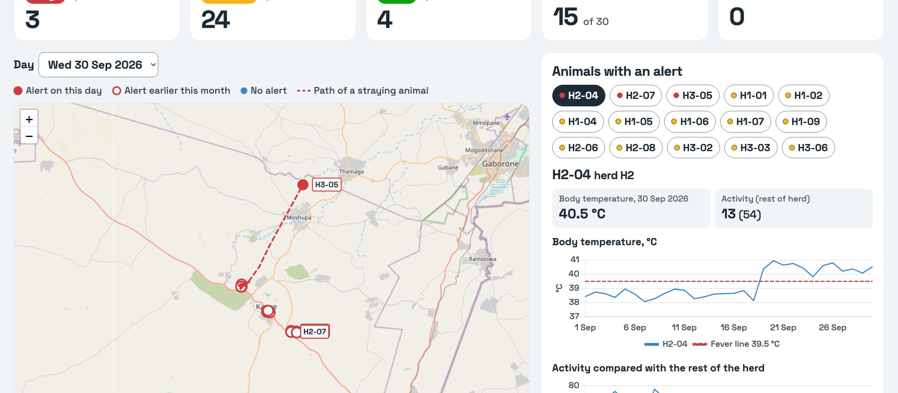
One dashboard: alerts, map and charts
Alerts
filter, set status, English or Setswana
Livestock
map, flagged animals in red, temperature chart
Crops
yield 2001–2024 and the 2024 forecast
Built with
FastAPI, Leaflet, Chart.js; API docs at /docs
Run it: uvicorn dashboard.main:app
then open 127.0.0.1:8000 in the browser
AgriSense BW · Early-warning engine · demo with sample data
6
Notes:
Live demo: start it with uvicorn dashboard.main:app and open localhost port 8000. Alerts tab: filter by risk, change a status, switch the advice to Setswana. Livestock tab: H3-05's path is the dashed red line; clicking H2-04 shows its temperature crossing the 39.5 degree fever line on 19 September. Crops tab: yield per site, with the 2024 forecast table. All JavaScript libraries are served locally; only the map tiles need internet. FastAPI also generates interactive API documentation at /docs.

Slide 7
What it can't do yet, and what comes next
Limitations
Next steps
The outbreak rule depends on the livestock model, which missed sick animal H2-09.
One GPS fix per day: movement at night can't be seen.
All crop and livestock data is sample data.
6 advice texts still need Setswana.
Compare each animal with its own normal, and add a fever rule.
Several GPS fixes per day.
Real weather and NDVI data (NASA POWER, CHIRPS).
PostgreSQL and accounts for farmers and vets.
AgriSense BW · Early-warning engine · demo with sample data
7
Notes:
The biggest limitation: the outbreak rule can only be as good as the livestock detection. Three animals in herd H2 had a fever from about 19 to 23 September, but the model compares each animal with its herd's average, and that average drops when several animals are ill at once, so H2-09 was never flagged. Comparing each animal with its own normal values, or adding a fever rule, would catch it. Also: one GPS position per day, sample data only, and six Setswana translations missing.

