Slide 1
RAIL/ROAD INTERFACE
General Controller (PC)
Serial Bus
PIC18F
CAN BUS
POWER SUPPLY 20V CC
POWER SUPPLY 24V CC
POWER SUPPLY 24V CC
Amplification and channel output + presence detection
S1
S2
Block control interface
Slave
Block control interface
Master
Block control interface
Slave
General Controller (PC)
Serial Bus
CAN BUS
CAN BUS
CAN BUS
POWER SUPPLY 24V CC
24V
24V
24V
24V
TRACK SECTION 1
TRACK SECTION i
TRACK SECTION N

Slide 2
PIN ASSIGNMENT
PIC18F4585
PIN | SIGNAL NAME | SIGNAL USED | SCHEMATIC | DIR | FONCTION
1 | MCLR/Vpp/RE3 | MCLR/Vpp | MCLR/Vpp | IN | PIC programming via PICkit2
2 | RA0/AN0/Cvref | AN0 | CURT0 | IN | Track voltage measurement 0
3 | RA1/AN1 | AN1 | CURT1 | IN | Track voltage measurement1
4 | RA2/AN2/Vref- | AN2 | CURT2 | IN | Track voltage measurement2
5 | RA3/AN3/Vref+ | AN3 | CURT3 | IN | Track voltage measurement
6 | RA4/T0CKI | RA4 | S1T0 | OUT | S1 Track 0
7 | RA5/AN4/SS/HLVDIN | AN4 | I/O_4 | IN | KNOB 0 analog value
8 | RE0/RD/AN5 | AN5 | I/O_5 | IN | KNOB 1 analog value
9 | RE1/WR/AN6/C1OUT | RE1 | I/O_6 | OUT | TM1637 SCK I2C bus (mode)
10 | RE2/CS/AN7/C2OUT | RE2 | I/O_7 | OUT | TM1637 SDA I2C bus (mode)
11 | Vdd | Vdd | VCC_5V | IN | +5V
12 | Vss | Vss | GND | IN | GND
13 | OSC1/CLKI/RA7 | RA7 | S2T0 | OUT | S2 Track 0
14 | OSC2/CLK0/RA6 | RA6 | S1T1 | OUT | S1 Track 1
15 | RC0/T1OSO/T13CKI | RC0 | S2T1 | OUT | S2 Track 1
16 | RC1/T1OSI | RC1 | S1T2 | OUT | S1 Track 2
17 | RC2/CCP1 | RC2 | S2T2 | OUT | S2 Track 2
18 | RC3/SCK/SCL | RC3 | S1T3 | OUT | S1 Track 3
19 | RD0/PSP0/C1IN+ | RD0 | S2T3 | OUT | S2 Track 3
20 | RD1/PSP1/C1IN- | RD1 | I/O_0 | IN | Global Purpose Input 0

Slide 3
PIN | SIGNAL NAME | SIGNAL USED | SCHEMATIC | DIR | FONCTION
21 | RD2/PSP2/C2IN+ | RD2 | I/O_1 | IN | Global Purpose Input 1
22 | RD3/PSP3/C2IN- | RD3 | I/O_2 | IN | Global Purpose Input 2
23 | RC4/SDI/SDA | RC4 | I/O_3 | IN | Global Purpose Input 3
24 | RC5/SDO | RC5 | IDENTBIT2 | IN | BIT 2 card identifier
25 | RC6/TX/CK | RC6 | IDENTBIT3 | IN | BIT 3 card identifier or TX line if MAX232 installed
26 | RC7/RX/DT | RC7 | IDENTBIT4 | IN | BIT 4 card identifier or RX line if MAX232 installed
27 | RD4/PSP4/ECCP1/P1A | RD4 | IDENTBIT1 | IN | BIT 1 card identifier
28 | RD5/PSP5/P1B | RD5 | IDENTBIT0 | IN | BIT 0 card identifier
29 | RD6/PSP6/P1C | RD6 | OUT0 | OUT | Low-power control (points, low beam, lighting, level crossings, various motors)
30 | RD7/PSP7/P1D | RD7 | OUT1 | OUT | Low-power control (points, low beam, lighting, level crossings, various motors)
31 | Vss | Vss | VCC_5V | IN | +5V
32 | Vdd | Vdd | GND | IN | GND
33 | RB0/INT0/FLT0/AN10 | RB0 | OUT2 | OUT | Low-power control (points, low beam, lighting, level crossings, various motors)
34 | RB1/INT1/AN8 | RB1 | OUT3 | OUT | Low-power control (points, low beam, lighting, level crossings, various motors)
35 | RB2/INT2/CANTX | CANTX | CANTX | IN/OUT | Bus CAN Transmission
36 | RB3/CANRX | CANRX | CANRX | IN/OUT | Bus CAN Reception
37 | RB4/KBI0/AN9 | RB4 | OUT4 | OUT | Low-power control (points, low beam, lighting, level crossings, various motors)
38 | RB5/KBI1/PGM | RB5 | OUT5 | OUT | Low-power control (points, low beam, lighting, level crossings, various motors)
39 | RB6/KBI2/PGC | PGC | PGC | IN/OUT | PIC programming via PICkit2
40 | RB7/KBI3/PGD | PGD | PGD | IN/OUT | PIC programming via PICkit2

Slide 4
Channel signal amplification

Slide 5
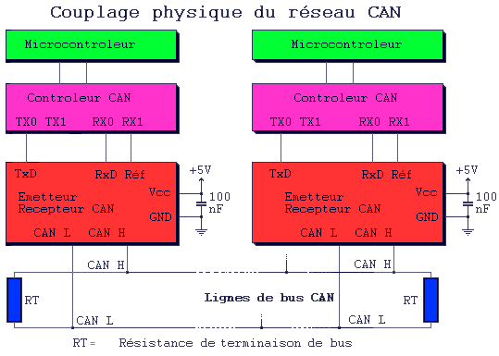
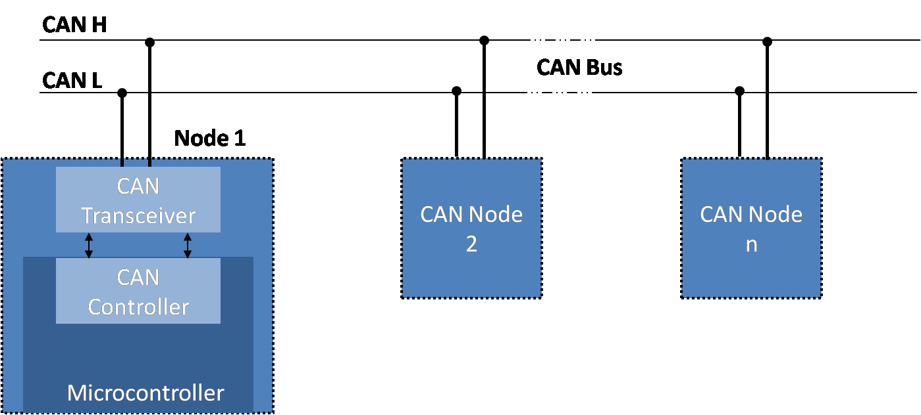
Communication via CAN bus
Remember the termination resistor on the last element!

Slide 6
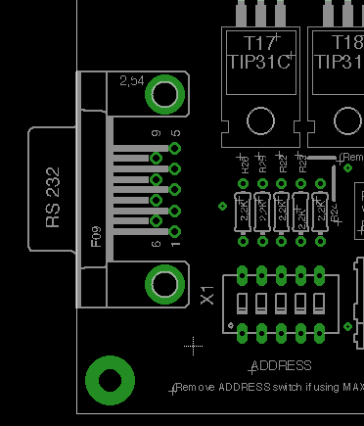

Slide 7
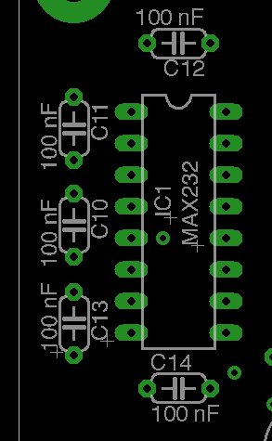

Slide 8
