Slide 1
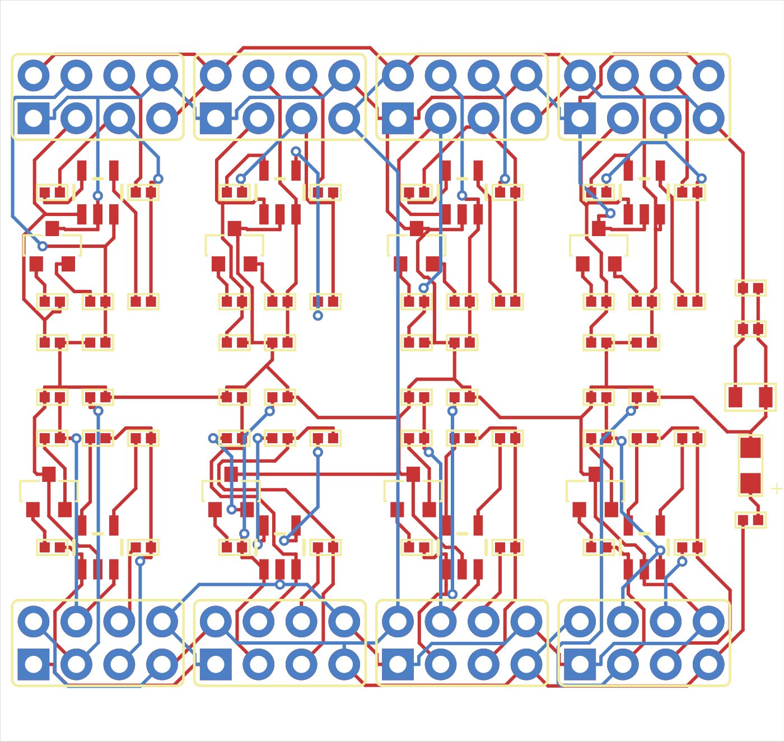
PCB Loop
AI-guided PCB
placement optimization
Philippe Ferreira De Sousa
CoreWeave Hackathon
Recorded Medium candidate
Notes:
0:00–0:20
I built PCB Loop to explore whether an AI agent can improve a circuit board by changing its placement, measuring the result, and trying again. The hard part is shrinking the design while keeping every required connection and manufacturing rule intact.
SOURCES
https://github.com/PhilippeFerreiraDeSousa/copper-scar/blob/main/docs/hackathon/README.md
/Users/philippe/.codex/worktrees/3bde/copper-scar/.local/medium-loop/stage2/edge-x-tight-01/candidate-01/score.json

Slide 2
Placement and routing loop
Stage 1: reach validity
Stage 2: lower the score
Preserve the circuit and manufacturing constraints
Codex task
Python
Freerouting
KiCad
Selects experiment
Creates a candidate
Traces and vias
Checks and scores
Saved result and diagnostics
One persistent task can run a candidate or a batch, then revise the experiment
Notes:
0:20–0:55
There are two stages: first get a valid board, then improve its score while preserving validity. A persistent Codex task reads the board, constraints, and previous failures. It writes or revises Python experiments. Freerouting chooses trace paths and vias across the allowed layers, and native KiCad checks decide whether the result passes. The saved diagnostics guide the next experiment. Some experiments evaluate a batch without another model decision between candidates. JITX import and display are separate from this demo routing path.
SOURCES
https://github.com/PhilippeFerreiraDeSousa/copper-scar/blob/main/docs/hackathon/README.md
https://github.com/PhilippeFerreiraDeSousa/copper-scar/blob/codex/medium-pcb-loop/experiments/medium-loop/shared_backend.py
https://github.com/PhilippeFerreiraDeSousa/copper-scar/blob/codex/medium-pcb-loop/scripts/copperhead_route.py

Slide 3
Medium score fell by 45.8%
65,288
35,365
Starting valid board
Best recorded valid board
Score = assembled volume (mm³) + 50 × vias + 5,000 × copper layers
85 components, reduced demo circuit. Original/full board remains incomplete.
Notes:
0:55–1:25
On the 85-component Medium circuit, the recorded score fell from 65,288 to 35,365, a 45.8 percent reduction. The score combines assembled volume with via and layer penalties. This line shows the best valid result after each completed attempt, including flat sections when attempts fail or do not improve it. These are native CAD checks on a reduced demo circuit. I am not claiming the full original competition board is solved or that this hardware has been manufactured.
SOURCES
/Users/philippe/.codex/worktrees/3bde/copper-scar/.local/medium-loop/stage2/baseline/score.json
/Users/philippe/.codex/worktrees/3bde/copper-scar/.local/medium-loop/stage2/edge-x-tight-01/candidate-01/score.json
https://github.com/PhilippeFerreiraDeSousa/copper-scar/blob/main/docs/hackathon/medium-candidate-ledger.json

Slide 4
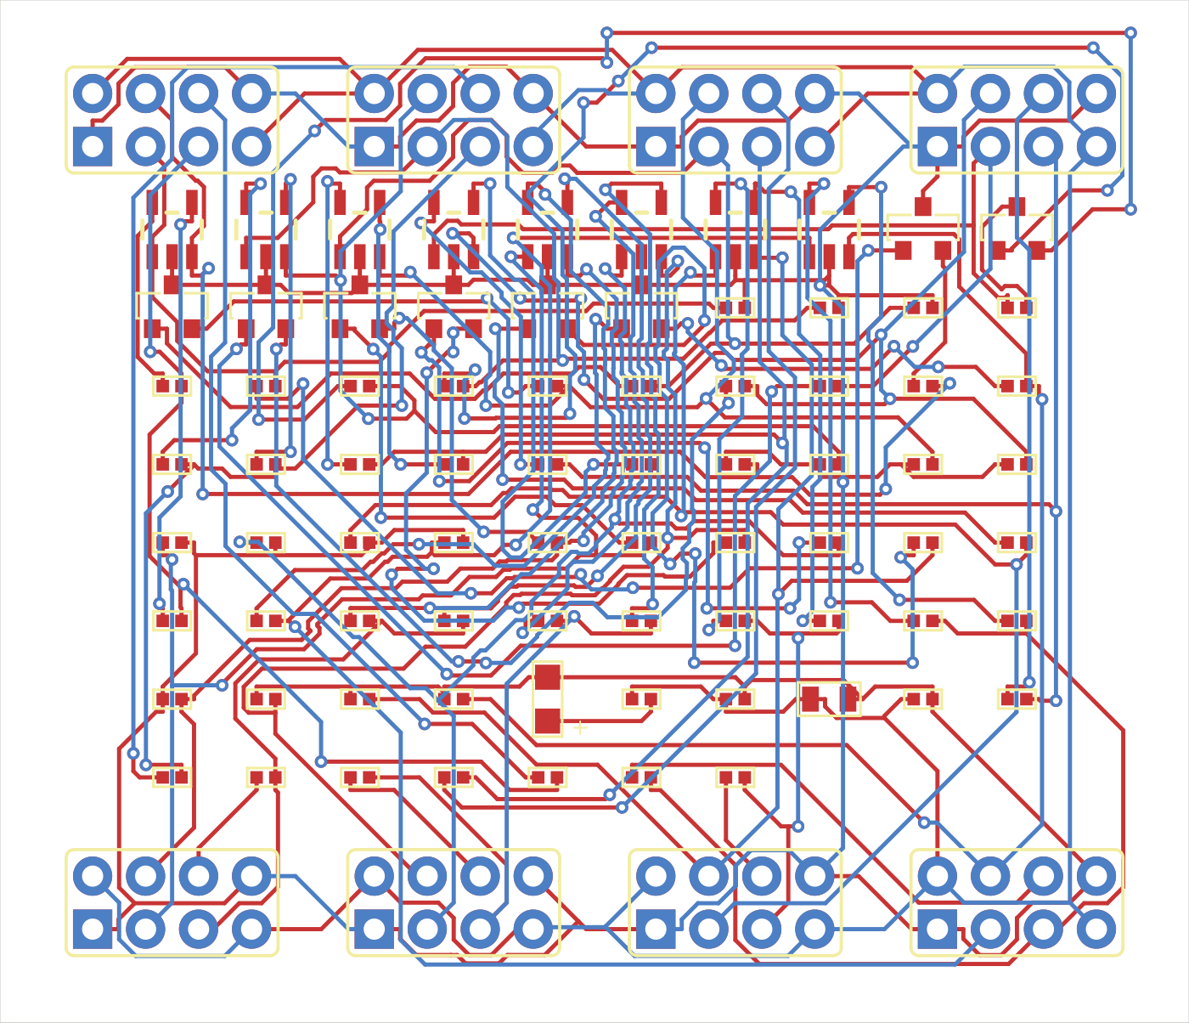
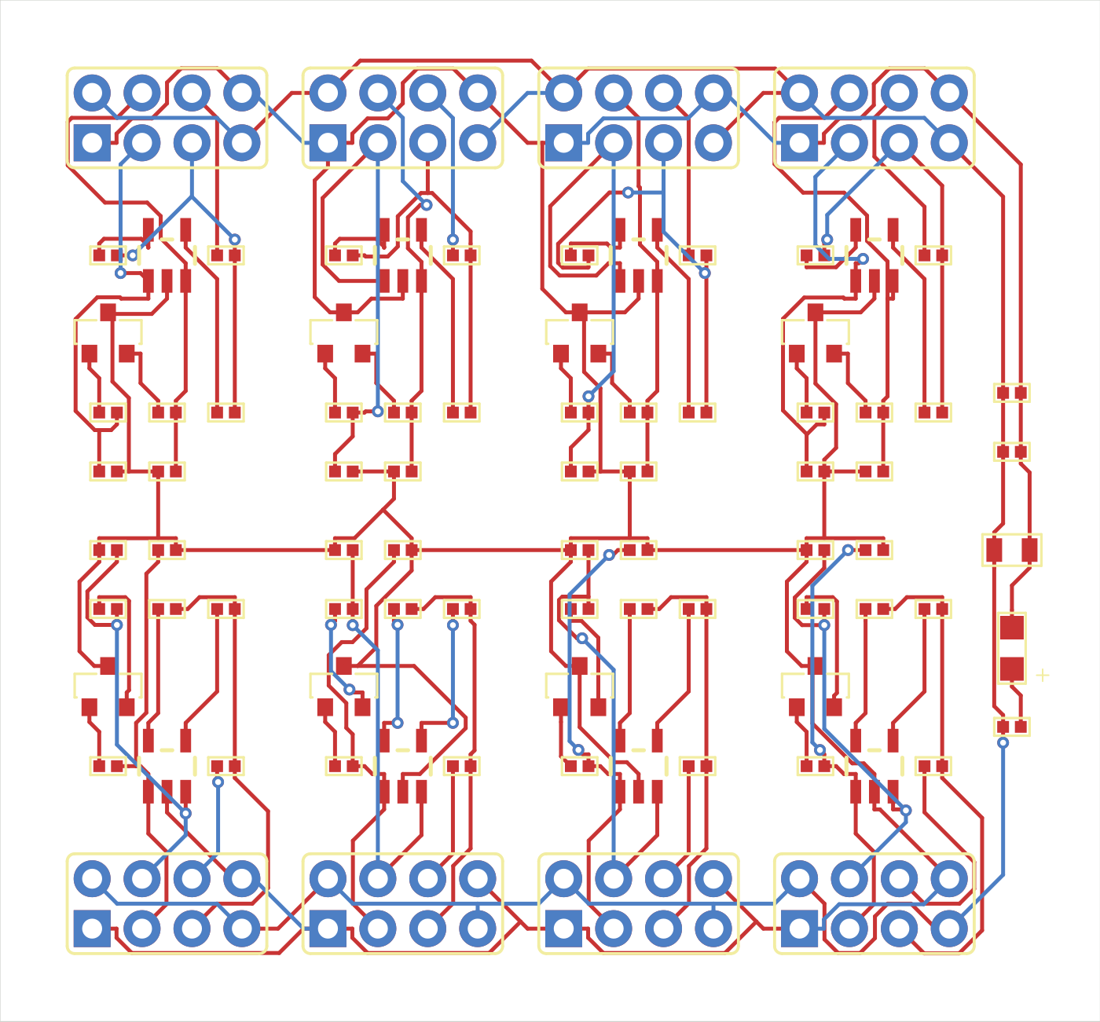
Functional grouping reduced the via cost
Before grouping
Connected blocks near their headers
148 vias
Score 49,910.52
29 vias
Score 45,345.68
Notes:
1:25–1:55
One useful experiment regrouped components around their own external headers. The resulting route used 29 vias instead of 148. The assembled volume actually increased slightly, but the lower via penalty more than compensated, improving the score by about 9 percent. This is why the loop measures the full objective rather than just trying to make the outline smaller. The pictures are the recorded native board renders; Python proposed placement, and Freerouting generated the routes.
SOURCES
/Users/philippe/.codex/worktrees/3bde/copper-scar/.local/medium-loop/stage2/continuation-01/candidate-02/score.json
/Users/philippe/.codex/worktrees/3bde/copper-scar/.local/medium-loop/stage2/functional-probe-01/candidate-01/score.json
https://github.com/PhilippeFerreiraDeSousa/copper-scar/blob/codex/medium-pcb-loop/experiments/medium-loop/grouped_input.py
https://wandb.ai/philippe-fdesousa/copper-scar/weave/calls/4ea50c71-2ab3-549f-8917-d32b321e2fa7

Slide 5
W&B connects each result to its evidence
Evidence | What I can inspect
Charts | Valid score, vias, volume and rejected attempts
Weave record | Action parameters, commands and validation output
Artifacts | Candidate PCB, native reports and source hashes
Open the optimization run
Open the grouping trace
Completed experiment records. Routing time comes from command logs.
W&B upload verified through 40,074.08. The latest local result is 35,365.44.
Notes:
1:55–2:30
W&B is how I inspect and compare the experiments. The charts show which attempts improved the retained score. In Weave, I can open a concrete attempt and see its action, source commit, commands, router log, and validation result. The artifact ties those measurements to the exact board. These records were uploaded after execution, so they are experiment evidence rather than live LLM spans. If time permits, click the grouping trace and expand action and result. The latest verified remote upload predates the latest local result.
SOURCES
https://wandb.ai/philippe-fdesousa/copper-scar/runs/medium-stage2-continuation-20260913
https://wandb.ai/philippe-fdesousa/copper-scar/weave/calls/4ea50c71-2ab3-549f-8917-d32b321e2fa7
/Users/philippe/.codex/worktrees/3bde/copper-scar/.local/medium-loop/stage2/continuation-observability/verified.json

Slide 6
Results and next step
Board family | Components | Recorded status
Small | 15 | Valid reduced circuit
Medium | 85 | Valid, 45.8% lower score
Large | 156 | Incomplete
Original / Full | 245 | Incomplete
Next: qualify the original 245-component board
Public code, prompts and candidate history
github.com/PhilippeFerreiraDeSousa/copper-scar
Notes:
2:30–3:00
We now have valid reduced Small and Medium circuits, and a saved history of how each candidate was generated and evaluated. Large and the original 245-component board remain incomplete. The next step is qualifying that original board while preserving the same circuit and manufacturing constraints. The source, agent instructions, and candidate action history are public, so people can inspect what ran and build on the experiment. Thank you.
SOURCES
https://github.com/PhilippeFerreiraDeSousa/copper-scar/blob/main/docs/hackathon/README.md
https://github.com/PhilippeFerreiraDeSousa/copper-scar/blob/codex/small-pcb-loop/experiments/small-loop/RESULTS.md
https://github.com/PhilippeFerreiraDeSousa/copper-scar/blob/codex/large-pcb-loop/experiments/large-loop/RESULTS.md

Slide 7
Backup: what prompts the update?
A persistent Codex task
Initial stage instructions + Coordinator feedback + inspected files
Actual initial prompt excerpt
“Outer iteration changes placement/topology, inner runs full-board enabled-layer autorouting then native evaluation.”
Stage 1 seeks full validity. Stage 2 accepts only a lower valid score.
Public prompt archive
Notes:
Backup slide, excluded from the three-minute script. The excerpt is from the actual creation prompt. A task continues across experiments; there is no fresh agent spawn for every candidate. Some candidates come from a deterministic batch. Later Coordinator messages ask for a specific diagnostic-driven intervention. The prompt describes intended action space, while the recorded actions establish what actually ran.
SOURCES
https://github.com/PhilippeFerreiraDeSousa/copper-scar/blob/main/docs/hackathon/prompts/stage-1-medium-initial.md
https://github.com/PhilippeFerreiraDeSousa/copper-scar/blob/main/docs/hackathon/prompts/stage-2-medium-transition.md

Slide 8
Backup: tool roles
Tool | Role in the four-family demo
Codex + Python | Propose and implement experiment changes
Freerouting | Trace paths and automatic via transitions
KiCad | Native geometry, connectivity and rule checks
JITX | Initial input import/display; separate routing research
W&B + Weave | Recorded metrics, actions and artifact evidence
Candidates are KiCad snapshots. Each completed attempt has its own folder.
Notes:
Backup slide. All four demo families used Freerouting for full-board trials. Earlier original/full work also used KiCadRoutingTools for targeted repairs. Separate JITX source-authored routing and transfer fixtures exist, but they do not establish the four-family demo as a JITX routing loop. Candidate directories preserve before-routing preview, evaluated board, actions, source hashes, and reports.
SOURCES
https://github.com/PhilippeFerreiraDeSousa/copper-scar/blob/main/docs/hackathon/README.md
https://github.com/PhilippeFerreiraDeSousa/copper-scar/blob/codex/medium-pcb-loop/experiments/medium-loop/jitx_input.py
https://github.com/PhilippeFerreiraDeSousa/copper-scar/blob/codex/medium-pcb-loop/scripts/copperhead_route.py

