Slide 2
Overview
Selling different tokens from an app in a physical sale running on mobile (phone or tablet)
Payments accepted:
In fiat money
In stable coins
Potentially in crypto
Supporting multiple vendors/customers
Being responsive enough, avoiding blockchain latencies

Slide 3
Sale in fiat
The salesman/customer selects a token to buy
The salesman locks the token preventing a concurrent sale
The payment is received (either in cash or by card)
The token is then transferred to the destination address
If the customer has no wallet, he is invited to pick up a prepared sealed envelope which contains the private key and on which the address is printed as QR code. (note that the private key could also be stored on a ledger in the envelope)
Otherwise, the customer is invited to present his address as a QR code which will be scanned by the salesman

Slide 4
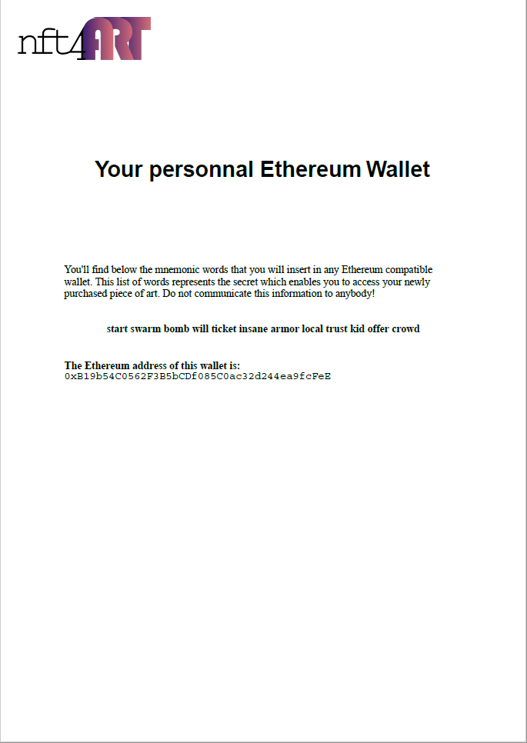
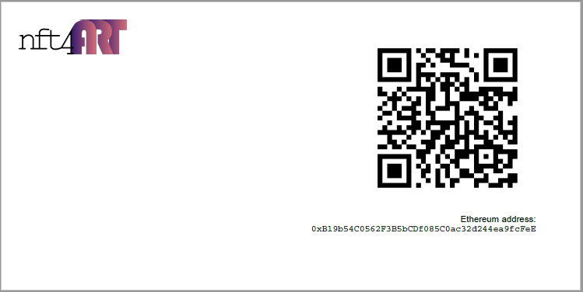
Generated Wallets
The envelope contains the Ethereum address displayed as a QR code and the letter contains the private key which can be imported in any Ethereum wallet

Slide 5
Sale in crypto
The customer selects a token to buy
The customer gives the source address and the crypto used to pay
The salesman locks the token preventing a concurrent sale
The customer transfers the crypto to the destination address
The server gets notified when the payment has arrived
The server compares the announced payment with what has been received and if this ok, performs the token transfer

Slide 6
Architecture
A server interfacing the PoS application with the blockchain:
Pushing the sales transactions either directly or the smart contract
Retrieving the events
Isolating the PoS application from potential Blockchain slowness
A PoS application (in ReactJS) connected to the server:
Displaying the available tokens, getting the sales events
Capturing the sale details (source address, amount), locking the token
Initializing the server (to load the encrypted private key)
In the future, minting the tokens
An companion app for the Nfts customers to visualize the video and the 3D of the shard

Slide 7
Deployment
The application is for now based on Ethereum but could be deployed on any EVM compatible chain. Choice to be made
The server connects to Ethereum via Infura services. Could be replaced by any other provider
The server is developed in Node.js + Typescript and runs for now on glitch.me. A more solid hosting would be good to offer a better security for the shop’s private keys

Slide 8
PoS
Displays a map of all available tokens, allows to define their price
Receives all the updates from the server when a token is locked/sold
Locks a token when a customer is interested
Capture the payment details from the customer
Instruct the server to perform the sale

Slide 9
Server
Interface between the PoS and the blockchain:
Caches all the Nft information (metadata, pictures, …)
Maintains the shop’s private keys (encrypted with a password)
Locks tokens when a customer has confirmed his interest
Receives the payment confirmation and generates the associated transaction
Publishes all the events to the PoS:
Locks
Transactions
Prices
Initial version configured with a file containing the Nft addresses and private key

Slide 10
Server – main end points
Tokens functions (tokens are identified with address and id):
listAvailableTokens: provides all the available tokens (including locked)
listAllTokens: provides the list of all the tokens (including sold)
lock/unlockToken: locks or unlocks a token
tokenImage: get a token’s full image
tokenIcon: get a token’s icon
authorizePoS: register a new PoS
Sale functions:
Register a payment fiat or crypto

Slide 11
Server – webSockets and Events
WS pushing to the PoSs the updates on:
Tokens locks / unlockcs / sales
Token price changes
Synchronize the video players in the client apps
Listens to blockchain events:
Stable coins transfers to the smart contract
Ether payments
Usage statistics

Slide 12
Pos – Main screens
The login screen registers a PoS with the admin password (the one which encrypts the private keys). When the PoS is registered, it can be accessed either by a regular salesman or by the administrator who has more functionalities (update prices, block PoS, …)
The landing screen is the map of all the shards. If a shard is not available, it is greyed out otherwise the area around the shard is clickable
Clicking on a shard opens its identity card it is then possible to buy it
Clicking the buy button reserves the shard, if the number of co-owners is reached (1 for an Nft), the shard is made non available

Slide 13
Pos – Main screens
The buying screen shows the different payment means:
Cash
Card
Crypto (stable coin or Ether)
This screen also contains a QR code scanner to read the destination address where the token should be transferred
The PoS only transfers the buying information to the server which performs the processing
A technical screens displays the progress of the different sales so that buyers can be updated on the progress

Slide 14
Client App
Shows the map
Shows the purchased shard (picture and model)
Plays the video (synchronized by the server)

