Slide 1
Crypto opportunities
04.11.2022

Slide 2
Looking back on what has been done in Crypto
Main milestones:
2018 Decision to deploy a crypto setup
2020 Finma approval
2021 Preparing Phase 2
Strategy:
2018-2021: Crypto as payment product and custody services
2021 - :
Corporates: crypto and crypto custody for treasurers, digital assets
Private banking: expanding the product mix to crypto, digital assets and collateralized loans
Institutional customers: custody services, collateralized loans, tokenization
Crypto pure players: gateway to traditional banking (stable coin guarantees, accounts, …)
The rational for our strategy has been to use our strength, our banking license and not competing frontally with crypto pure players which are more technical and agile and have for some of them a direct access to the market.
Notes:
GPBS is a crypto early adopter even though the approval from Finma took a while to get.
In the early stage, the strategy was seeing crypto as a mean of payment and offering custody as a service. This was adequate when defined but became obsolete when the Finma approval was granted. The market moved during those two years and it was difficult for GPBS to compete against the pure players which were much stronger than in 2018.
The revised strategy was to rely on one bank’s asset: its banking license and use that asset to service the customers, in particular the pure players which are struggling to get banking services. With this we offered stable coin guarantees which were well received in the market. We were also looking at collateralized loans where our banking license and our capital were two competitive advantages.
The relaunch of private banking was also offering an exciting perspective, offering to customers an attractive product mix and in some cases being able to attract as private customers, entrepreneurs in the crypto space and doing with them some further business.
Over the last months, institutional corporate customers have been increasingly attracted by crypto, giving to GPBS the opportunity to grow the business mix.

Slide 3
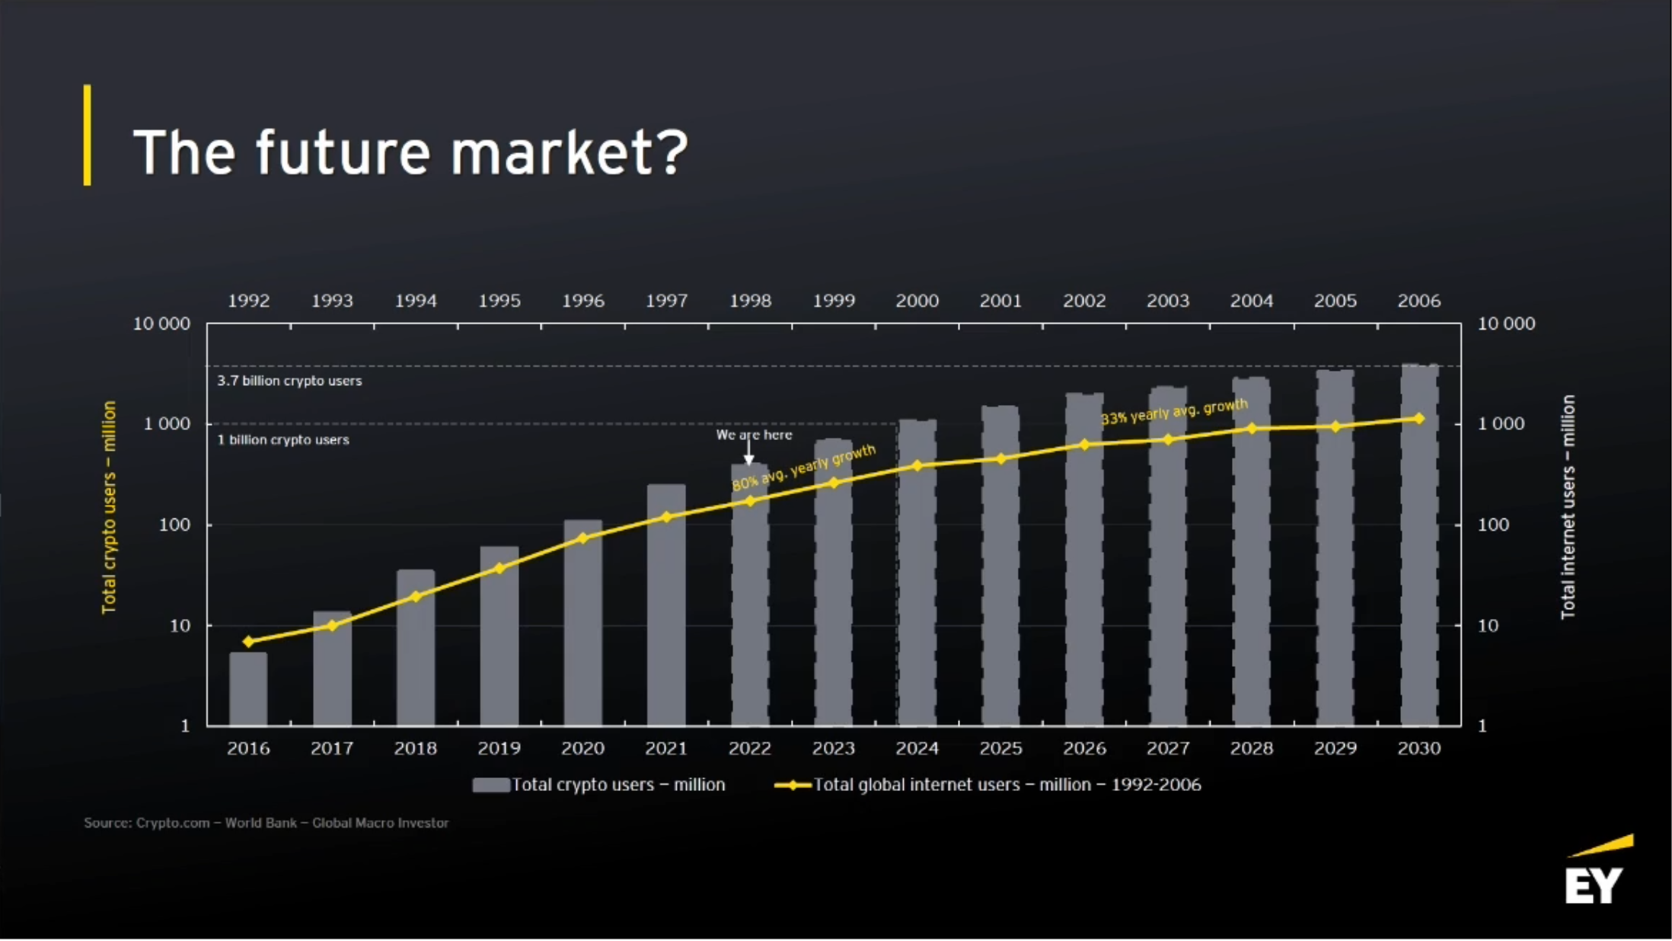
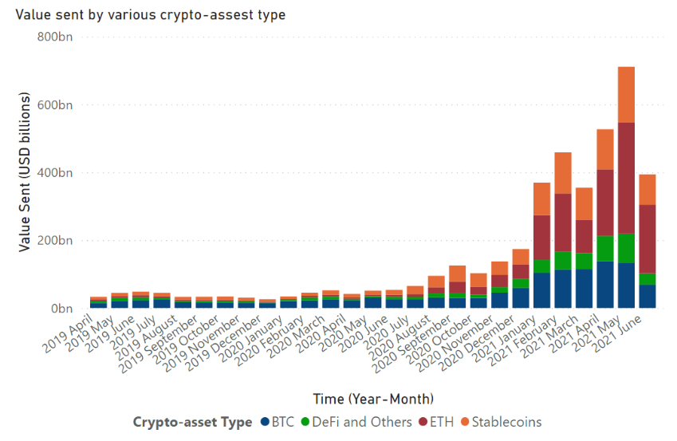
Crypto market update
Despite the «crypto winter» the market remains strong in terms of users and transactions:
The regulation is coming together: institutional players start investing with more confidence:
JPMorgan
BNParibas
CitiBank
Blackrock
Google,….
Notes:
Despite the «crypto winter» the attraction for crypto products remain very high in both retail and wholesale segments.
We see that the number of users is progressing in a similar way as internet users were growing 25 years ago. Within 7 years, we should reach the 1B users mark.
Consumers are still transacting on crypto and even if the volumes are lower than last year, they still remain pretty strong.
The institutional players are more and more investing heavily in blockchain / crypto space. A number of big players like JPM, Citi, Visa, Blackrock have increased their investments in the crypto space and will offer crypto products to their customers.
The digital asset space is lagging behind because replacing the whole securities infrastructure is an overwhelming task. Some smaller areas are steadily developing though: private placement, niche product like CO2, ad-hoc services like just in time payments,…

Slide 4
SWOT
Strengths
Weaknesses
Know-How: strong in TF and widespread in crypto (Management, IT, Compliance, Middle Office, …) Convenience: seamless crypto integration Crypto custody and processes in place Compliance and Risk Mgmt in place Strong network in Central/Eastern Europe Russian language | No Banking license Lost some team members in the crypto space Not as agile and technical as non regulated entities Internal and external communication to be improved to able to compete wit pure players
1.7 T$ Financing gap in TF Connections to Eastern Europe / RU Connections to commodities markets Regulated entities are wiling to enter in the crypto market Enter the DeFi space (DeFi gateway for investors) | High reputational risk drastically limiting partnerships with providers and potentially any new license People retention Sanctioned customers Time to market, the setting up the business could easily take more than a year
Opportunities
Threats

Slide 5
From a Bank to an SRO
As a Bank, we were selling our products, from our balance sheet, managing the Assets and Liabilities
As a SRO, from our strengths, we should look at:
Leverage our network to develop Trade Finance related activities
Leverage our Blockchain knowledge to streamline operations and develop new services
Therefore, we could evaluate the following options:
Distribute products created by partner banks to customers form our network,
Set up a fund to continue financing operations,
From our network identify problems to solve and assemble solutions including blockchain based components

Slide 6
Crypto Market Overview
Some other non regulated entities offer the following services:
Other ideas:
Ad-hoc payment services (JPM example)
Trade finance with a “crypto touch”
Asset Management traditional and crypto
Activity | Feasibility in our context
Trading | Difficult without the know-how and without the market accesses
Staking | Quite technical service, probably possible as a distributor to our customers
Custody | Still possible but the competition there is strong and margins will soon shrink
Prime brokerage | Too capital intensive
Tokenization | Possible combining structuration and blockchain know-how
Stablecoins | We could sell the stable coin guarantee service and issue a stable coin

