Slide 1
Visual SLAM
Presentation heavily based on
coursera robotics perception
course

Slide 2
Terminology
Visual Odometry : The process of incrementally estimating your position and orientation with respect to an initial reference frame by tracking visual features
Visual SLAM : used interchangeably but Visual SLAM produces also map of features while visual odometry focuses on the camera trajectory

Slide 3
Warning : no filters here … in some way
2 methodologies have become predominant in V-SLAM
  1) Filtering methods fuse the information from all the images with a probability distribution
  2) Nonfiltering methods (also called keyframe methods) retain the optimization of global bundle adjustment to selected keyframes
We focus on method 2 for V-SLAM here !
(a la ORB SLAM which is a state of the art method)
But in some way, anyways, we will slide over a window, track and control uncertainty and minimize least squares all over the place

Slide 4
Formulation of the VO problem
An agent is moving through an environment and taking images with a rigidly attached camera system at discrete time instants k
2 cameras positions at adjacent time instants k-1 and k are related by a rigid body transformation (4x4 matrix)
The set of camera poses C[0:N] contains the transformations of the camera with respect to the initial coordinate frame at k=0

Slide 5
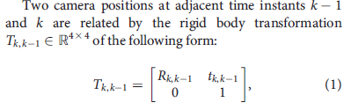
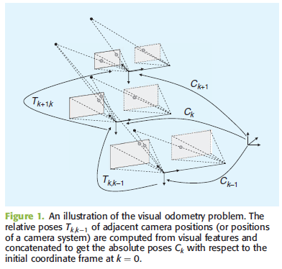
Formulation of the VO problem

Slide 6
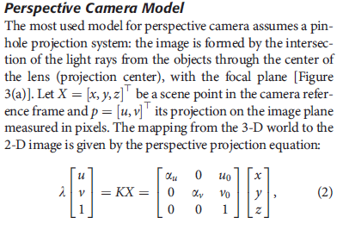
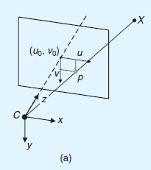
Preliminaries :
Perspective camera model

Slide 7
Preliminaries :
2D transformations and Homogeneous coordinates
Rotation : orthogonal matrix
Translation
Similarity : scaled rotation + translation
Affine transform : parallel lines remain paralel
Homography or projective transform: the most generic 2D linear transform (straight lines remain straight but not necessarily parallel)
Reminder : we will use homogeneous coordinates (so that translation can be handled via matrix multiplications)

Slide 8
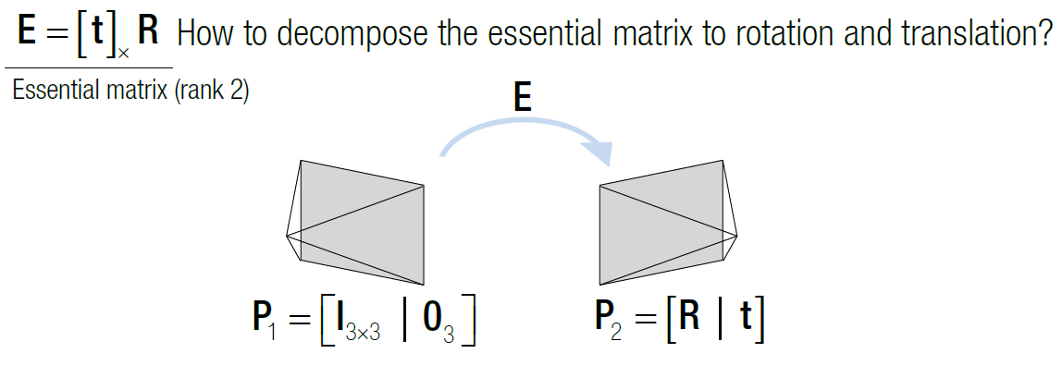
Preliminaries :
Rigid body transformation

Slide 9
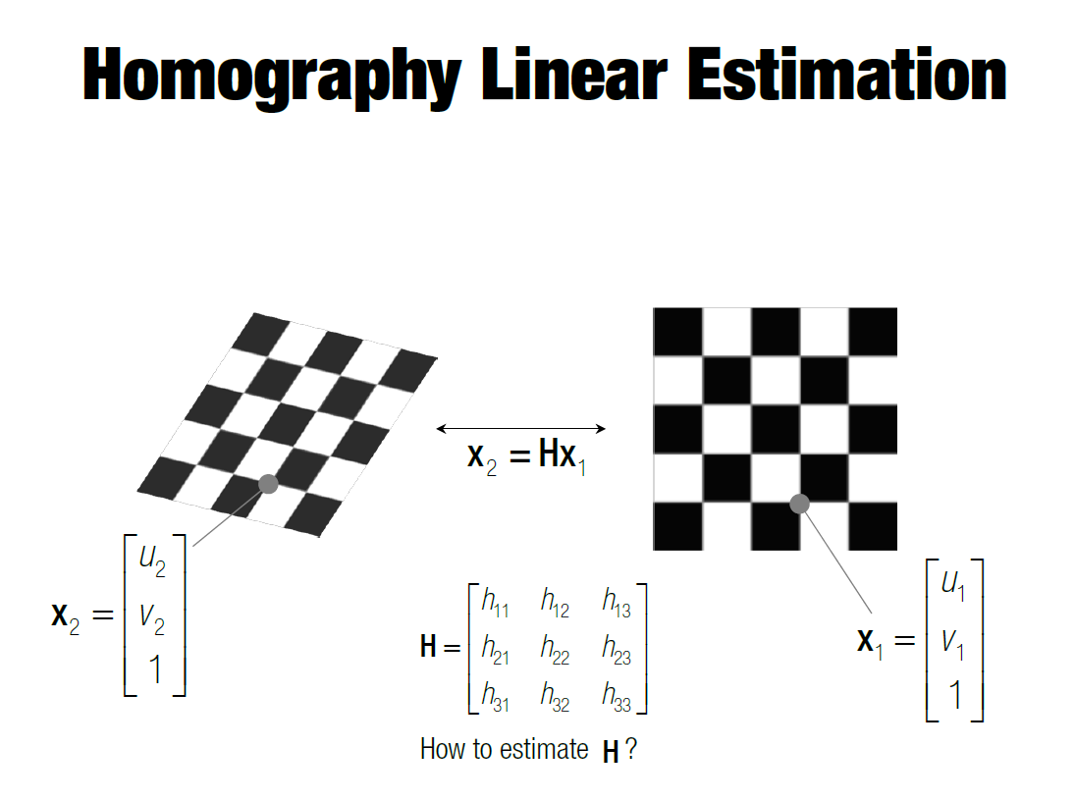
Preliminaries : fundamental example

Slide 10
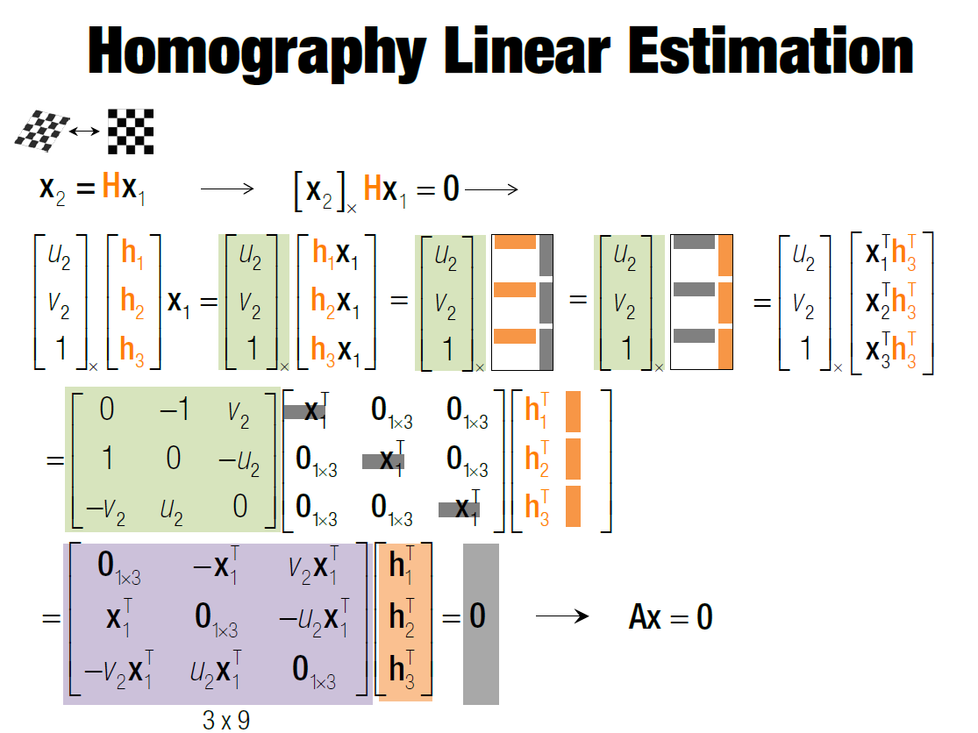
Preliminaries : fundamental example

Slide 11
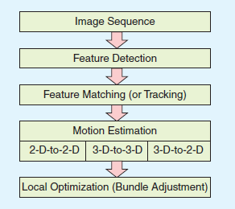
VO or V-SLAM pipeline (simplified)

Slide 12
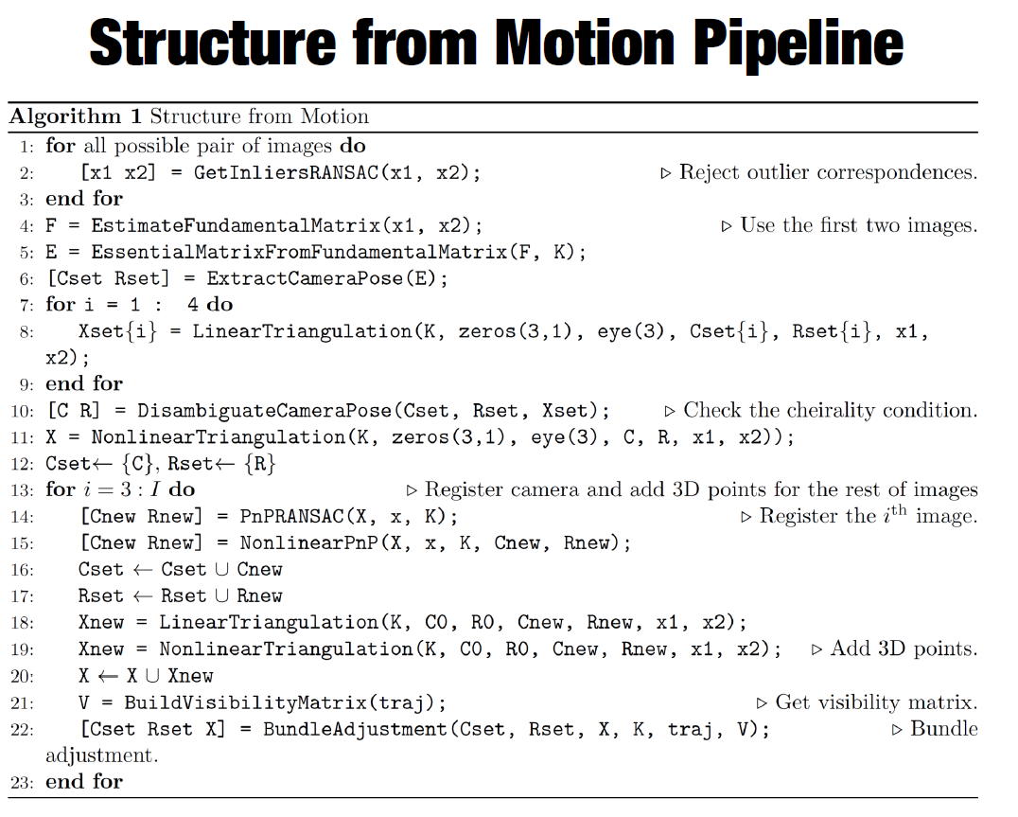
VO pipeline (some details)

Slide 13
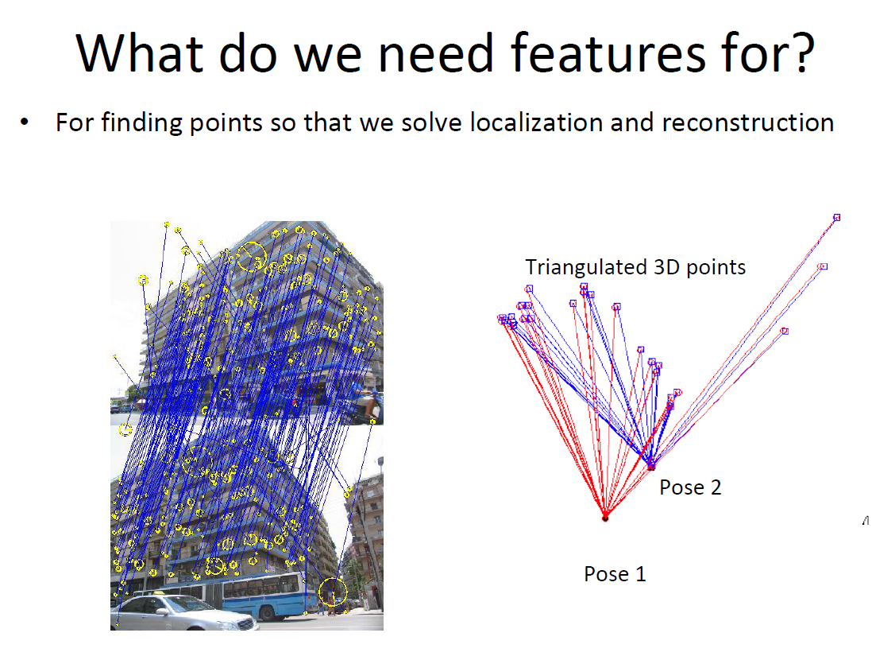

Slide 14
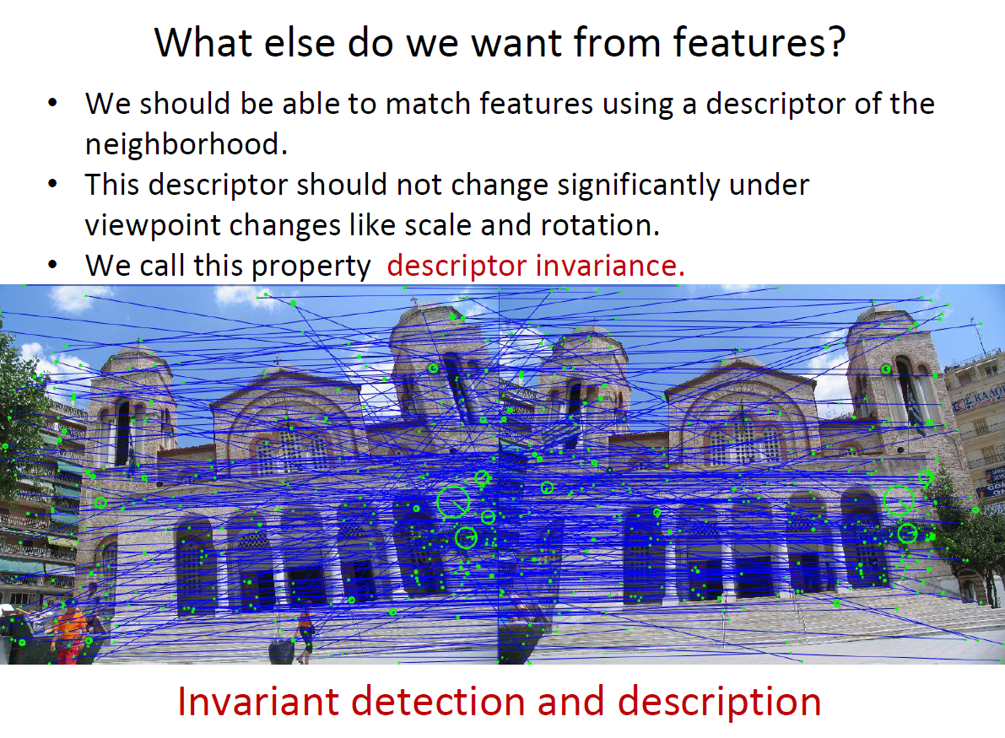
Features wanted

Slide 15
2D to 2D : motion estimation
Objective : from image k and image k-1, estimate Rk (rotation) and Tk (translation) for our camera
  Use only pixels coordinates
  Assume camera is calibrated
  (K intrinsics known, easier to handle)

Slide 16
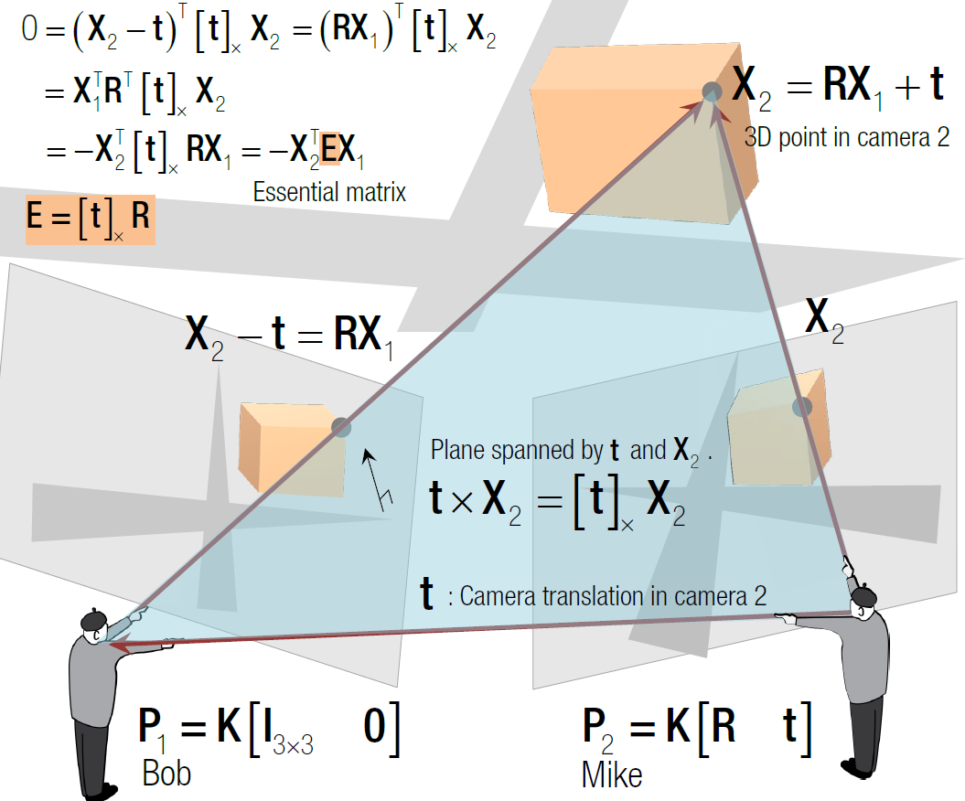
2D to 2D : motion estimation

Slide 17
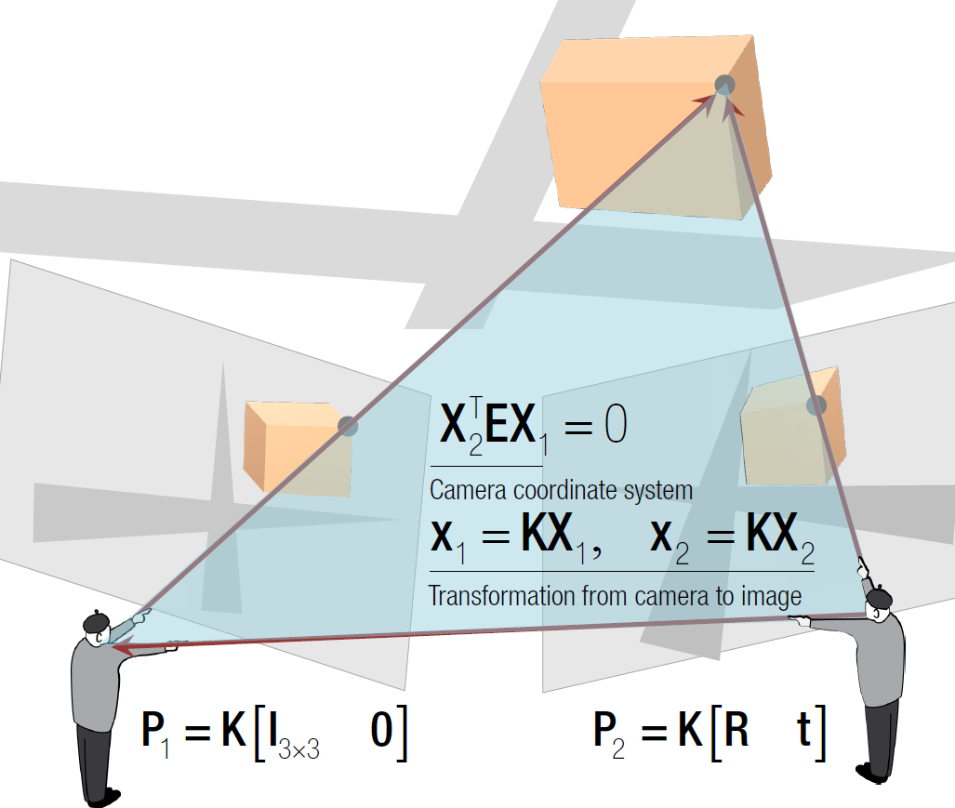
2D to 2D : motion estimation

Slide 18
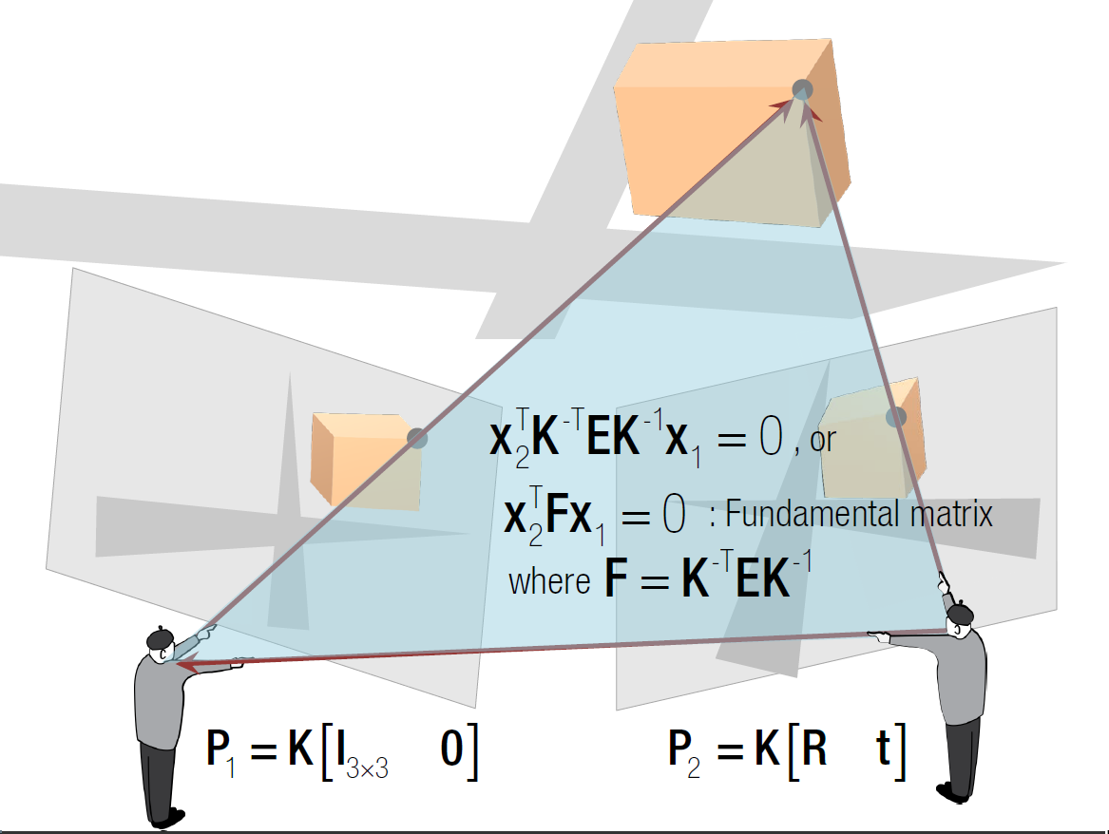
2D to 2D : motion estimation

Slide 19
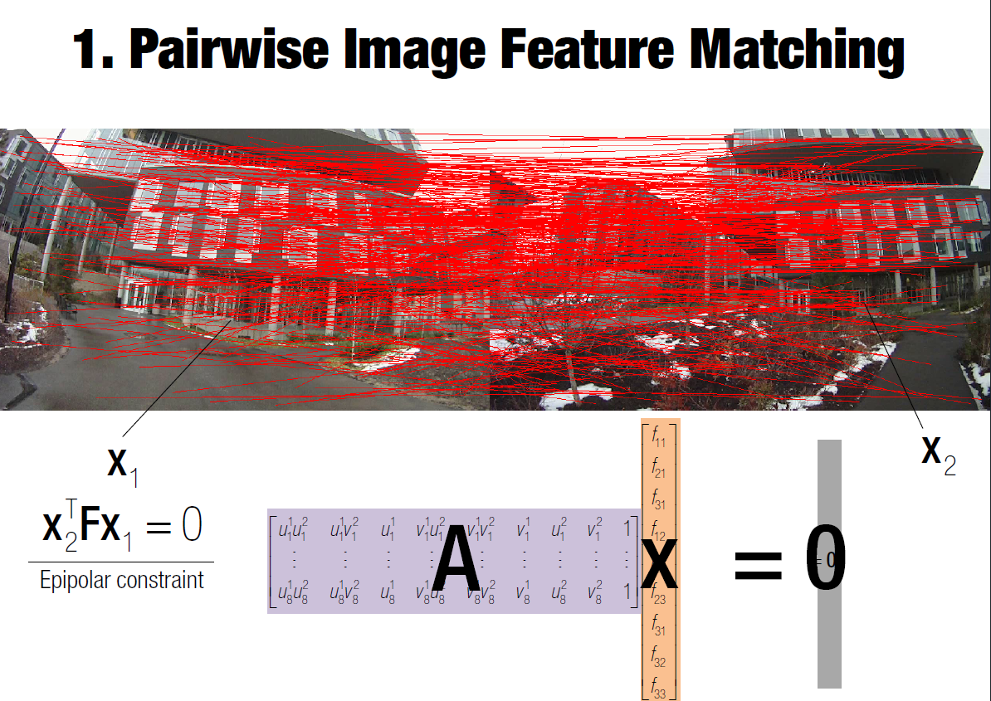
2D to 2D : motion estimation

Slide 20
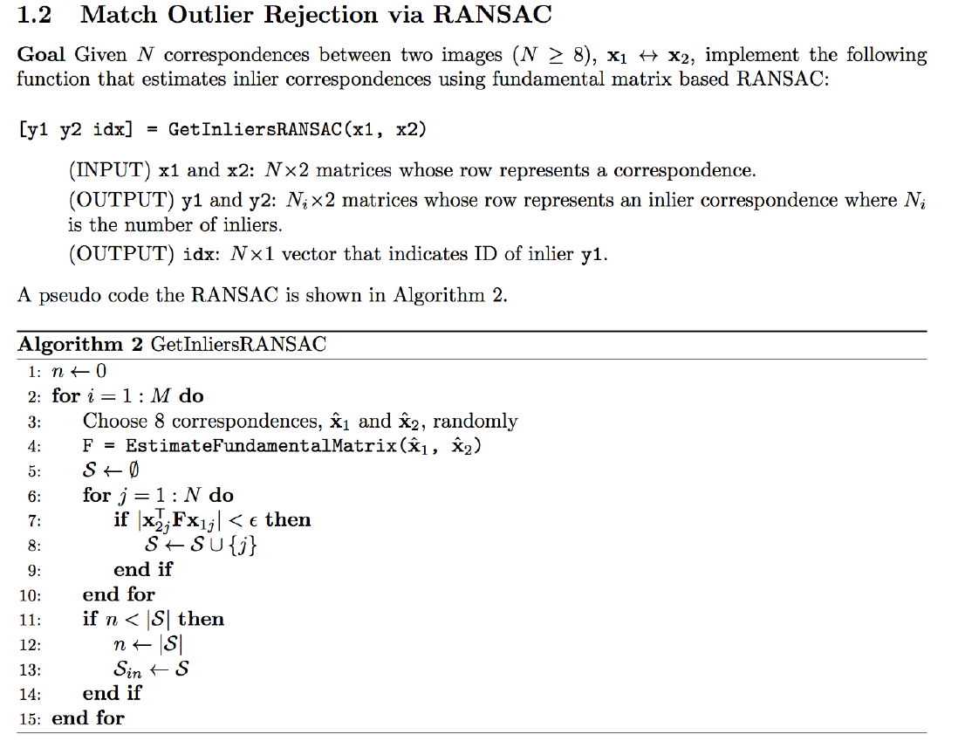
Outliers rejection

Slide 21
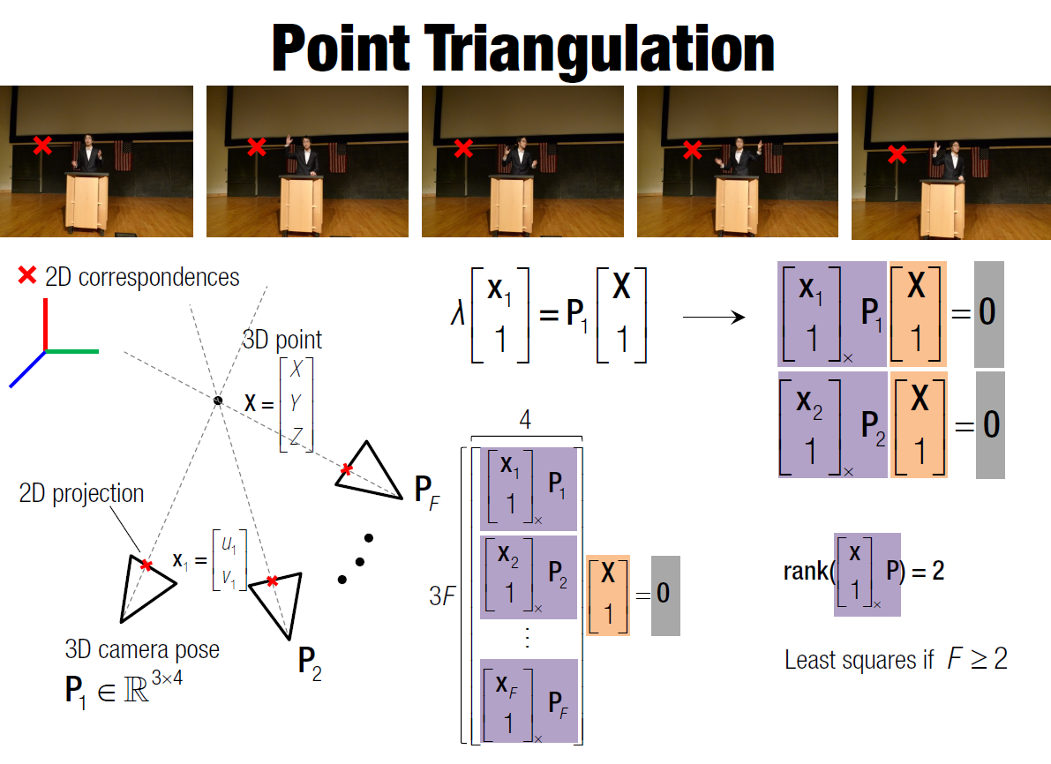
2D to 3D : building a map

Slide 22
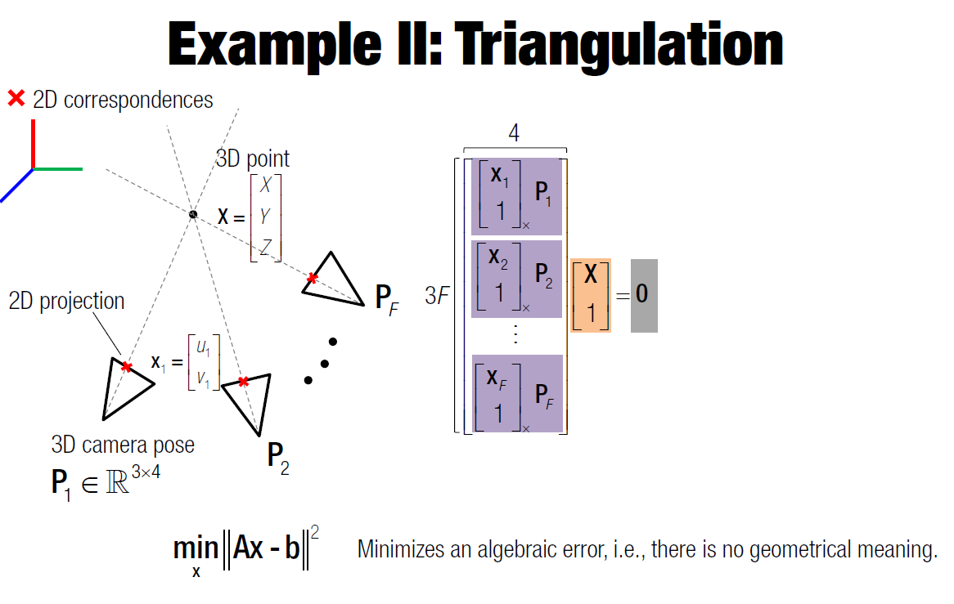
2D to 3D : building a map

Slide 23
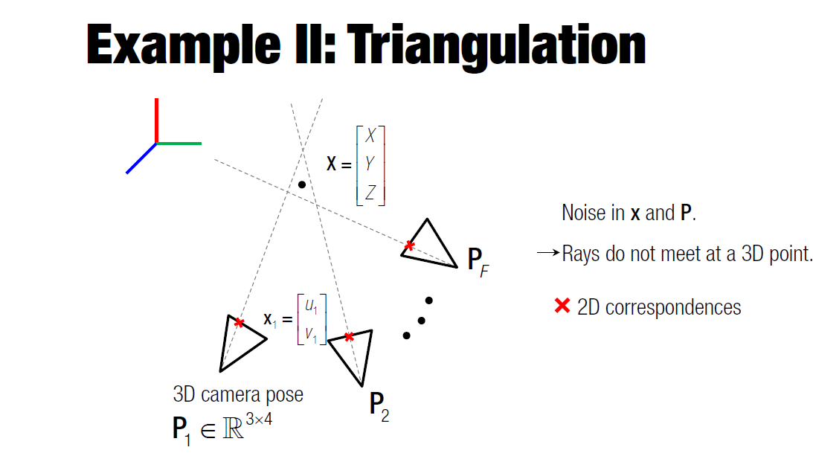
Keyframe selection via error estimate

Slide 24
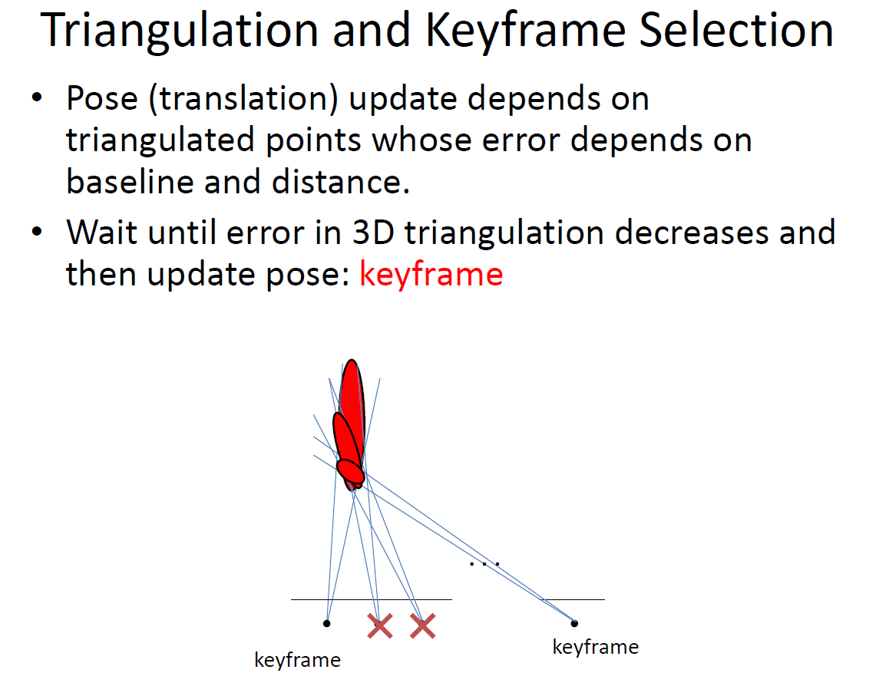
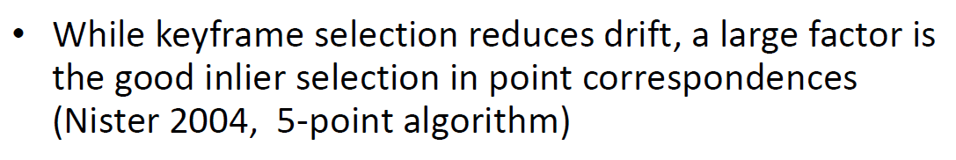
Keyframe selection via error estimate

Slide 25
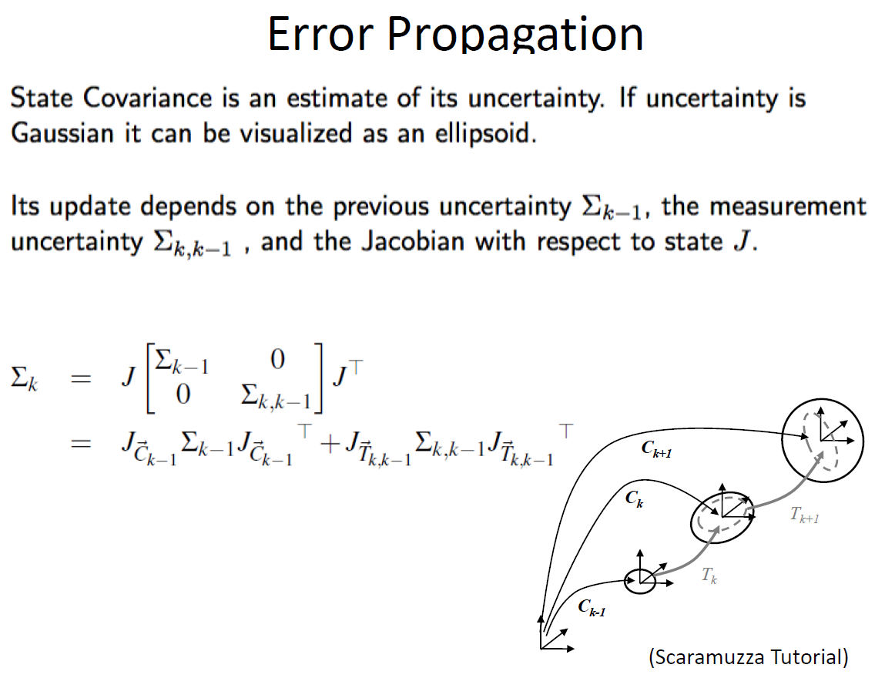

Slide 26
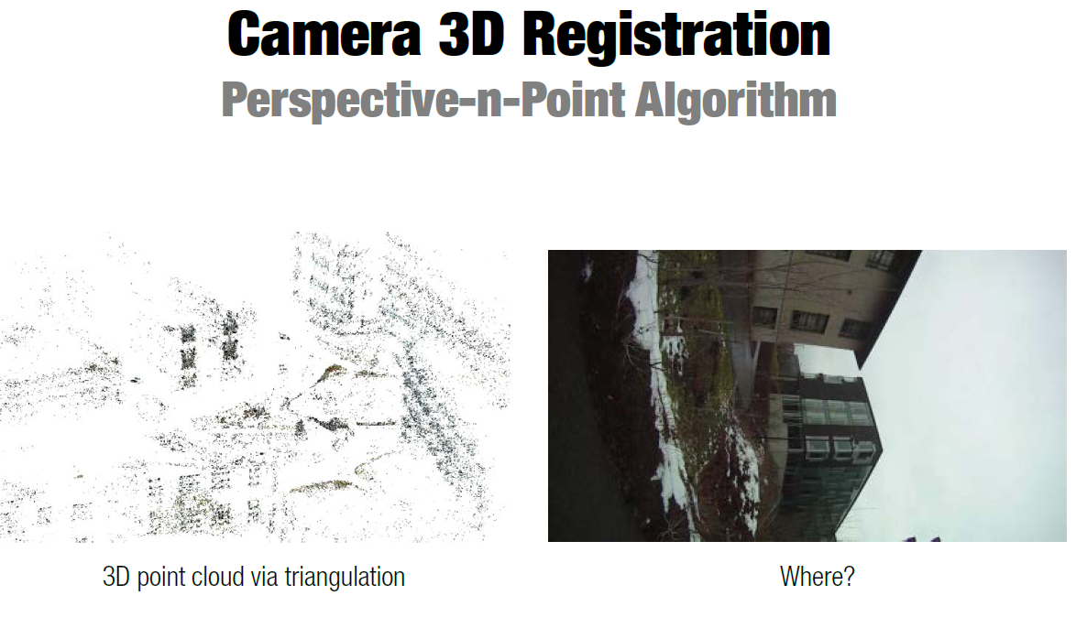
3D to 2D : motion & localization from a 3D map

Slide 27
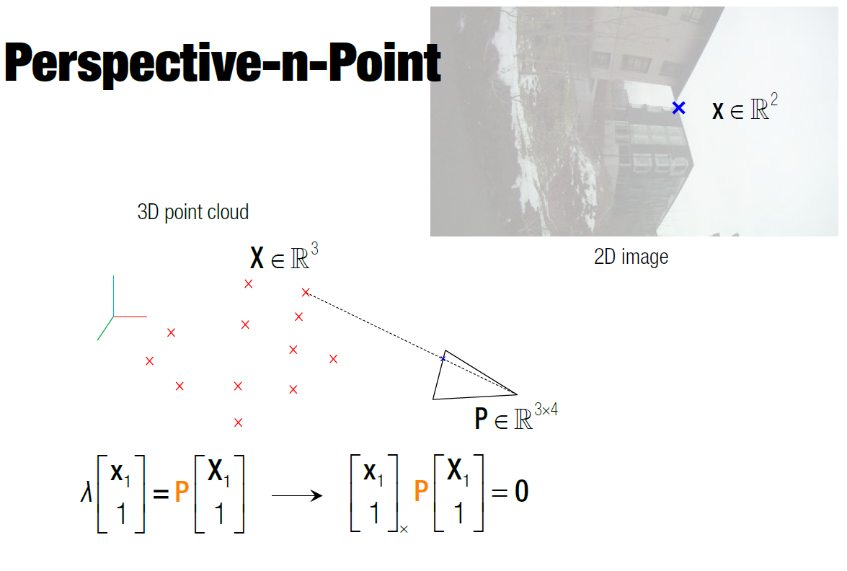
3D to 2D : motion & localization from a 3D map

Slide 28
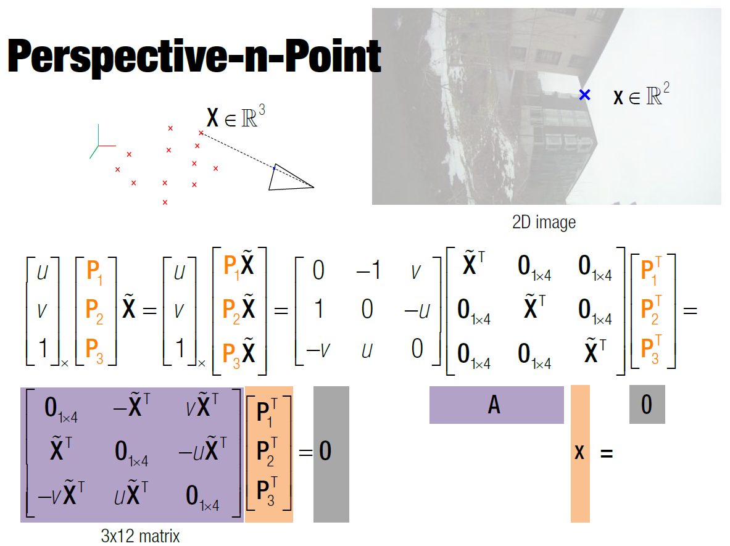
3D to 2D : motion & localization from a 3D map

Slide 29
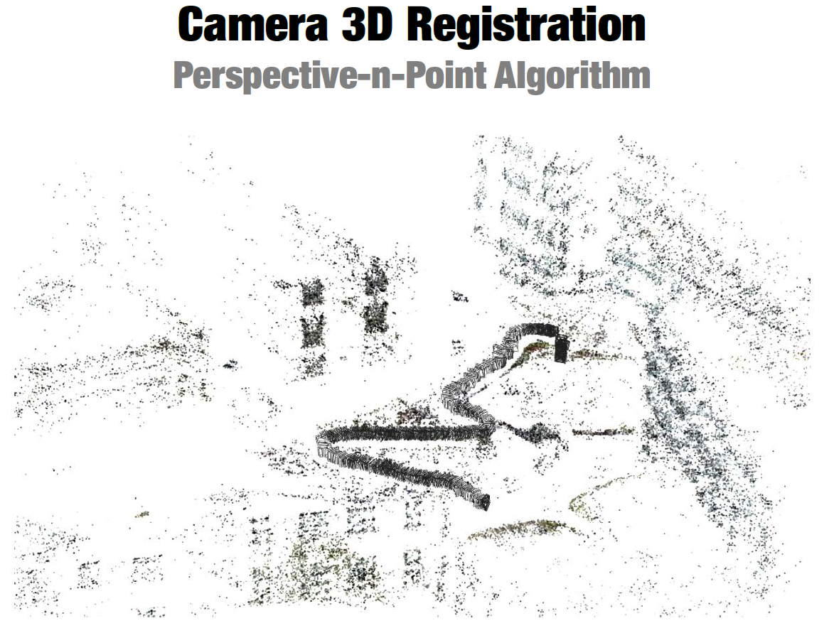
3D to 2D : motion & localization from a 3D map

Slide 30
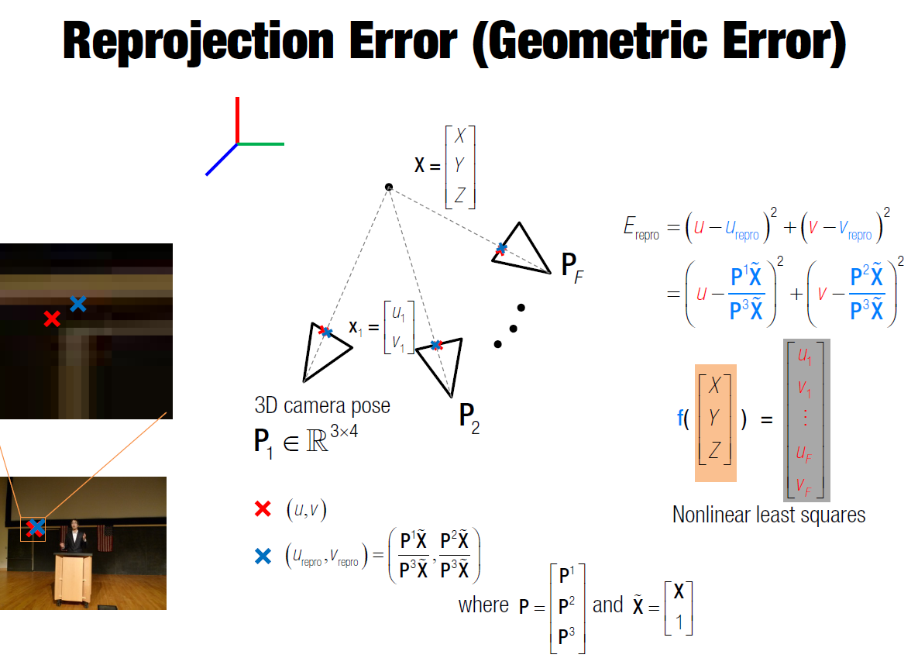
Bundle adjustment

Slide 31
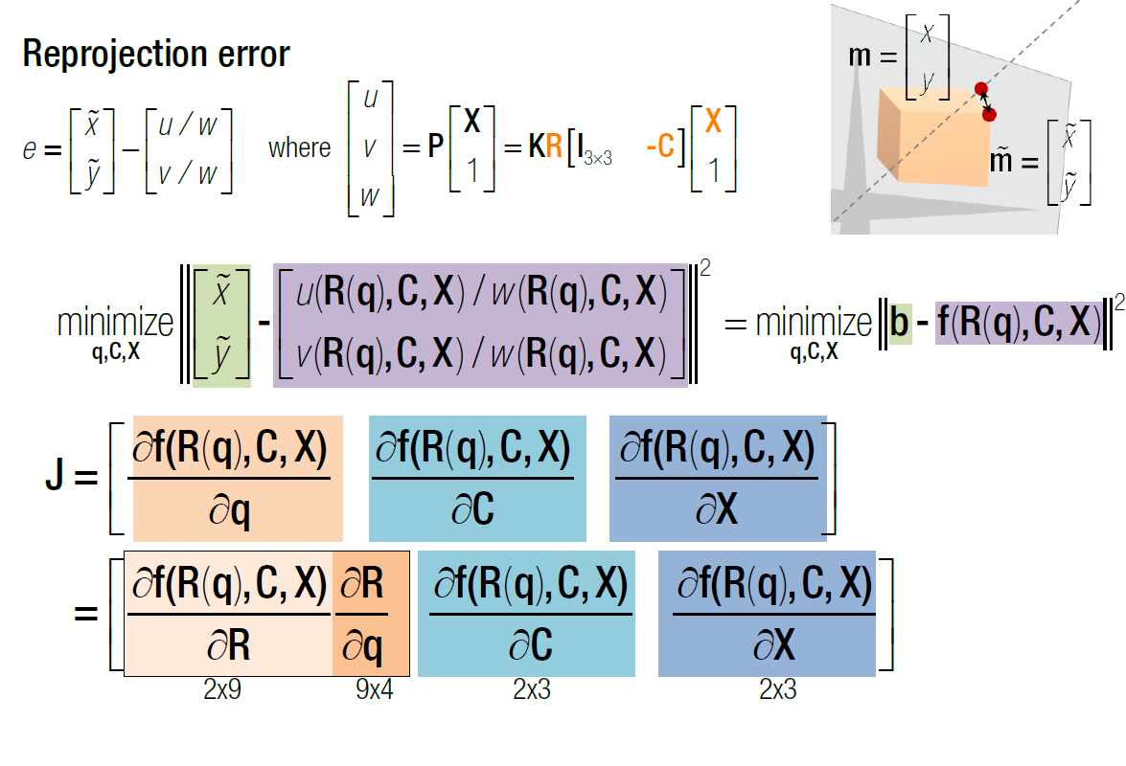
Bundle Adjustment
(simplified single point, single pose)

Slide 32
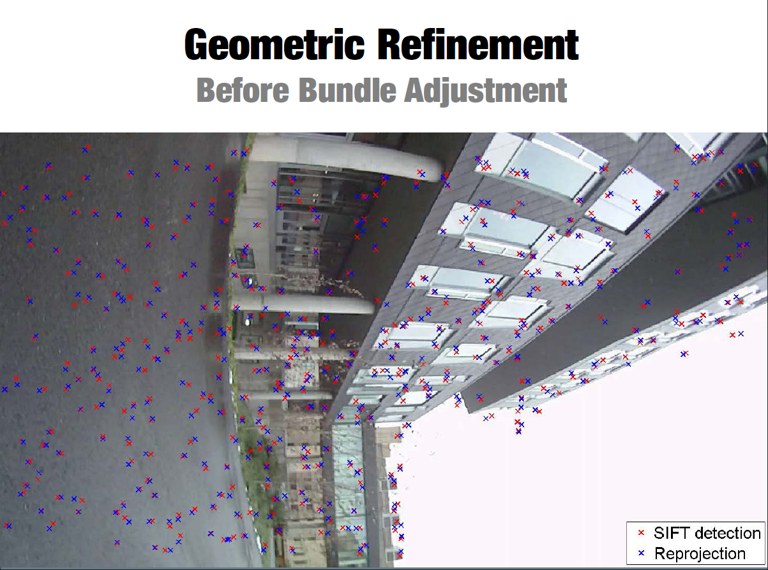
Bundle adjustment

Slide 33
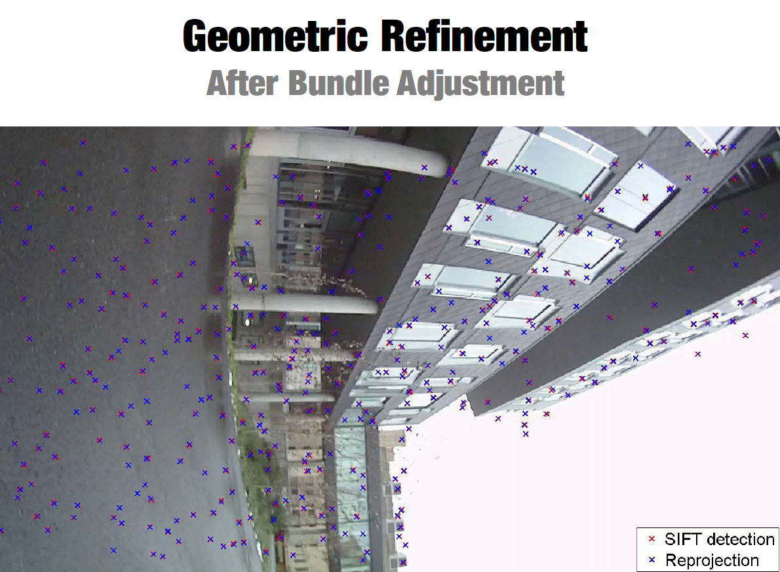
Bundle adjustment

Slide 34
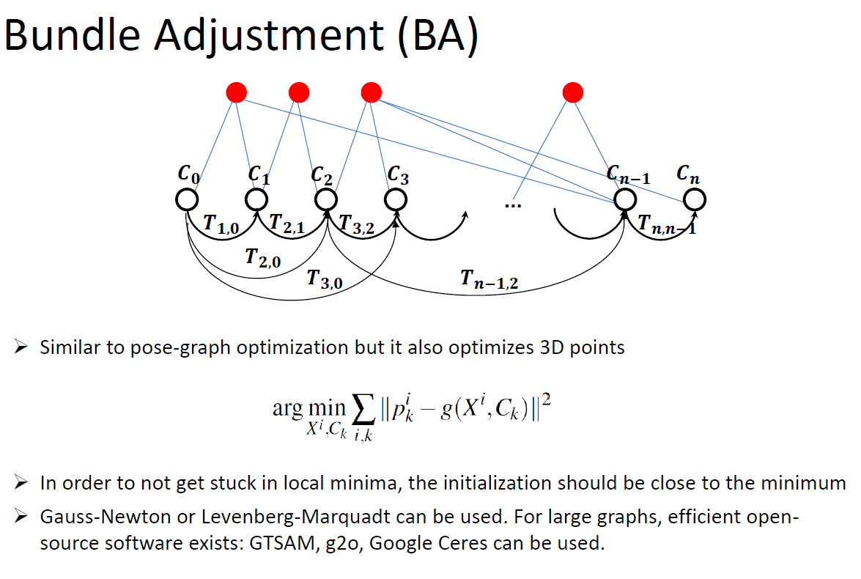

Slide 35
Loop closure detection
Typicaly done in 3 steps :
  1) bag of visual words : to identify visual similarity between 2 images (place recognition)
  2) After finding the top-n similar images, usually a geometric verification using the epipolar constraint is performed
  3) Rigid-body transformation is computed and added to the pose graph as an additional loop constraint for the pose-graph optimization
  => Enables to minimize errors in our parameter estimations

Slide 36
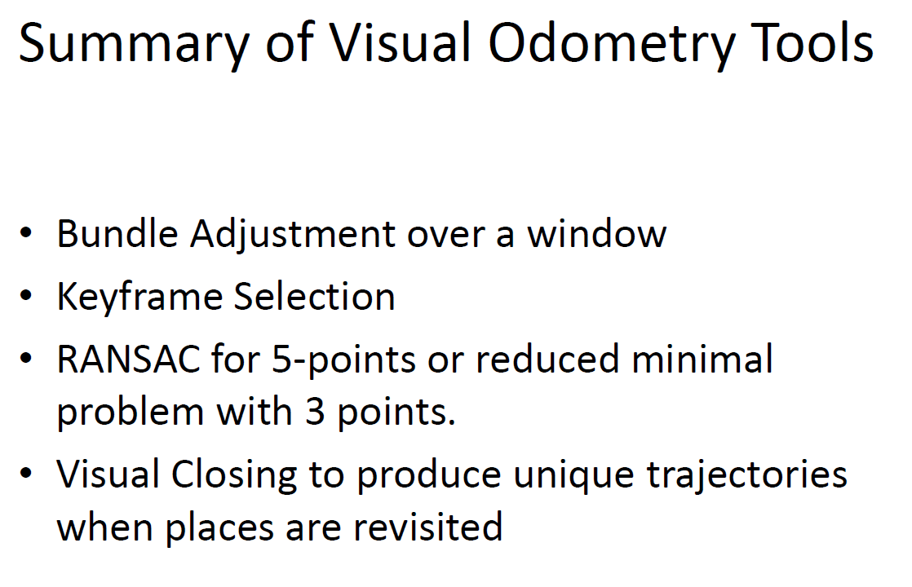

Slide 37
Leverage on OpenCV, g2o, sba, orbslam...
Most of the key building blocks are provided by OpenCV (features detection and matching, RANSAC, Essential and Fundamental matrix estimation, PnP triangulation …)
Optimization problems are handled by existing open source libraries : https://github.com/RainerKuemmerle/g2o, http://users.ics.forth.gr/~lourakis/sba/
State of the art V-SLAM framework : https://github.com/raulmur/ORB_SLAM2

