Slide 1

44th series Student Project Programme (SPP): 2020-21
EVALUATION OF STUDENT PROJECTS
AI BASED SMART MIRROR USING RASPBERRRY PI
Project reference number : 44S_BE_0107
Name of the Students : 1. Mr. Bharath Surya
2. Ms. Kavita Sah
3. Ms. Raksha S
4. Ms. Shaun John Philipose
Project guide : 1. Prof Gunapriya Parthasarathy
2. Prof Vinod Kumar S
Department : ELECTRICAL AND ELECTRONICS ENGINEERING
Name of the College : NEW HORIZON COLLEGE OF ENGINEERING

Slide 2
Introduction
A smart mirror is basically a mirror with a screen behind it .That screen can be an Android tablet or a computer monitor.
Basically, the mirror is looks like normal mirror but when someone stand in front of it the scene changes. The mirror provides a functional, user friendly and interactive UI to its user for accessing their social sites, messengers, etc. It has widgets for displaying the current whether conditions, Time, Events, Latest news headlines
The Smart Mirror would help in developing smart houses with embedded artificial intelligence, as well as finding its applications in industries. Switching home appliances becomes easy with mirror. Virtual dressing, a smart way of having trials with your fashion sense make things quite easy in malls. Having such intellectual mirror will only surge the beauty of home. The raspberry pi is programmed using python and connects to a monitor with inbuilt speaker so as to provide an onscreen interface and voice assistance as well
Our project aims at exploring other fields where this technology can be used. It aims at including this technology in a mirror, because in general people spend a considerable amount of time in front of a mirror.

Slide 3
Objectives
The objective of the Smart mirror is to give a passageway to a client to gather practical data that could influence the course of their everyday life. We have subbed the requirement for TV or radio through portable stages presently go to the period that will oust even telephones. The idea of the smart mirror is presented with regards to the worldwide studies that guarantee men spend approx. 3 hours of the week before the mirror, establish the framework for a superior innovatively progressed framework. The objective clients are older and in an unexpected way abled client as this open up another range for them, making signal investigation
one of the modules last executions. The goal of the smart mirror is to provide an access point for a user to accumulate viable information that could affect the course of their day-to-day life.

Slide 4
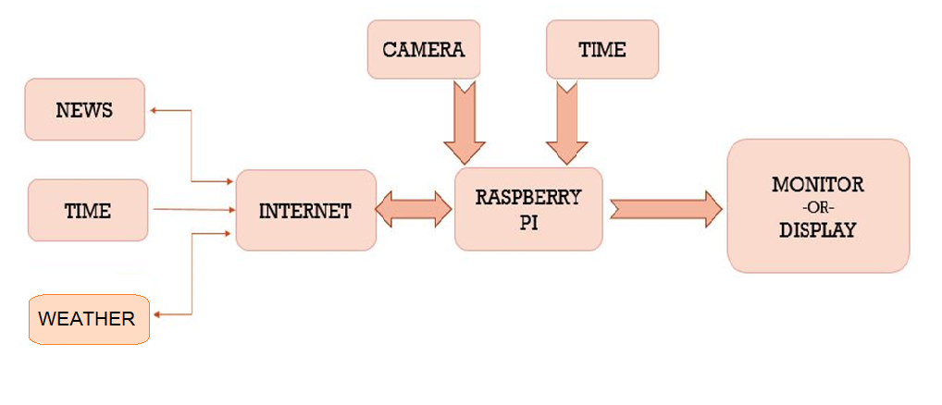
Methodology
The proposed framework is to plan an intuitive advanced brilliant mirror with man-made consciousness utilizing Raspberry Pi. In the proposed framework, the capacity of the framework to recognize the client and react as far as the main job, joining the hypothesis of man-made brainpower. Intelligent registering, with remotely associated inserted gadgets that are being utilized in different everyday exercises. In light of this innovation, numerous gadgets/items are currently arising and with this knowledge it is giving agreeable, secure and helpful individual administrations all over. The venture targets making a keen framework for clients where it perceives the client utilizing mediums like OpenCV. The mirror will perceive client's face and it will be prepared utilizing Raspberry Pi and show client's feeds. Client's test pictures will be put away in data set.

Slide 5
Implementation
Setting Up the Raspberry Pi - The operating system "Raspbian" has to be installed on the micro SD card, plug in the keyboard and mouse to the Pi and attach the HDMI cable to the monitor that is in use. Boot into Raspbian and connect to the internet.
Since it is most likely that Raspberry Pi smart mirror is going to be hung on a wall somewhere, it is better to be connected to Wi-Fi.
Magic Mirror Software Setup- Now, there are two ways to install the latest version of Magic Mirror, either manually or using an automatic installation script.
Installing Magic Mirror on Raspberry Pi - Once the operating system "Raspbian" is installed on the micro SD card, plug it with keyboard and mouse to the Pi and attach the HDMI cable to the monitor.
After the system boots up, begin configuring the Pi to the required location. After all the location is configured. Just save and reboot the Pi. Now, then the programming begins!

Slide 6
Implementation
Magic Mirror- Using the Pi, one must download and clone the repository, along with its dependencies. By doing this, the Pi will be able to run the program and display certain elements contained in the Magic Mirror file.
To add some extra features , one must access the modules folder. This folder is the key to housing all the desired options you want for Magic Mirror
The Frame - Though the frame is relatively easy to build, there are a few crucial things that one must considered in order to prepare. First off, dealing with the two way mirror. Depending on the size of the monitor, one is required to cut the mirror to size around a half an inch larger (width and length wise) than the monitor.
Once the frame has been set and is stable, sandwich the mirror between the frame and the monitor. Screw in the 3D brackets, making sure they are firmly placed.
Assembling the Smart Mirror - We must conceal the hardware in a way that looks like a normal mirror. Mount the Raspberry Pi on the backside of the monitor. Then attach the two-way mirror on the top face of the monitor carefully.

Slide 7
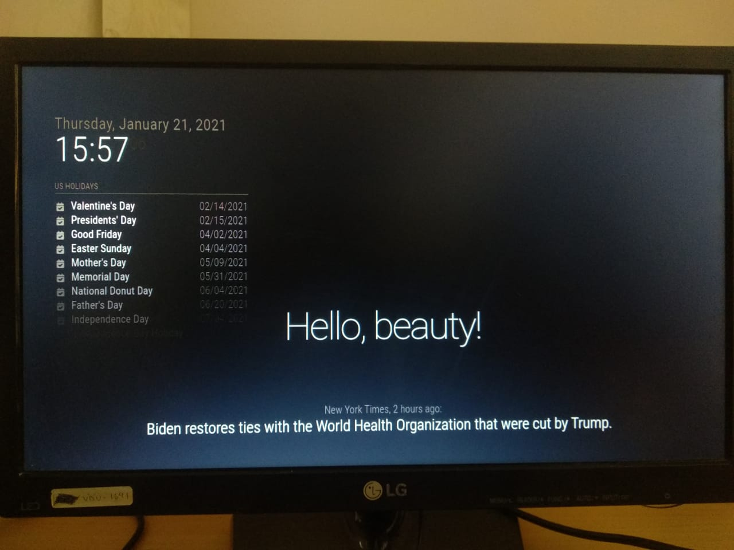
Results – (1 or 2 Slides)
This paper demonstrated a smart mirror device with a user-friendly architecture with many impressive features. Following a service-oriented approach, a stable and easy-to-use architecture was also introduced in this article. However, security issues cannot be overlooked in today's world of interconnected devices.
Therefore, this system was designed with a strong authentication framework to ensure the system's end-to-end security.
The output of the Smart Mirror has a black output screen which displays weather, news and time. The screen displays time which is present in the Raspberry Pi. It makes use the calendar for displaying the day and date along with time.
Weather condition update changes every hour and is displayed on the screen if there is a change in temperature else the temperature remains unchanged. Complete understanding of user command and necessary action for the same.

Slide 8
Advantages, Disadvantages in the project
ADVANTAGES:
Smart mirrors are often used in the retail sector wherein retailers try to catch the interest of potential clients and encourage them for frequent or regular visits.
Additionally, they can display useful information, ranging from price and size availability to the fabric used.
Smart mirrors allow shoppers to share their shopping experiences on social media.

Slide 9
Applications, Advantages, Disadvantages in the project
DISADVANTAGES:
Currently, the costs of smart mirrors are quite high. The costs increase with the integration of features such as augmented reality (AR) and RFID with these mirrors.
Smart mirrors is a comparatively new concept to audiences belonging to different regions, and so to the end users.
With the increase in the use of these mirrors in the automobile and retail industry, the mirror providers are likely to witness a surge in popularity in the upcoming years.

Slide 10
Potential for Future Work / Scope of Commercialization
All that should be updated and overhauled on an opportune premise to adapt up to the current innovation. Aside from up-degree, there can be numerous different highlights also which could amount to the capability and capacity of our smart mirror. There are numerous future degrees for this paper and ideally, it will arise as the greatest advantage in the field of man-made reasoning. The most essential component can be savvy reflect based home computerization which will give a characteristic method for association by which we can handle the home devices like switch on/off light and fans through fundamental voice orders. Significantly, since we are utilizing this mirror in a school climate, fundamental functionalities like a standardized tag scanner or unique finger impression sensor can be incorporated to satisfy essential assignments like school participation or program enlistments, and so on This could incorporate enrolling in programs by checking ID cards.

Slide 11
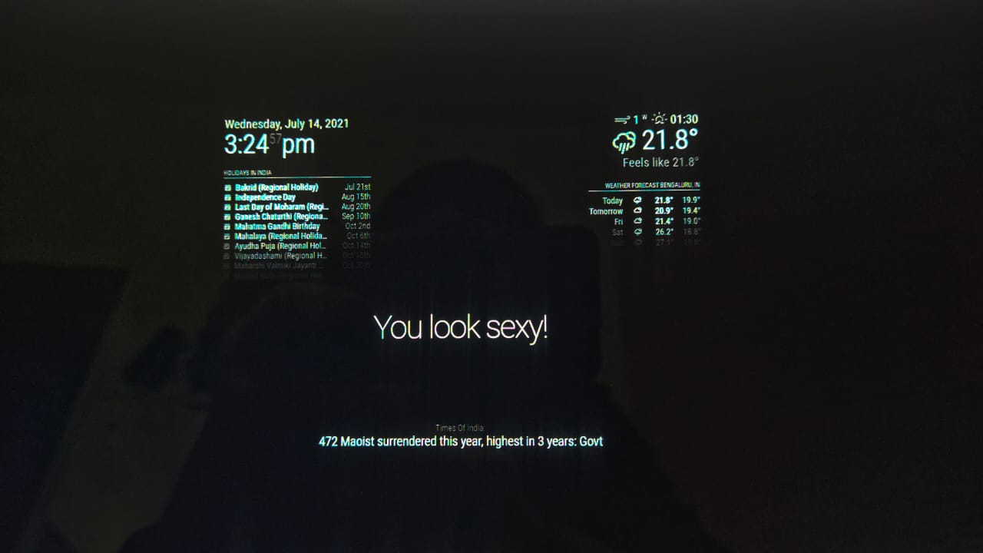

Slide 12
Conclusion
The Smart Mirror is fundamentally a Personal Assistant for Human cooperation between the Mirror and client. The Smart Mirror is proposed so that it gives everyday life data at the same time while preparing. It gives data like Real-Time, Calendar, Indian Holidays, current Weather Forecast and furthermore forthcoming day's climate determining as per the Smart Mirror's Geo-Location, RSS News Feeds and praises, while preparing. The smart mirror can also be implemented in various industrial and home applications. Hence IoT proves out to be an important technology for making household appliances smart. The facial recognition technology used in the smart mirror proves out to be an important means of security. Smart mirrors can be connected to home appliances and smart phones.
The mirrors can detect face and provide access to personalized services. The mirror can also be implemented to recognize emotions. The mirrors can be better enhanced to be deployed in beauty parlors, cloth shops, hotels, etc. With better advancements in technology, mirrors can be used in many other fields.

