Slide 1

SMART MIRROR USING
RASPBERRY PI
PRESENTED BY:
BHARAT SURYA – 1NH17EE706
KAVITA SAH – 1NH17EE718
RAKSHA S – 1NH17EE745
SHAUN JOHN – 1NH17EE748

Slide 2
INTRODUCTION
Smart mirror is a wall mounted mirror which displays weather, time, news and other areas of interests.
A smart mirror is basically a mirror with a screen behind it .That screen can be an Android tablet or a computer monitor.
In recent years more and more devices are connected to the internet. The internet has played an important role in connecting more and more people across the world. Devices started to become smarter a smarter, mobile phones became smartphones and most importantly internet was connected to a variety of devices and the concept came to be known as the ‘Internet of Things’.
Our project aims at exploring other fields where this technology can be used. It aims at including this technology in a mirror, because in general people spend a considerable amount of time in front of a mirror.

Slide 3
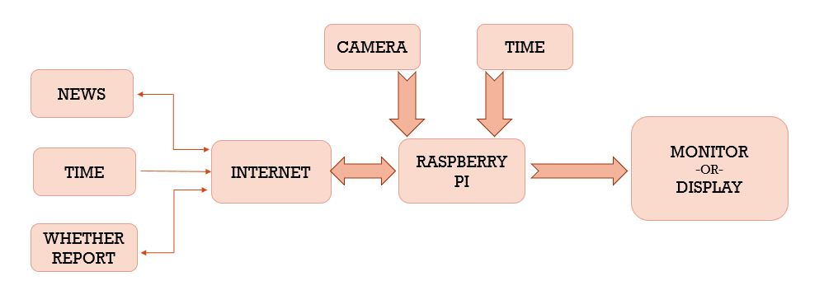
BLOCK DIAGRAM

Slide 4
PROPOSED METHODOLOGY
The proposed system is to design an interactive futuristic smart mirror with artificial intelligence using Raspberry Pi.
In the proposed system, the ability of the system to recognize face and provide details of the same, incorporates the theory of artificial intelligence.
Interactive computing, with wirelessly connected embedded devices that are being used in various day– to–day activities. Based on this technology, many devices/products are now emerging and with this intelligence it is providing comfortable, secure and convenient personal services everywhere.
The project aims at creating a smart system for users where it detects face using OpenCV. The mirror will recognize user’s face and it will be processed using Raspberry Pi and display user’s feeds. User’s image will be stored in database.

Slide 5
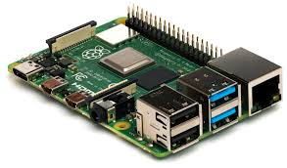
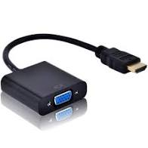
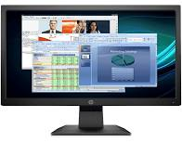
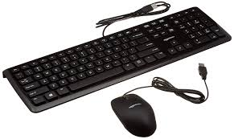
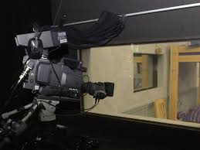
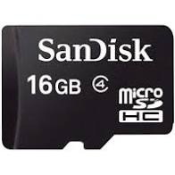
COMPONENTS USED
Raspberry Pi
HDMI Cable
Monitor
Micro SD Card
Mouse & Keyboard
Two-way mirror

Slide 6
WORKING
Setting Up the Raspberry Pi - The operating system "Raspbian" has to be installed on the micro SD card, plug in the keyboard and mouse to the Pi and attach the HDMI cable to the monitor that is in use. Boot into Raspbian and connect to the internet.
Since it is most likely that Raspberry Pi smart mirror is going to be hung on a wall somewhere, it is better to be connected to Wi-Fi.
Magic Mirror Software Setup- Now, there are two ways to install the latest version of Magic Mirror, either manually or using an automatic installation script.
Installing Magic Mirror on Raspberry Pi - Once the operating system "Raspbian" is installed on the micro SD card, plug it with keyboard and mouse to the Pi and attach the HDMI cable to the monitor.
After the system boots up, begin configuring the Pi to the required location. After all the location is configured. Just save and reboot the Pi. Now, then the programming begins!

Slide 7
Magic Mirror- Using the Pi, one must download and clone the repository, along with its dependencies. By doing this, the Pi will be able to run the program and display certain elements contained in the Magic Mirror file.
To add some extra features , one must access the modules folder. This folder is the key to housing all the desired options you want for Magic Mirror
The Frame - Though the frame is relatively easy to build, there are a few crucial things that one must considered in order to prepare. First off, dealing with the two way mirror. Depending on the size of the monitor, one is required to cut the mirror to size around a half an inch larger (width and length wise) than the monitor.
Once the frame has been set and is stable, sandwich the mirror between the frame and the monitor. Screw in the 3D brackets, making sure they are firmly placed.
Assembling the Smart Mirror - We must conceal the hardware in a way that looks like a normal mirror. Mount the Raspberry Pi on the backside of the monitor. Then attach the two-way mirror on the top face of the monitor carefully.

Slide 8
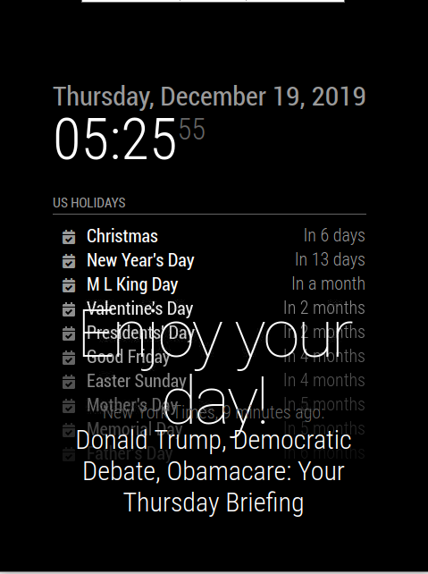
EXPECTED OUTPUT
The output of the Smart Mirror has a black output screen which displays weather, news and time. The top right corner of the screen displays time which is present in the Raspberry Pi. It makes use the calendar for displaying the day and date along with time.
Weather condition update changes every hour and is displayed on the screen if there is a change in temperature else the temperature remains unchanged.

Slide 9
CONCLUSION
The smart mirror can also be implemented in various industrial and home applications.
Hence IoT proves out to be an important technology for making household appliances smart.
The facial recognition technology used in the smart mirror proves out to be an important means of security. Smart mirrors can be connected to home appliances and smart phones.
The mirrors can detect face and provide access to personalized services. The mirror can also be implemented to recognize emotions.
The mirrors can be better enhanced to be deployed in beauty parlors, cloth shops, hotels, etc. with better advancements in technology, mirrors can be used in many other fields.

