Slide 1
26184 : Cook book to propositions for creating a Proposition App from Reference App
By Team Amalgam

Slide 2
Objective
To draft a cook book – end to end guide for developer
To able to help a developer in taking the code base of reference app and create his own app easily and quickly
It deals with granular details that will help propositions add their specific stuff at appropriate places
It gives code snippets to provide better understanding
It gives contact points for getting setup ready for example , whom to contact for microsite ID or language pack
Tried to keep the content description as precise as possible so that the developer need not have to read a long document .

Slide 3
Differences in mobility PDF
Mobility PDF
Cook book
It is a gives an idea of platform
at superficial level
Cookbook digs inside the platform
It is good to understand how platform
sits in the overall architecture of CDP2
Cookbook aims to concentrate on
the architecture of reference app
It helps the business to get insight
of all features provided by platform end- end
Made for developers keeping in mind
The issues we face as developers if
we try creating our own app using
reference app as platform
Provides information about all the
Components of CDPP but it is not
enough as a single document
It contains granular level details of
reference app specific stuff
Good for read if you have enough time
As document is lengthy and generic
If you have to be quick and do fast
App development

Slide 4
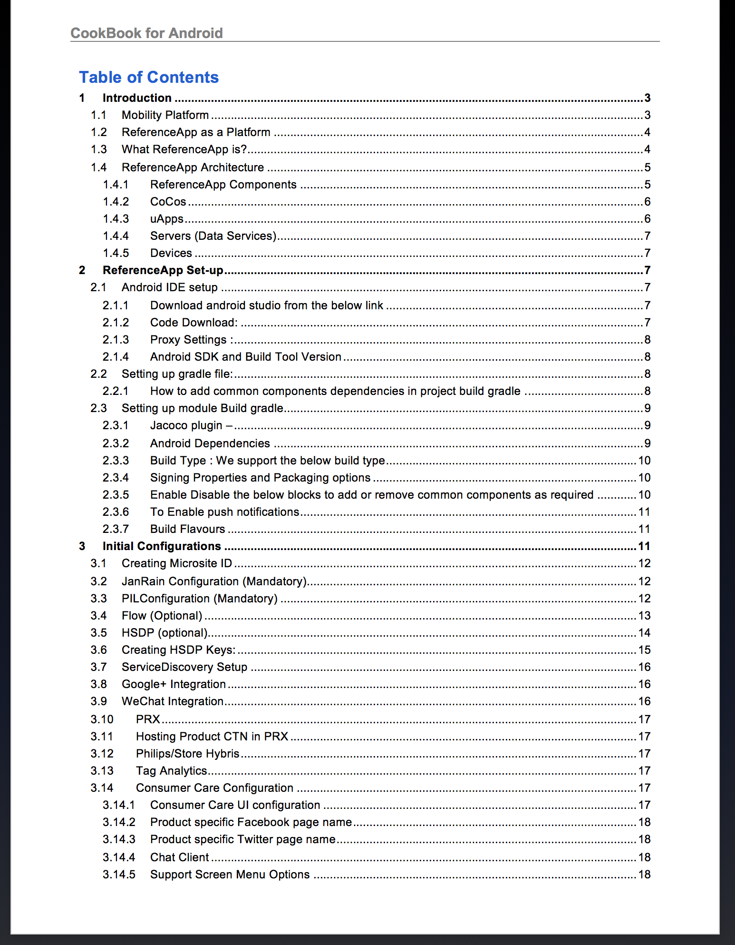

Slide 5
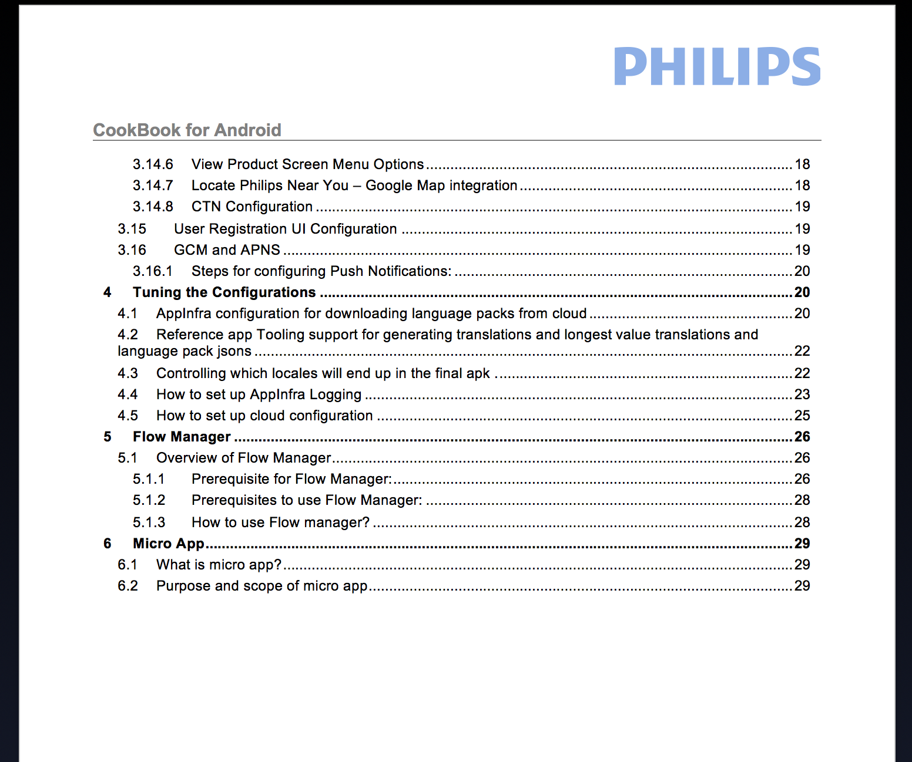

Slide 6
Future Scope
To show how to add a new flavor in reference app
Video tutorials wherever applicable
Identify common error scenarios that a developer can face while using/developing reference app

Slide 7
Thank you

