Slide 1
Hill Climbing

Slide 2
Hill Climbing爬山法
A mathematical optimization technique which belongs to the family of local search.
是一种属于局部搜索家族的数学优化方法
It is an iterative algorithm: starts with an arbitrary solution to a problem, then incrementally change a single element of the solution, if it's a better solution, the change is made to the new solution, repeating until no further improvements can be found.
是一种迭代算法:开始时选择问题的一个任意解，然后递增地修改该解的一一个元素，若得到一个更好的解，则将该修改作为新的解;重复直到无法找到进一步的改善 。
Most basic local search algorithm without maintaining a search tree.
大多数基本的局部搜索算法都不保持一颗搜索树。

Slide 3
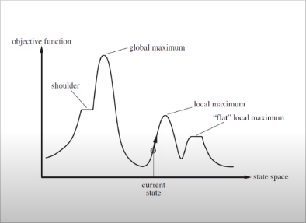
State-Space Landscape状态空间地形图
It can be explored by one of local search algorithms.
可通过局部搜索算法对其进行搜索。
A complete local search algorithm always finds a goal if one exists.
一个完备的局部搜索算法总能找到一个存在的目标。
an optimal local searchalgorithm always finds aglobal minimum or maximum.
一个最优的局部搜索算法总能找到一个全局的最小或最大值。

Slide 4
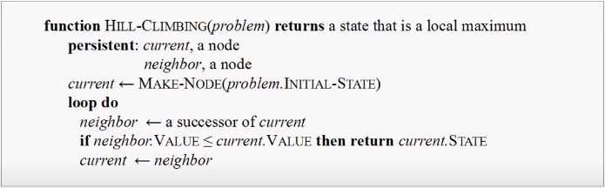
Hill-Climbing Search Algorithm爬山搜索算法
Steepest-ascent version: at each step, current node is replaced by the best neighbor
(the neighbor with highest value), else it reaches a“peak" .
最陡爬坡版:当前节点每一步都用最佳邻接点(具有最高值的邻接点)替换，否则到达一个“峰值”。

Slide 5
Hill-Climbing Search Algorithm爬山搜索算法
Hill-Climbing search algorithm is the most basic local search technique.
爬山搜索算法是最基本的局部搜索方法。
It often makes rapid progress toward a solution, because it is usually quite easy to improve a bad state.
它常常会朝着一个解快速地进展，因为通常很容易改善一个不良状态。
It is sometimes called greedy local search, because it grabs a good neighbor state without thinking ahead about where to go next.
它往往被称为贪婪局部搜索，因为它只顾抓住一个好的邻接点的状态，而不提前思考下一步该去哪儿。
Although greed is considered one of the “seven deadly sins", it turns out that greedy algorithms often perform quite well.
尽管贪婪被认为是“七宗罪”之一，但是贪婪算法往往表现的相当好。

Slide 6
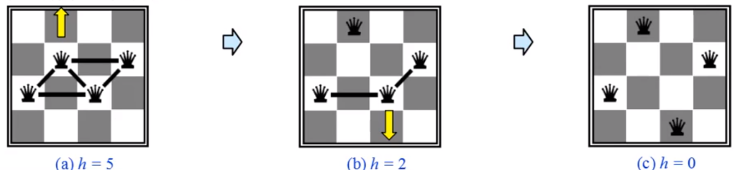
Example: n-queens problems n皇后问题
To illustrate hill climbing, we will use the n-queens problem. L ocal search typically use a complete-state formulation.
为了举例说明爬山法，我们将选用r皇后问题。局部搜索通常采用完整状态形式化。
Put all n queens on an n x n board. Each time move a queen to reduce number of conflicts, to be with no two queens on the same row, column, or diagonal.
把n个皇后放在n x n的棋盘上。每次移动-个皇后来减少冲突数量，使得没有两个皇后在同一行、同一列、或同一对角线上。

Slide 7
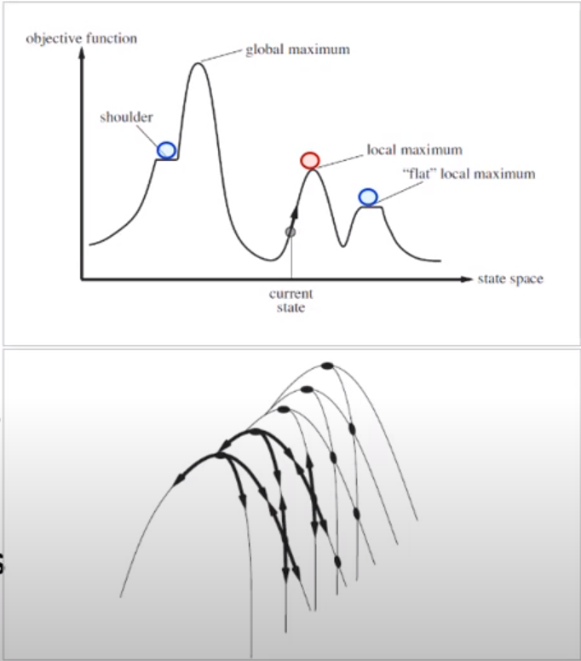
Weaknesses of Hill-Climbing爬山法的弱点
It often gets stuck for the three reasons:
它在如下三种情况下经常被困:
Local maxima局部最大值
higher than its neighbors but lower than
global maximum.
高于相邻节点但低于全局最大值。
Plateaux 高原
can be a flat local maximum, or a shoulder.
可能是一个平坦的局部最大值，或山肩。
Ridges山岭
result in a sequence of local maxima
that is very difficult to navigate.
结果是一系列局部最大值，非常难爬行。

Slide 8
Variants of Hill-Climbing爬山法的变型
Stochastic hill-climbing随机爬山法
It chooses at random among uphill moves; the probability of selection
can vary with the steepness of uphill move.
This usually converges more slowly than steepest ascent.
在向上移动的过程中随机选择;选择的概率随向上移动的斜度而变化。
与最陡爬坡相比，收敛速度通常较慢。
First-choice hill-climbing首选爬山法
It implements stochastic hill climbing by generating successors
randomly until one is generated that is better than the current state.
This is a good strategy when a state has many of successors.
它通过随机生成后继点来实现随机爬山法，直到生成-一个比当前状
态好的点。当某个状态有许多后继时，用此策略为好。

Slide 9
Variants of Hill-Climbing爬山法的变型
Random-restart hill-climbing随机重启爬山法
It conducts a series of hill-climbing searches from randomly
generated initial states, until a goal is found.
It is trivially complete with probability approaching 1, because it
will eventually generate a goal state as the initial state.
If each hill-climbing search has a probability p of success, then the
expected number of restarts required is 1/p.
它好于其它爬山搜索方法，从随机生成的初始状态直到找到目标。
它十分完备，概率逼近1，因为最终它将生成一个目标状态作为
初始状态。如果每次爬山搜索成功的概率为p,则重启需要的期望
值是1/p。

