Slide 1
GeekHub (8 season) - Data Science & Python
TRAJECTORY DATA MINING:
Researching trajectory data by GPS tracks
Project participants :
Leleko Serhiy
Palahin Volodymyr
Filipov Vitalii

Slide 2

Relevance of Research
The advances in location-acquisition have generated massive trajectory data, which represent the mobility of a diversity of moving objects:
vehicles
cargo vehicles
humans
animals
Tasks:
Trajectory data preprocessing
Trajectory data management
Trajectory pattern mining
Trajectory outlier detection
Trajectory classification
Health data mining and result prediction (for sport data)
Traveling recommendation
This project research the connections, correlations and differences in trajectory data received from different GPS tracks.
There are many public trajectory datasets that can help to conduct researching in the field of trajectory data mining
2

Slide 3

Research stages
1. Classification of the sources generating trajectory data
2. Trajectory pre-processing
2.1. Noise filtering
2.2. Trajectory compression
2.3. Stay point detection
2.4. Map-Matching (if it needed or if it possible)
2.5. Trajectory segmentation
2.6. Trajectory uncertainty removing (if needed)
3. Mining task solving
3.1. Feature Engineering
3.2. Model development and research (Data modeling)
3.3. Data Exploration & Visualization
3.4. Model Deployment
3

Slide 4
Research methods
Pattern clustering
Graph mining
Collaborative filtering
Matrix factorization
Tensor decomposition
3

Slide 5
Datasets information
1. Data information: source of GPS tracks – humans / vehicles
start time / end time
transportation mode
2. Data information: source of GPS tracks - vehicles (taxi / traffic)
coordinates, duration time
speed (motion algorithm, average speed, accelerometer, if possible)
fuel level (fuel consumption, if possible)
engine mode (temperature, engine speed, if possible)
voltage battery (if possible)
3. Data information: source of GPS tracks - cargo vehicles
planned duration
actual duration
unique id for departure
unique id for transport
4. Data information: source of GPS tracks – sport data
coordinates
speed (accelerometer, cadence, steps, if possible)
heart rate data
power (estimated or evaluated, if possible)
temperature, barometer
4

Slide 6

Possible results
1. 2. Vehicles / humans
predict movement trajectory
predict of duration
classification of movement, passengers
predict economy effect (less fuel consumption,
time earnings)
predict vehicle mileage (without damage)
3. Cargo vehicles
logistic optimization by transport and departure id
predict of duration
predict vehicle mileage
classification by transport and departure id
4. Humans, sport data
classification by movement (daily use, walking, running,
cycling, swimming)
classification by human (athlete score)
classification by sport conditions and health
predict time for sport event and recovery time
predict health problems, weight loss recommendations
logistic optimization by sport activities
5

Slide 7
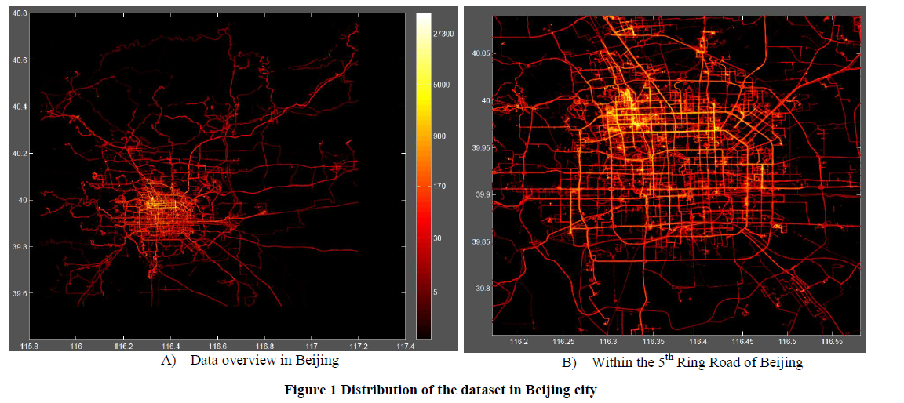
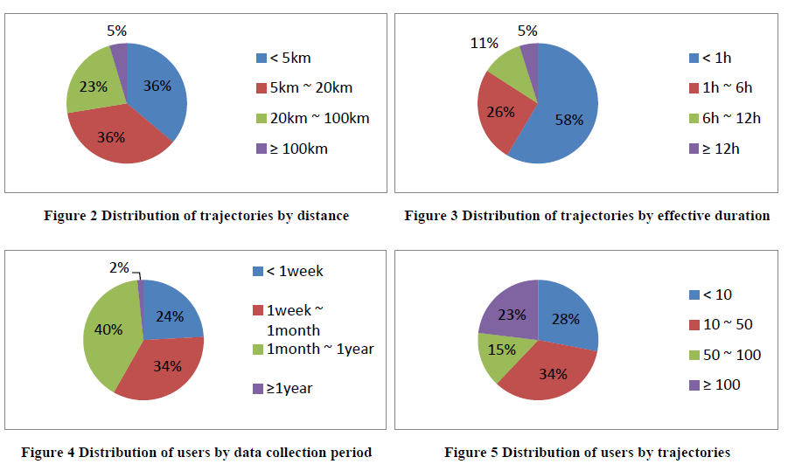
Example source of GPS tracks – humans / vehicles
https://www.microsoft.com/en-us/research/project/geolife-building-social-networks-using-human-location-history/?from=http%3A%2F%2Fresearch.microsoft.com%2Fen-us%2Fprojects%2Fgeolife%2Fdefault.aspx
6

Slide 8
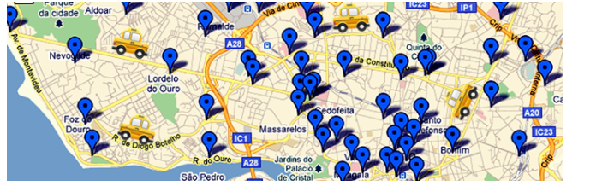
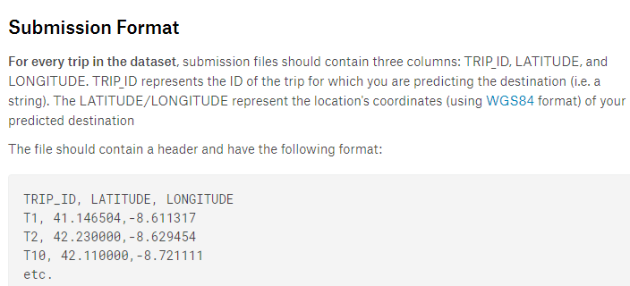
Vehicles (taxi) tracks - example
https://www.kaggle.com/c/pkdd-15-predict-taxi-service-trajectory-i
https://onedrive.live.com/?authkey=%21ADgmvTgfqs4hn4Q&id=CF159105855090C5%211438&cid=CF159105855090C5
7

Slide 9
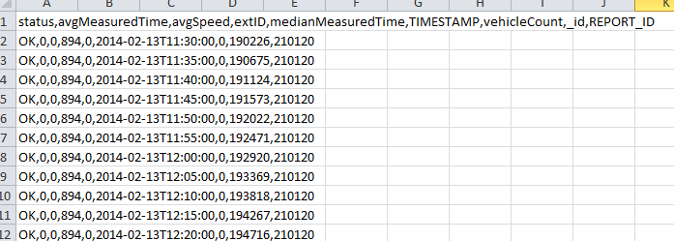
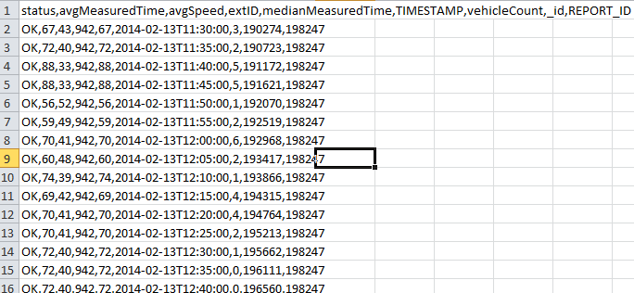
Vehicles tracks (traffic in Denmark) - example
http://iot.ee.surrey.ac.uk:8080/datasets.html#traffic
8

Slide 10
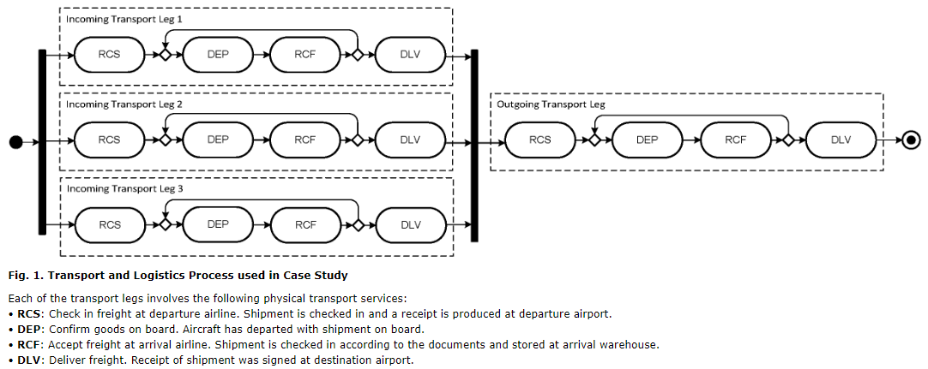
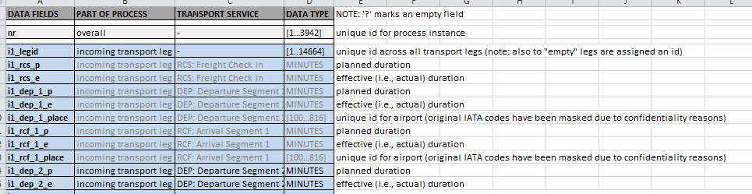
Cargo vehicles - example
http://s-cube-network.eu/c2k/
9

Slide 11
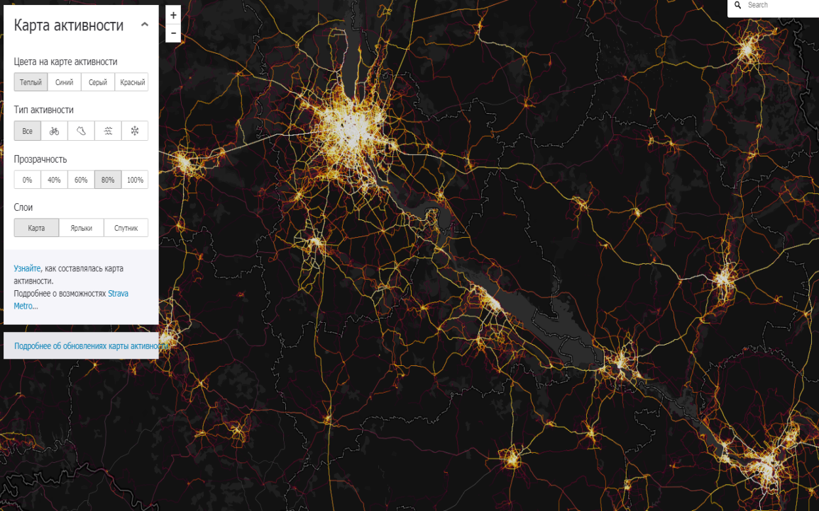
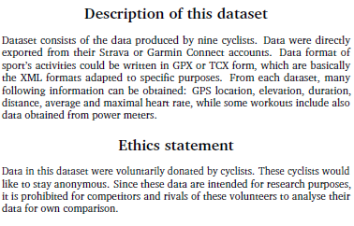
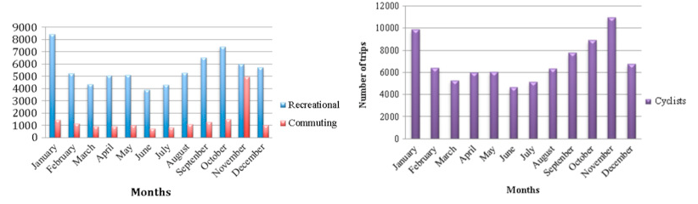
Sport activity example
http://academictorrents.com/details/af55533bf8229c3bff260b77a652f8b8058f6c9e
https://www.sciencedirect.com/science/article/pii/S235234091630662X
10

Slide 12
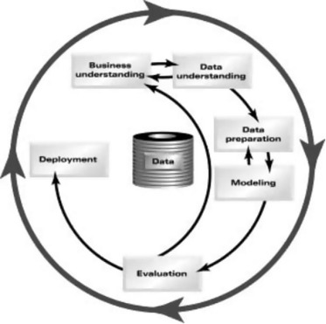
Task solving examples
Solved examples:
Task: Identifying Transportation Modes from Raw GPS Data
Solve: Random Forest classifier
Link: https://www.researchgate.net/publication/305728530_Identifying_Transportation_Modes_from_Raw_GPS_Data
Task: Taxi Trajectory Prediction
One of solves: The prediction was generated by minimizing the weighted sum of the distances between the sample destinations and the guess
Link: https://www.kaggle.com/c/pkdd-15-predict-taxi-service-trajectory-i/discussion/15020
Task: Taxi Trajectory Prediction
Stages of solves: Matrix factorization, Collaborative filtering, Tensor decomposition, Semisupervised learning and Transfer learning
Link: https://clck.ru/F64Jo
Task: Sport result prediction
One of solves: CRISP-DM framework or SRP-CRISP-DM framework
Link: https://www.sciencedirect.com/science/article/pii/S2210832717301485
Our solutions and suggestions:
selection a more optimal (effective) model
add effective noise filtering algorithm
more target features distribution
selection of the optimal in terms of speed / performance classification method
11

Slide 13

Conclusions
That’s all for today ;)
12

