Slide 1

Agile method
By Phillip Kimbrel

Slide 2
Agile Roles
Product owner – Mange product roadmap and backlog
Developer- Works on work that is prioritized by the product owner
Tester- Tests the products that the developers develop and checks for mistakes before it is sent to client
Scrum Master- Identifys needs of the client and sends it to the product owner.

Slide 3
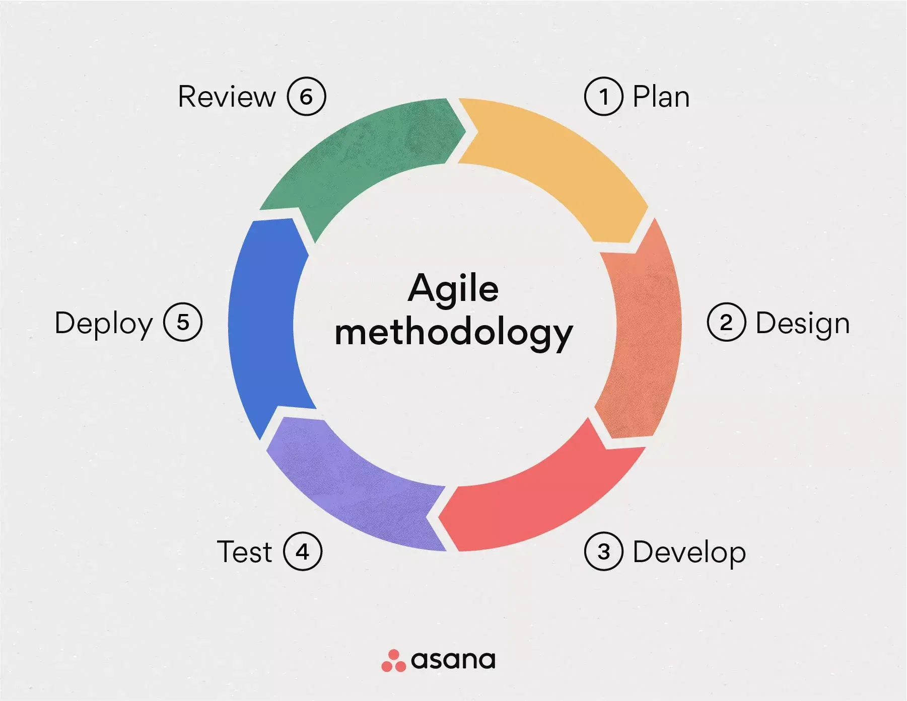
Agile phases
Stage 1-Plan- figure out what you are doing the project
Stage 2 –Design- produce the ways you are going to do the project
Stage 3-Develop- code the project.
Stage 4 –Test- double check the work or the project.
Stage 5-Deploy- ship the project.
Stage 6- Review- figure out how you could of improved the project.

Slide 4
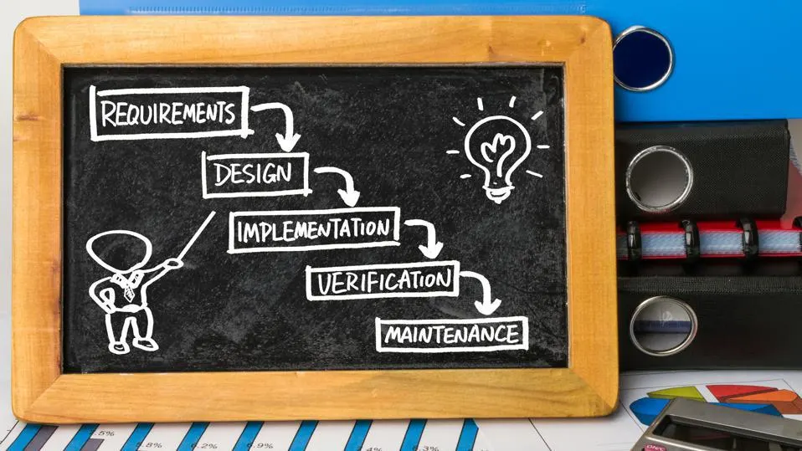
The Waterfall Model
The waterfall models is unlike the agile model as it does not go in cycle and matches more to the name of the model a waterfall.
With out the cycle more bugs and Problems could end up showing up the longer the product is out .

Slide 5
Differences between waterfall and agile
Waterfall
agile
Strict timetable
Set budget
Straight forward direction
Little client involvement
Ment for projects the require deliverables on time
More flexible timeline
Flexible budget
Adaptes to change.
Massive client involvement
Ment for projects that are constently being worked on

Slide 6
Refrences
Hoory, L., & Bottorff, C. (2022a, March 25). What Is Waterfall Methodology And How Do I Use It? Forbes Advisor; Forbes. https://www.forbes.com/advisor/business/what-is-waterfall-methodology/
Laoyan, S. (2024, February 2). What Is Agile Methodology? (A Beginner’s Guide). Asana. https://asana.com/resources/agile-methodology
Hoory, L., & Bottorff, C. (2022). Agile vs. Waterfall: Which Project Management Methodology Should I Use? Forbes Advisor; www.forbes.com. https://www.forbes.com/advisor/business/agile-vs-waterfall-methodology/
Vasiliauskas, V. (2022, August 18). Agile Team Roles and Responsibilities: A Brief Guide. Teamhood. https://teamhood.com/agile-resources/agile-team-roles/

