Slide 1
The Final Push
Analyzing and Visualizing Groundwater Quality in California
Jo Bagri, Chris Lachman, Phil Lee, Anand Purohit and Mark Souverville

Slide 2

Database Creation - Sources
https://data.ca.gov/dataset/ground-water-water-quality-results
https://www.census.gov/data/tables.html
https://droughtmonitor.unl.edu/Data/DataDownload/ComprehensiveStatistics.aspx
Notes:
Initial download was from the California Open Data Portal, https://data.ca.gov/dataset/ground-water-water-quality-results. This data contains the statewide groundwater quality data for all chemicals from the GAMA Domestic Well (DW) and Priority Basin (PB) programs. It is the most comprehensive statewide groundwater quality information publicly available.

Slide 3
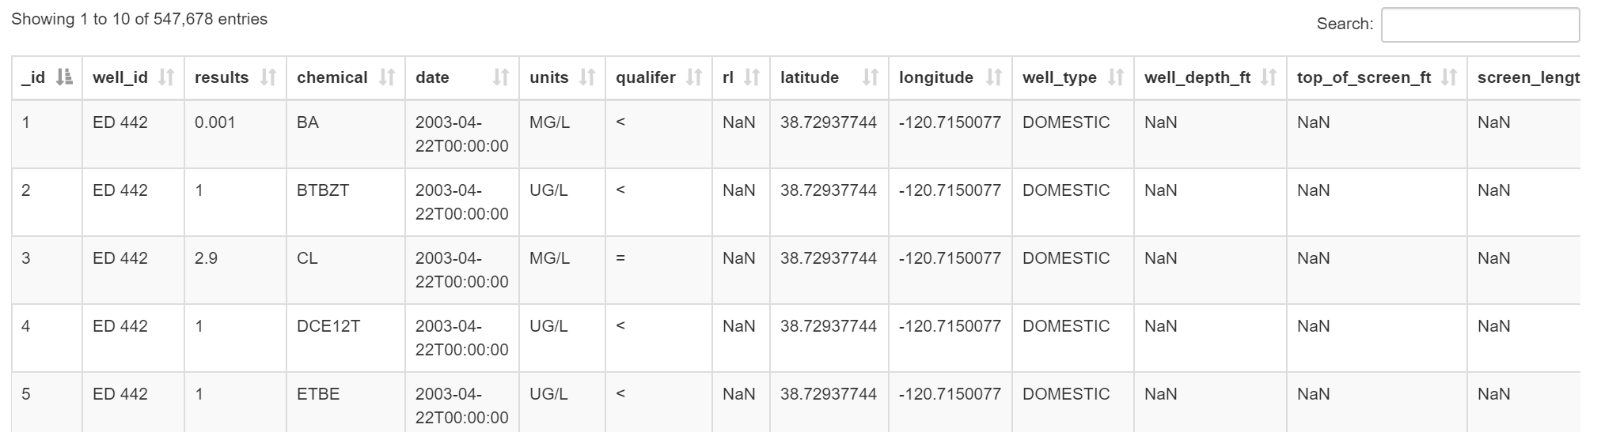
Database Creation
Statewide groundwater quality data for all chemicals from the Groundwater Ambient Monitoring and Assessment Program (GAMA)
Most comprehensive statewide groundwater quality information publicly available
Notes:
Initial download was from the California Open Data Portal, https://data.ca.gov/dataset/ground-water-water-quality-results. The Groundwater Ambient Monitoring and Assessment Program (GAMA) is a statewide, comprehensive assessment of groundwater quality designed to help better understand and identify risks to groundwater resources. GAMA is being implemented by the California Water Board. It is the most comprehensive statewide groundwater quality information publicly available.

Slide 4
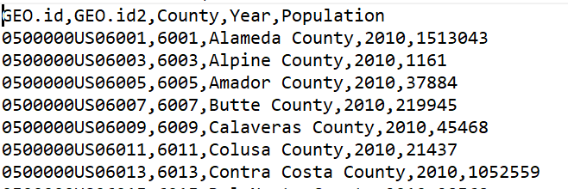
Database Creation
Population Data

Slide 5
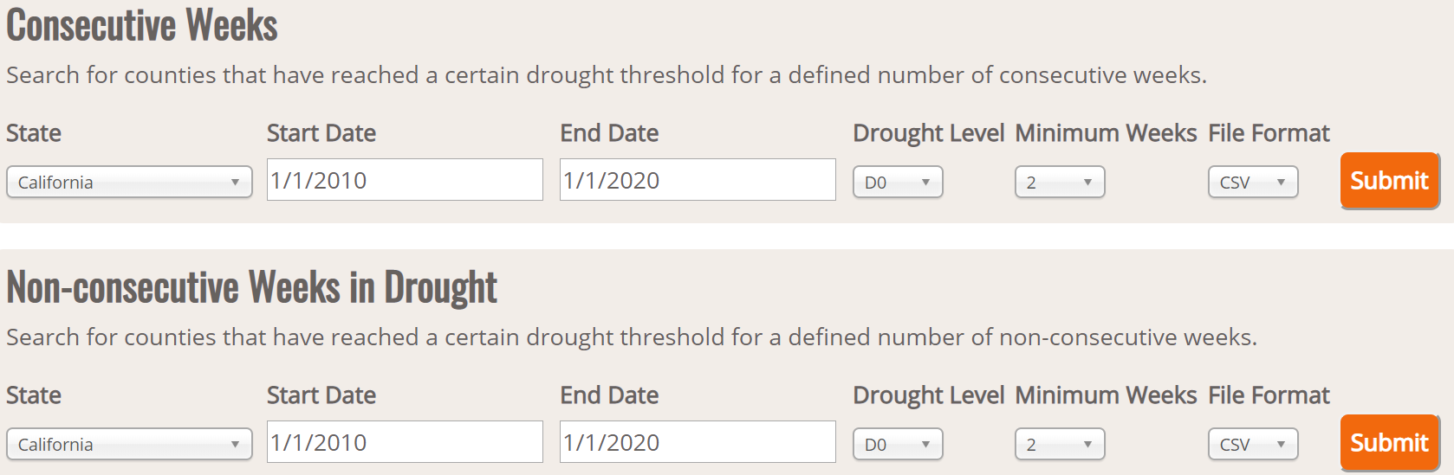
Database Creation
Drought Data

Slide 6
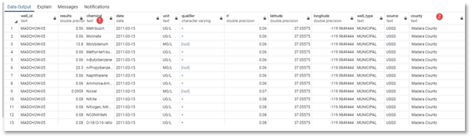
Data Cleanup
Groundwater Quality Master File
We removed needless columns and NaN data
Updating column names
Changing data types to allow the merge to occur
Ensuring equal amount of rows to each column
We also inserted two new columns:

Slide 7
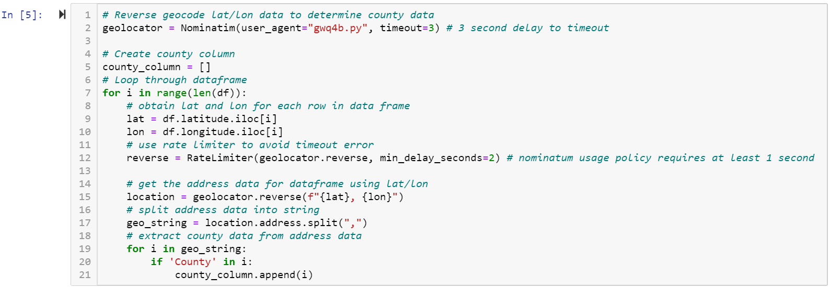
Data Processing
Adding county data to water quality data
This was done with reverse geocoding, getting geographical information in a list associated with a latitude longitude location. We found a free geocoder, geopy.geocoders with an import called Nomanatim that we ran in Jupyter Notebook to accomplish this task.
Notes:
Originally all we had was latitude and longitude, but we needed a county column to join with other tables in database. This was done with reverse geocoding, getting geographical information in a list associated with a latitude longitude location. We found a free geocoder, geopy.geocoders with an import called Nomanatim that we ran in Jupyter Notebook to accomplish this task.
It was found that the number of geocode requests had to be limited to successfully process the data and 547,678 rows in the original file was too many. Since there were multiple rows of the same well, which is in the same location and has the same lat/long data, we were able to drop duplicate rows with the same “well_id”. This left me with a much easier to manage file with 4,085 rows of data, which was still too many, and the geocoder would time out. Through trial and error, we were able to find that about 400 rows would not time out the geocoder, so we split the 4,085 row file file into 10 separate files. With Pandas, WEwas then able to reverse geocode each file, produce 10 files with the county data, and concatenate those files into a new 4,085 row file that included county data as a new column. We then imported that new file and the master file into Pandas as separate dataframes and added all the county data to the master file.

Slide 8
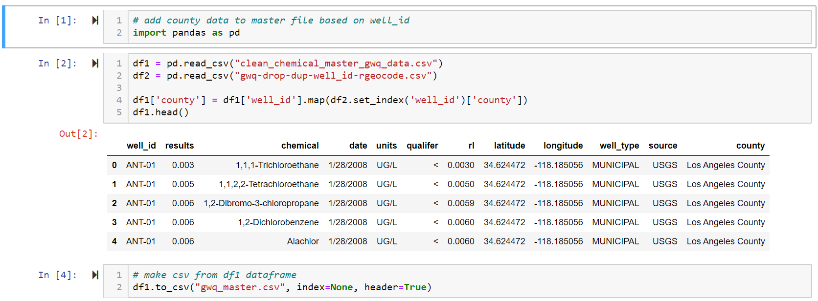
Data Processing
Adding county data to water quality data
We then imported that new file and the master file into Pandas as separate dataframes and added all the county data to the master file.

Slide 9
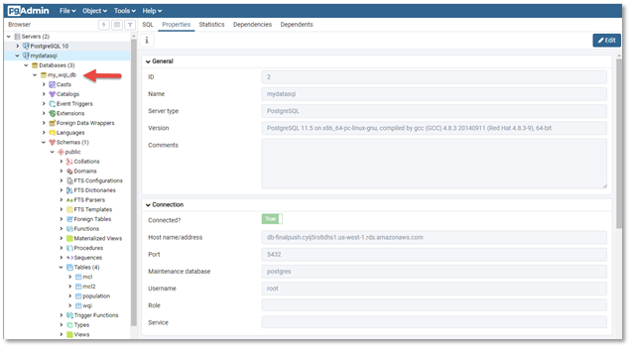
PostgreSQL on AWS
We then created a PostgreSQL database instance on Amazon Web Services. We created the database schema in SQL and imported the CSV files into database. We also added the census information into its own table and added two additional tables for chemical contaminant levels, and one for drought conditions.

Slide 10
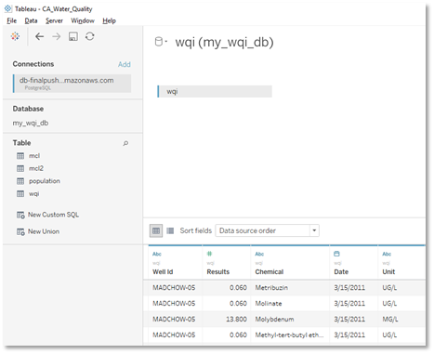
Tableau Connection
We connected our PostgreSQL database to Tableau. Here’s a screenshot of the data tab and tables. At this point, all project members had access to the AWS for our data reporting purposes.

Slide 11
Tools we Used
We connected our PostgreSQL database to Tableau. Here’s a screenshot of the data tab and tables. At this point, all project members had access to the AWS for our data reporting purposes.
Pandas
Jupyter Notebook with SKLearn
HTML and Javascript
PostgreSQL
Tableau
Geopy.geocoder with Nomanatim
Amazon Web Services

