Slide 1


Machine Learning in the Cloud
Phillip Williams
January 18th, 2019
Notes:
Hello Everyone, my name is Phil and I’m a software developer at Kinaxis of the Machine Learning team.
For those of you that don’t know Kinaxis, we make supply chain software. What does supply chain software mean? Well we help companies plan things like how much material they need, where and when they need to get material from and predict supply and demand.
As you might imagine, we want to predict stuff like prices, supply and demand really accurately, so for a lot of stuff we use Machine Learning.

Slide 2

What is ML in the Cloud?
Why is ML useful?
Automatic ML
ML in the Cloud
Notes:
Today I’m going to talk about how we do Machine Learning at Kinaxis, but more specifically we’re going to talk about 3 things:
What is a machine learning model and why is it useful?
What is Automatic Machine Learning
What does ML in the cloud look like?
Now that you have an idea of what I’m going to talk about, let’s get into it.

Slide 3
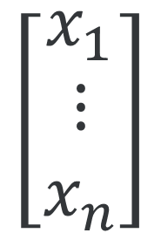
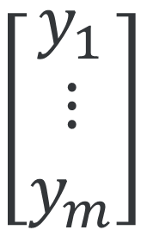
What is a Machine Learning model?
$$\left[\begin{matrix}x_{1} \\ ⋮ \\ x_{n}\end{matrix}\right]$$
$$\left[\begin{matrix}y_{1} \\ ⋮ \\ y_{m}\end{matrix}\right]$$
Model
Input
Output
Notes:
I’m sure that everyone here has heard about Machine Learning and AI, but what do those words mean in the context of an actual production system?
When we talk about a model, we’re talking about any algorithm that takes in some numerical input data and generates a prediction. For example we could predict how long it takes to deliver an item based on the weather, or classify parts using meta data.
So cool, we know what a model is, but how do we get a model and how is it useful?

Slide 4
Machine Learning Overview
Historical Data
…
Train
Machine Learning Algorithm
Trained Model
New Data
…
Prediction
…
Predict
Trained Model
Notes:
There are two main things you want to do with a model : training and prediction.
When we train a model, we take some historical and pick an algorithm from a library of ML techniques. We then apply some complicated math so that our model can figure out the relationships in the data that we gave it. A model that understands the relationships of some data is called a “trained” or “fitted” model.
When we “predict”, we want the model to tell us something about new data. Since the “trained” model understands how the data works, we can actually use it to process new data that it has never seen before and predict how this new data will behave.
So now we know what a “trained” model is and we know that it’s useful since we can use it to automatically figure out relationships in the data and give us answers about new data as we get it. But at Kinaxis, our data is changing daily and we have so many datasets that we can’t deal with them all manually.
This leads us into what’s called Automatic Machine Learning. Since we can’t have a data scientist go through each data set, we need a system that can automatically do a lot of the work for us.

Slide 5
Automatic Machine Learning
Raw Data
Feature Generation
Model
Selection
Notes:
Some of you may be wondering : What exactly is the work that our Automatic Machine Learning needs to take care of? Well there’s a few main things that we need to handle:
First, we need to load all of the data we need and clean it up so that our models can ingest it.
Next, we want to do some more sophisticated processing of the data to make it easier for our models to figure out what the relationships in the data are. This step is called Feature Generation. In this step, we take raw input variables and we transform them into new variables (called features) which are more easily understood.
After we’ve generated all this additional data, we want to pick the best model for our dataset. But first, let’s look at feature generation.

Slide 6
Feature Generation
Raw Variable | Feature
Date | IsWeekday
Date | IsHoliday
Date | DayOfYear
Date | WeekOfYear
Date | Month
Temperature | WeeklyAvg
Temperature | WeeklyMin
Temperature | WeeklyMax
Date | Temperature | Items Sold
2017-01-01 | -20 | 5
2017-01-02 | -19 | 6
2017-01-03 | -10 | 7
2017-01-04 | -15 | 6
2017-01-05 | -25 | 6
2017-01-06 | -35 | 4
2017-01-07 | -34 | 5
Feature Generation
Notes:
Here’s a example of what feature generation looks like.
Let’s say we want to predict the number of items sold based on the date and the temperature. Maybe it’s hard for a model to accurately predict the supply with just those variables, so in our feature generation step, we would break up the date into things like day, week, month, year, holidays, etc. The temperature on the other hand, we might calculate the weekly average, minimum and maximum since that information might be useful for the model.
At this step, we want to calculate a ton of transformations so that the model has all sorts of different variables and features that it can use to figure out relationships. The goal of the feature generation is to explode the number of variables that our model has access to, in the hopes that some of the additional variables will improve the accuracy of the model.
So now that we have all of the data for our models, how do we pick the best one?

Slide 7
Model Selection
Linear Model
Learning Rate
All Features
Neural Network
Model Complexity
Embedding
Ensemble Model
Number of Iterations
Dimensionality Reduction
SVM
Preprocessing
Correlation Analysis
Decision Trees
Postprocessing
Model Zoo
Model Configurations
Feature Selection
Notes:
The process we use to pick the best model is called model selection. There are a few key concepts that we use to do model selection.
A model zoo is a list of all the different types of models that we can use.
The model configuration is how you set up the model, for example how many iterations of training we do, how many parameters we use and if we normalize the data at all.
Finally, we want to pick the variables/features that we want to use. If you remember for the feature generation, we want to generate every possible feature we can to give our models the best chance at figuring out the data. The issue with this is that if we have tens of thousands of input variable, the models will be very slow, so sometimes we want to filter down all of the features we generated to a set of promising candidates. This is called feature selection.
Now that that is out of the way, how do we use all of this to pick the best model for our data? The answer is actually super simple, we try every combination of models, configurations and features and we simply pick the most accurate one.
---
Cool, so we get our raw data, we generate all the features we care about, we try every combination of models and configurations and we pick the best one and then use that best model to make predictions.
Sounds pretty straight forward right?
---
If you wanted to predict for one dataset, you could do that on one computer, but what do we do if we want to process 10 datasets? What about 100,000? What would you do with 100 million?
We obviously can’t run our processing on a single computer when we start getting a lot of data, so we want some way of doing machine learning on many computer at once.
This is where the “Cloud” or “Distributed Computing” part of it fits in. We want to use a bunch of servers in the cloud because we have so much data that we can’t do it on a single computer anymore.

Slide 8
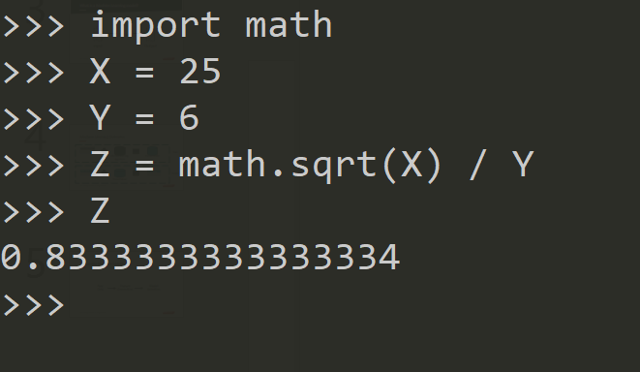
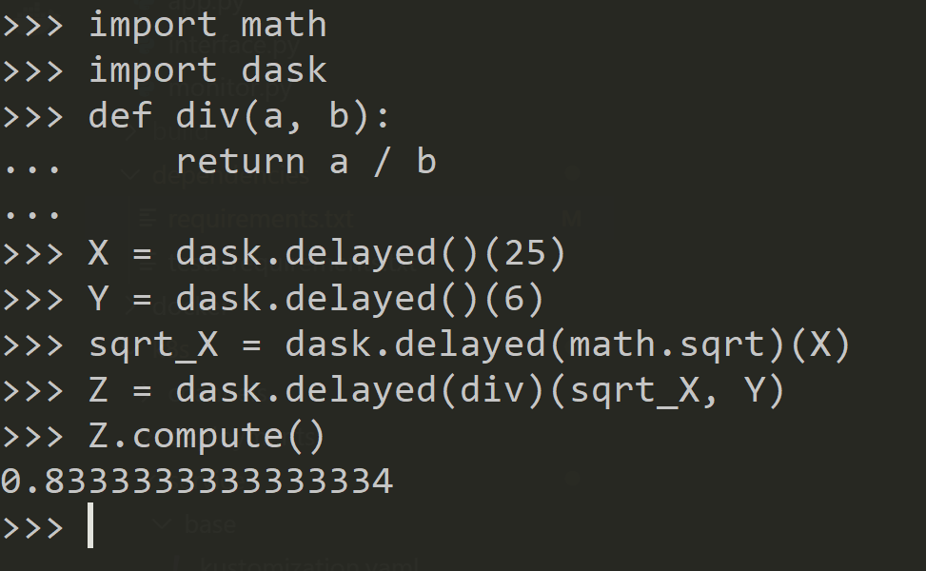
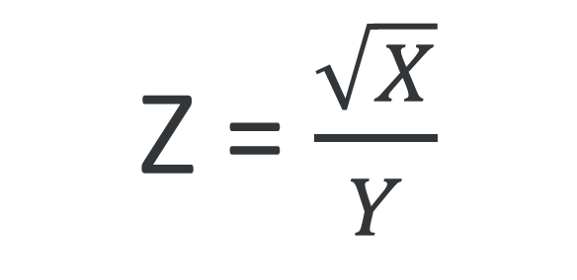
Dask and the Directed Acyclic Graph
Z = $\frac{\sqrt{X}}{Y}$
X
Sqrt
sqrt_X
Div
Z
Y
Notes:
For our code to run across many machines, we use Dask. Dask is a python library that allows you to write code that runs on as many servers as you want. Even better, the exact same code can run on 1 server or 100 without any changes due to how dask works.
The way that dask accomplishes this is using a concept called a Directed Acyclic Graph called a DAG.
The idea behind the DAG is that you can break your entire program into a set of variables and functions. If you look at the output of the program, it depends only on other functions and variables.
For example, let’s say I wanted a program that calculates the square root of X divided by Y. This would be super easy to implement in python. But let’s look at how this would work in Dask. We would probably come up with a DAG that looks like this, I have an output Z that is calculated as a function of Y and sqrt_X, and sqrt_X is a function of X. I can then implement this using the Dask.Delayed API and get the same result as regular python but potentially distributed.
This is powerful since as long as you know how your functions and variables depend on each other, it doesn’t actually matter where your variables and functions live. In theory, each function and variable could live on it’s own server since you would know how they are related and could transfer over data where and when you need it.

Slide 9
Complex DAG
Source : Speeding up your Algorithms Part 4— Dask
Link : https://towardsdatascience.com/speeding-up-your-algorithms-part-4-dask-7c6ed79994ef

Slide 10

Running code in the Cloud
Master
Server
Worker
Servers
Notes:
As long as we know what the DAG for our application is, we don’t care where the data lives, using this you can write an application in Dask and run it on multiple servers. Dask creates what’s called a Master Server that stores the DAG and will use other servers (called workers) to do all of the calculations. Since master keeps track of your DAG it will tell all the workers which functions and variable to process.
That’s super cool, we went from nothing and now we have a system that can automatically train models and make accurate predictions on millions of datasets a day.
But wait a minute, how does dask know how to take control of the servers, and who is in charge of these servers? The answer is that we use two technologies : Docker and Kubernetes.

Slide 11
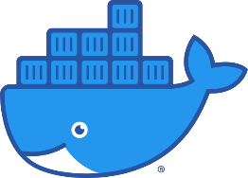


Deploying in the Cloud
Docker
Container
Kubernetes
Cluster
Pods running
your code
Dockerfile
Notes:
Firstly, instead of running your code on a server manually, Docker lets you bundle up all your code and libraries into a single package called a container. You can then run your container on any computer that has docker installed. This is very similar to how virtual machines work.
For example you could write all your dask code in python, bundle it in a Docker container and then run your dask application on multiple servers without you needing to install anything on the server or manually set it up. You just need to send your docker container to the servers and you’re set. Pretty useful right?
This gets interesting when we combine Docker with Kubernetes. Kubernetes is something that allows you to take a bunch of servers, connect them together and turn them into a cluster. This way, you don’t actually care about the servers anymore, you just care about the cluster. You can write all of your code to run on a cluster and Kubernetes will take care of setting your code up as well as running multiple copies of it on different servers.
With Kubernetes you don’t need to care about how many servers you want and where they are. We simply tell kubernetes “Run this container” and Kubernetes will take our container and run the dask code on as many servers as it needs in the cluster.

Slide 12

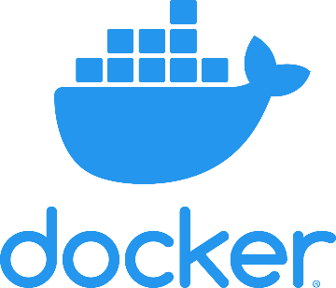
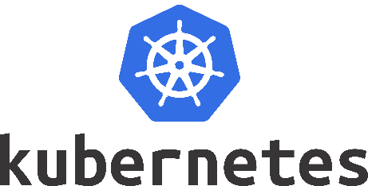
A couple key technologies
Notes:
To conclude, we set up an Automatic Machine Learning system that will process the data and give us the best models and predictions without any human intervention.
Then you implement your machine learning application using Dask so that it can run on many machines at once.
Finally once your code is setup, you can wrap it in a Docker Container and using kubernetes to run it on dozens of computers at once in a large scale data center.

Slide 13
Know sooner. Act faster.
Phillip Williams
Pwilliams@kinaxis.com
Notes:
- Relate back to kxs
Thanks for listening to my talk, I hope that you all learned something about machine learning and cloud technologies. If you have any questions or want to chat feel free to reach out or come talk to me at the Kinaxis career fair booth.

