Slide 1
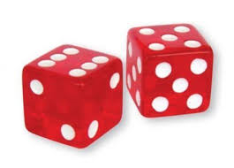
One Player
Main​
df
Create dice1
Create dice2
Create DiceGame() with two dice
Call the play()
Dice Game
IDice
IDiceGame
Interface for a Dice
Interface for a game of dice
Dice
DiceGame​
Implements IDice
roll()
Math.random ()
Implements IDiceGame
Point/round/total = 0
play()
Round++
Print out the comments

