Slide 1
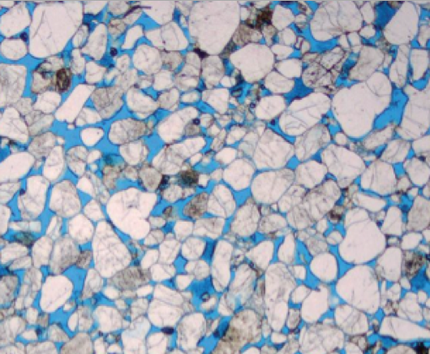
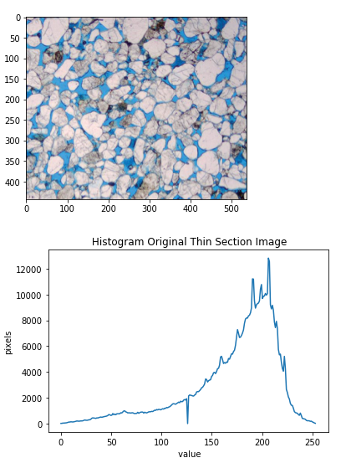

Slide 2
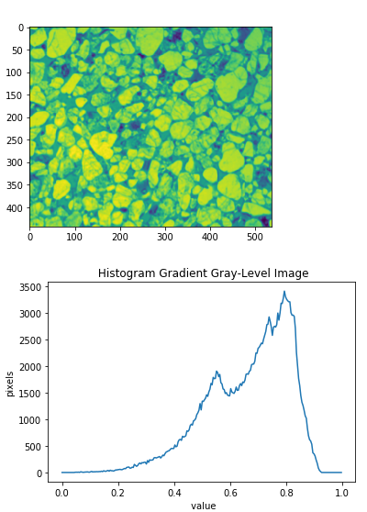
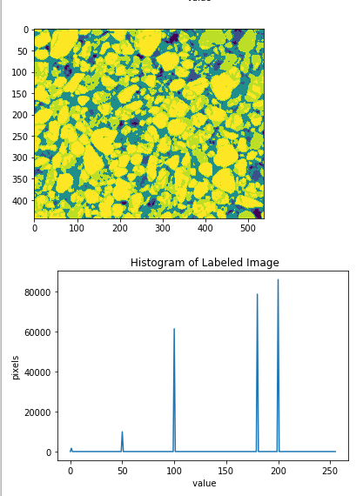

Slide 3
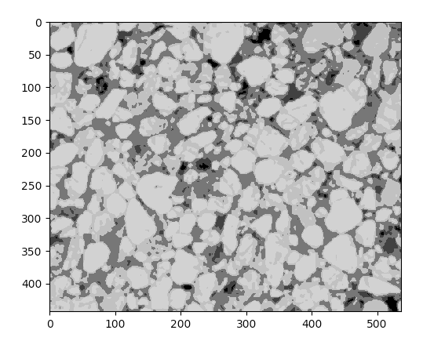
﻿ label = np.zeros(gradient.shape )
label[gradient < 0.25] = 1 #black grains
label[gradient > 0.25] = 50 #darker grains
label[gradient > 0.4] = 100 #blue-dye epoxy or visual porosity
label[gradient > 0.6] = 180 #darker grains
label[gradient > 0.75] = 200 #bright quartz grains
Label Value: 200
Bright grains
Label Value: 100
blue-dye epoxy

