Slide 1
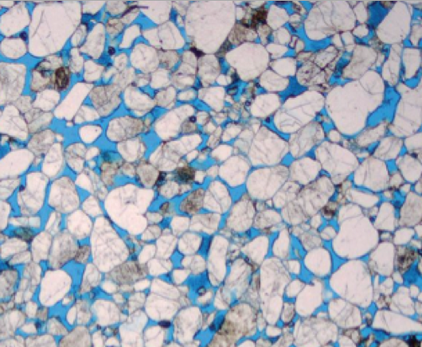
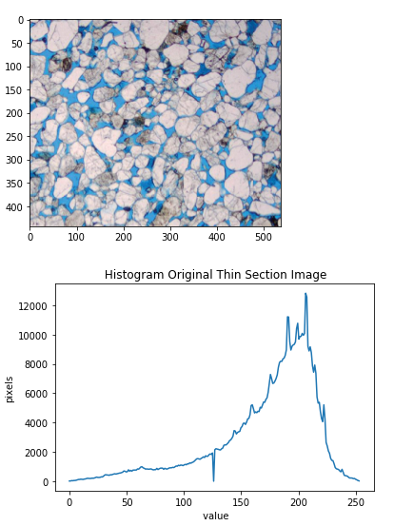

Slide 2
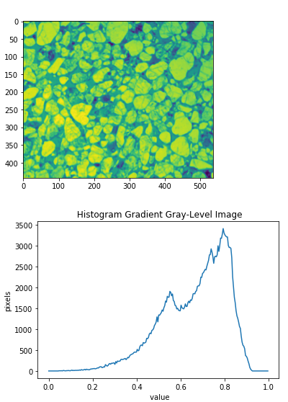
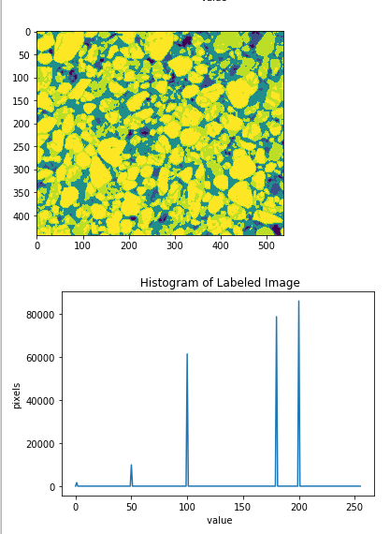
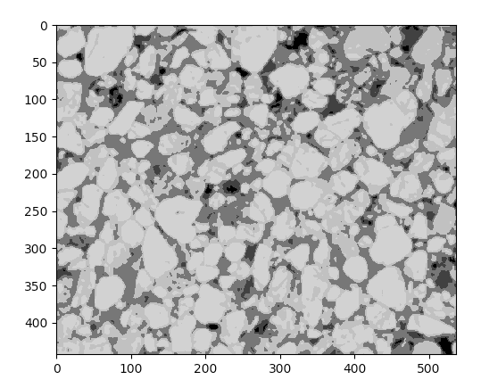
Label Value: 200
Bright grains
Label Value: 100
blue-dye epoxy

Slide 3
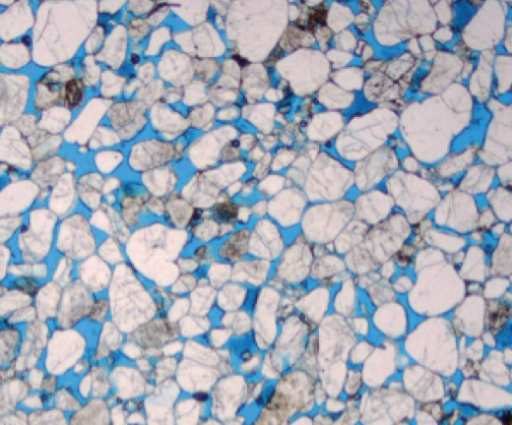
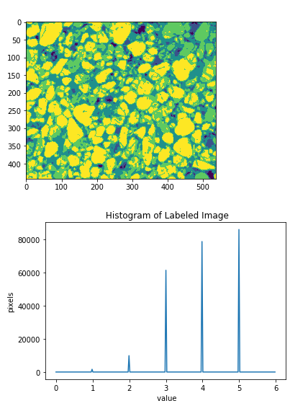
Label Value = 3
blue-dye epoxy
Label Value = 5
Bright grains

Slide 4
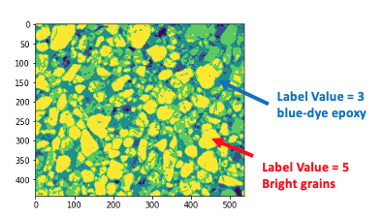
﻿ label = np.zeros(gradient.shape )
label[gradient < 0.25] = 1 #black grains
label[gradient > 0.25] = 2 #darker grains
label[gradient > 0.4] = 3 #blue-dye epoxy or visual porosity
label[gradient > 0.6] = 4 #darker grains
label[gradient > 0.75] = 5 #bright quartz grains

