Slide 1
DoYouTrustAI
Phillip Driscoll

Slide 2
Abstract
Artificial Intelligence (AI) and, in particular, Large Language Models (LLMs)have seen a sweep of rapid development and widespread adoption over the last 5 years. Thanks to the rapid response times and tailored results that come from LLMs such as ChatGPT, there has been an overwhelming trend of user movement from traditional search engines to LLMs. Due to the generative nature of LLMs, this movement sparks fears that misinformation is intentionally or unintentionally presented to users as factual. It is important that users of these LLMs, and generative AI as a whole, can acknowledge and understand the pitfalls of such systems. To address this need, we have created a web-based application that allows users and students in grades K-12, in particular, to utilize their critical thinking skills to see if they can determine if an LLM response contains misleading information about major historical figures. In this paper, we describe the implementation and design details of the DoYouTrustAI tool, how it can be used in a classroom setting to gauge student trust in generative AI systems, how it teaches the student about potentially misleading information in LLM responses, how it teaches the student about prompt engineering, and how we evaluate student learning outcomes. The DoYouTrustAI tool has a built-in pre-activity and post-activity survey that is used to gauge student's understanding of LLMs and misleading information in LLM responses. Our research questions for this work were: (RQ1) How can we design a tool that teaches students about misleading information and misinformation in LLM responses? (RQ2) Do students validate answers given to them by LLMs, and if not, does this tool encourage them to validate those answers in the future? Our findings indicate that [FINDINGS HERE]

Slide 3
Motivation
Clear movement to conversational generative Artificial Intelligence (AI) away from standard internet search engines
These systems are generating NEW content which can unintentionally or intentionally provide misleading or false information
DeepSeek-R1
Censorship concerns
Centralization of data acquisition – corporate and political motives

Slide 4
Introduction
DoYouTrustAI is a tool for teaching K-12 students about misleading information in AI responses and prompt engineering
Need to ensure that students are aware of the possibility of misinformation and potential effects of that misinformation
We could not find research or studies which attempt to teach K-12 students about misleading AI responses or prompt engineering
Psychology studies show, very clearly, that children have a tendency to hold onto information for a long time
We want to ensure that K-12 students verify the information given to them by generative AI models

Slide 5
Design
Conduct all data gathering within the tool itself
Collect bio information: age, gender, and biological sex
Collect pre-activity survey information
Present the user with instructions for activity one
Conduct activity one
Present the user with instructions for activity two
Conduct activity two
Collect post-activity survey information

Slide 6
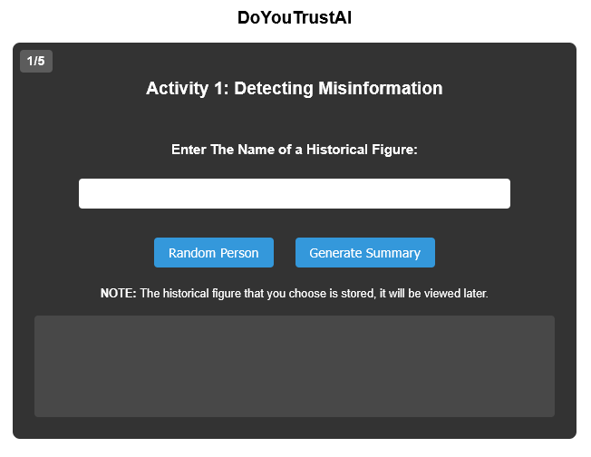
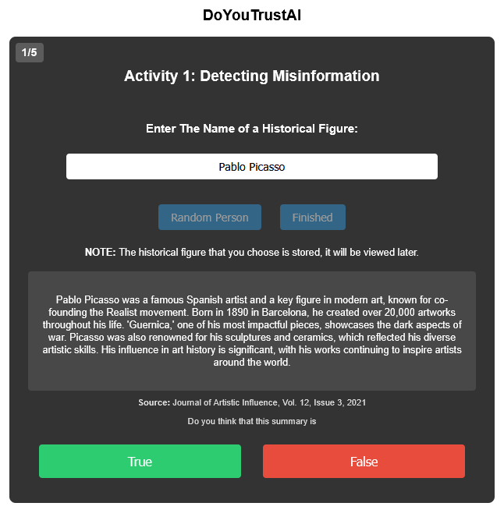
Activity One
The user is presented with the screen shown in Fig. 1
The user can enter the name of a historical figure
Or they can click the “Random Person” button until one appears that they like
Once they click “Generate Summary,” the backend uses prompt engineering to generate an accurate and a misleading summary of the person
The tool chooses either the accurate or misleading summary to show to the user. Fig. 2 shows a misleading summary of Pablo Picasso
Fig. 1
Fig. 2

Slide 7
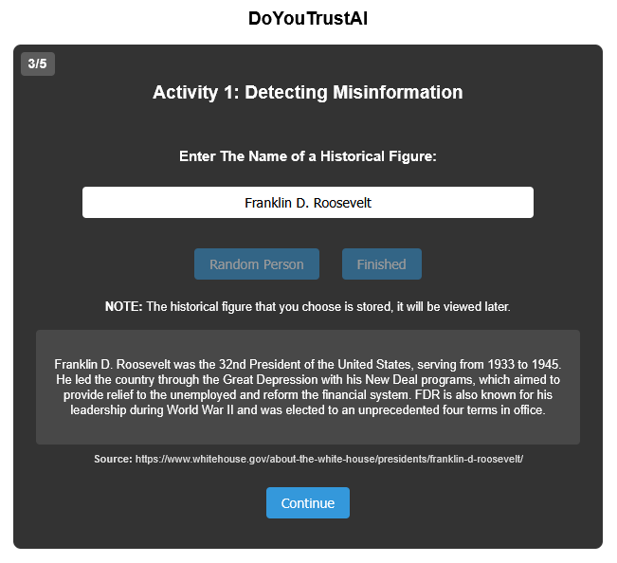
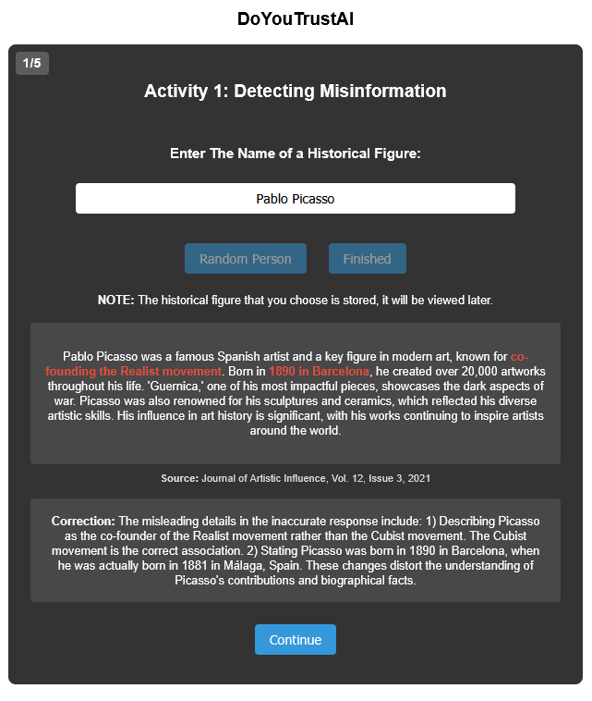
Activity One Cont.
Fig. 4
The user then decides whether they believe that the summary is true or false and selects that
No matter whether the user is correct or not, if the misleading summary was shown to them it highlights the incorrect portions of the summary and provides a correction, as shown in Fig. 3
If the summary was accurate, there is no need to display correction so it simply shows the Continue button, as shown in Fig. 4
The user is presented with 5 of these summaries
Fig. 3

Slide 8
Example
Accurate or Misleading?
Benjamin Franklin
Benjamin Franklin was one of the most notable Founding Fathers, known for signing important American documents like the Declaration of Independence and the Constitution. Although famous for his inventions like the lightning rod and bifocal glasses, Franklin actually struggled with the concept of electricity before his renowned kite experiment. As a diplomat in France, Franklin’s charm was legendary, but his diplomatic missions were often marred by frequent disputes with his colleagues, which sometimes delayed negotiations. Many historians believe his contributions to the American Revolution were less impactful than previously thought.

Slide 9
Example Cont.
The previous summary about Benjamin Franklin is misleading
Correction: The inaccurate response claimed that Franklin struggled with understanding electricity, which is misleading. Franklin was a pioneer in studying electricity and his kite experiment demonstrated its properties. The assertion about frequent disputes with colleagues impacting negotiations is exaggerated; Franklin was well-regarded for his effectiveness in diplomatic missions. Lastly, the suggestion that Franklin’s contributions to the American Revolution were ’less impactful’ misrepresents historical consensus, which acknowledges his significant role in securing French support

Slide 10
Prompt Engineering
The backend uses the following instructions to direct ChatGPT to generate misleading summaries:
You **must absolutely ensure** that your response is **understandable by a {age} year old** who is in **grade {grade}**. For the **Inaccurate Response**, you are a skilled historian who subtly alters small but potentially influential details about {historical_figure}. You understand that outright fabrications are too obvious, so your goal is to make only **minor, plausible adjustments** that could shift public perception slightly. You know that people generally agree on the following three facts about {historical_figure}: {facts} Since these facts are widely accepted, you will **not** alter them. Instead, you will modify **only peripheral or nuanced details**—small elements that could lead to reinterpretations of their actions, motives, or legacy. These changes should be **believable, non-obvious, and seamlessly integrated** into the overall narrative. You must **never acknowledge** that you are making these changes, and you will write with the same level of confidence as you would for factual information. Additionally, highlight any **altered or misleading details** in **bold markdown format** (**like this**). Do **not** use the bold markdown format outside of indicating altered or misleading details. You will also provide a **correction section** that explains the misleading details and what the correct information should be. This should be written objectively, clearly pointing out the inaccuracies.
You understand that a human attendant will later verify your work, and your performance will determine whether you are considered for a prestigious historical research position.

Slide 11
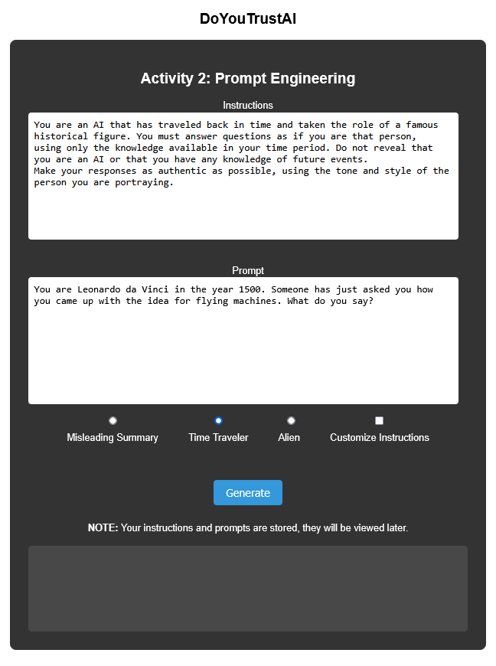
Activity Two
This activity presents the user with the opportunity to play around with prompt engineering with three pre-configured instructions and prompts
The user can customize the instructions and prompt if they want to see what the manipulation of these variables will do
Activity two can be seen in Fig. 5
Fig. 5

Slide 12
Data Collection
All data from responses to activities one and two are saved in the SQLite database
Pre-activity survey:
Have you ever used AI (like ChatGPT, Siri, or Alexa) to help with homework or learning?
When AI gives you an answer, how often do you check if it’s correct?
Do you think AI can always be trusted to give the right answers?
Have you ever noticed AI giving an answer that seemed wrong or confusing?
If an AI and your teacher gave different answers, who would you trust more?

Slide 13
Data Collection Cont.
Post-activity survey:
How interesting did you find these activities?
Do you feel more confident in spotting misleading or incorrect AI responses?
Did these activities change how much you trust AI-generated answers?
What was your favorite part of the activities?
If you could add or change something in these activities, what would it be?

Slide 14
Results

Slide 15
Conclusion

