Slide 1
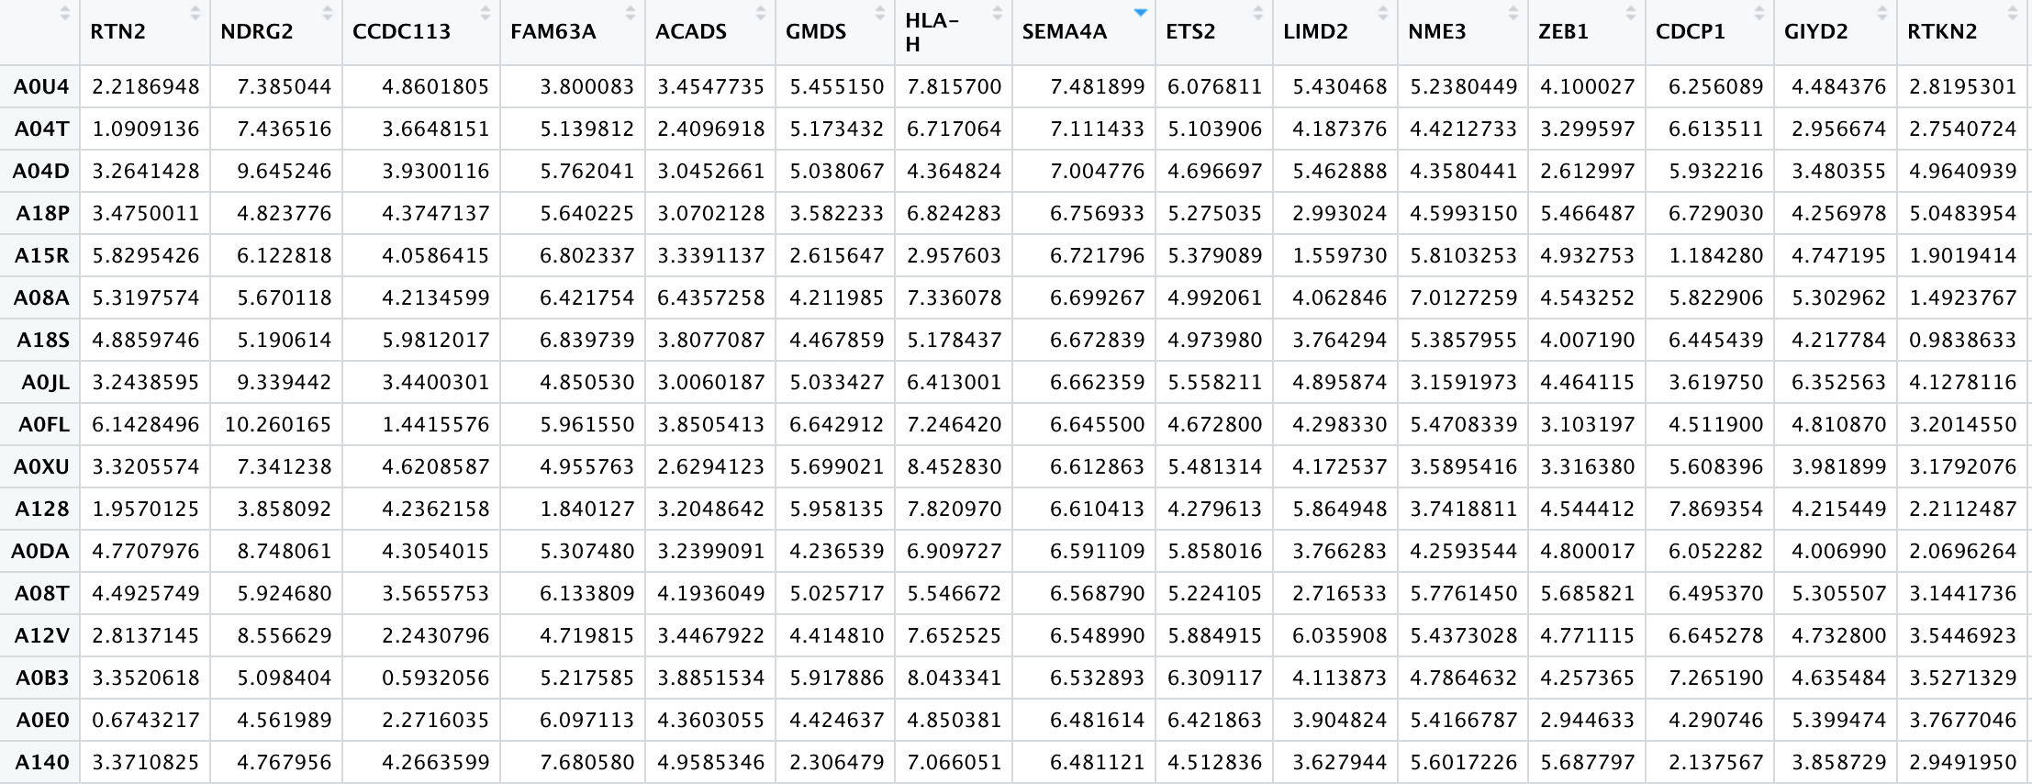

Slide 2
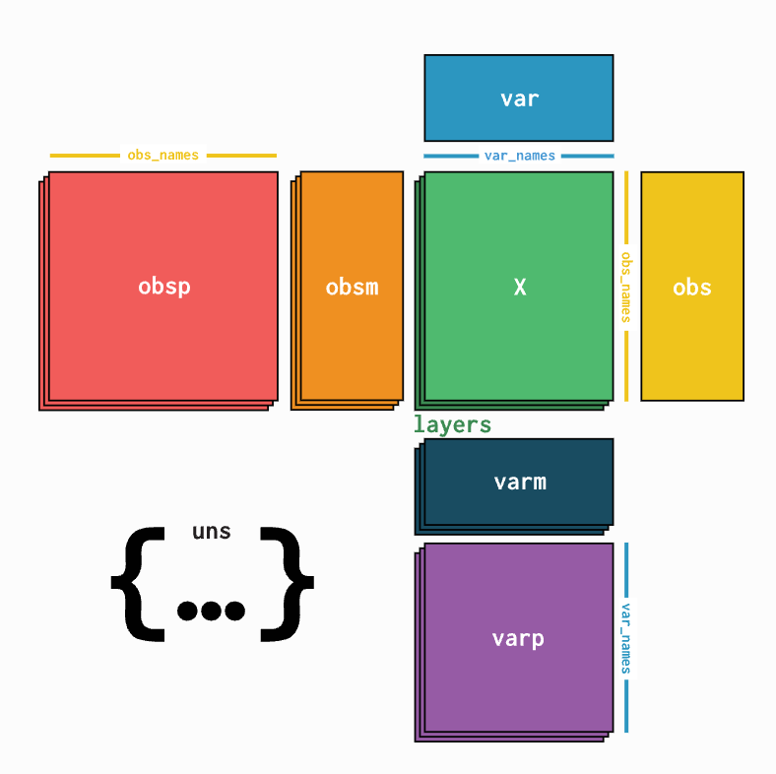
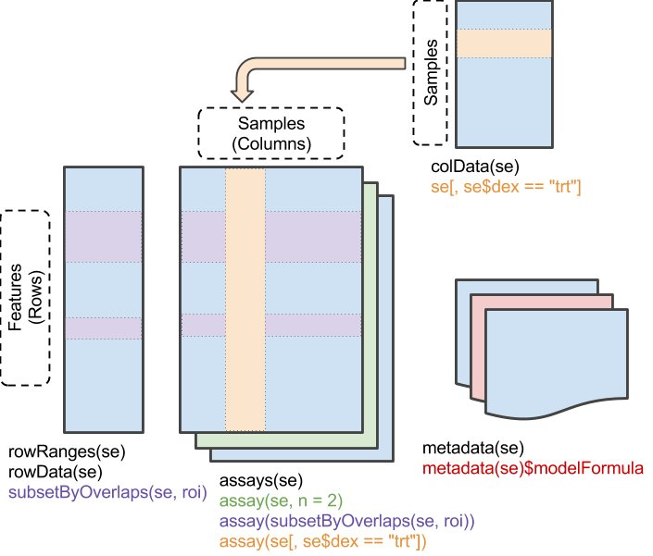
anndata: Annotated data
Isaac Virshup, Sergei Rybakov, Fabian J. Theis, Philipp Angerer, F. Alexander Wolf
doi: https://doi.org/10.1101/2021.12.16.473007
SummarizedExperiment
Morgan M, Obenchain V, Hester J, Pagès H (2022). R package version 1.26.1.

