Slide 1
Hand gesture recognition based on deep learning
Course title: Neural Networks and Deep Learning (1002)
Supervisor: Dr. Canhao XU
Students: Deng Suming 1730026014
Liang Zhenxuan 1730026061
Huang Lantao 1730026030
Jia Changjin 1730026033
Gao Kunwei 1730026023

Slide 2
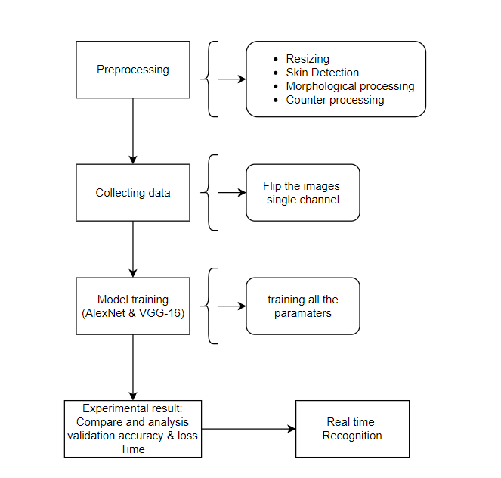
Workflow
Fig.1 picture of workflow generated by us using open google Drive

Slide 3
Introduction

Slide 4
Introduction
Background:
Gesture recognition is an issue that recognizes human gestures through computer.
Two categories: static gesture and dynamic gesture.
A way for computers to understand human language, thereby hand gesture recognition can building a richer bridge between the machine and the human than the original text user interface or even GUI (graphical user interface).

Slide 5
Introduction
Motivation:
Users can use simple gestures to control or interact with devices
At the same time, it’s very helpful to the daily life of the disabled.

Slide 6
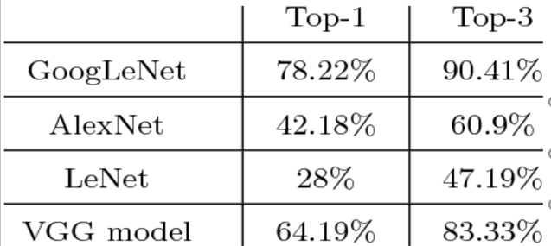
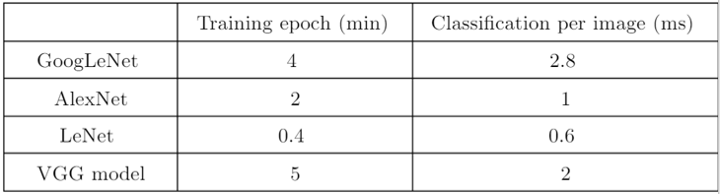
Introduction
Related work:
Convolutional neural networks have the characteristics of self-adaptation and self-organization, and can automatically extract features, so they are often used for classification and recognition.
Gjorgji Strezoski et al. used VGG, AlexNet ,GoogLenet, lenet and other model to train on Marcel data set and compared the results. [1]
Googlenet had a high accuracy but slow in the classification.
Letnet categorized fast however the accuracy is low.
In the VGG model and AlexNet performance average.
Fig.3 The timing evaluation between different model
Fig.2 The accuracy between different model
[1] Strezoski, G., Stojanovski, D., Dimitrovski, I., & Madjarov, G. (2016, September). Hand gesture recognition using deep convolutional neural networks. In International conference on ICT innovations (pp. 49-58). Springer, Cham.

Slide 7
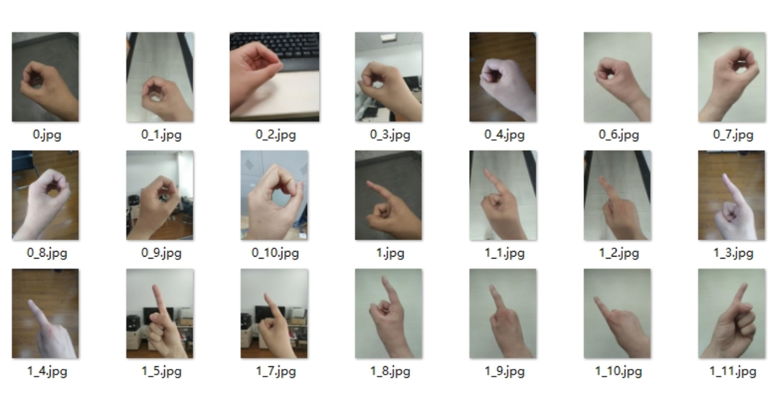
Introduction
Problem: Some of the dataset contain too many interferences.
Fig.4 Dataset from the website

Slide 8
Major contribution

Slide 9
Major contribution
Innovation:
Design a project that can complete real-time gesture recognition with a high recognition accuracy in a complex background, and the project model can be trained with only general equipment without spending a lot of time. At the same time, the model prediction time is short.

Slide 10
Major contribution
We have changed the parameters and the structure of VGG-16 and AlexNet and use the preprocessing method to improve our accuracy from 96.56% to 99.49% in VGG-16 model and improve our accuracy from 97.51% to 99.43% in Alexnet model. Our modified model is mainly according to time complexity and space complexity. We use fewer floating point calculations and fewer parameters to obtain better accuracy. Our model is cleaner and simpler. At the same time, these operations reduce the burden of the computer.

Slide 11
Algorithm and improvement

Slide 12
Algorithm and improvement
Data preprocessing:
Skin detection
Morphological processing
Contour processing
The main goal of data preprocessing is to extract the obvious features and decrease the pressure of model.

Slide 13
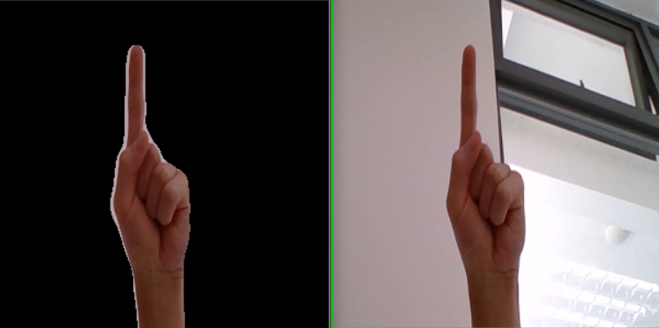
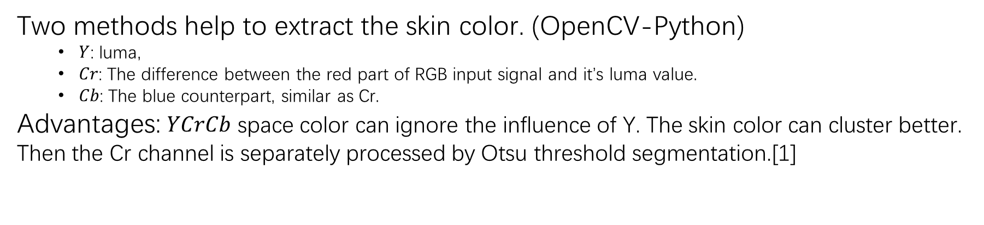
Skin detection: $YCrCb$ color space + Otsu threshold segmentation
Two methods help to extract the skin color. (OpenCV-Python)
$Y$: luma,
$Cr$: The difference between the red part of RGB input signal and it’s luma value.
$Cb$: The blue counterpart, similar as Cr.
Advantages: $YCrCb$ space color can ignore the influence of Y. The skin color can cluster better. Then the Cr channel is separately processed by Otsu threshold segmentation.[1]
Fig.12 Generated by our laptop’s camera. Base on $YCrCb$ color space + Otsu Threshold segment.
[1]S. Kolkur1 , D. Kalbande2 , P. Shimpi2 , C. Bapat2 , and J. Jatakia2 , Human Skin Detection Using RGB, HSV and YCbCr Color Models (2017), Page 324-229

Slide 14

Morphological processing:
Two methods to further process the segmented gesture images.
Erosion
Dilation
Use cv2.erode and cv2.dilate from OpenCV-Python. Erosion followed by dilation, remove isolated small points, burrs.
Solve the problems of many noisy points in the hand.
Fig.13 Generated by our laptop’s camera. After erosion and dilation.(right)

Slide 15
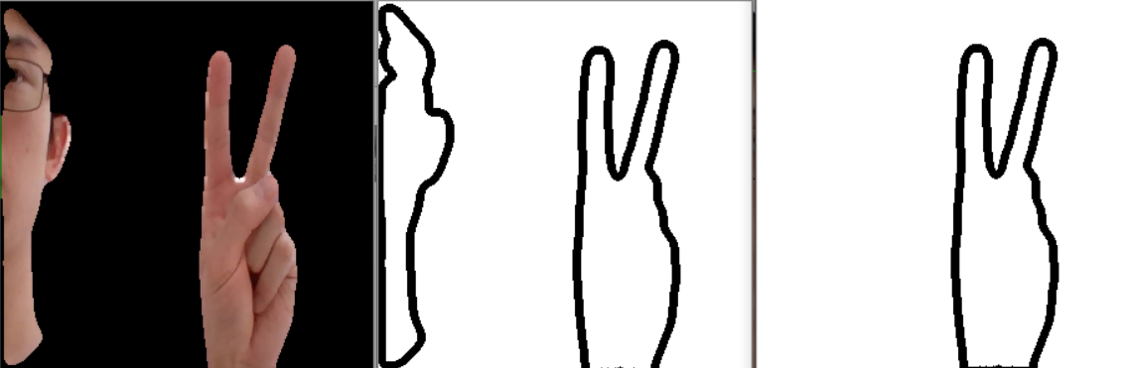
Contour processing
The method’s goal is to find the contour of the hand gesture. (OpenCV-Python.)
Draw contour
Sort biggest one
Use cv2.findContours and cv2.drawContours. After contour extraction, only the curve with the largest area is retained.
Fig.14 Generated by our laptop’s camera. After contour and sorting

Slide 16
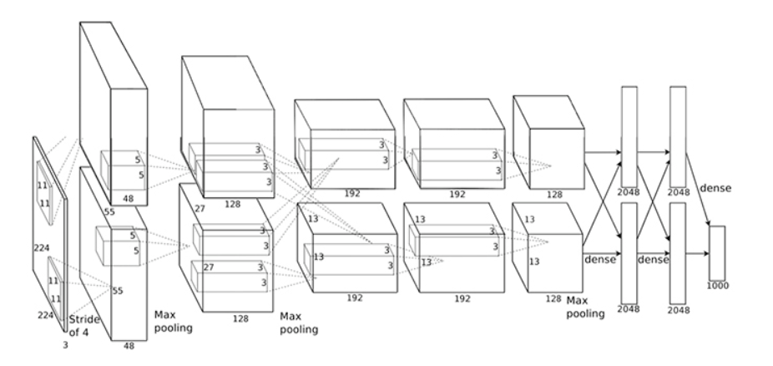

$$AlexNet$$
Fig.17 structure of $AlexNet$from website https://www.itread01.com/content/1545228731.html

Slide 17
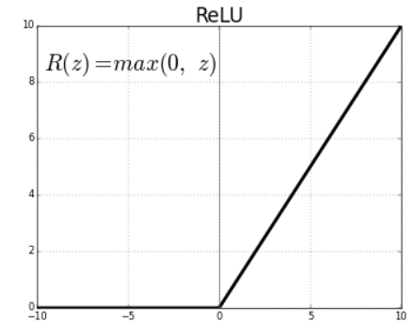
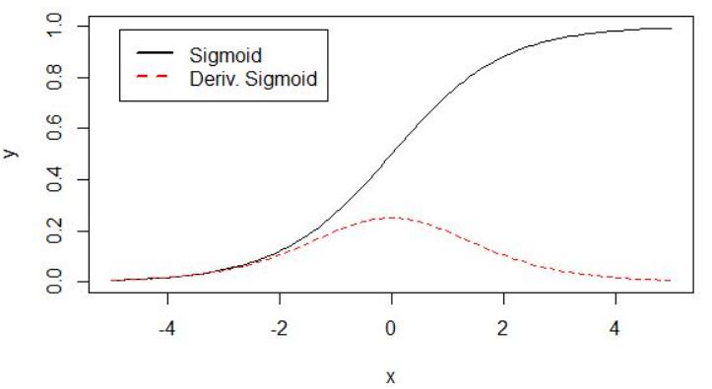

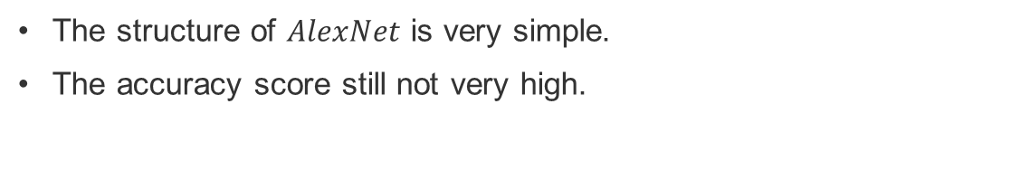
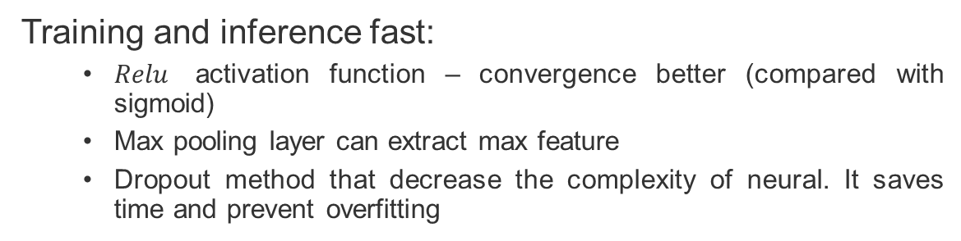

Advantages of $AlexNet$
Training and inference fast:
$Relu$ activation function – convergence better (compared with sigmoid)
Max pooling layer can extract max feature
Dropout method that decrease the complexity of neural. It saves time and prevent overfitting
Fig.19 Relu activation function. From the website https://allen108108.github.io/blog/2019/10/05/Gradien
Disadvantages of $AlexNet$
The structure of $AlexNet$ is very simple.
The accuracy score still not very high.
Fig.20 sigmoid function and derivative. From the website
https://allen108108.github.io/blog/2019/10/05/Gradien

Slide 18
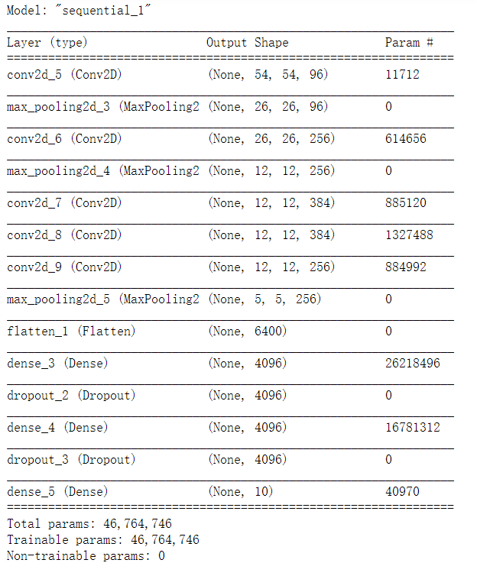

$$AlexNet−Original$$
Fig. $AlexNet$-origin-1channel-10classes, structure
Notes:
The running time of the previous layer minus the running time of the next layer

Slide 19
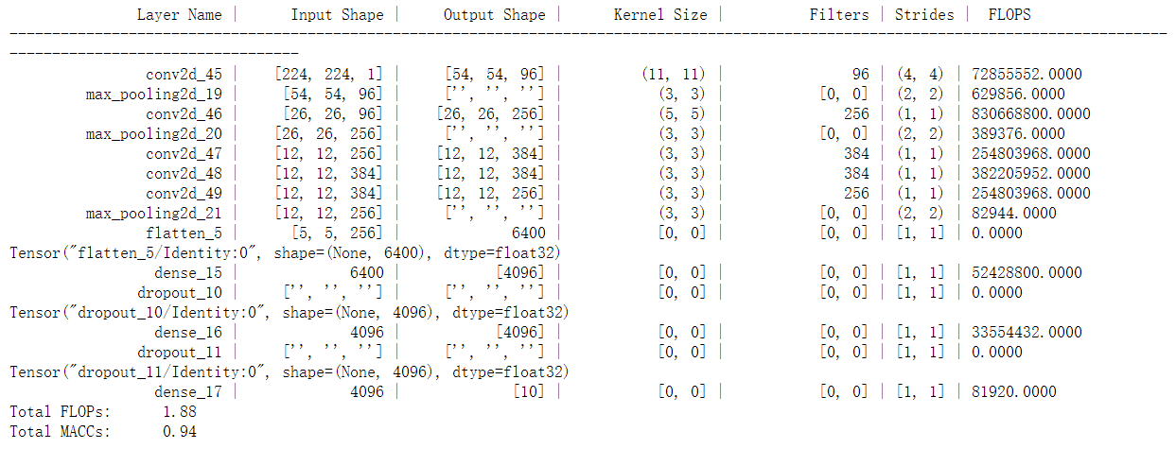




$$AlexNet−Original$$
Fig. $Keras$ FLOP Estimator

Slide 20
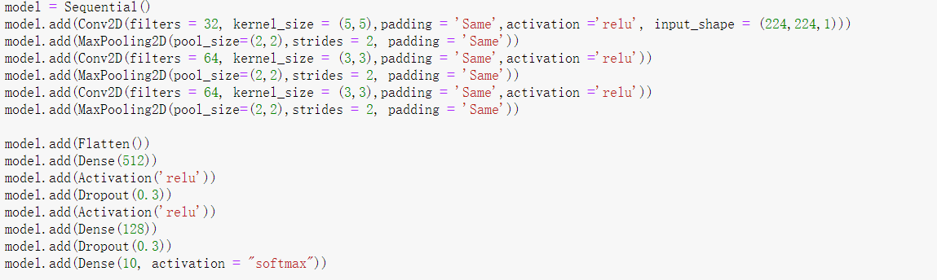
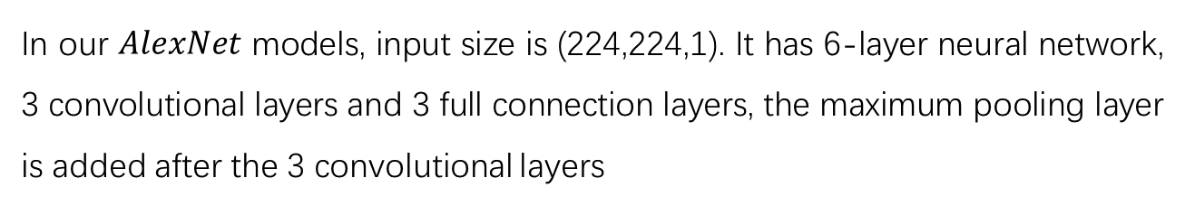

$$AlexNet−Modified$$
In our $AlexNet$ models, input size is (224,224,1). It has 6-layer neural network, 3 convolutional layers and 3 full connection layers, the maximum pooling layer is added after the 3 convolutional layers
Notes:
When we modified the model, we should mainly consider the size of convolution kernel (11x11). 1. model can be more non-linear2. less parameters.
The depth of the network is closely related to the ability of expressing feature, so it is not appropriate to cut too much, so the first place to cut the model is usually the number of channels.
We changed the number of convolutional layers from 5 to 3.
The first dense layer changed from 4096 to 512 and dropout layer changed from 0.5 to 0.3.
The second dense layer changed from 4096 to 128 and dropout layer changed from 0.5 to 0.3.

Slide 21
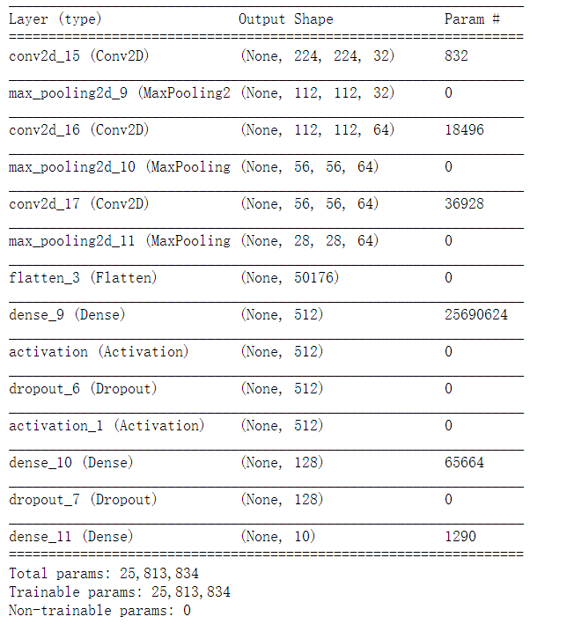

$$AlexNet−Modified$$
Fig. $AlexNet$-our-1channel-10classes, structure

Slide 22
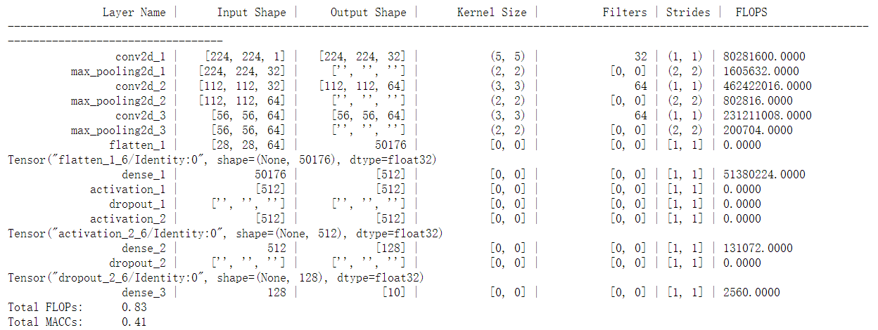
$$AlexNet−Modified$$
Fig. $Keras$ FLOP Estimator (GB)

Slide 23
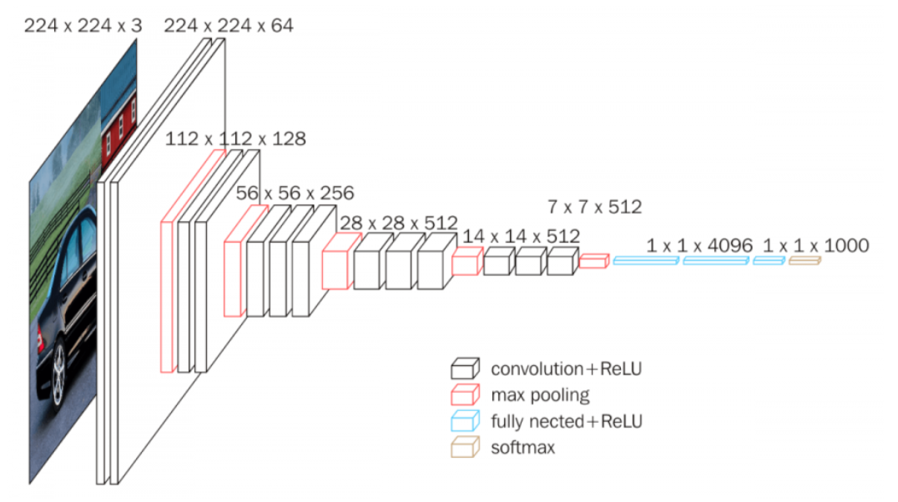

$$VGG−16$$
Fig.21 From website: https://neurohive.io/en/popular-networks/vgg16/

Slide 24


Advantages of $VGG$
The structure of VGG Net is regular. The depth of layers makes the features wider. It’s more suitable for large data sets.
Several small filters (3x3) is better than a large filter (5x5 or 7x7), which have fewer parameters than the large filters.
Disadvantages of $VGG$
Parameters are too much:
The size is big.
Training speed is slow

Slide 25
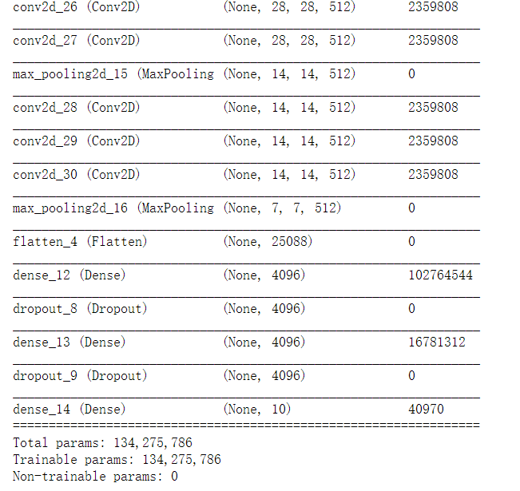

$$VGG−16 Original version$$
Fig. $VGG−16$-origin-1channel-10classes, structure

Slide 26
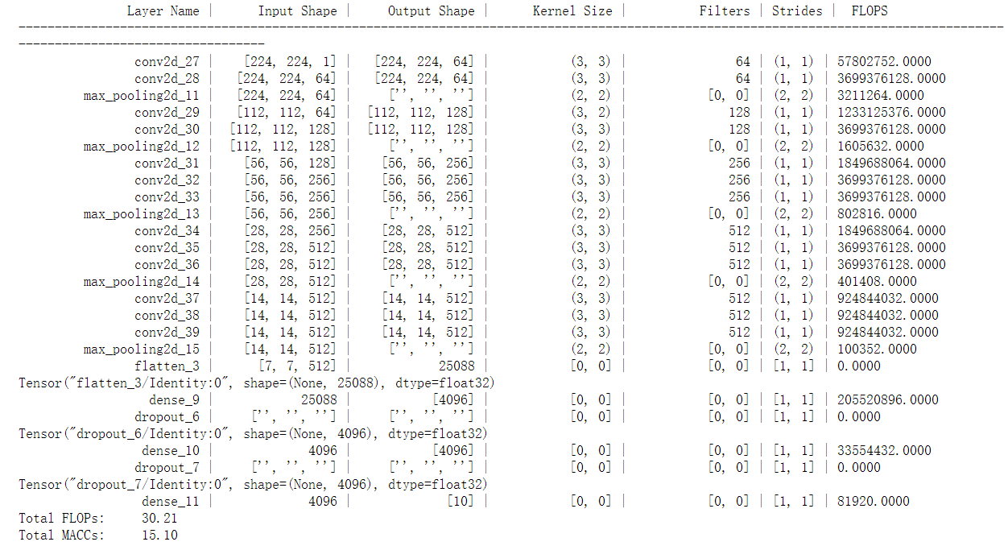
$$VGG−16 Original version$$
Fig. $Keras$ FLOP Estimator

Slide 27
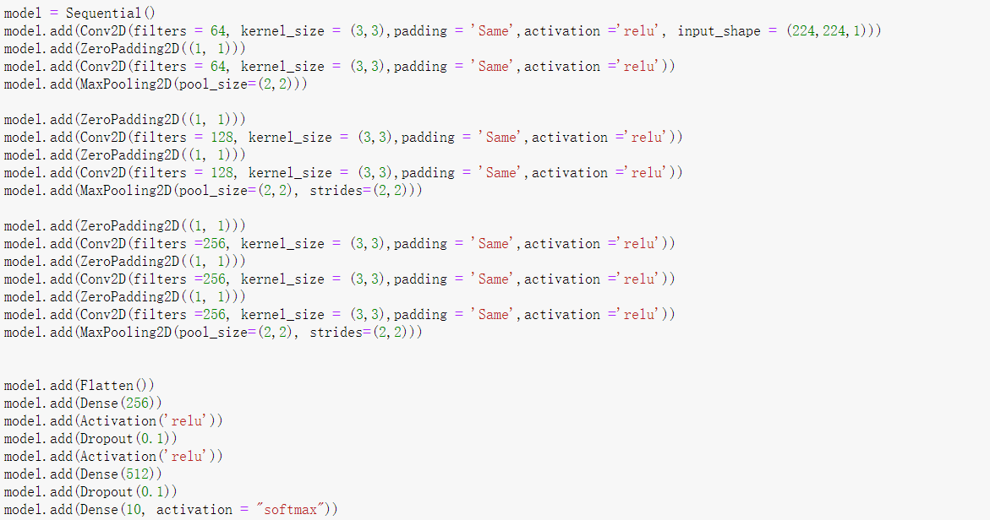

$$VGG−16−modified$$
In our VGG models, it adopts 10-layer neural network, 7 convolutional layers and 3 full connection layers. It contains about 68 million parameters.
Notes:
VGG-16:
We deleted all the convolutional layer which have 512 filters
The first dense layer changed from 4096 to 256 and dropout layer changed from 0.5 to 0.1.
The second dense layer changed from 4096 to 512 and dropout layer changed from 0.5 to 0.1.
The last dense layer changed from 1000 to 10

Slide 28
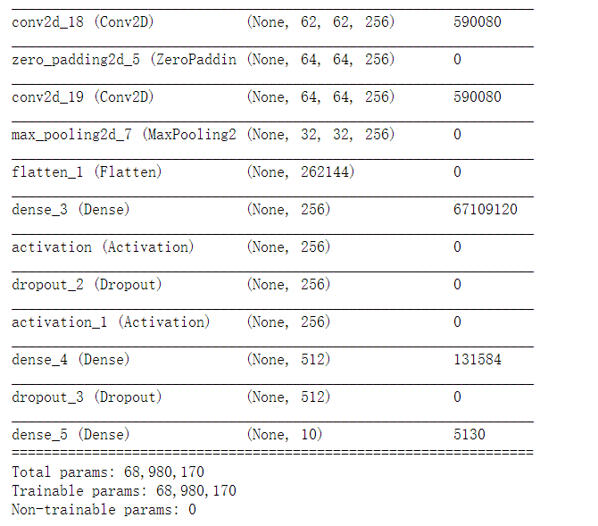
$$VGG−16−modified$$
Fig.22 generate by python $model.summary()$

Slide 29
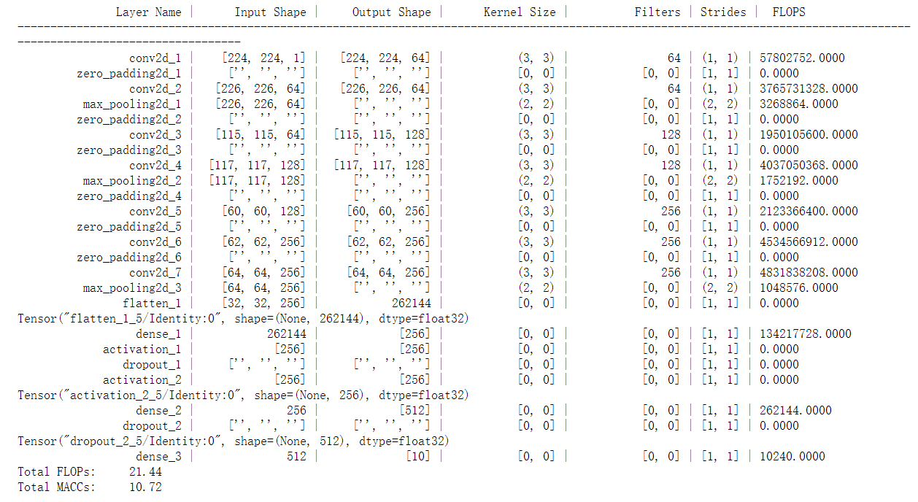
$$VGG−16−modified$$
Fig. $Keras$ FLOP Estimator

Slide 30
Experimental Result

Slide 31
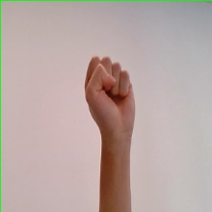
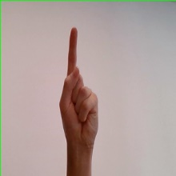
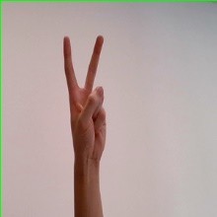
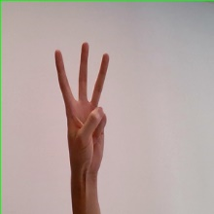
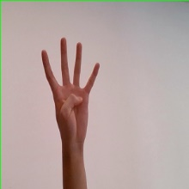
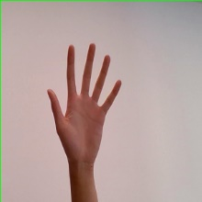
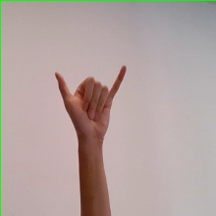
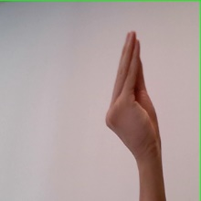
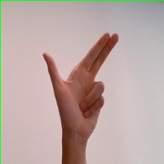
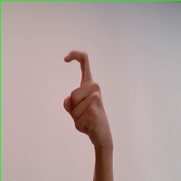
Experimental platform and dataset
Experimental platform
Inter(R) Xeon(R) CPU E5-2650 V4, 2.20GHz
GeForce GTX TITAN X
Linux system
Experimental dataset
18,447 image collected by camera, consisting of 5 people in the light of 10 kinds gestures (from 0 to 9)
Input shape: (224,224)
Divide into two part: 14,757 training set, 3,690 validation set

Slide 32
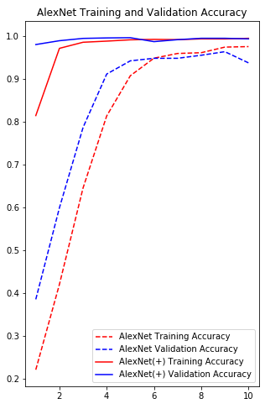
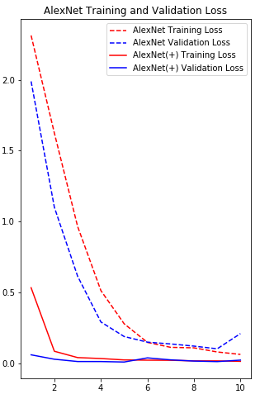
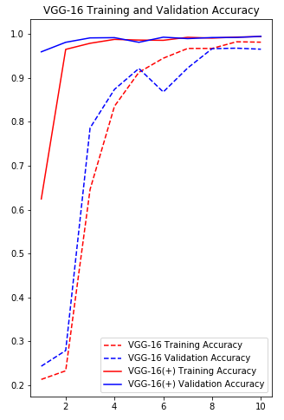
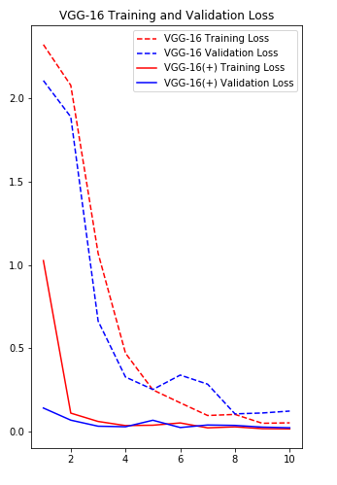
Results and comparisons
Accuracy Analysis
(+) means that the modified model

Slide 33
Results and comparisons
Time Consume Analysis (Predict consuming)
Model | Predict consuming per image(s)
VGG-16(+) | 0.83
AlexNet(+) ✔ | 0.03
(+) means that the modified model

Slide 34
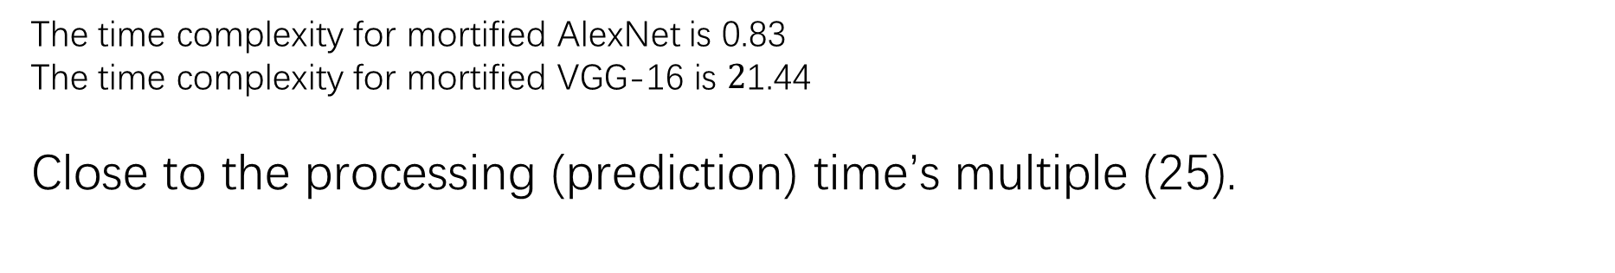
Results and comparisons
Time Complexity Analysis (related to predict consuming)
Formula mentioned in pervious slide:
The time complexity for mortified AlexNet is 0.83
The time complexity for mortified VGG-16 is $2$1.44
Close to the processing (prediction) time’s multiple (25).

Slide 35
Results and comparisons
Model | Test Accuracy(%)
VGG-16 | 96.56
VGG-16(+) ✔ | 99.49
AlexNet | 97.51
AlexNet(+) ✔ | 99.43
We chose:
Modified AlexNet
Model | Time consume per epoch(s)
VGG-16(+) | 230
AlexNet(+) ✔ | 41
Model | Predict consuming per image(s)
VGG-16(+) | 0.85
AlexNet(+) ✔ | 0.03

Slide 36

Demo($AlexNet$ + data preprocessing)

Slide 37
Future work
WHAT ELSE CAN WE DO?
Dynamic hand gesture recognize
3d hand gesture recognize
IDEA
Combine hand gestures and movements
Use the feature that inside the contour
Better model (Resnet-50, Hidden Gauss-Markov Models)[1]
Depth image (KINECT)[2]
[1] Wang, Z. , Li, G. , & Yang, L. . (2020). Dynamic hand gesture recognition based on micro-doppler radar signatures using hidden gauss-markov models. IEEE Geoence and Remote Sensing Letters, PP(99), 1-1.
[2] Camgoz, N. C. . (2017). Using Convolutional 3D Neural Networks for User-Independent Continuous Gesture Recognition. International Conference on Pattern Recognition. IEEE.

Slide 38
Conclusion
Proposed a useful preprocessing method to process the dataset made by ourselves.
We improve the VGG and AlexNet.
Compared with the data set without preprocessing and the model without processing, the accuracy after our preprocessing and model changes has been improved. And AlexNet performed best.

Slide 39
Reference
Strezoski, G., Stojanovski, D., Dimitrovski, I., & Madjarov, G. (2016, September). Hand gesture recognition using deep convolutional neural networks. In International conference on ICT innovations (pp. 49-58). Springer, Cham.
Y. Liu, Z. Gan, Y Sun. Static hand gesture recognition and its application based on support vector machines. The Ninth ACIS International Conference on Software Engineering, Artificial Intelligence, Networking, and Parallel／Distributed Computing Phukgt, Thailand, 2008: 517-521
Y. Fang, K. Wang, J. Cheng, et. A real-time hand gesture recognition method. IEEE International Conference on Multimedia and Expo, Beijing, China, 2007: 995-998
He, K., Zhang, X., Ren, S., & Sun, J. (2016). Deep residual learning for image recognition. In Proceedings of the IEEE conference on computer vision and pattern recognition (pp. 770-778).
Al-johania, N., & Elrefaei, L. (2019). Dorsal hand vein recognition by convolutional neural networks: Feature learning and transfer learning approaches. International Journal of Intelligent Engineering and Systems, 12(3), 178-191.
J. Wachs，H. Stern, Y Edan，et a1. Gestix: a doctor-computer sterile gesture interface for dynamic environments. Soft Computing in Industrial Applications, 2007：30-39．
Popa, D., Simion, G., Gui, V., & Otesteanu, M. (2008). Real time trajectory based hand gesture recognition. WSEAS Transactions on Information Science and Applications, 5(4), 532-546.

Slide 40
Reference
S. Kolkur1 , D. Kalbande2 , P. Shimpi2 , C. Bapat2 , and J. Jatakia2 , Human Skin Detection Using RGB, HSV and YCbCr Color Models (2017), Page 324-229
João F. Henriques, Rui Caseiro, Pedro Martins, Jorge Batista, High-Speed Tracking with Kernelized Correlation Filters, [Submitted on 30 Apr 2014 (v1), last revised 5 Nov 2014 (this version, v3)]
Wang, Z. , Li, G. , & Yang, L. . (2020). Dynamic hand gesture recognition based on micro-doppler radar signatures using hidden gauss-markov models. IEEE Geoence and Remote Sensing Letters, PP(99), 1-1.
Camgoz, N. C. . (2017). Using Convolutional 3D Neural Networks for User-Independent Continuous Gesture Recognition. International Conference on Pattern Recognition. IEEE.

Slide 41
Q&A

