Slide 1
Group 27
邓苏鸣 1730026014
邹罗瑾 1730026167
周寒雨 1730014088

Slide 2
Text file collection
Test
>200MB

Slide 3
Test data
https://www.wuxiaworld.com/novel/stellar-transformations
FetchUrl(url)
GetContent(html)
Savefile(content, path, filename)

Slide 4
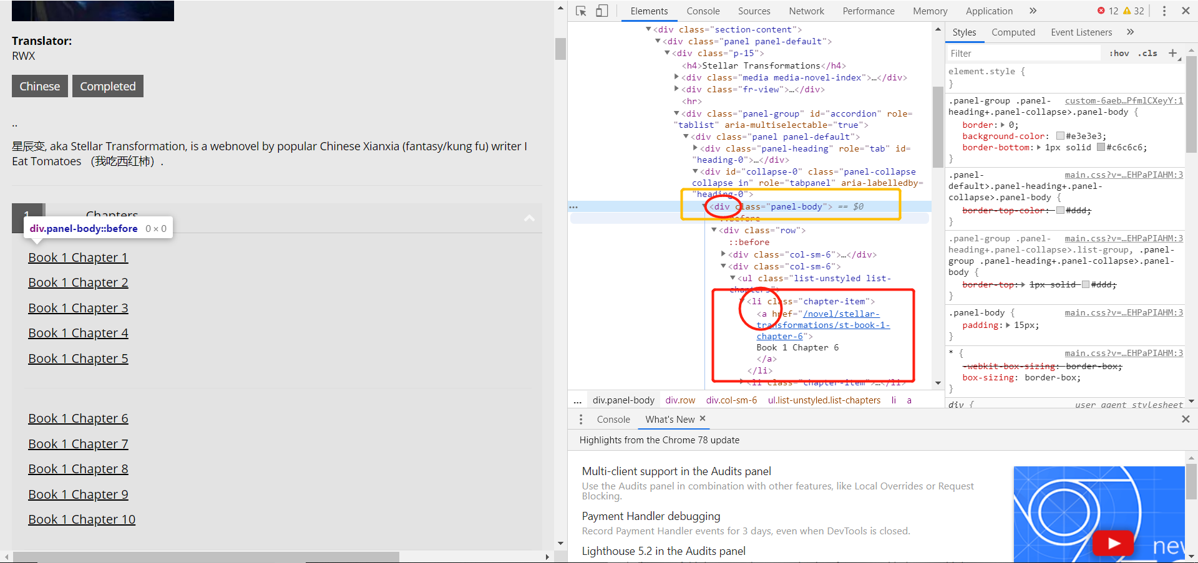
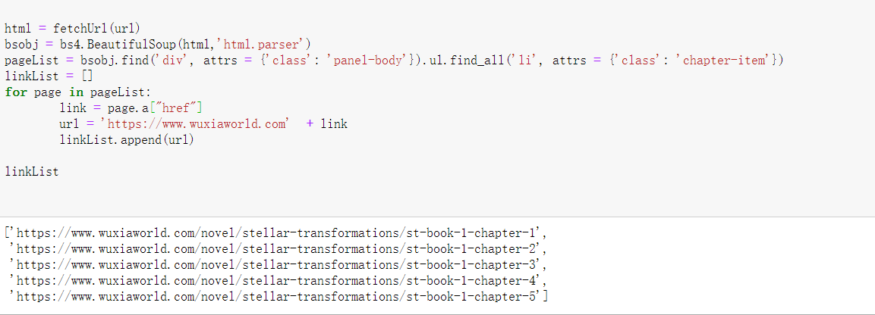

Slide 5
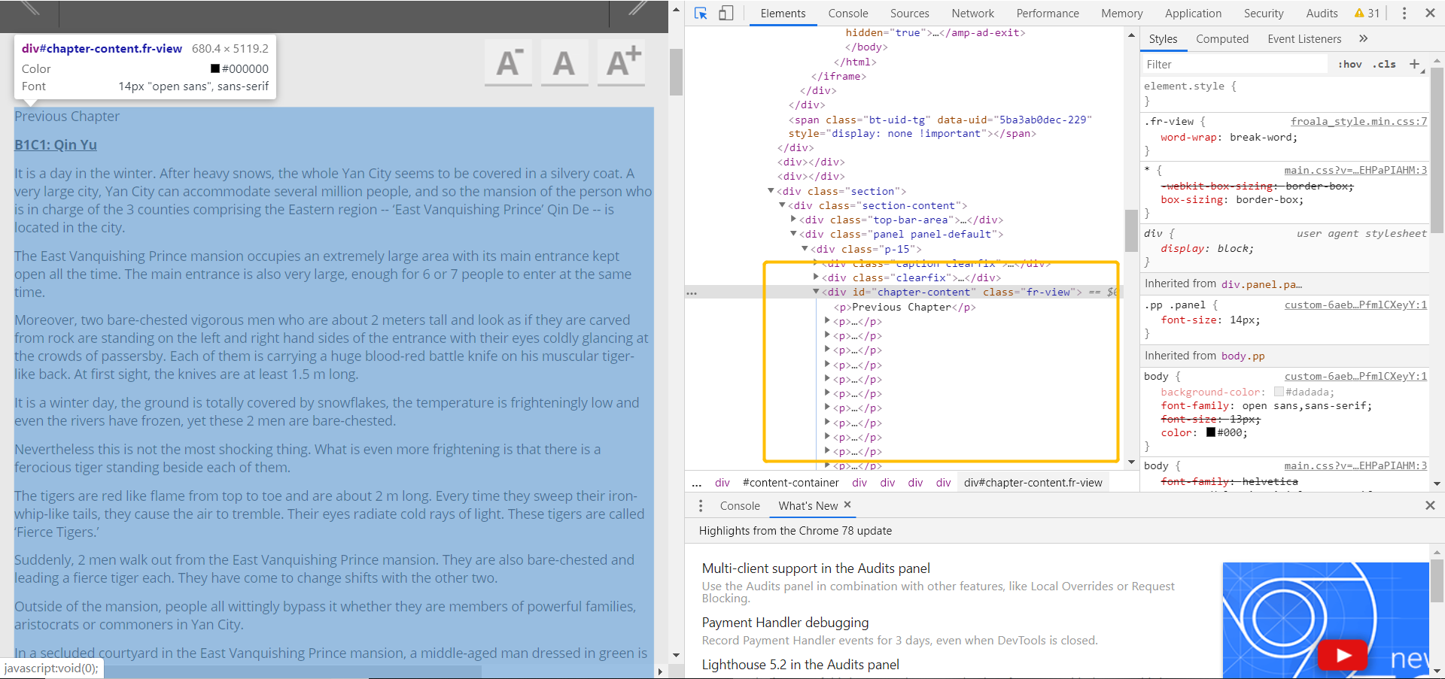
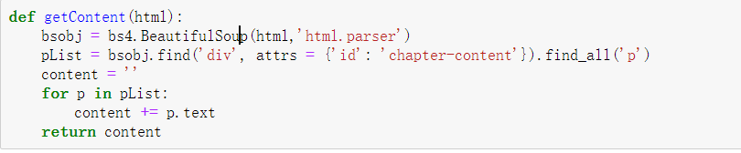

Slide 6
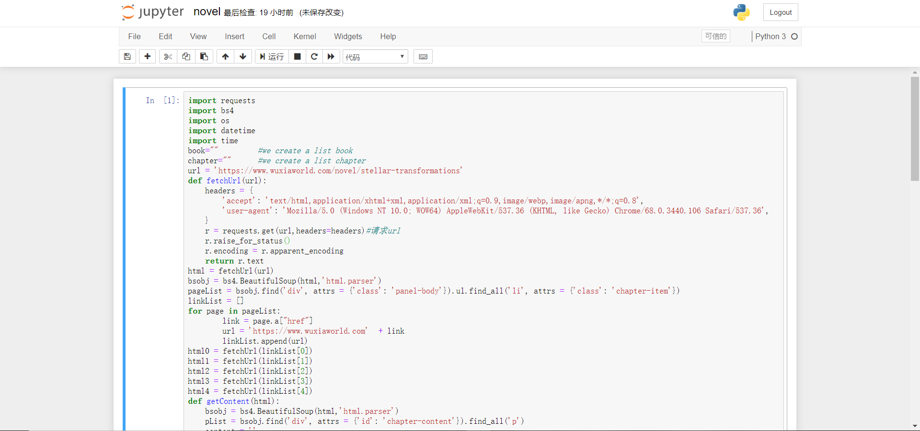
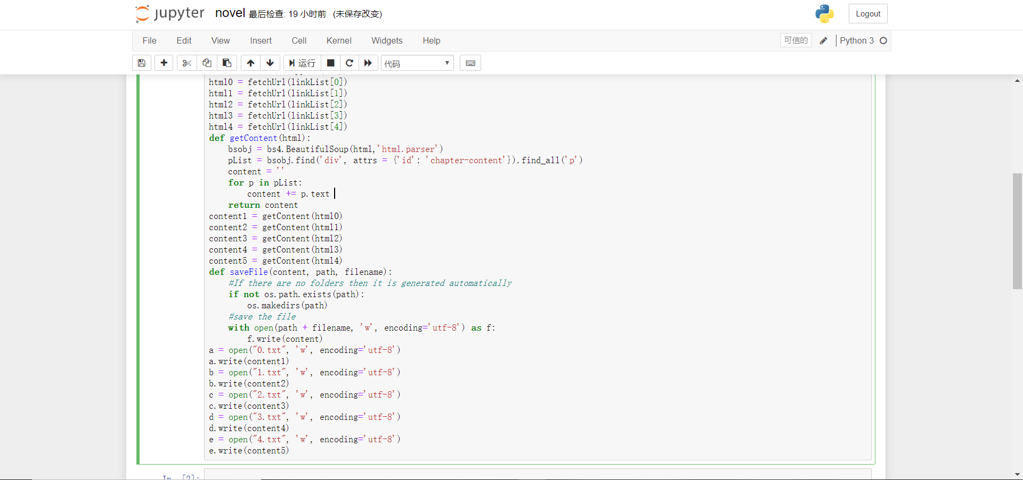
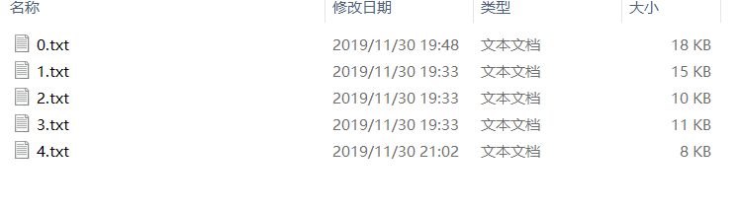
All code of crawling

Slide 7
>200MB data
The main problems:
The folder has a bunch of subfolder
50000+ TXTfiles number is too big
Cannot extract the RAR from Wikipedia
How to divide a big TXTfile into some small parts

Slide 8
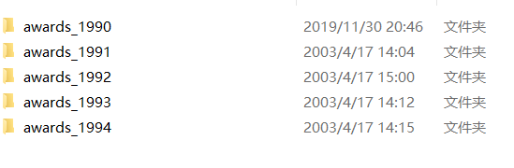
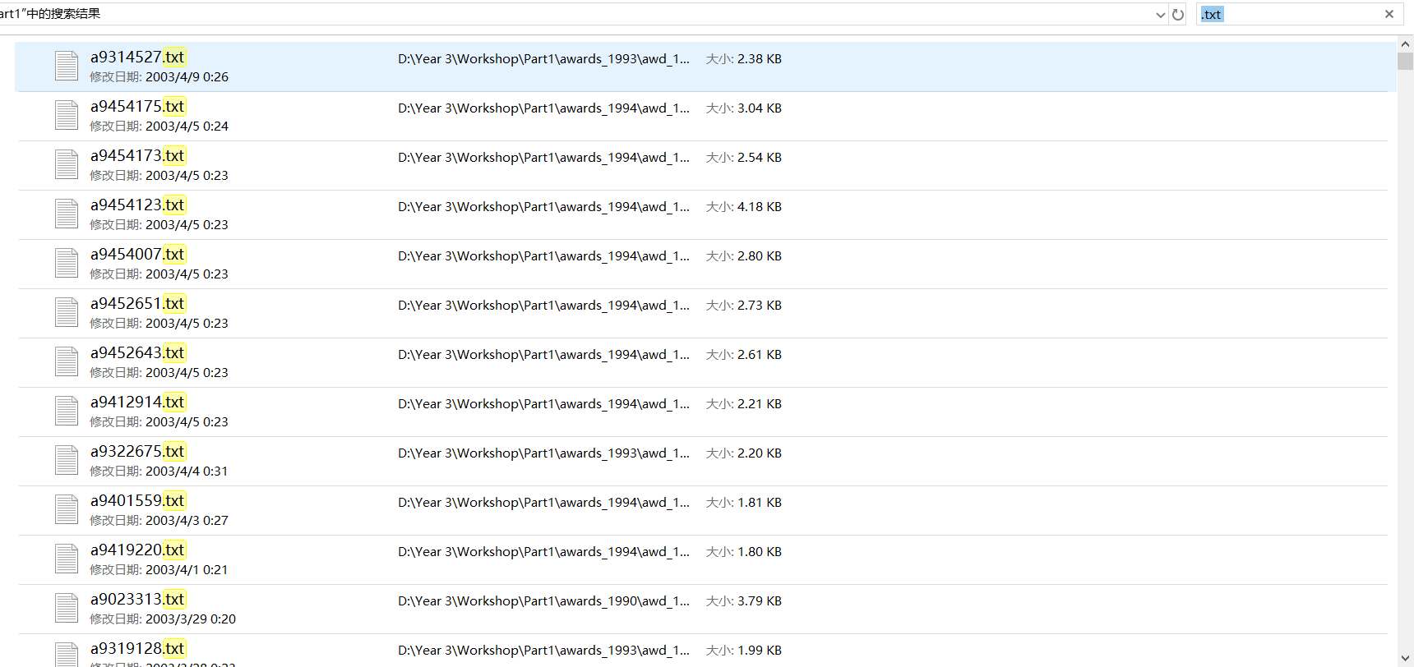
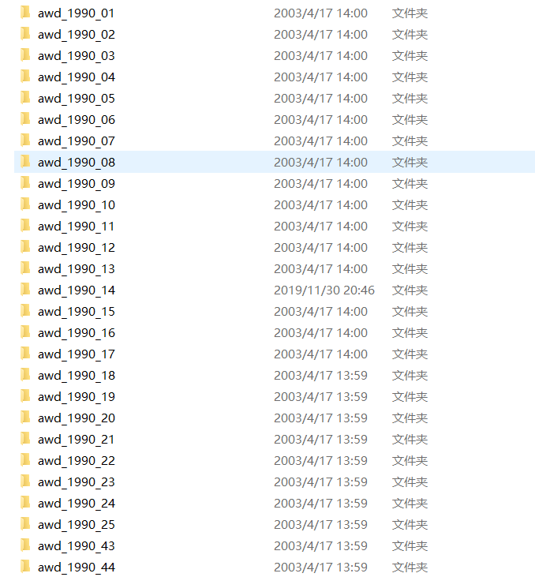
Type the “.txt” in the search

Slide 9
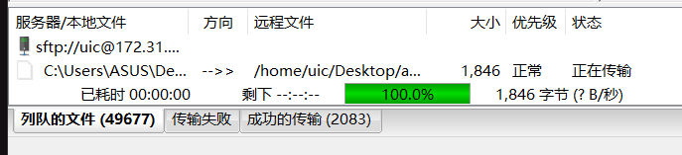
50000 TXT Files number is too big
The transfer is slow
The index values can appear in the tens of thousands rows
Start to find the second dataset
Third problem:Cannot extract the RAR from Wikipedia

Slide 10

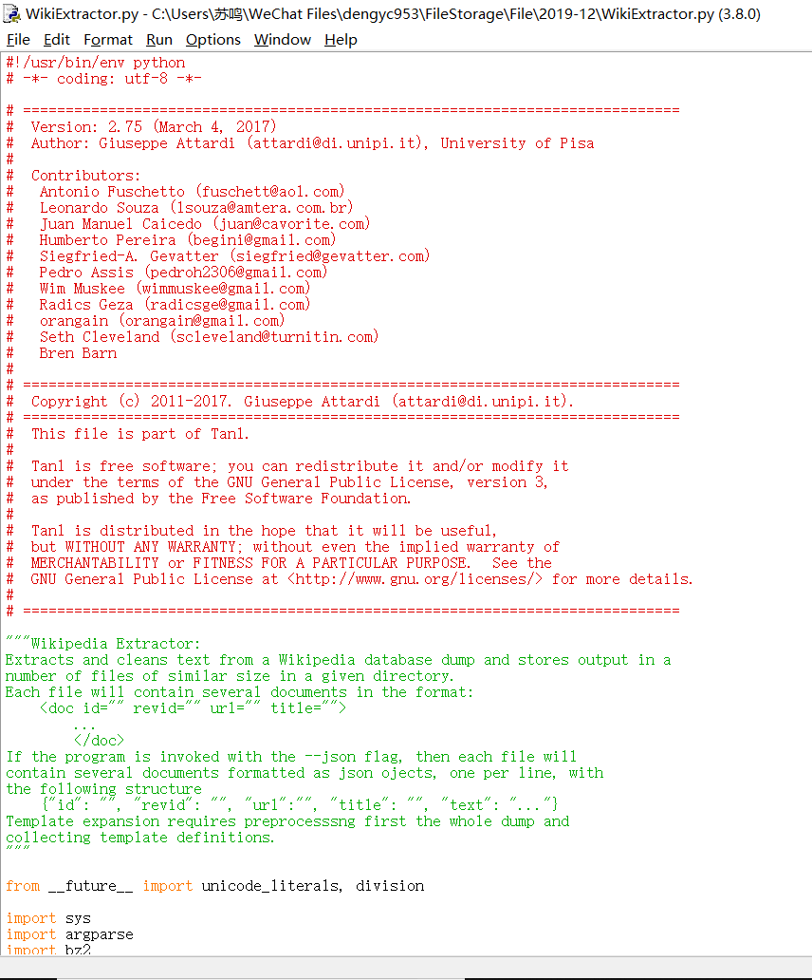
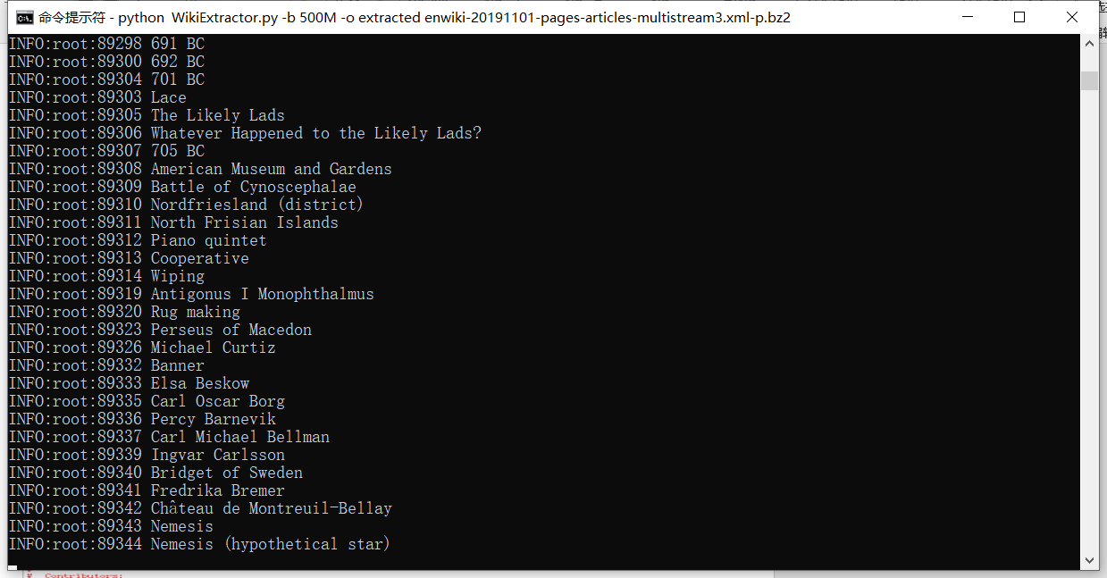
The steps:
The files are in the same folder as wikiextractor.py
CMD enters the file directory
Perform: python WikiExtractor.py -b 500M -o extracted enwiki-20191101-pages-articles-multistream3.xml-p.bz2

Slide 11
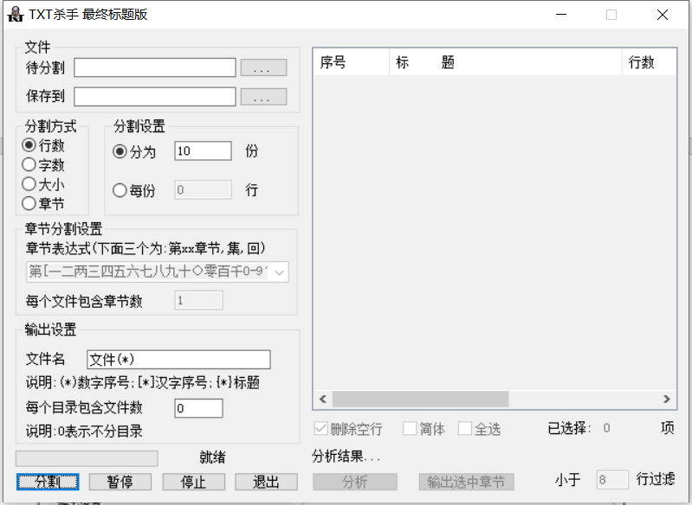
Because there is only one text file, which is too large, bigger than 1GB, so I download an app called TXT divider to divide the whole txt file to some proper size.

Slide 12
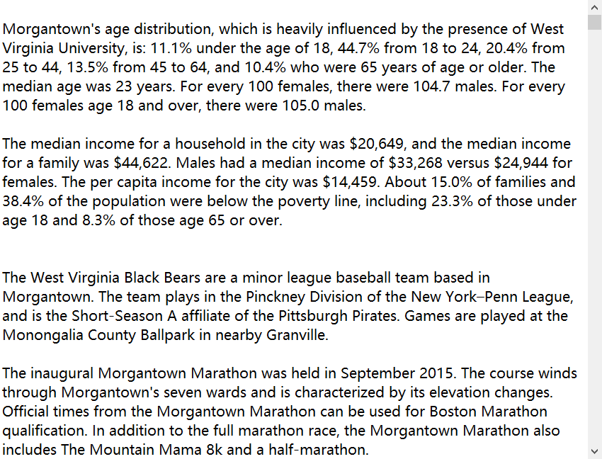
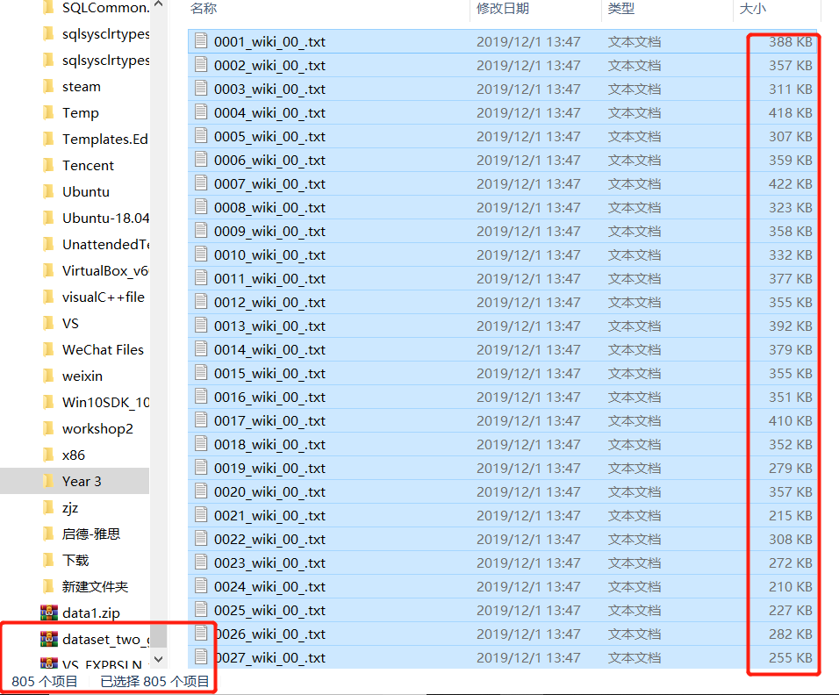

Slide 13
Tree Map
<key, value> form
Word is the key, value is line number
Create a file index
Find the file and read by line
Record the word and line number
Write the index
Return the value and write in to tree map

Slide 14
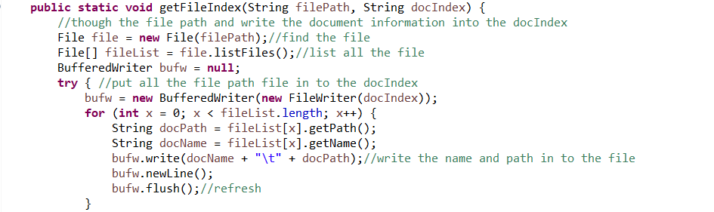
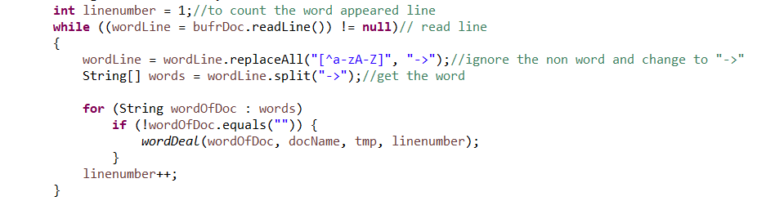

Slide 15
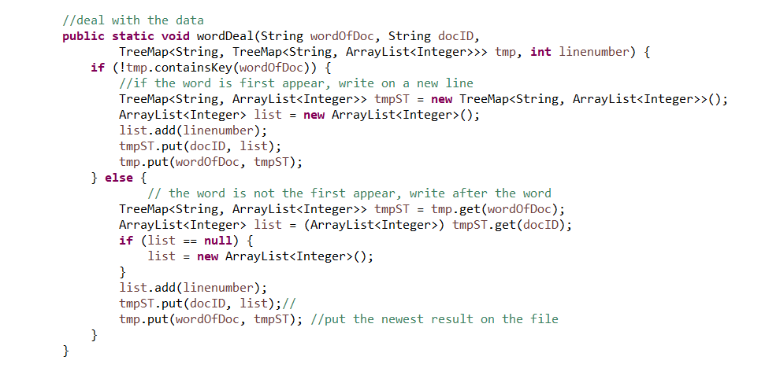

Slide 16
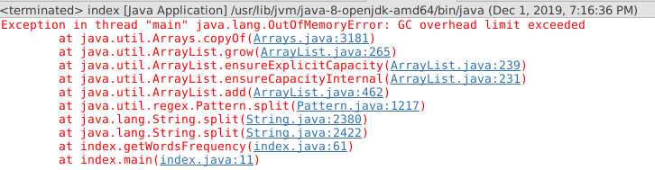
Some problem
It can not run correctly on the ubuntu(test data: 214M)
some file data is too big, cause there is some program is always occupy memory and never free it.
Analysis:
Should optimize the code. Reduce use some while function
Try to edit the eclipse configuration file.
Increase the initial and the Max Xms JVM heap size
Still fail

Slide 17
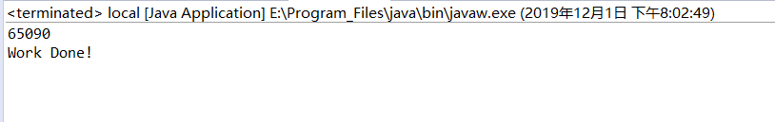
Try on my own computer

Slide 18
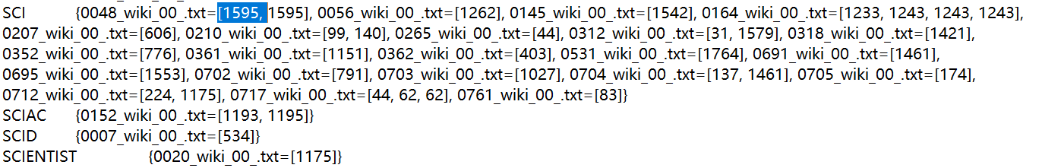
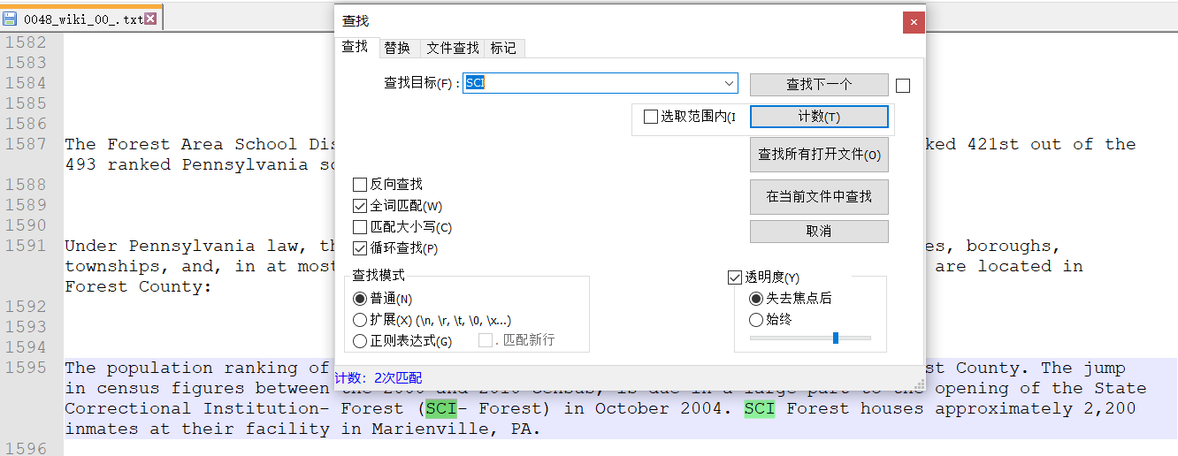

Slide 19
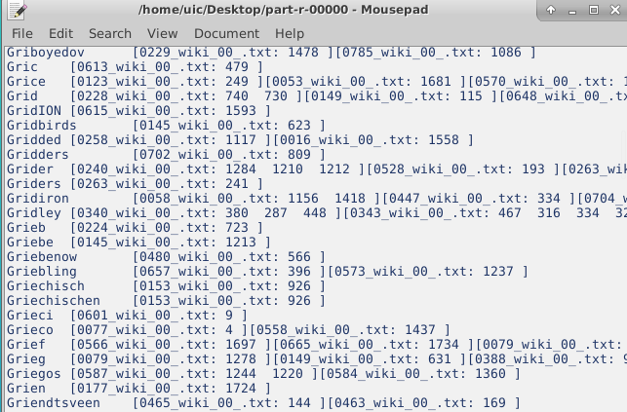
Hadoop
Split the word
Split the word and filename
filename
Combine the filename and line number
Key(Word + Filename)
Value(line number)
Output:
Key(Word)
Value(filename + line number)
Run correct

Slide 20

Lucene is an open source library for full-text retrieval and search.
Lucene can provides a simple but powerful application program interface capable of full-text indexing and searching

Slide 21
Steps:
Create a directory object and specify where the index library is saved
Create an Index Writer object based on the directory object
Read files and create document object for each file
Add field to document object
Write the document object to the index library
Close the Index Writer object

Slide 22
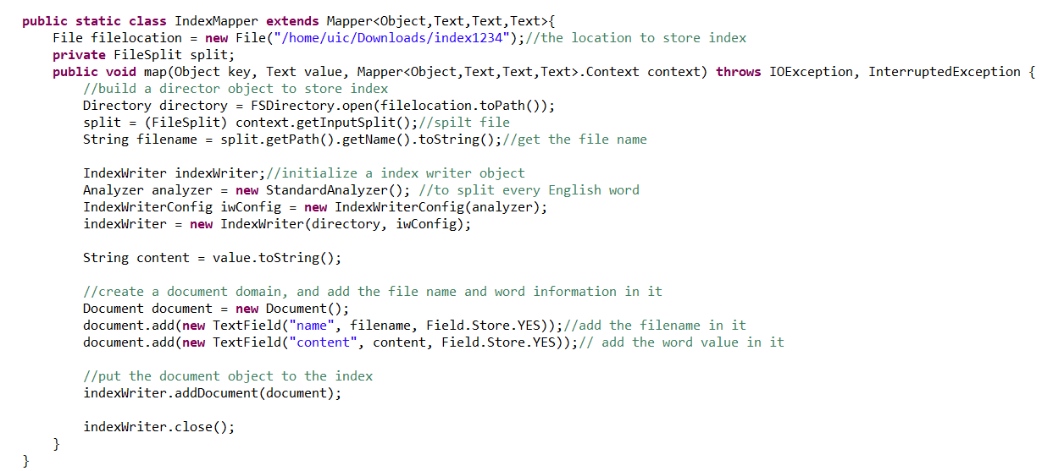
Hadoop + Lucene
Create the index location
Standard analyzer to split the word
For every word to create the Field
Add the word and file name to the Field
Write to the Index library and close the Index Writer

Slide 23
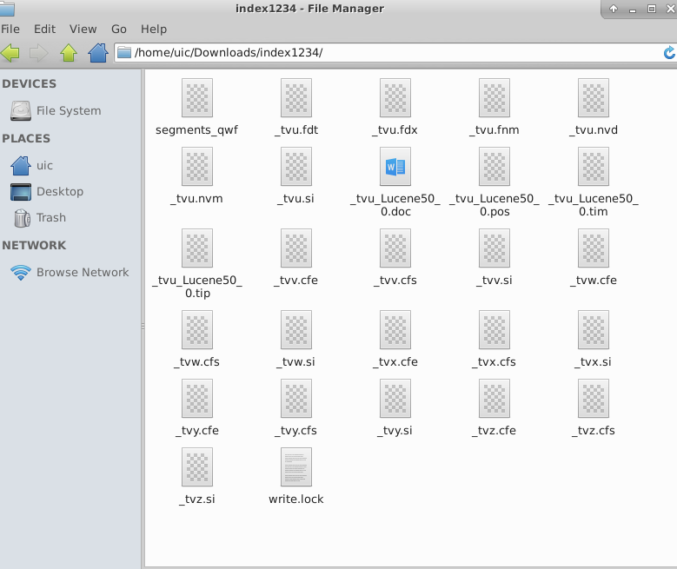
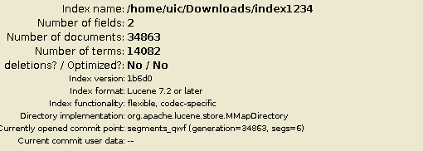
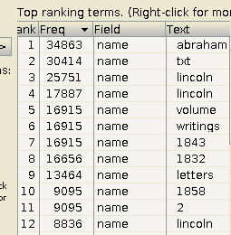

Slide 24
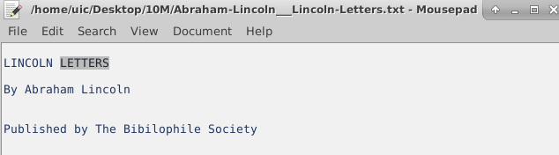
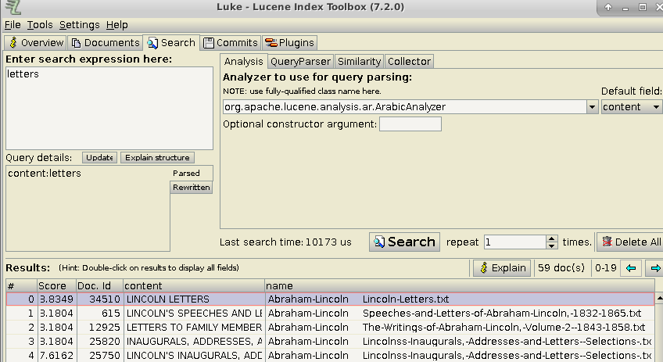
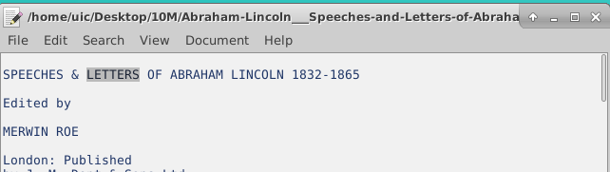
Search for one word to test

Slide 25
Problems
It run very slow.
Lucene cannot index directly to a HDFS file system
Analysis:
In the local, we always create the file object, but in the Hadoop, we create the word object and do index.
Word >> file

Slide 26
TF-IDF
Three main steps:
1. for every file, count the word appeared times.
output(word + filename, appeared time)
2. count the sum of the words have in one file.
output(word + filename, word appeared time + words in file)
3. count the file numbers, count the word appeared in how many files. And calculate the TF-IDF value.

Slide 27
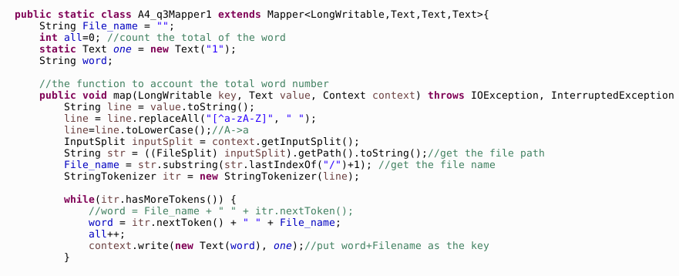
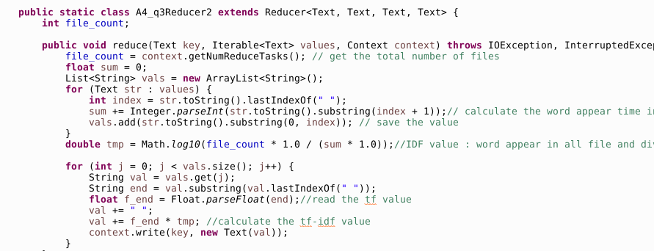
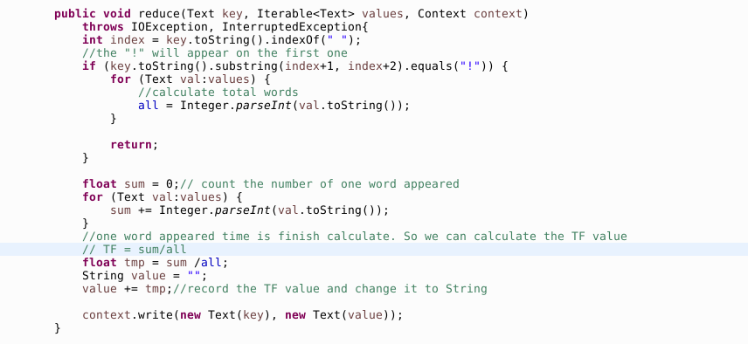

Slide 28
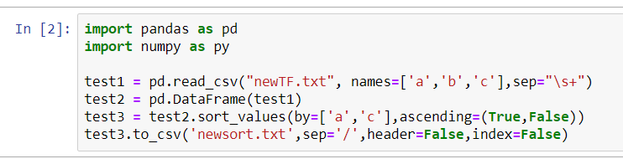
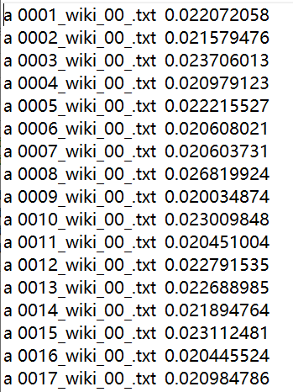
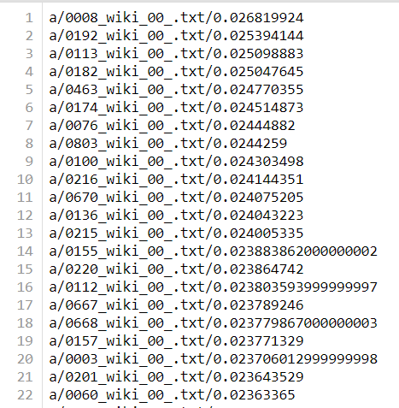
Ranking

Slide 29
Django
Keyword/filename/TF-IDF value

Slide 30
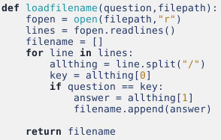
Django
1. Find the filename
Searching word
Split the line into three parts:
Keyword, filename, TF-IDF value

Slide 31
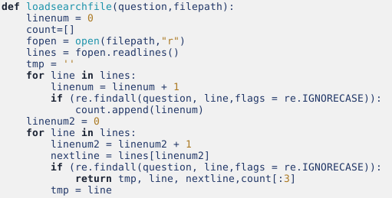
Django
Find all the number of lines that have the searching word
Find the front and back of the word
How we use it ? ? ?

Slide 32
Django
First try:
for i in filename:
context[‘tmp’], context[‘line’], context[‘nextline’], context[‘count’] = loadsearchfile(post_data, “static/essay/{name}”.format(name = i))
It just store the last file’s information.
Second try:
1. Append the filename, line number, front, current and back context into one list
2. Use a large list to store all of the information of this filename

Slide 33
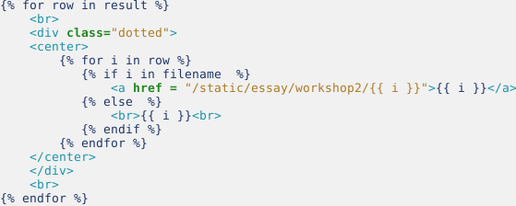
Django
Some changes in html

Slide 34
Django
Highlight
1. Use views.py to highlight the searching word in the line.
If the searching word appears multiple times in this line, then this line will be split into many pieces. But I do not know how many parts each sentence is divided into.

Slide 35
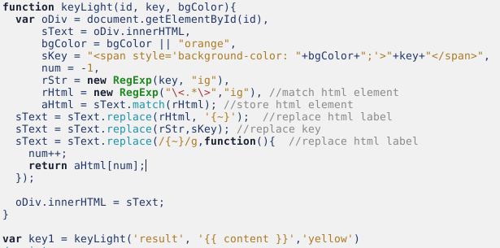
Django
Highlight
2. Use Java Script in html to find this searching word.
It will also highlight the front and back context that have the searching word.

