Slide 1
Text file collection
Test
>200MB

Slide 2
Test data
https://www.wuxiaworld.com/novel/stellar-transformations
FetchUrl(url)
GetContent(html)
Savefile(content, path, filename)

Slide 3
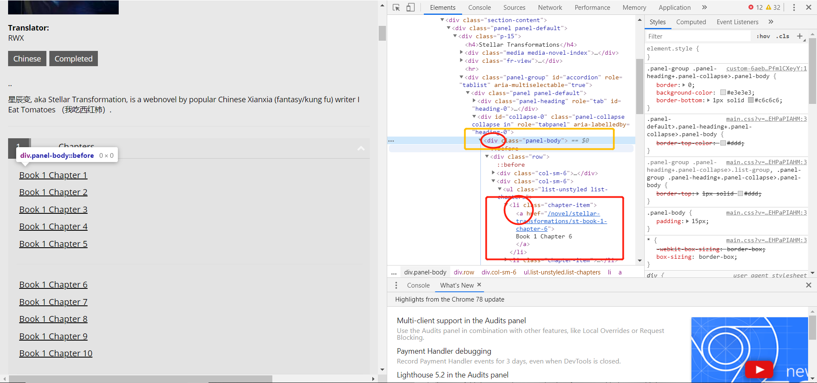
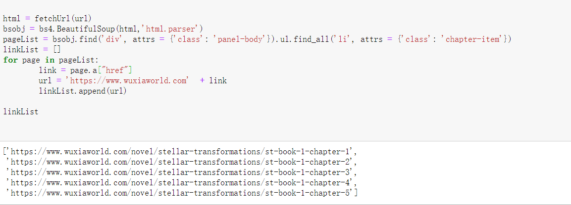

Slide 4
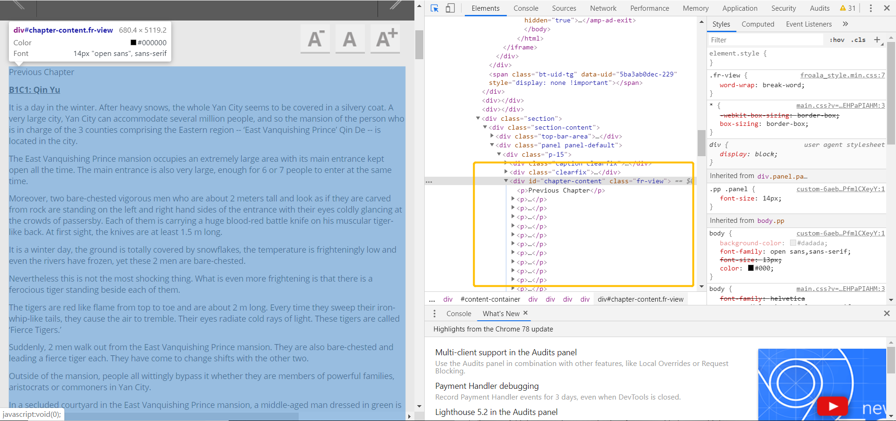
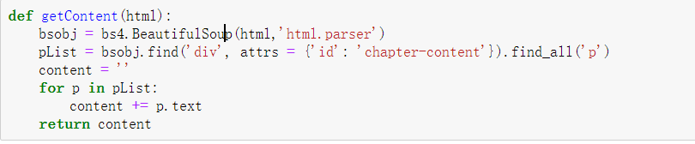

Slide 5
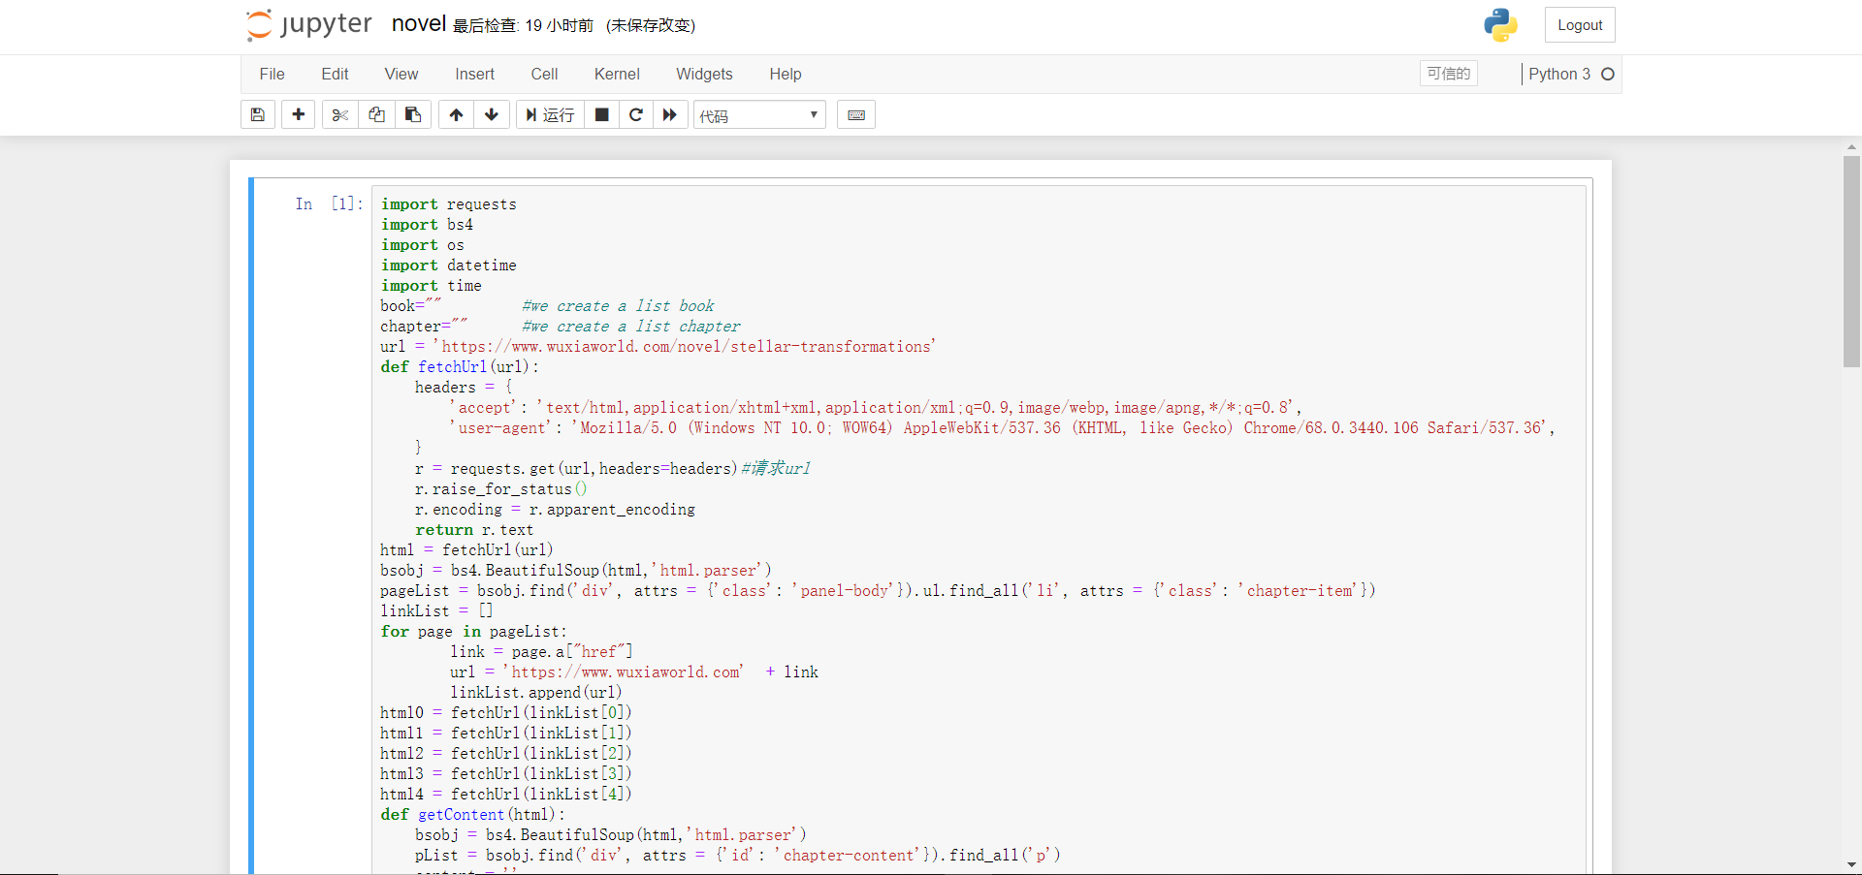
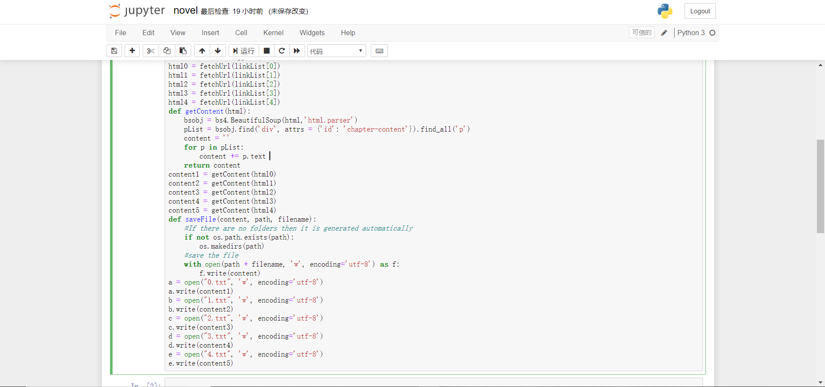
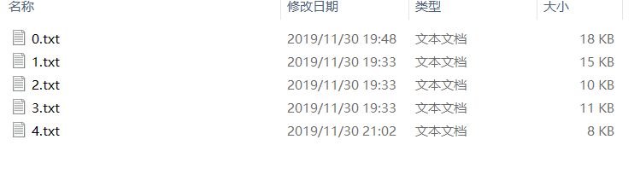
All code of crawling

Slide 6
>200MB data
The main problems:
The folder has a bunch of subfolder
50000+ TXTfiles number is too big
Cannot extract the RAR from Wikipedia
How to divide a big TXTfile into some small parts

Slide 7
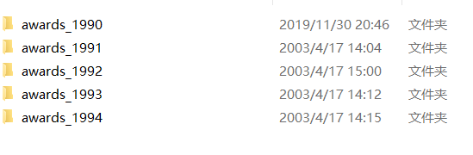
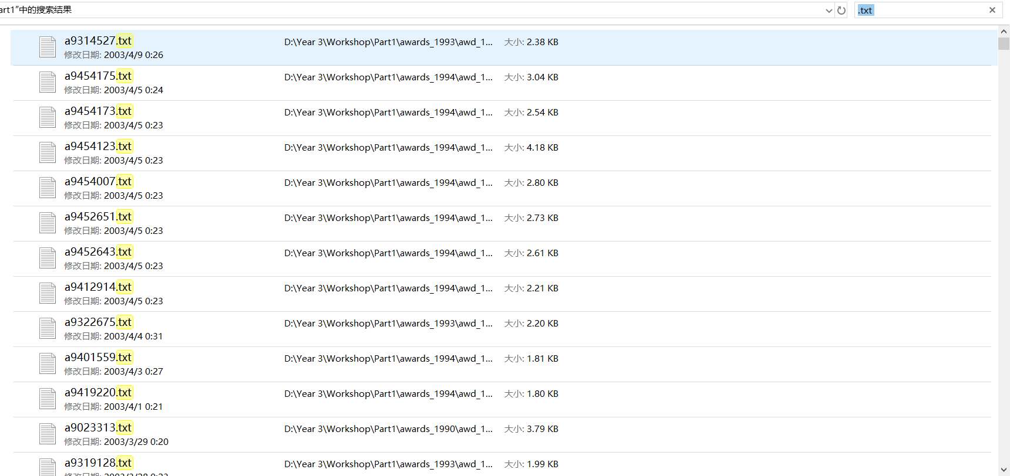
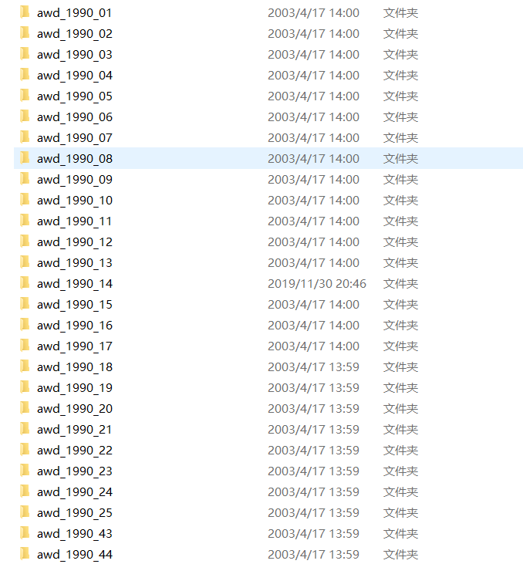
Type the “.txt” in the search

Slide 8
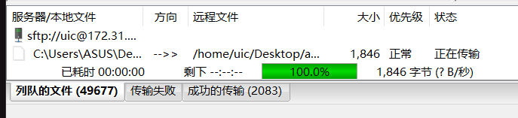
50000 TXT Files number is too big
The transfer is slow
The index values can appear in the tens of thousands rows
Start to find the second dataset
Third problem:Cannot extract the RAR from Wikipedia

Slide 9

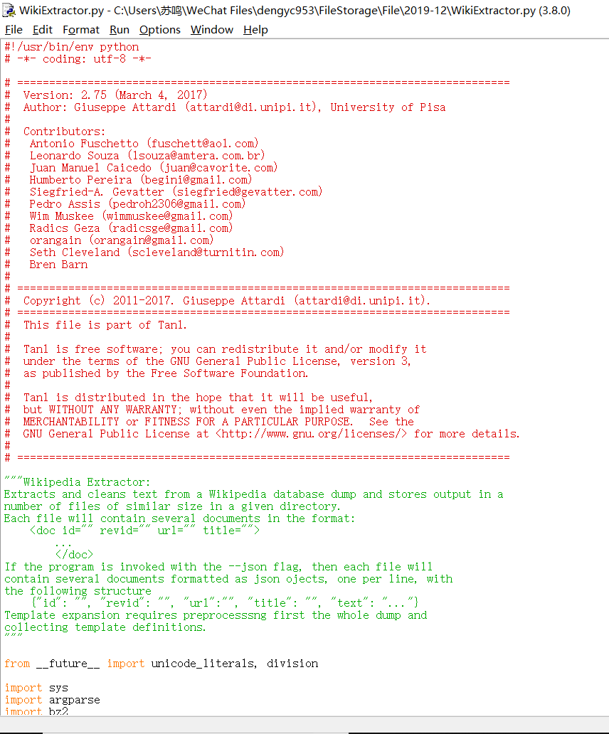
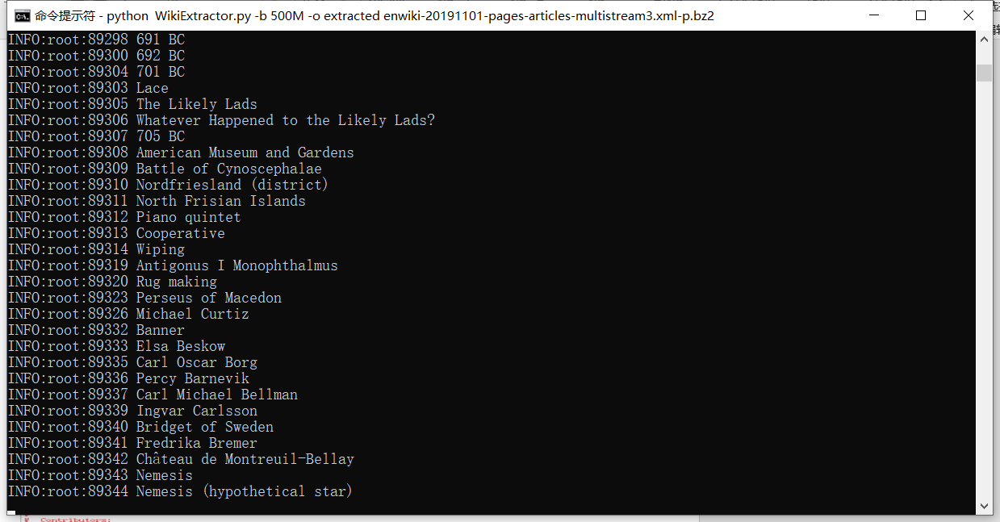
The steps:
The files are in the same folder as wikiextractor.py
CMD enters the file directory
Perform: python WikiExtractor.py -b 500M -o extracted enwiki-20191101-pages-articles-multistream3.xml-p.bz2

Slide 10
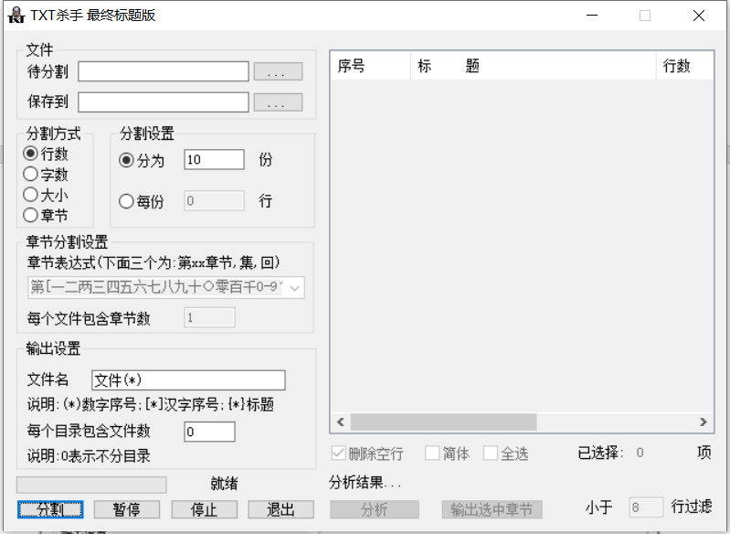
Because there is only one text file, which is too large, bigger than 1GB, so I download an app called TXT divider to divide the whole txt file to some proper size.

Slide 11
