Slide 1
Comprehensive Project Plan
TrailForge Gear, Inc.
TrailForge at a glance
$5M current revenue
Executive presentation for leadership approval and investor funding
$30M two year target
10 employees today
30 employees planned
Business model: DTC ecommerce outdoor gear
Facility: two story standalone building
Approach: SaaS first + right sized onsite network
Phillip Gross
Professor Mark Cohen
CIS599
March 16, 2026
Notes:
Today is the final recommendation for TrailForge’s IT foundation for the new facility and the next two years of growth.
This is not a stack of previous assignments — it’s the investor version: the critical decisions, the risks, and the funding ask.
The outcome I’m asking for at the end is approval to fund and execute the plan.

Slide 2
Why TrailForge needs this project now
Business need and decision point
No production ready network, identity platform, or implementation roadmap exists for the new facility
Growth to $30M requires secure commerce, stronger support operations, and better visibility into orders, returns, and customers
A fragmented or under secured setup would slow onboarding, increase downtime risk, and limit investor confidence
The decision is whether to fund a scalable operating foundation now or absorb higher risk and rework later
What is at risk without action?
Customer friction at checkout
Security and compliance gaps
Poor support responsiveness
Weak reporting and planning
Higher cost to scale later
Notes:
Right now we’re moving into a new building without a production-ready network, identity foundation, or a complete implementation roadmap.
If we try to grow without a stable foundation, we’ll feel it first in checkout friction, security gaps, and support slowdowns.
This is a timing decision: fund a scalable operating foundation now, or pay more later in rework and downtime.

Slide 3
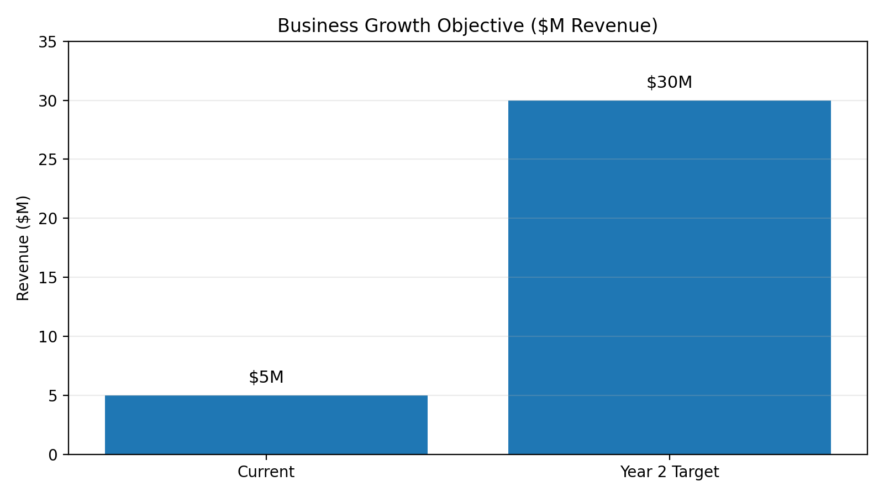
Market opportunity supports the investment
Ecommerce scale makes platform readiness essential
U.S. ecommerce sales in 2025 were estimated at $1.2337T and 16.4% of total retail sales
TrailForge does not need enterprise scale on day one, but it does need a platform that can scale without redesign
A modest first year IT investment supports a much larger revenue objective and protects the customer experience during growth
This project is sized for the business we are becoming, not just the company we are today
Notes:
Ecommerce is big and still growing — which means customers expect speed, stability, and trust by default.
We’re not trying to build enterprise complexity on day one. We’re building a platform that won’t collapse when growth accelerates.
This investment is sized for the company TrailForge is becoming over the next two years, not just the company today.

Slide 4
Project goals, scope, and controls
What the project will and will not do
Goals
Controls
Secure facility connectivity
Hosted commerce and business platforms
Standardized endpoints and support tools
Baseline security and monitoring
Repeatable implementation and hypercare
Design sign off before procurement
Stage gate approvals before go live
Formal change control for scope and cost
Acceptance testing and security validation
Hypercare support after launch
Notes:
These goals tell you what you’re funding: secure facility connectivity, hosted platforms, standardized endpoints, baseline security and monitoring, and a repeatable rollout.
The controls are how we prevent ‘startup chaos’: design signoff before procurement, gate approvals before go-live, change control, and acceptance testing.
This is how we keep timelines and costs predictable.

Slide 5
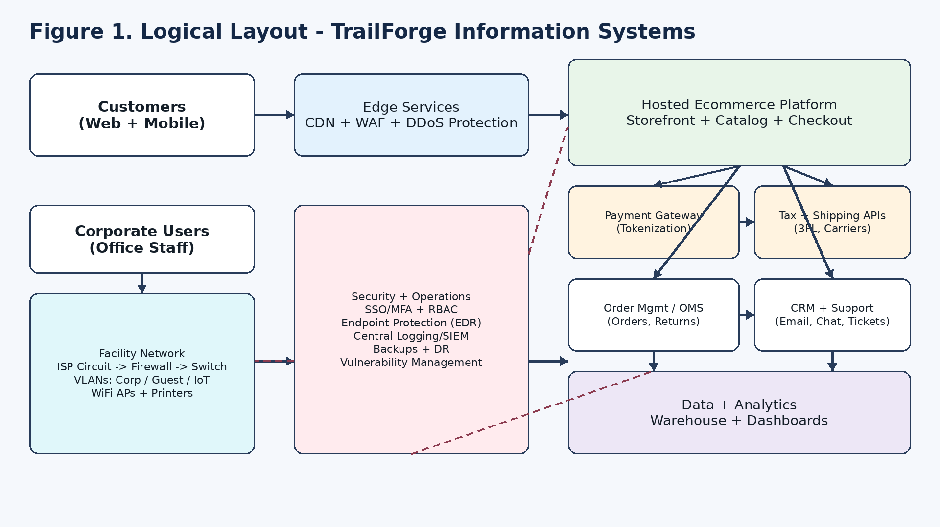
Recommended solution: SaaS first, right sized onsite infrastructure
Hybrid architecture for speed, security, and scale
Hosted ecommerce, payments, support, and analytics
Onsite network closet, firewall, switching, WiFi, printers, and cameras
Central identity, MFA, endpoint protection, logging, and backups
Lower complexity than a server heavy, on premises buildout
Notes:
The strategy is SaaS first so we can move faster and avoid building a server-heavy environment that’s expensive to maintain.
Onsite infrastructure is intentionally limited to what the facility needs: network closet, firewall, switching, WiFi, printers, cameras.
That gives us speed to launch plus a clean path to scale without redesign.

Slide 6
How IT creates competitive advantage
Technology becomes a growth enabler, not overhead
Faster launch and scaling
Better customer experience
Hosted services reduce implementation time and support promotional spikes without a large capital build.
Stable storefront, payment flows, and support operations improve trust and repeat purchase likelihood.
Operational leverage
Decision quality
Standardized devices, identity, and logging let a small team support more growth with less complexity.
Shared analytics improve visibility into conversion, returns, support demand, and margin.
Notes:
This is where IT stops being overhead and becomes a growth enabler.
Hosted services let us launch faster and handle traffic spikes without major capital spend.
Standardization gives operational leverage: a small team supports more growth because identity, devices, and logging are consistent.
Analytics improves decision quality: we can actually see conversion, returns, support demand, and margin drivers.

Slide 7
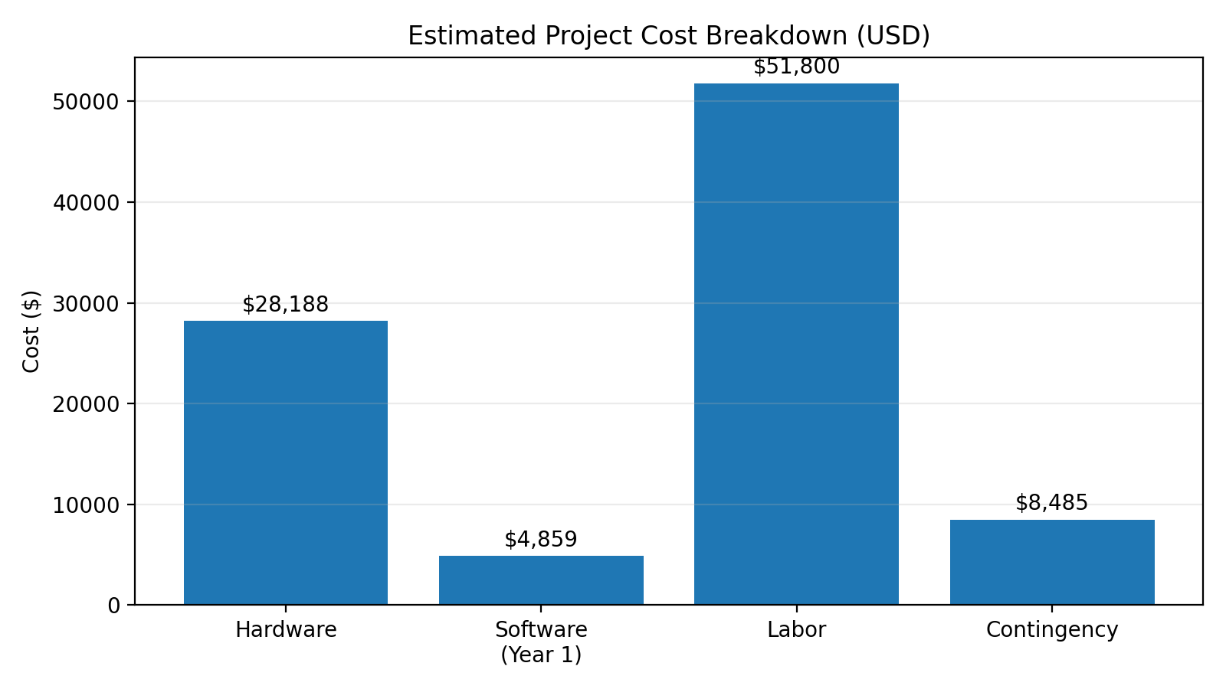
Rough first year project cost estimate
Hardware, software, labor, and contingency
Hardware and physical equipment: $28,188
Software and subscriptions, Year 1: $4,859
Labor: $51,800
Contingency reserve: $8,486
Most recurring cost scales gradually with headcount rather than in large capital jumps
Estimated first year total: $93,333
Notes:
The first-year estimate is about $93K, and it’s broken into hardware, software, labor, and contingency.
The key point: software spend is modest; most costs are tied to initial build work and setup labor.
Recurring costs scale more gradually with headcount rather than requiring big ‘step function’ purchases.

Slide 8
Security and compliance posture
Risk reduced through governance, standardization, and hosted payments
Security program aligned to the NIST CSF 2.0 lifecycle: Govern, Identify, Protect, Detect, Respond, Recover
Hosted payment approach reduces scope by avoiding direct storage of cardholder data
Baseline controls include MFA, least privilege access, endpoint protection, centralized logging, and backups
Security is designed into the project, not added after go live
Why investors should care
Protects customer trust
Lowers outage and breach risk
Improves audit readiness
Supports scalable operations
Notes:
Security is built in, not bolted on after go-live.
We’re aligned to NIST CSF 2.0, which gives a clear lifecycle for governance and response.
Payments are hosted, which reduces exposure because we avoid storing cardholder data directly.
For investors, this is about protecting customer trust, reducing outage risk, improving audit readiness, and supporting scale.

Slide 9
Top execution risks and mitigations
The plan is designed to reduce avoidable startup mistakes
Vendor or delivery delay
Early ordering, approved alternates, staged receiving
ISP activation delay
Pre move validation and temporary failover option
Security misconfiguration
MFA, peer review, logging, acceptance checks
User adoption issues
Quick start training, role based support, hypercare
Notes:
These are realistic startup risks: vendor delays, ISP activation timing, misconfiguration, and user adoption.
The plan reduces avoidable mistakes by ordering early, using alternates, validating internet early, and using acceptance checks for security.
Hypercare and role-based training prevent the ‘go-live and panic’ cycle.

Slide 10
Execution roadmap
Disciplined sequence from approval to go live
Governance + Requirements
Design + Procurement
Build + Validation
Go Live + Hypercare
Scope, approvals, budget, business and technical needs
Architecture, security, BOM, vendor ordering
Configuration, installation, testing, training
Cutover, stabilization, lessons learned
Control points: design sign off → procurement approval → security validation → go live readiness
Notes:
At the executive level, the project is four phases: governance and requirements, design and procurement, build and validation, then go-live and hypercare.
The control points are the real management tool here: design signoff, procurement approval, security validation, and go-live readiness.
This keeps the project disciplined and prevents rushing into go-live with unresolved risks.

Slide 11
How we will measure success
Technical readiness and business enablement
Technical success
Business success
Stable Internet and LAN connectivity
Complete user onboarding
Hosted platform access and support workflows working
Backups, logging, and security controls verified
Better support for growth and promotional spikes
Improved customer trust and service experience
Cleaner visibility into orders, returns, and conversion
A platform that scales without major rework
Notes:
We measure success in two ways: technical readiness and business enablement.
Technical success means connectivity is stable, onboarding is complete, workflows function end-to-end, and security controls are verified.
Business success means we support growth spikes, improve trust and service experience, improve visibility into operations, and scale without major rework.

Slide 12
Recommendation and funding request
Approve the architecture, budget, and execution schedule
Approve TrailForge’s hybrid, SaaS first technology plan and authorize execution of the first year implementation budget of approximately $93K.
Business fit: right sized for a $5M startup targeting $30M growth
Risk posture: governed, secure, and easier to operate than a server heavy build
Financial fit: modest first year spend relative to strategic value
Execution fit: phased controls and clear acceptance gates
Notes:
The ask is approval of the architecture, the budget, and the execution schedule.
This plan is right-sized for a $5M company aiming for $30M: it’s scalable but not overbuilt.
It improves risk posture and operational efficiency without putting us into a server-heavy model that creates long-term overhead.

Slide 13
Sources
References used in the comprehensive plan and presentation
National Institute of Standards and Technology. (2024). The NIST Cybersecurity Framework (CSF) 2.0.
PCI Security Standards Council. (2024). PCI Data Security Standard (PCI DSS) v4.0.1.
U.S. Census Bureau. (2026). Quarterly retail e-commerce sales report, fourth quarter 2025 and full year 2025.
Internal course deliverables: Week 2 inception plan, Week 6 infrastructure design, Week 8 system implementation plan, Week 8 BOM spreadsheet.

