Slide 1

https://kafka.apache.org/

Slide 2
What is Apache Kafka?
A protocol at transport layer (much like TCP)
A Streaming platform, with 3 key capabilities:
publish and subscribe to streams of records (similar to a message queue or enterprise messaging system.
store streams of records in a fault-tolerant way
process streams of records as they occur

Slide 3
Main Goals
Enabling users to publish and subscribe to streams of records. In this respect it is similar to a message queue or enterprise messaging system.
Enabling users to store streams of records in a fault-tolerant way.
Enabling users to process streams of records as they occur.
Enabling users to build real-time streaming data pipelines that reliably get data between systems or applications
Enabling users to build real-time streaming applications that transform or react to the streams of data

Slide 4
Background
Open Source
Built by the development team of LinkenIn
Written in Java, Scala, and Python (and small bits of other languages)

Slide 5
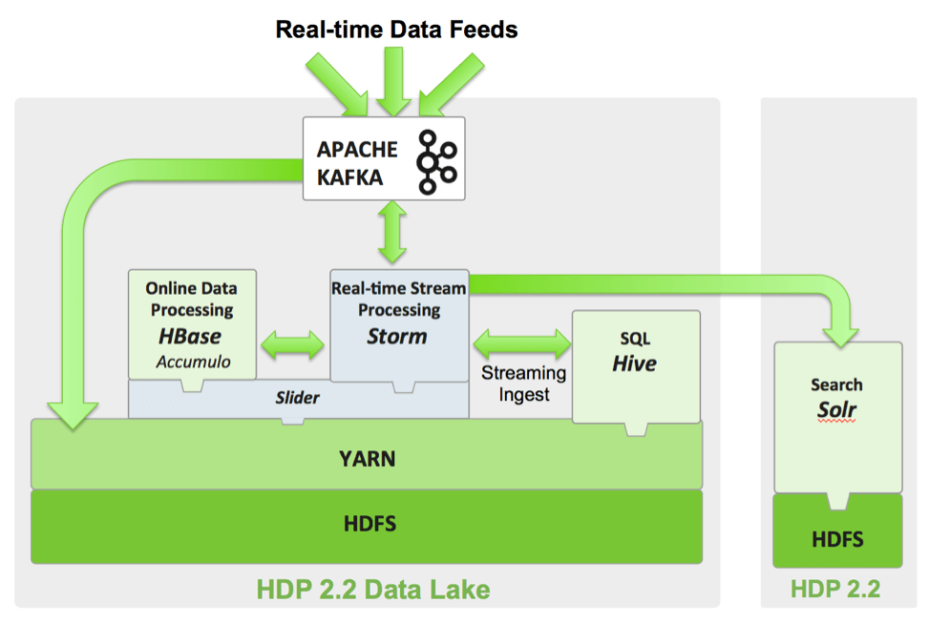
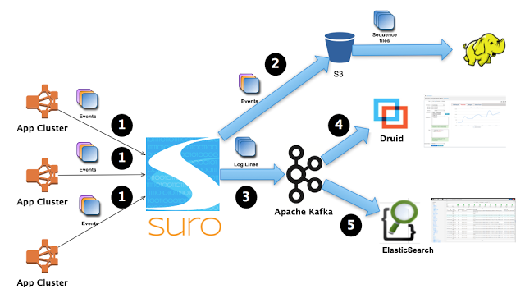
Background
Commonly used alongside other powerful applications: Apache Storm, DataTorrent, Hadoop, or any database. LinkedIn pairs Kafka with its own programs: Samza, and Camus.
The team that created Kafka left LinkedIn to open a business around Kafka.
(Integration with Apache Storm and Hadoop)
(Kafka’s fit into Netflix’s data pipeline)
Notes:
Samza was created by Jay Kreps, the same manager of Kafka
Camus is used to stream the data into Hadoop

Slide 6
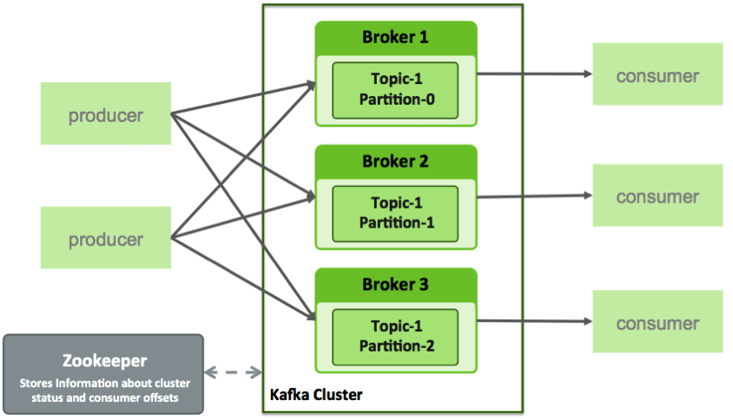
Under the hood
Producers –send data to Kafka for distribution to consumers.
Brokers – workers that take data from the producers and send it to the consumers. They handle replication as well.
Consumers – applications that subscribe to topics; for example, a custom application or any of the products listed at the bottom of this post.
Topics – categories for messages. They could be something like “apachelogs” or “clickstream”.
Apache Zookeeper – starts services in distributed systems. Not part of Kafka, though needed

Slide 7
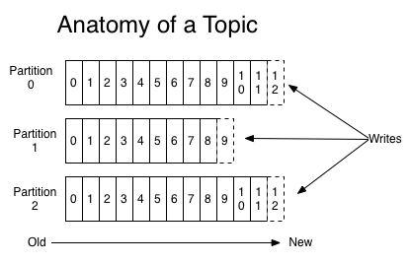
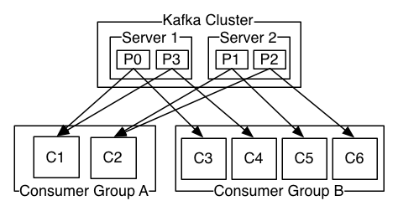
Operation
Partitions – the physical divisions of a topic. Used for redundancy as partitions are spread over different storage servers.

Slide 8
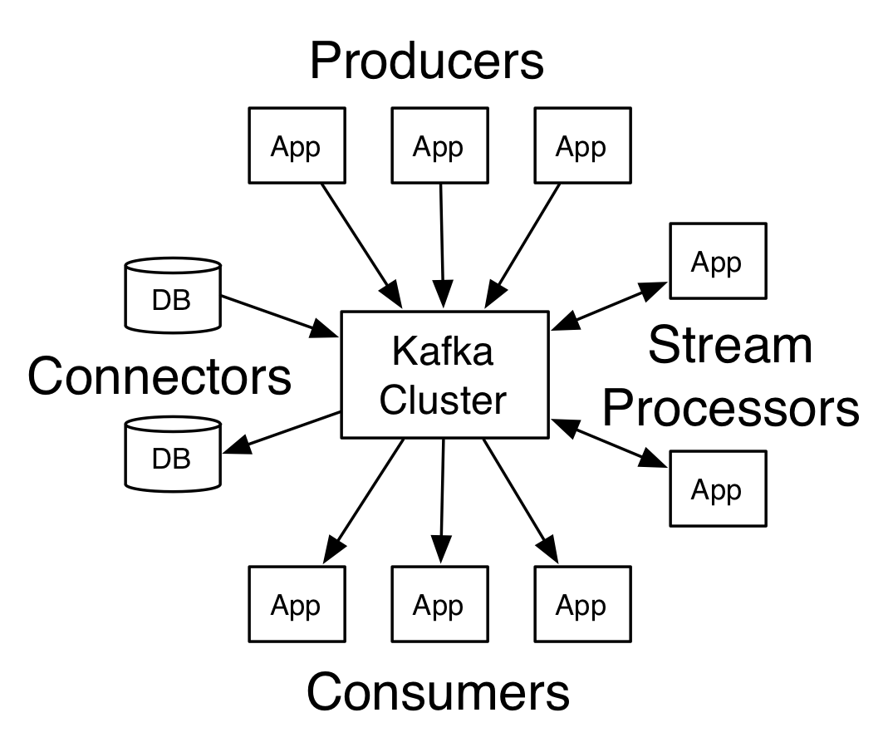
Characteristics
2 Models
Queue (scalable. Single read, then erase)
Publish-subscribe (non-scalable. Broadcast to every subscriber)
Logs in sorted manner (keeps order)
Real-time
Failure-tolerant (replication system)

Slide 9
Build layout
Kafka has four core APIs:
The Producer API allows an application to publish a stream of records to one or more Kafka topics.
The Consumer API allows an application to subscribe to one or more topics and process the stream of records produced to them.
The Streams API allows an application to act as a stream processor, consuming an input stream from one or more topics and producing an output stream to one or more output topics, effectively transforming the input streams to output streams.
The Connector API allows building and running reusable producers or consumers that connect Kafka topics to existing applications or data systems. For example, a connector to a relational database might capture every change to a table.

Slide 10
What should it be used for?
Building real-time streaming data pipelines that reliably get data between systems or applications
Building real-time streaming applications that transform or react to the streams of data

Slide 11
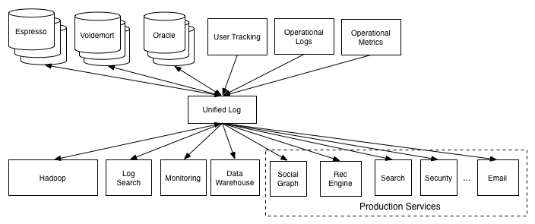
Use Case (almost)

Slide 12
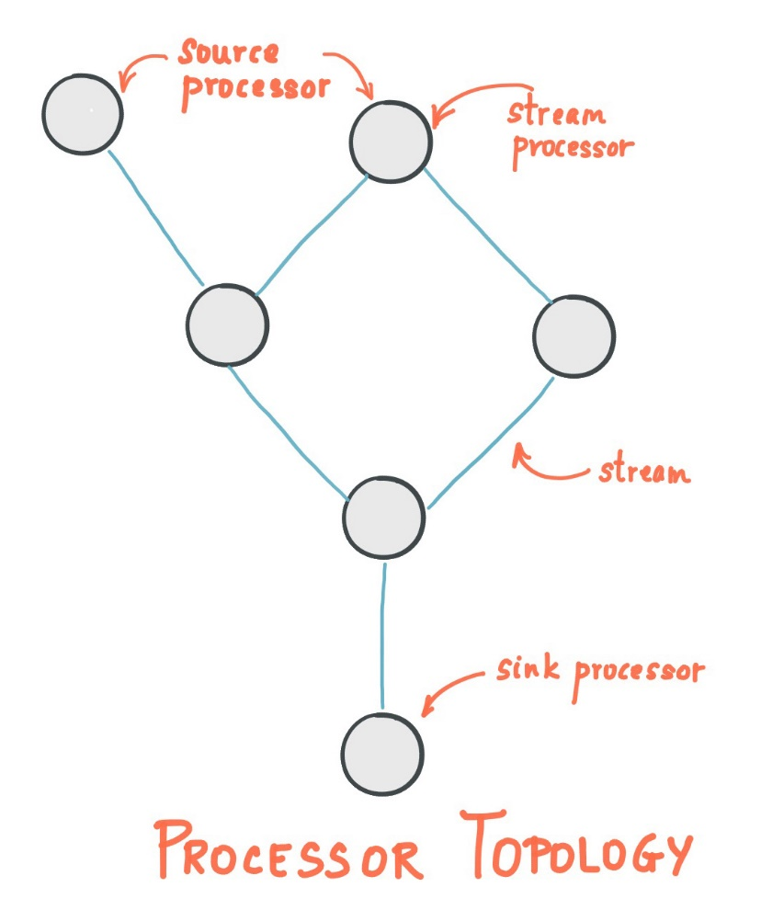
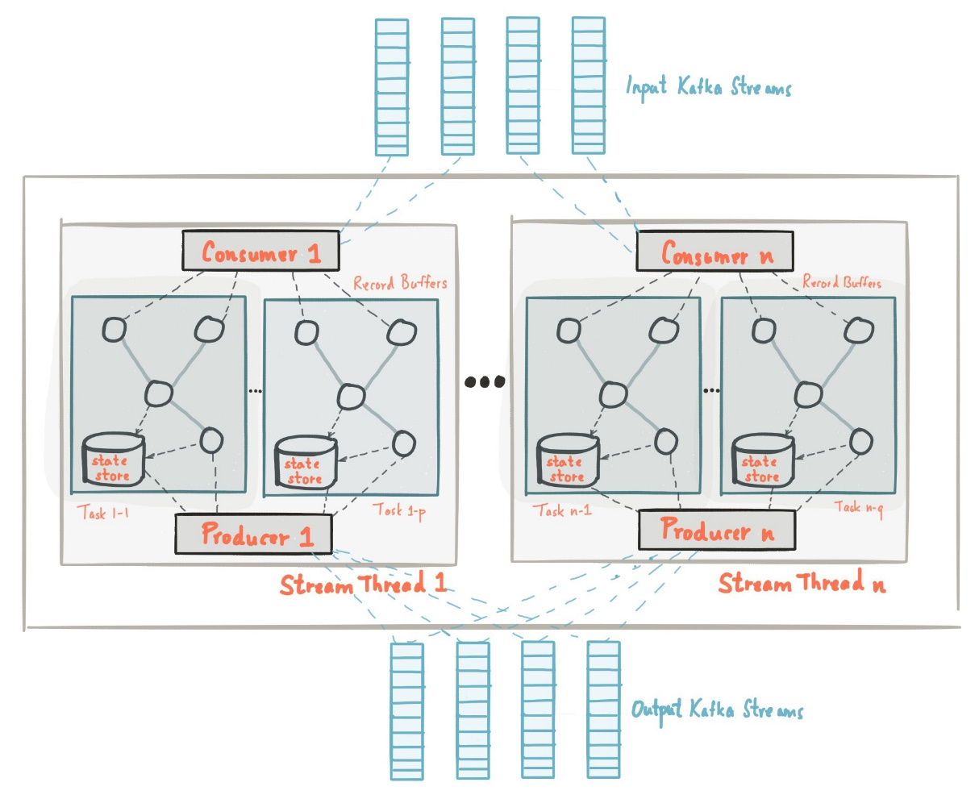
Flow

Slide 13
Stakeholders
Aquirers – system is paid for by the users of the service.
Assessors – if not part of the service, probably none.
Communicators – Training is up to clients, documentation exists on kafka.apache.org
Developers – 3 engineers who work(ed) for LinkedIn
Maintainers – the Developers and third party developers (clients)
Suppliers / Support Staff / System Administrators – various service providers, notably the Developers themselves
Users – clients (software developers) who need a MQ service

Slide 14
Stakeholders
Class of stakeholders | Role(s) and concern(s) | Kafka stakeholder
Acquirers | Oversee the procurement of the system or product | PMC (Project Management Committee)
Assessors | Oversee the system’s conformance to standards and legal regulation | PMC
Communicators | Explain the system to other stakeholders via its documentation and training materials | PMC and Committers, but also developers and system administrators that use Kafka that communicate through the Apache Kafka website and documentation
Developers | Construct and deploy the system from specifications (or lead the teams that do this) | PMC (in the form of development managers), Committers and other GitHub contributors as core developers
Maintainers | Manage the evolution of the system once it is operational | PMC and Committers
Production Engineers | Design, deploy, and manage the hardware and software environments | Third party software organizations such as JIRA, Jenkins, Gradle, CheckStyle, ect.
Suppliers | Build and/or supply the hardware, software, or infrastructure on which the system will run | JVM, Scala, Apache Zookeeper, Clients
Support Staff | Provide support to users for the product or system when it is running | PMC and Committers, but also individual developers active in the Kafka's users mailing lists
System Administrators | Run the system once it has been deployed | System administrators at companies that use Kafka
Testers | Test the system to ensure that it is suitable for use | PMC and Committers vote for approval, Users also contribute to (context specific) testing and the creation of issues, as well as Developers in general
Users | Define the system’s functionality and ultimately make use of it | Confluent and LinkedIn seem to play a major role in defining functionality, a multitude of (large) companies are regular users
Researchers | Work with or on the system from a research perspective, Apache Kafka is thereby a separate object of study or used in a larger system under study | An active community of researchers (Kafka is stated in over 800 papers that may also be PMC members, Committers or other developers
Competitors | Offer (a subset of) similar functionalities as Kafka | Traditional messaging platforms such as ZeroMQ and RabbitMQ, related modern messaging platforms such as Amazon Kinesis and Apache Flink
Notes:
Almost all PMC (Project management comitee) amd github contributors

Slide 15
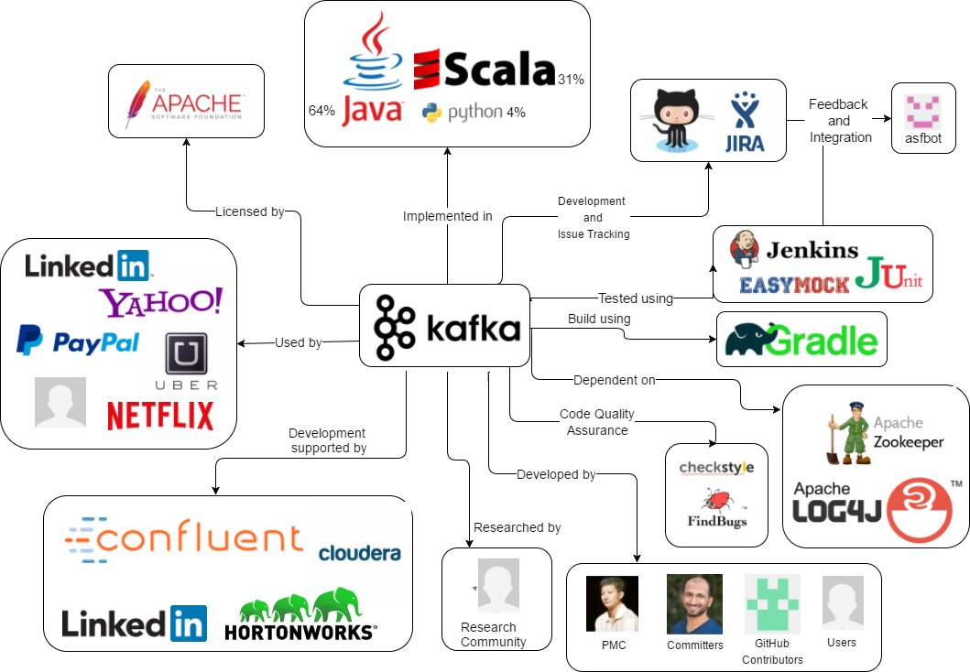
Context View (1)
The organisation that has started the project: LinkedIn.
Owner of the project: Apache Software Foundation.
Programming languages used in the project: Java (63.7%), Scala (31.3%), Python (4.2%), Other (0.8%)
The services used for development and issue tracking: GitHub and JIRA.
The test entities: EasyMock and JUnit software used to develop test cases. The other test entities through which automated testing is applied are Ducktape and Jenkins

Slide 16
Context View (2)
The code quality assurance tools: Checkstyle and FindBugs for codestyle and bugs respectively
The integration software: ASFBot, which integrates GitHub with JIRA.
Users: companies that use the Kafka platform in their own processes e.g. Spotify, Uber and Netflix, which may also actively contribute to the project, e.g. LinkedIn and Cloudera.

Slide 17
Context View (3)
The development community: consisting of PMC members, Committers, Users, Researchers and other GitHub contributors

Slide 18
Module Overview

Slide 19
Conclusion
The essence of Kafka (actual video link from documentation)

