Slide 1
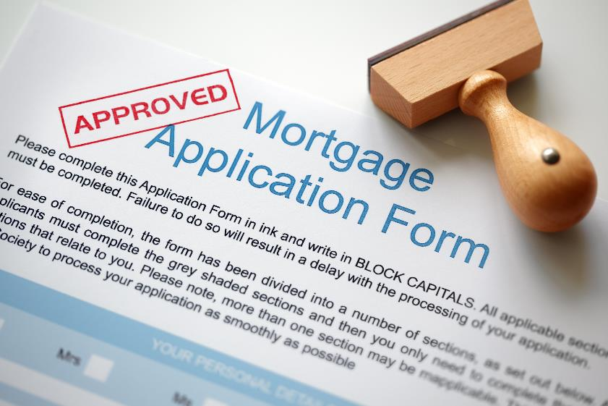
Mortgage Essentials
Your Name

Slide 2
Steps
Check your credit score
Prequalification
Preapproval
Mortgage application

Slide 3
What Are Points?
Fees the borrower pays the lender at closing.
Calculated as a percentage of the loan.
$200,000 loan
  2 points (2%) = $4,000
  3 points (3%) = $6,000
“No points loans” usually have a higher interest rate than a loan with points.

Slide 4
What Are Closing Costs?
Expenses incurred to complete the mortgage application.
Common costs are:
  Loan origination fees
  Appraisal fees
  Title search and insurance
  Property survey
  Deed-recording fees
  Credit report charges
“No closing costs loans” usually have a higher interest rate than a loan with closing costs.

Slide 5
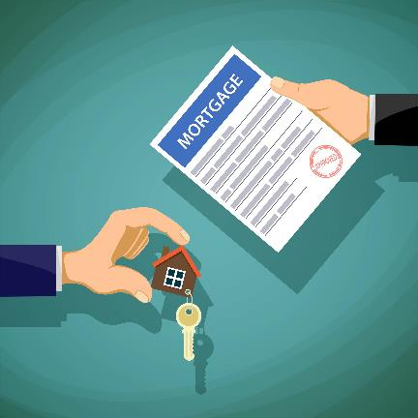
Documents Needed
Past two years of tax returns and W-2s or 1099s
Past two months of bank statements
Past month of pay stubs
Driver’s license and passport or Social Security card
Notes:
Make sure applicants understand that they need two forms of ID.

Slide 6
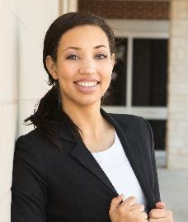
Contact Information
Sophia Baker
VP Residential Lending
Upper Coast Bank, Hartford, CT branch
sophia.baker@uppercoastbank.example.com
(860) 555-0187
www.uppercoastbank.example.com/mortgages

Slide 7

Upper
Coast
Bank
The Friendly Bank

