Slide 1
RETRO AGAIN
Your Name

Slide 2
ABOUT RETRO AGAIN
Created by Simon Gauthier in 2018
Mr. Gauthier spent 11 years as head designer at Gwen Ashbury Designs before leaving to create his own line
Headquarters
  480 East Canal St.
  New York, NY 10010
Main office phone
  (212) 555-0186

Slide 3
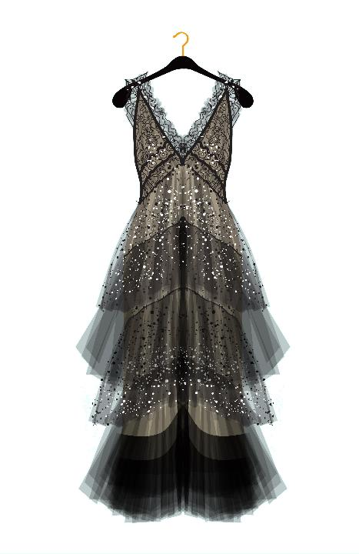
Lacy Black Formal Dress

Slide 4
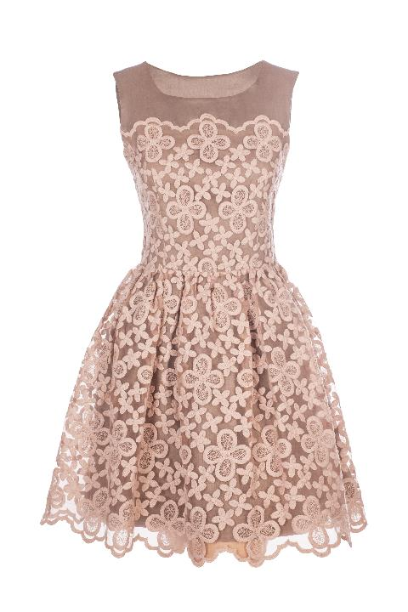
Fifties Style Sleeveless Lace Dress

Slide 5
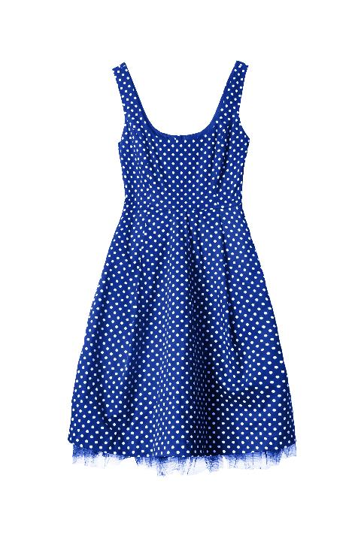
Metro Style Sundress

Slide 6
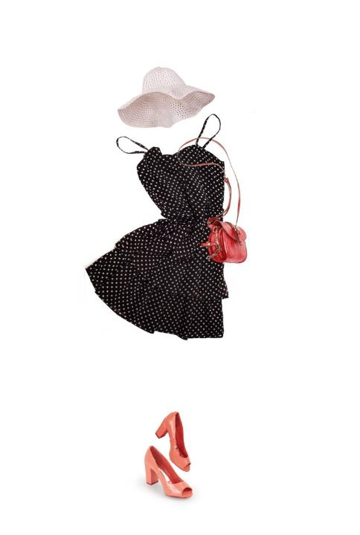
Casual Ensemble

Slide 7
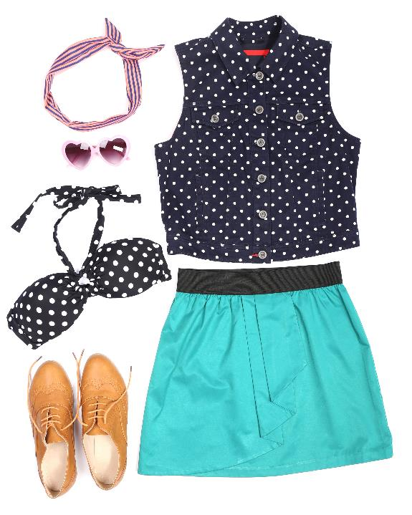
Beach Outfit

Slide 8
Next Steps
MARKET
Define the target market
TOUCH POINTS
Identify touch points
BUDGET
Create the budget
MEDIA
Create plan for all types of media

