Slide 1
Developing New Sales Leads
Your Name

Slide 2
New Products
Southwest Insurance Company is growing 28% a year
Core products are still
  Health
  Life
  Disability
We now offer
  Auto/Boat/Motorcycle/RV
  Homeowner’s/Renter’s
  Liability
  Worker’s Comp

Slide 3

Contact Your Existing Clients
Offer our new products
  Auto
  Boat
  Homeowner’s/Renter’s
  Liability
  Worker’s Comp
Offer competitive package pricing
Emphasize your personal connection and service

Slide 4

Create Custom Packages for Self-Employed
Customize our Self-Insured package for your customers
Research local discount possibilities
  Reduced membership at gyms
  Reduced membership at weight-loss groups
  Percentage off at local farmer’s markets
Schedule an open house

Slide 5

Contact Organizations and Clubs
Chamber of Commerce
Service Organizations
  Rotary
  Lions
Professional Organizations
  Houston CPA Society
  Texas Society of Professional Engineers

Slide 6
Recipe for Success
Offer new products to existing clients
Reach out to self-insured with customized packages
Present to local organizations
Notes:
Some local organizations to consider are the Chamber of Commerce, service organizations, and professional organizations.

Slide 7
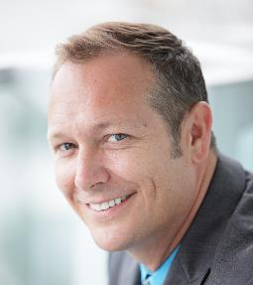
For More Information
Contact Anthony Scorsone
Sales Manager, Houston Office
Email: a.scorsone@sic.example.com
Cell: (281) 555-0187

