Slide 1

Traffic Simulation
Project Core Phase-Procp
Group 3 – Mikaeil, Mervin, Tarwiya, Nibras

Slide 2
Group Members
Client
(Mr.George)
Tutor
(Ms.Maja)
Project Leader
(Mikaeil Shaghelani)
Programming manager
Mervin Vrolijk
Design manager
Mikaeil Shaghelani
Testing manager
Tarwiya
Quality manager
Nibras

Slide 3
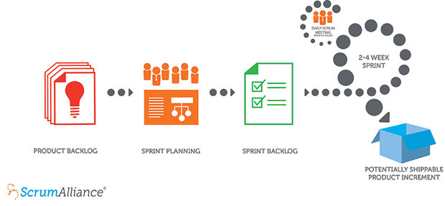
Step One Analyze
Gathering Requirements
Domain Analysis
Behavioral Modeling
Structural Modeling
Dynamic Modeling
Scrum
Notes:
Scrum is an Agile framework for completing complex projects

Slide 4
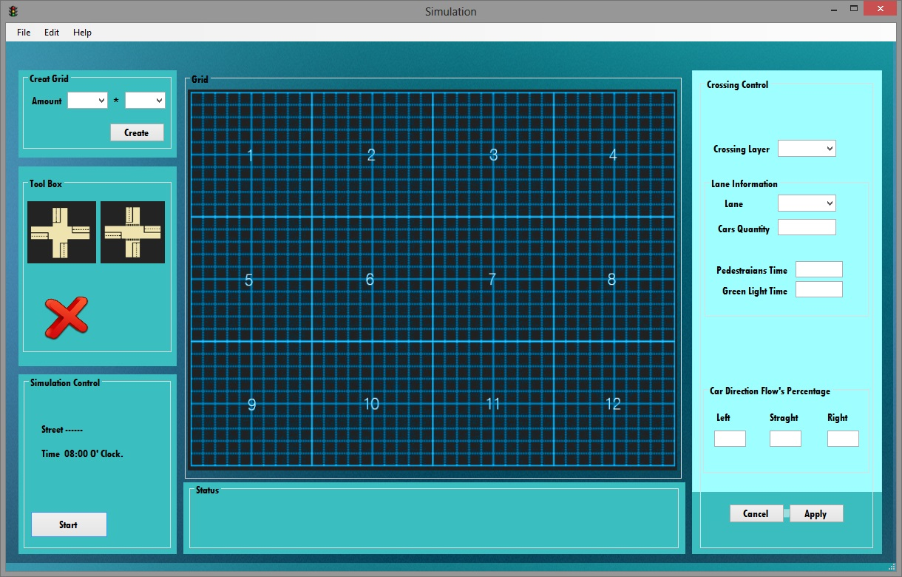
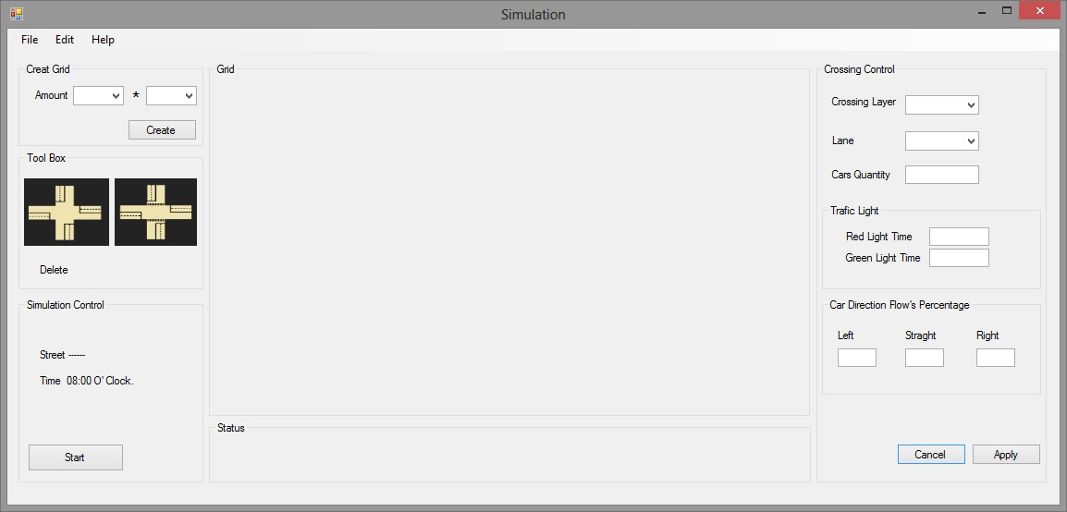
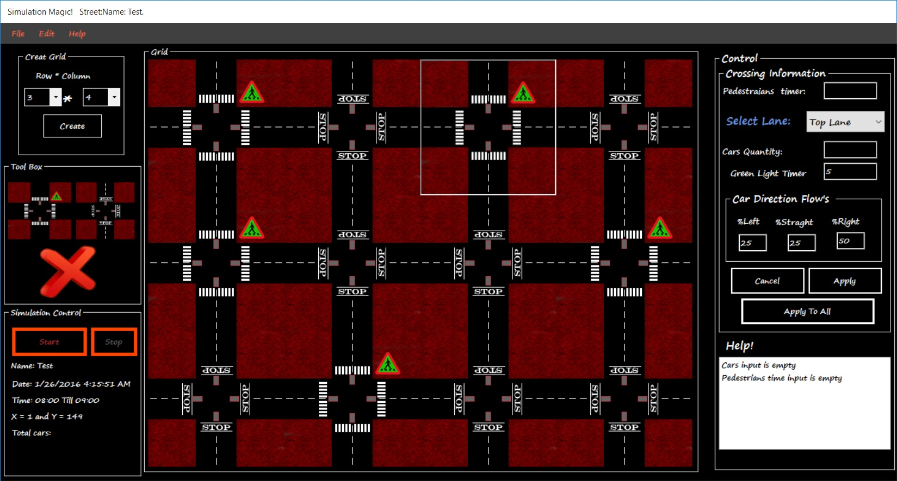
Step Two Design
User research, job shadowing, contextual interviews, personas.
Activity centered design, and text usability.
Hierarchies, card sorting, mental model.
Sketching, paper prototyping, guerilla testing.
Realism, NUI’s, Fit’s law, animations, consistency, discoverability, interrupt, undo, modes, opinions and hierarchies.
(Guerilla) usability testing, remote testing, mistakes, user error.
Building the final prototype.

Slide 5
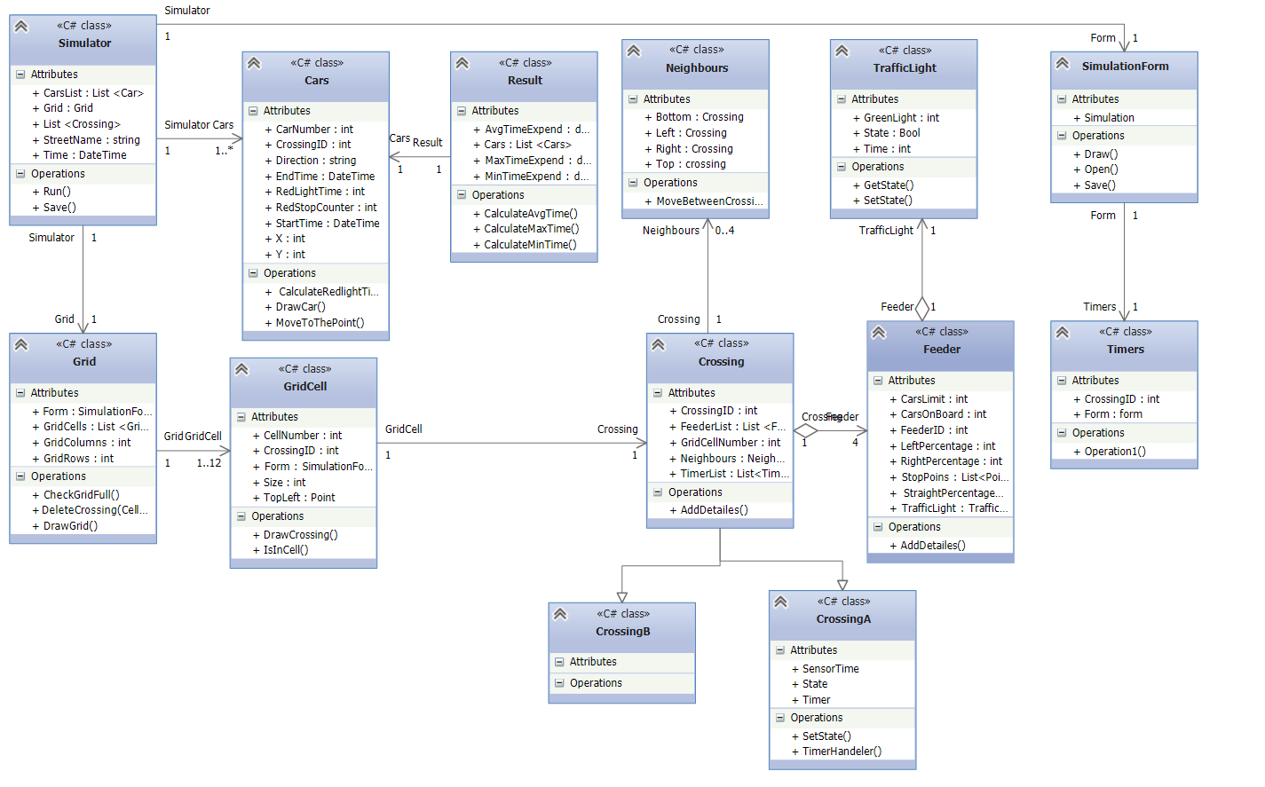
Step Three Developing
Strategy Pattern
Observer Pattern
Memento Pattern
Command Pattern
Abstract Factory Pattern
Decorator Pattern
….

Slide 6
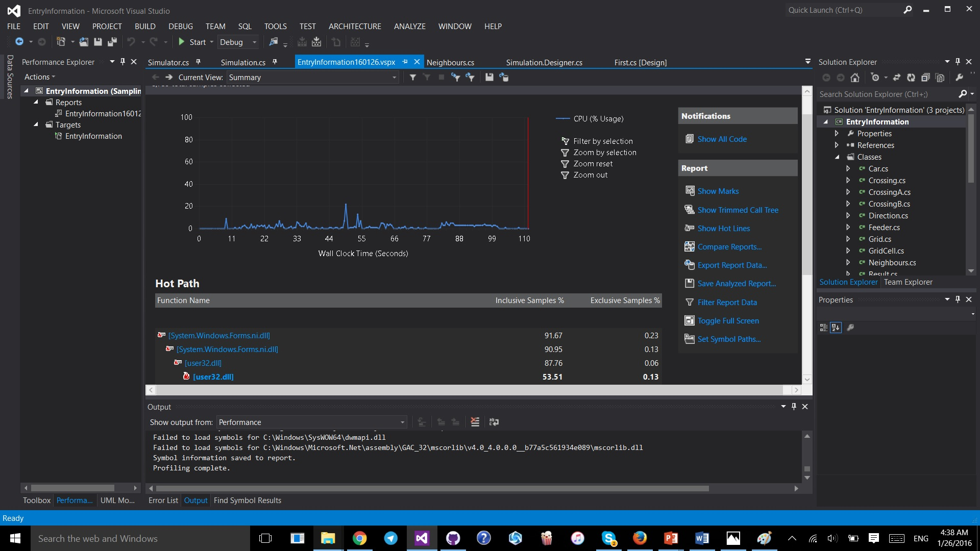
Step Four Testing

Slide 7

Question Time

