Slide 1



Dealing with a hacking incident and securing your website (understanding website security and best practices)
By: Phillip Yuan

Slide 2

Objective: an overview of website hacking incidents and the importance of security
Website hacking refers to unauthorized access to or manipulation of a website's data, code, or functionality by a cybercriminal or hacker. The goal of website hacking can vary, but it often involves exploiting vulnerabilities in the website's code, infrastructure, or user systems to steal data, deface the website, launch malicious attacks, or cause disruptions.
Why Website Security is Important for Businesses and Personal Websites
Protecting Sensitive Data:
Websites often store personal information like usernames, passwords, and payment details. If hacked, this data can be stolen and misused.
Maintaining Trust and Reputation:
If a website is hacked, customers might lose trust in the business, leading to loss of sales and a damaged reputation.
Legal Compliance:
Many industries have laws about protecting user data. A breach can result in legal fines and penalties.
Preventing Financial Loss:
Hacking can lead to direct financial losses through fraud, recovery costs, and lost revenue.
Stopping Malicious Attacks:
Hackers can use compromised websites to infect visitors with malware or steal data, causing further damage.

Slide 3
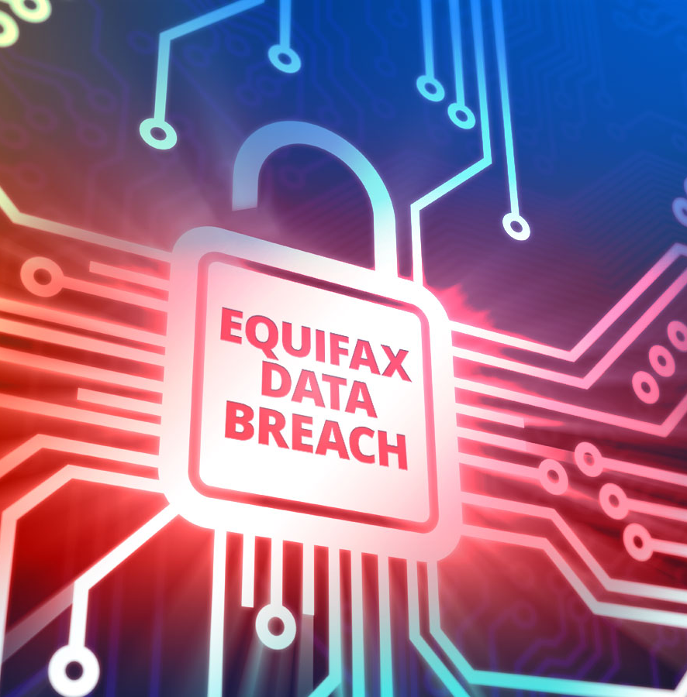
2017 Equifax Data Breach
Description:
In 2017, Equifax, one of the largest credit reporting agencies in the United States, was hacked due to a vulnerability in an Apache Struts software framework used on their website. This vulnerability had been discovered months earlier, but Equifax failed to apply the security patch that would have protected them. Hackers exploited this flaw to gain access to sensitive data stored on Equifax's servers.
Impact:
The breach compromised the personal data of approximately 147 million people. The stolen information included names, Social Security numbers, birthdates, addresses, and in some cases, driver’s license numbers. Additionally, about 209,000 consumers had their credit card information exposed, and another 182,000 had personal identifying information exposed.
Outcome:
As a result of the breach, Equifax faced widespread backlash, including lawsuits, regulatory fines, and a severe loss of consumer trust. The company had to pay around $700 million in settlements and penalties. They also faced a significant drop in their reputation, leading many customers to question the security of their personal data. Furthermore, Equifax had to offer free credit monitoring services to affected individuals and took steps to improve their security measures moving forward.

Slide 4
Types of website attacks
1. SQL Injection
What It Is:
Hackers exploit vulnerabilities in a website’s database by inserting malicious SQL code through input fields (such as login forms).
How It Works:
The attacker manipulates the input fields to gain unauthorized access to the website's database, allowing them to view, modify, or delete data.
Impact:
Stolen sensitive data, such as user credentials or financial information, or even complete control of the database.
2. Cross-Site Scripting (XSS)
What It Is:
Hackers inject malicious scripts into webpages that are then executed by unsuspecting users’ browsers.
How It Works:
The attacker adds malicious JavaScript, which is then executed when another user views the compromised page. This script can steal cookies, session tokens, or redirect users to malicious websites.
Impact:
Theft of user data, including login credentials, or spreading malware to other users.
3. DDoS Attacks (Distributed Denial of Service)
What It Is:
A DDoS attack floods a website's server with massive amounts of traffic, overwhelming its resources and causing it to become slow or completely unavailable.
How It Works:
The attacker uses multiple computers (often infected with malware) to send traffic to the target server, overwhelming it and making the website or service unavailable.
Impact:
Service disruptions, financial losses, and damage to reputation as users are unable to access the site.
4. Phishing
What It Is:
Hackers create fake websites or emails that look like legitimate ones to trick users into providing sensitive information.
How It Works:
A hacker sends a phishing email or creates a fake website that mimics a trusted source (like a bank or e-commerce site). Unsuspecting users enter their login credentials or financial information, which is then stolen by the attacker.
Impact:
Compromised user accounts, financial losses, and identity theft.

Slide 5

Consequences of hacking
1. Reputation Damage
Loss of Customer Trust:
Customers may stop trusting the business if their personal data is exposed, leading to loss of customers.
Negative Media Coverage:
News reports about the hack can damage the company’s image, making it harder to regain trust.
2. Financial Loss
Fines and Legal Fees:
The company could face fines for not protecting data properly and legal fees from lawsuits.
Cost of Recovery:
Recovering from a hack is expensive, including hiring experts and fixing security issues.
3. Data Breach
Stolen Personal Data:
Hackers can steal sensitive information like names, addresses, and Social Security numbers, leading to identity theft.
Stolen Financial Records:
If credit card or banking info is stolen, it can result in fraud.
Intellectual Property Theft:
Hackers can steal business secrets, hurting the company’s competitive edge.

Slide 6
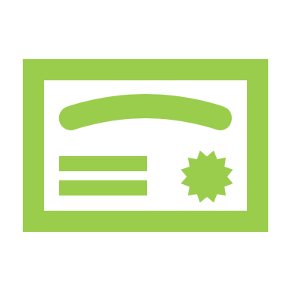
Website security best practices
1. Implement SSL Certificates
Why It’s Important:
SSL certificates encrypt data transferred between the website and users, ensuring sensitive information (like passwords and payment details) is protected.
How to Do It:
Make sure your website uses HTTPS instead of HTTP. This ensures secure communication and protects against data interception.
2. Regular Software Updates
Why It’s Important:
Software, plugins, and themes can have security flaws that hackers can exploit. Keeping them updated helps protect your website from known vulnerabilities.
How to Do It:
Regularly check for and install updates for your website's content management system (CMS), plugins, and themes.
3. Use Strong Passwords
Why It’s Important:
Weak passwords make it easier for hackers to gain unauthorized access to your website. Strong, unique passwords increase security.
How to Do It:
Use complex passwords with a mix of letters, numbers, and special characters. Enforce password policies and enable multi-factor authentication (MFA) for added protection.
4. Backup Regularly
Why It’s Important:
Regular backups ensure that if your website is hacked or experiences data loss, you can restore it to its previous state quickly.
How to Do It:
Set up automated backups for your website data, including files and databases, and store them securely off-site or in the cloud.

Slide 7
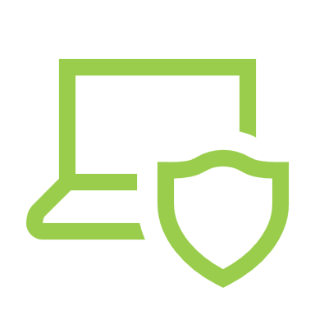
Using firewalls and anti-malware software
1. Web Application Firewalls (WAF)
Why It's Important:
A WAF helps block attacks like SQL injection and XSS by filtering malicious traffic before it reaches your website.
How to Use It:
Install a WAF (like Cloudflare or Sucuri) to protect your site from harmful requests.
2. Anti-Malware Tools
Why It's Important:
Malware can infect your website and steal data. Anti-malware tools help detect and remove these threats.
How to Use It:
Use tools like Malwarebytes or Wordfence to regularly scan and clean your website.

Slide 8

Monitoring and detection
1. Website Monitoring Tools
Why It's Important:
Monitoring tools help track your website's security and performance, alerting you to potential issues like malware or vulnerabilities.
How to Use It:
Set up tools like Google Search Console and Sucuri to monitor your website for security issues, such as malware or broken links, and receive alerts if anything suspicious is detected.
2. Log Analysis
Why It's Important:
Website logs record all activity on your site. Regularly reviewing them helps identify unusual patterns that could indicate a security breach.
How to Use It:
Periodically check server logs for signs of suspicious activity, such as unauthorized login attempts or unusual traffic patterns. Tools like Splunk or Loggly can help automate log analysis.

Slide 9
Having an incident response plan
Identify and Isolate the Breach:
Find out what’s compromised and disconnect affected systems to prevent further damage.
Notify Stakeholders and Customers:
Inform those affected, especially if their data is involved.
Change Passwords, Restore from Backups, and Patch Vulnerabilities:
Update passwords, restore from backups, and fix any weaknesses.
Work with Security Experts:
Get help from experts to investigate and prevent future breaches.
This plan helps minimize damage and restore your website quickly after a hack.

Slide 10
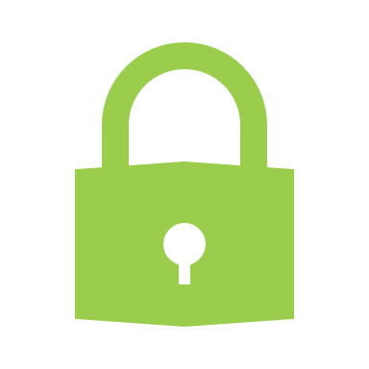
Conclusion
Website security is an ongoing process.
Proactive security measures are essential to prevent hacking.
Timely response and proper recovery are critical in the event of an attack.
Your website’s security is an investment in your reputation and business longevity.

