Slide 1

DRIFT: Distributed Real-time Inertial and Frame Tracking on Resource-Constrained ESP32 Hardware
Phillipp Gery, Vedant Patkar, Francisco Benitez, Jack Kester and Sam Pisciotta

Slide 2
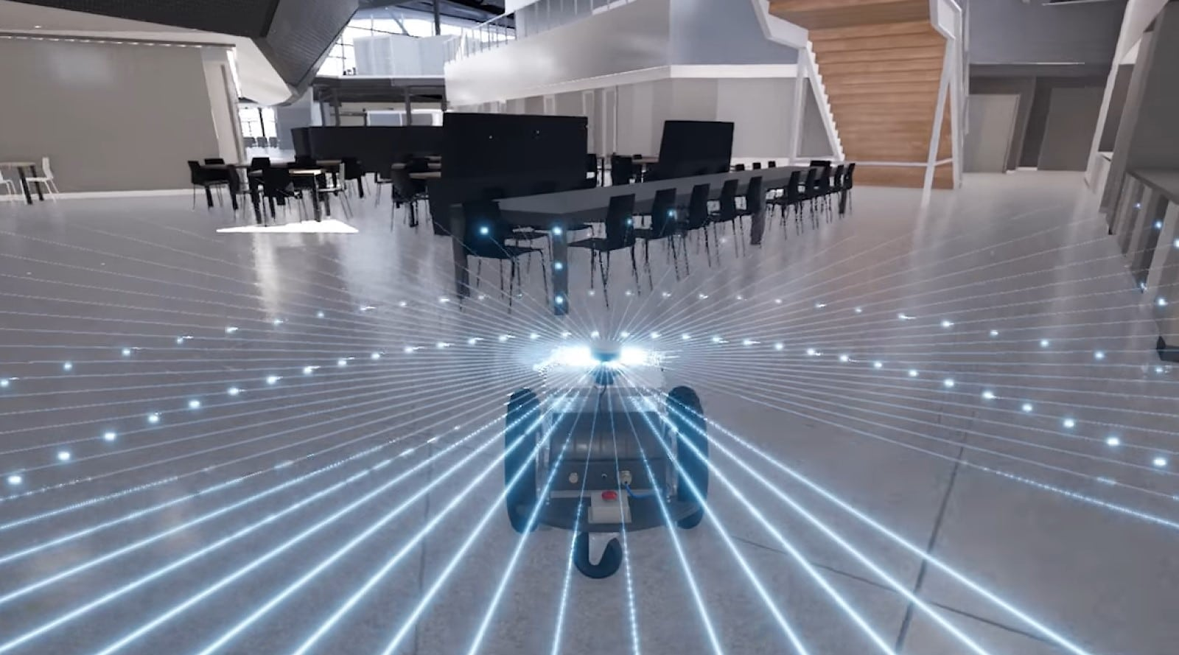
Localization Without GPS, Without a Real Computer
Indoor, underground, GPS-denied → robots need self contained pose estimation
State-of-the-art VIO (ORB-SLAM3, VINS-Mono) targets ARM Cortex-A / GPU
We target a ESP32-S3 — two orders of magnitude less compute
Why care? Inspection swarms, search-and-rescue, indoor wearables — all deploy at MCU scale

Slide 3
Hardware Constrains
Scale ambiguity: monocular vision can't recover metric scale alone
Compute wall: SVD, Essential matrices, RANSAC don't fit a 240 MHz dual core
Pure IMU dead-reckoning fails after a few seconds; pure vision fails on scale

Slide 4
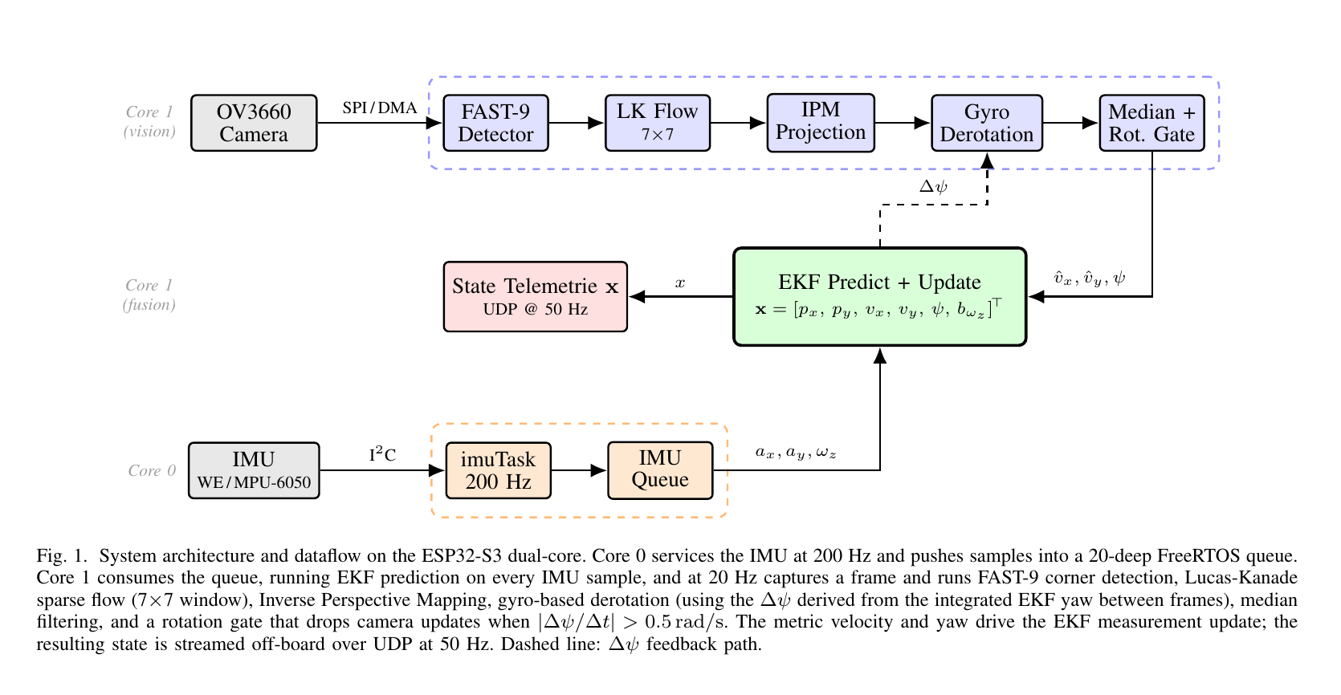
System Architecture

Slide 5
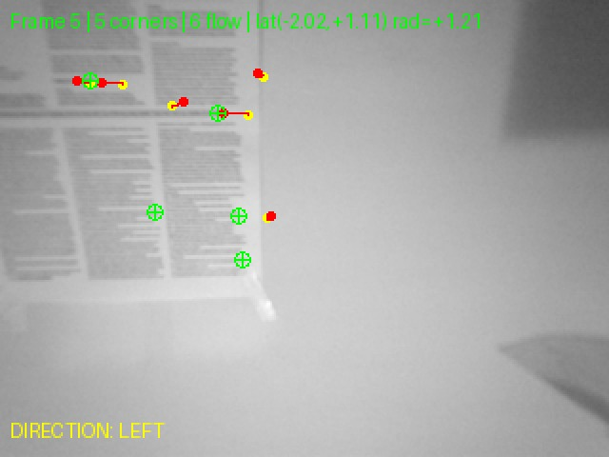
Optical Flow and Lucas-Kanade tracking
Fast 9 corner detection:
Finds good points to track by looking for sharp corners in each grayscale frame. It checks the pixels around each point, keeps the ones with strong brightness changes, quickly rejects weak points, and removes duplicate corners that are too close together.
Lucas-Kanade Optical Flow:
The method tracks each corner by comparing the previous and current frame. It looks at how the pixel brightness changes, estimates how far the corner moved, and rejects areas that are too flat or lack texture. The final result is a motion vector (dx, dy) for each corner, showing how much it moved between frames.
Example of optical flow
Outputs direction:
FORWARD / LEFT / RIGHT / BACKWARD / STATIONARY
Confidence value

Slide 6
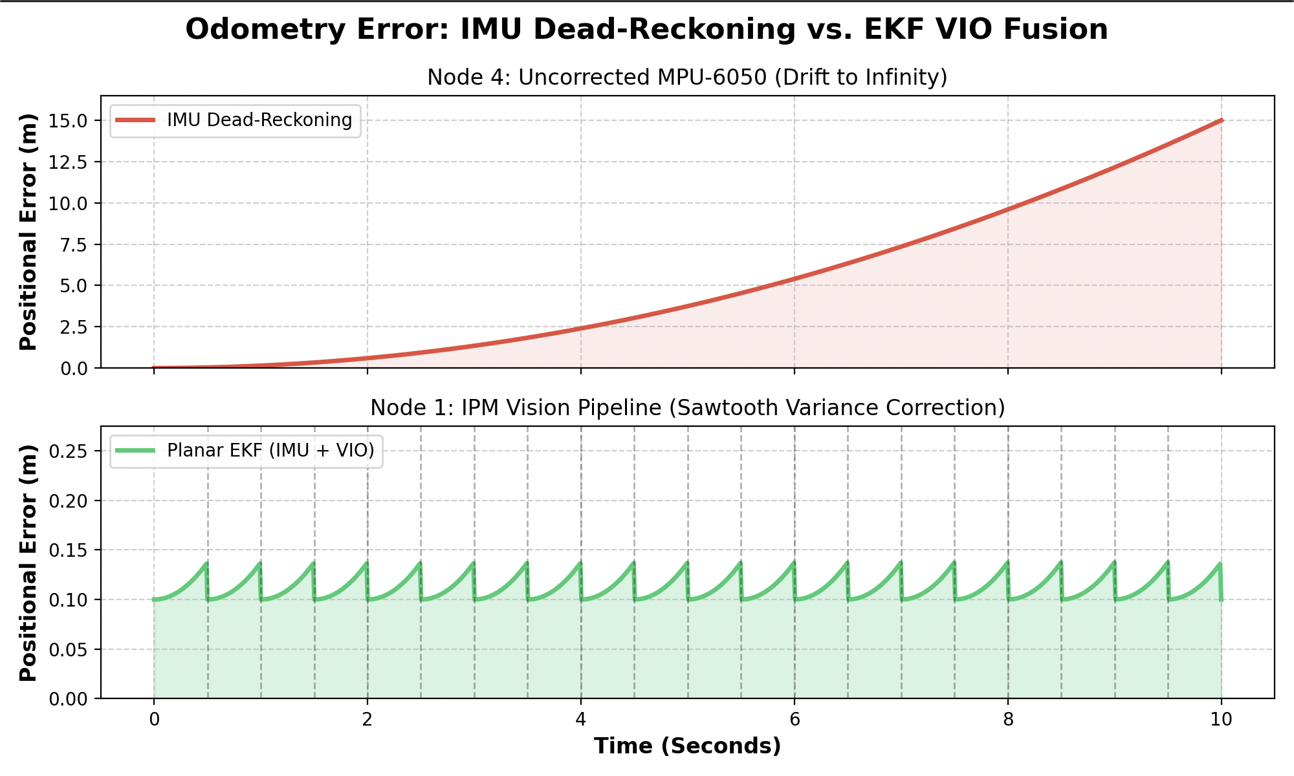
Extended Kalman Filter

Slide 7
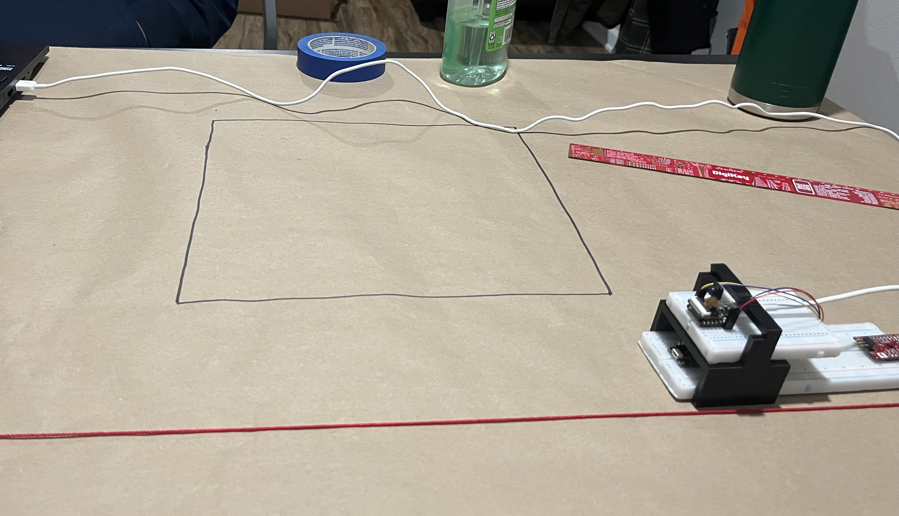
Experimental Setup
Four Different nodes:
Node 1 — WE ISDS + VIO. Industrial-grade Würth
Node 2 — MPU-6050 + VIO. Hobby-grade
Node 3 — WE ISDS only. IMU dead-reckoning.
Node 4 — MPU-6050 only. IMU dead-reckoning.
Five Scenarios:
Static, 10 s / Straight line, 2 m / Rectangle, 1.0 m ×0.5 m / Circle, 40 cm diameter / Free-form path

Slide 8
Demo

Slide 9
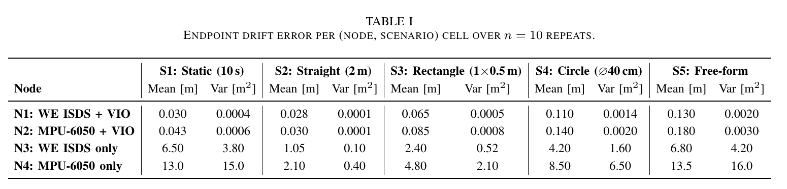
Results

Slide 10
Conclusion and Future Steps
Done:
✓ End-to-end VIO on basic MPU ESP32-S3
✓ IPM + gyro derotation + planar EKF
✓ Drift bounded on closed-loop trajectories where IMU-only diverges
Future Steps:
TinyML motion-class auxiliary channel (Edge Impulse) for adaptive filter tuning

Slide 11
Thank You

