Slide 1




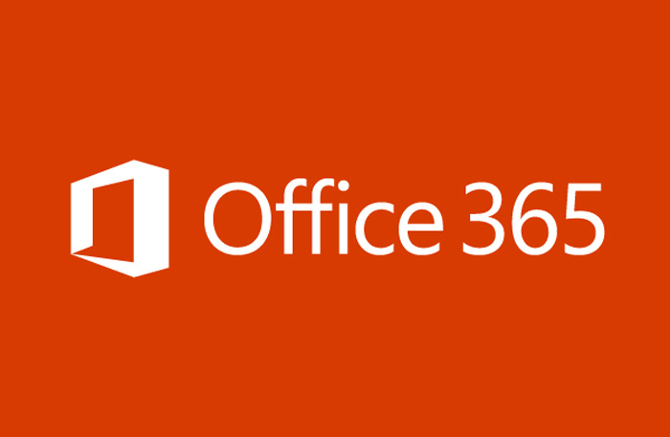

Are you Cloud Ready?
Take the Cloud Skills Challenge!
Learn the skills you need to compete in today’s cloud world.
Follow Microsoft learning paths designed by experts to get you cloud ready.
Complete web-based self paced exercises.
Earn points and compete with your peers to see who can climb to the top of the leaderboard.
Win prizes each month.
Details and Registration @ https://aka.ms/usocpcsc

Slide 2
Are your Partners Cloud Ready?
Invite Them to Take the Cloud Skills Challenge!

Slide 3
Are you Cloud Ready?
Take the Cloud Skills Challenge!

