Slide 1
OpenRefine and reconciliation
Intro & demo

Slide 2
OpenRefine
OpenRefine (previously Google Refine, until 2012) is an open-source desktop application for data cleanup and transformation to other formats.
Principal features:
  Explore Data.
  Clean and Transform Data.
  Reconcile and Match Data.
Desidered feature for us: Integration with Wikibase.
More info: https://openrefine.org/ and https://docs.openrefine.org/

Slide 3
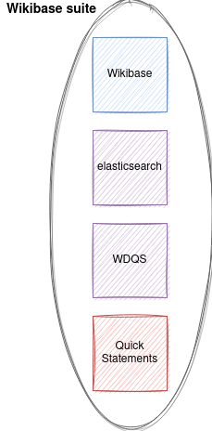
Wikibase environment

Slide 4
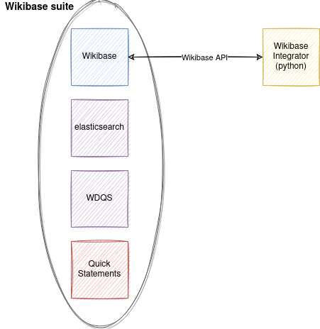
Wikibase using API

Slide 5
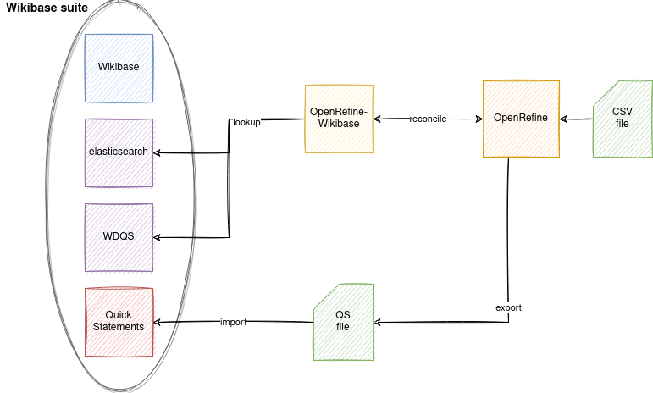
Wikibase with OpenRefine

Slide 6
Demo
Create OpenRefine environment from scratch.
Create a OpenRefine project with PhiloBiblon institutions.
Create a Wikibase schema and map a few columns.
Export result in a QS format file.
Import QS file using QuickStatements.

Slide 7
Requirements
Installed software:
  git
  docker
  docker-compose

Slide 8
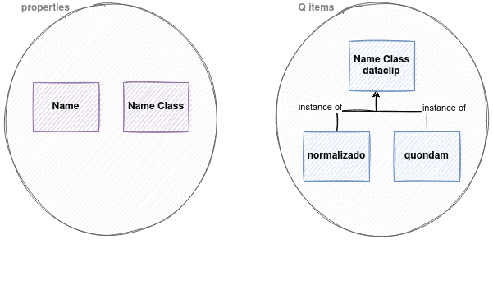
Demo properties and items

Slide 9
URLs
Local Philobiblon Wikibase sandbox: https://github.com/faulhaber/PhiloBiblon/tree/master/philobiblon-sandbox/local
OpenRefine docker image: https://github.com/opencultureconsulting/openrefine-docker

Slide 10
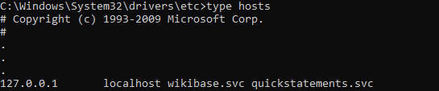
Bonus extra: QS login
QS requires Wikibase authorization to operate with the OAuth protocol.
In order to be authorized, OAuth must use the Wikibase and QS service name. Not the IP or localhost.
To map the service name to localhost, we need to modify the hosts file.
F.ex:

Slide 11
Thank you!

