Slide 1
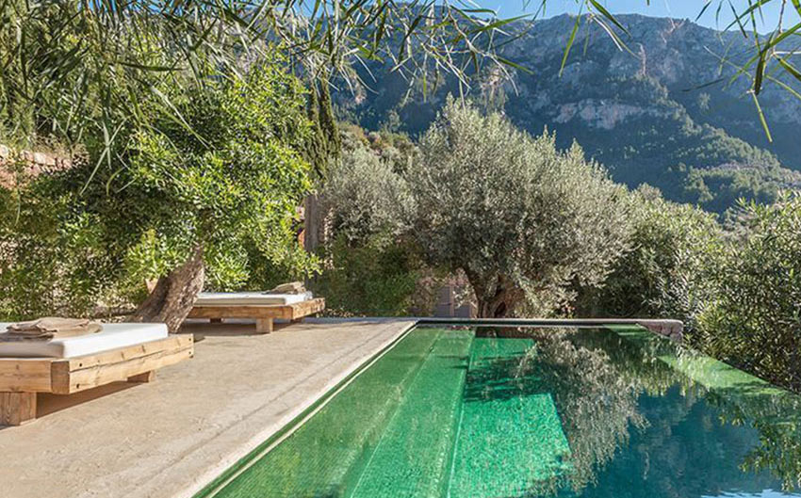

PCleaner
Robots can do it for you !
Daily care Swimming Pools
Just place PCleaner at the water and push the start button.
PCleaner
Notes:
To change this brochure, replace our sample content with your own. Or, if you'd rather start from a clean slate, press the New Slide button on the Home tab to insert a new page. Now enter your text and pictures in the empty placeholders. To change the logo to your own, select the picture “replace with LOGO” and choose Change Picture on the Picture Tools Format tab.
And did you notice we made fold marks for you? They are really light, but if you don’t like them showing on your brochure, select and delete them before you print.

Slide 2
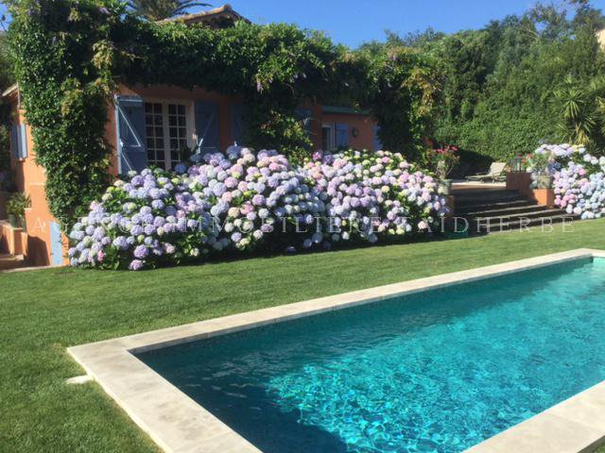
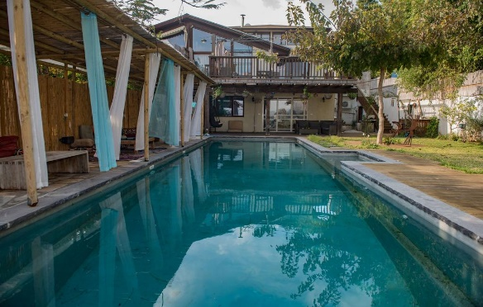
PCleaner is capable of comforting you from regular cleaning of your swimming pool !
Regular Clean pool in NO TIME !
Keeps you in your comfort zone and Effortless !
PCleaner can provide you daily care for your rectangular average sized pool best.
It’s also very efficient and consumes less time more than you can imagine.
If you clean your pool yourself, no need for that now. Just push the start button and it’s done!
“
Keeps you in your comfort zone and Effortless !
PCleaner is capable of comforting you from regular cleaning of your swimming pool !
If you usually ask some total stranger to come regularly to clean your pool surface, we can ask PCleaner to do it quickly for you.
If you clean your pool yourself, no need for that now. Just push the start button and it’s done!
Pcleaner lets you enjoy your own private pool even more !
Sanitized Pool all the time
Robots can do it for you !
Just place PCleaner at the water and push the start button.
PCleaner can provide you daily care for your rectangular average sized pool best PCleaner can provide you daily care for your rectangular average sized pool best.
Pcleaner can do it for you !
PCleaner can provide you daily care for your rectangular average sized pool best.
If you usually ask some total stranger to come regularly to clean your pool surface, we can ask PCleaner to do it quickly for you.
It’s also very efficient and consumes less time more than you can imagine.
Notes:
To change this brochure, replace our sample content with your own. Or, if you'd rather start from a clean slate, press the New Slide button on the Home tab to insert a new page. Now enter your text and pictures in the empty placeholders. To change the logo to your own, select the picture “replace with LOGO” and choose Change Picture on the Picture Tools Format tab.
And did you notice we made fold marks for you? They are really light, but if you don’t like them showing on your brochure, select and delete them before you print.

