Slide 1
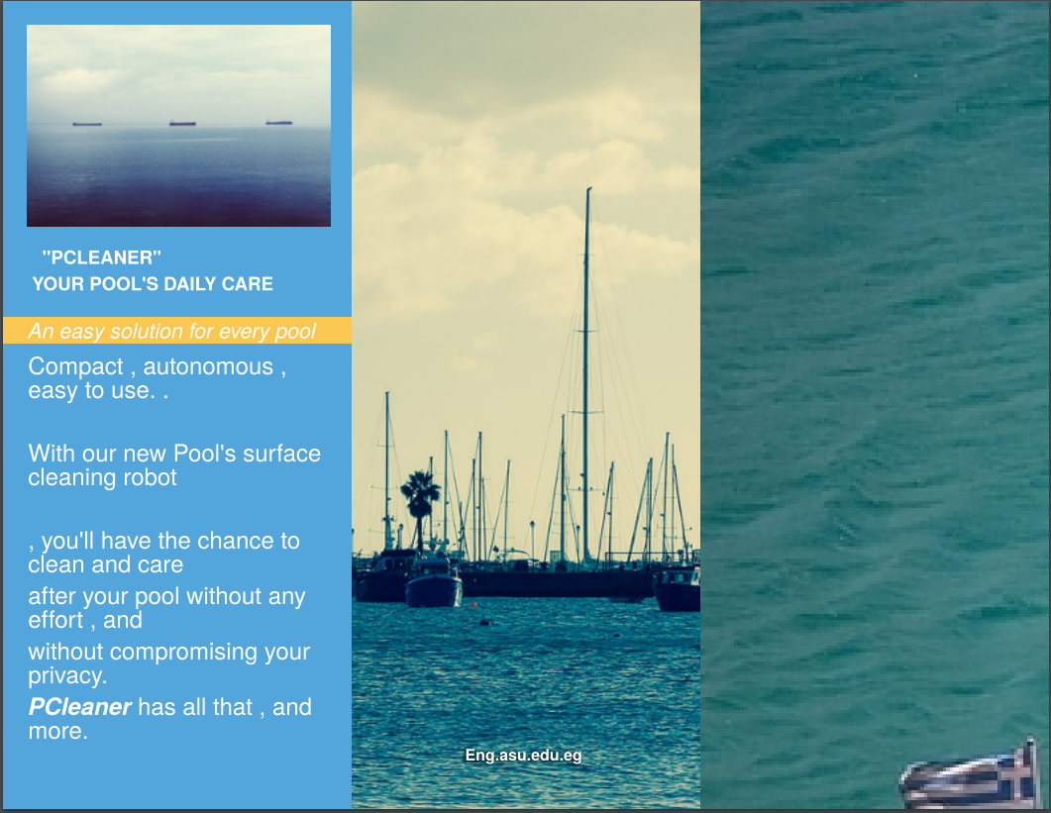
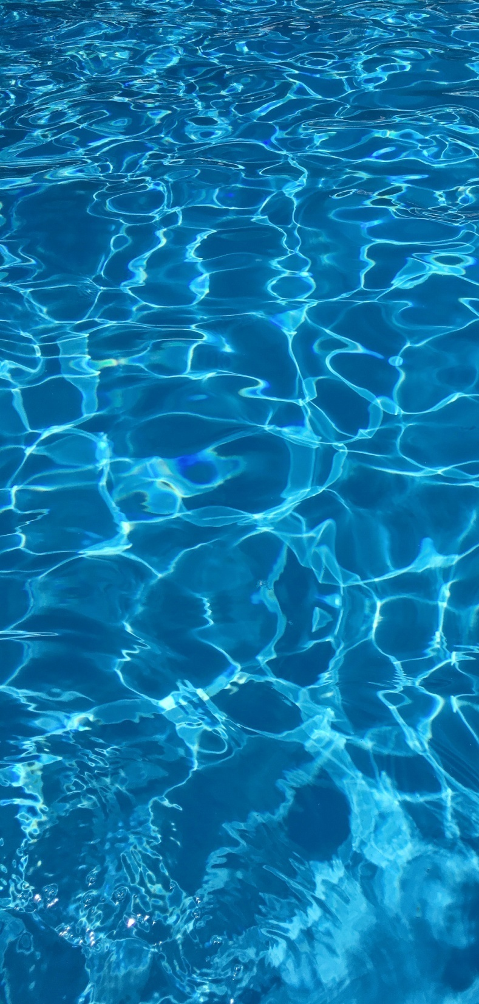
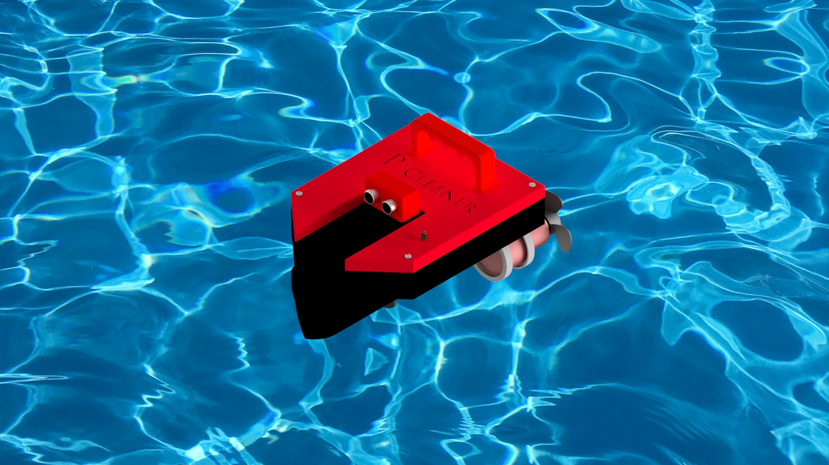
Our robot will clean your pool smoothly and easily , with a simple user interface , as simple as pressing just 1 button – on and off -.
It can float over the water’s surface and clean all the environmental contaminations over it.
With just 1 press of a button.
With more attributes to be added : like insecticides , Chlor for the water , water temprature sensor.
PCleaner
Starting at 200$

