Slide 1



Other System Engineering Activities
Zhenkun Wang (王振坤)

Slide 2
C1.2. Define Stakeholder Needs and Requirements (SNR)
Identify Major Stakeholders and Constraints
Elicit Business Needs
Scope System
Define Business Requirements
Finalize Business Needs and Requirements
Conceptual Design
C1. Define business
needs and requirements
C2. Define stakeholder
needs and requirements
Define Stakeholder Needs
Define Stakeholder Requirements
Finalize Stakeholder Needs and Requirements
C3. Define system requirements
C4. Conduct system-level synthesis
C5. Conduct System Design Review (SDR)
To Preliminary Design

Slide 3
C1.2. Define Stakeholder Needs and Requirements (SNR)
Identify Major Stakeholders
Identify Business and Project Constraints
Identify External Constraints
Identify Design Constraints
Identify Major Stakeholders and Constraints
Elicit Business Needs
Scope System
Define Business Requirements
Finalize Business Needs and Requirements
Define Mission, Goals, and Objectives
Define Preliminary Operational Scenarios
Define Preliminary Validation Criteria
Define Preliminary Life-cycle Concepts
Develop Context Diagram
Define System Boundary
Define External Interfaces
Feasibility Analysis
Business Requirements Specification (BRS)
Notes:
Example, ATM

Slide 4
C3. Define System Requirements
Identify Major Stakeholders and Constraints
Elicit Business Needs
Scope System
Define Business Requirements
Finalize Business Needs and Requirements
Conceptual Design
C1. Define business
needs and requirements
C2. Define stakeholder
needs and requirements
Define Stakeholder Needs
Define Stakeholder Requirements
Finalize Stakeholder Needs and Requirements
C3. Define system requirements
Establish Requirements Framework
Perform Requirements Analysis and Allocation
Draft System Requirement Specification (SyRS)
Conduct System Requirements Reviews (SRR)
C4. Conduct system-level synthesis
C5. Conduct System Design Review (SDR)
To Preliminary Design

Slide 5
C4. Conduct System-level Synthesis
Identify Major Stakeholders and Constraints
Elicit Business Needs
Scope System
Define Business Requirements
Finalize Business Needs and Requirements
Conceptual Design
C1. Define business
needs and requirements
C2. Define stakeholder
needs and requirements
Define Stakeholder Needs
Define Stakeholder Requirements
Finalize Stakeholder Needs and Requirements
C3. Define system requirements
Establish Requirements Framework
Perform Requirements Analysis and Allocation
Draft System Requirement Specification (SyRS)
Conduct System Requirements Reviews (SRR)
C4. Conduct system-level synthesis
C5. Conduct System Design Review (SDR)
Conduct System-level Synthesis
To Preliminary Design

Slide 6
C5. Conduct System Design Review (SDR)
Identify Major Stakeholders and Constraints
Elicit Business Needs
Scope System
Define Business Requirements
Finalize Business Needs and Requirements
Conceptual Design
C1. Define business
needs and requirements
C2. Define stakeholder
needs and requirements
Define Stakeholder Needs
Define Stakeholder Requirements
Finalize Stakeholder Needs and Requirements
C3. Define system requirements
Establish Requirements Framework
Perform Requirements Analysis and Allocation
Draft System Requirement Specification (SyRS)
Conduct System Requirements Reviews (SRR)
C4. Conduct system-level synthesis
C5. Conduct System Design Review (SDR)
Conduct System-level Synthesis
Conduct System Design Review (SDR)
To Preliminary Design

Slide 7
Agenda for today
Preliminary Design
Detailed Design
Construction and Production
Utilization Phase
Retirement
System Management
Project Management

Slide 8
Agenda for today
Preliminary Design
Detailed Design
Construction and Production
Utilization Phase
Retirement
System Management
Project Management

Slide 9
The starting point
We have obtained a system-level functional definition of the system
Various potential solutions are provided, and the most preferred solution is selected.
Preliminary Design continues to translate system-level requirements into design requirements for the elements (subsystems).
System-level
Subsystem-level
Functional design
Physical design
What
How

Slide 10
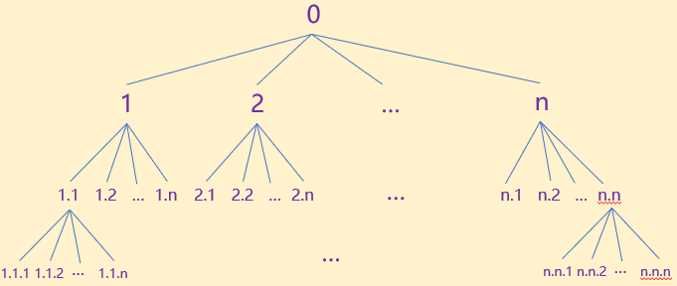
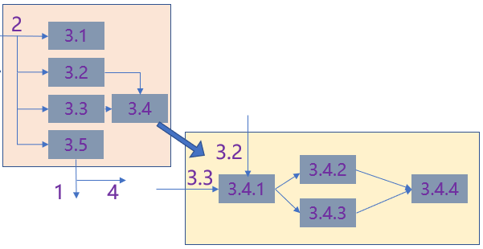
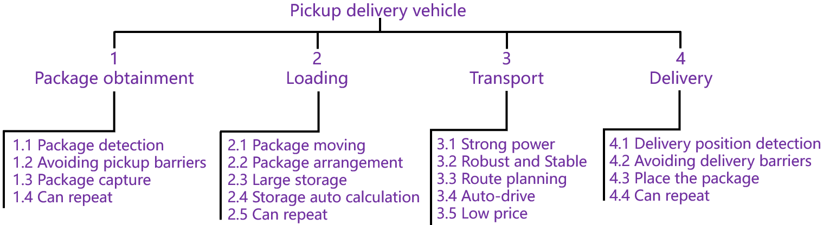
Preliminary Design
Elaborate (decomposed and derived) from the system level to the subsystem level and so on until all functions are defined.
Preliminary Design
Subsystem Requirements Analysis
Requirement Allocation
Interface Identification and Design
Subsystem-level Synthesis and Evaluation
Preliminary Design Review (PDR)
Detailed Design

Slide 11
Preliminary Design
Elaborate (decomposed and derived) from the system level to the subsystem level and so on until all functions are defined.
Preliminary Design
Subsystem Requirements Analysis
The requirement allocation here is based on a preliminary physical architecture formulated by the designers, rather than logical RBS headings.
Requirement Allocation
Interface Identification and Design
Subsystem-level Synthesis and Evaluation
Preliminary Design Review (PDR)
Detailed Design

Slide 12
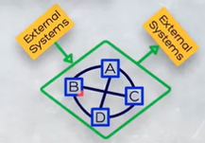
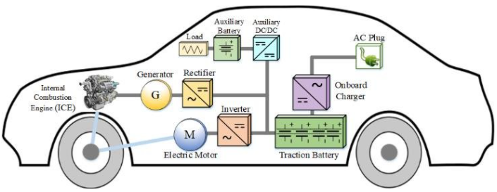
Preliminary Design
Elaborate (decomposed and derived) from the system level to the subsystem level and so on until all functions are defined.
Preliminary Design
Subsystem Requirements Analysis
The requirement allocation here is based on a preliminary physical architecture formulated by the designers, rather than logical RBS headings.
Requirement Allocation
The interfaces (e.g., physical, electrical, electronic, and software interfaces) between the elements should be identified. Additional requirements on the design of the elements may arisen.
Interface Identification and Design
Subsystem-level Synthesis and Evaluation
Preliminary Design Review (PDR)
Detailed Design

Slide 13
Preliminary Design
Elaborate (decomposed and derived) from the system level to the subsystem level and so on until all functions are defined.
Preliminary Design
Subsystem Requirements Analysis
The requirement allocation here is based on a preliminary physical architecture formulated by the designers, rather than logical RBS headings.
Requirement Allocation
The interfaces (e.g., physical, electrical, electronic, and software interfaces) between the elements should be identified. Additional requirements on the design of the elements may arisen.
Interface Identification and Design
Subsystem-level synthesis results in a Preliminary Design that meets the subsystem-level requirements. Three options are available.
Subsystem-level Synthesis and Evaluation
Preliminary Design Review (PDR)
Detailed Design

Slide 14
Subsystem options
Commercial-off-the-shelf (COTS)
Modified COTS
Developmental Items
readily available
risk may be reduced
maintenance and support
validated in the operation
more suitable
match the desired criteria precisely
All aspects are understood well
not be perfectly suitable
out-dated technology
constrained by ownership
limited documentation
Increase technical risk
take more time and cost
maintenance and support are voided
maintenance and support may be voided
take more time and cost

Slide 15
Subsystem optimization
Commercial-off-the-shelf (COTS)
Modified COTS
Developmental Items
readily available
risk may be reduced
maintenance and support
validated in the operation
more suitable
match the desired criteria precisely
All aspects are understood well
not be perfectly suitable
out-dated technology
constrained by ownership
limited documentation
Increase technical risk
take more time and cost
maintenance and support are voided
maintenance and support may be voided
take more time and cost
Iterate to make optimal use of all the design options in subsystem design

Slide 16
Preliminary Design
Elaborate (decomposed and derived) from the system level to the subsystem level and so on until all functions are defined.
Preliminary Design
Subsystem Requirements Analysis
The requirement allocation here is based on a preliminary physical architecture formulated by the designers, rather than logical RBS headings.
Requirement Allocation
The interfaces (e.g., physical, electrical, electronic, and software interfaces) between the elements should be identified. Additional requirements on the design of the elements may arisen.
Interface Identification and Design
Subsystem-level synthesis results in a Preliminary Design that meets the subsystem-level requirements. Three options are available.
Subsystem-level Synthesis and Evaluation
PDR assesses the solution in terms of technical risk and the satisfaction of the FBL, finalizes the preliminary design in the form of requirements specifications for each of subsystems.
Preliminary Design Review (PDR)
ABL
Detailed Design

Slide 17
Agenda for today
Preliminary Design
Detailed Design
Construction and Production
Utilization Phase
Retirement
System Management
Project Management

Slide 18
Detailed Design
The detailed design finalizes the design of specific components that make up subsystems, so that the solution is ready for construction and production.
define the lower-level components through specifications and design data;
procure the components, or modify them if needed, develop the unavailable components;
finalize the design of all interfaces necessary to support system integration;
integrate all the items for design verification, and system-level test and evaluation;
redesign and retest may be needed.
conduct the Critical Design Review (CDR) to form the Product Baseline (PBL).
Ensure that the items can be manufactured using available technology and resources;

Slide 19
Construction and Production
The production baseline has been established (and the production may have been proven using protype). We have
detailed design documents (e.g., drawings and software design documents);
detailed parts lists, materials specifications, and process specifications to explain how to produce and construct the system.
The system can move into Construction and Production.

Slide 20
Agenda for today
Preliminary Design
Detailed Design
Construction and Production
Utilization Phase
Retirement
System Management
Project Management

Slide 21
Construction and Production
Some system development aims to produce only one copy of the system (one-off system). The construction may blend with the detailed design and integration.
For example, building a large building, a prototype may be developed to support detailed design and integration.
This prototype may pass trough all the test and evaluation and be finished to provide to customer for acceptance.
Other system development may aim to produce many copies of the system.
A car is an example.
One or two prototypes may be used. Even a small batch of cars are produced as prototypes to support design verification and validation.

Slide 22
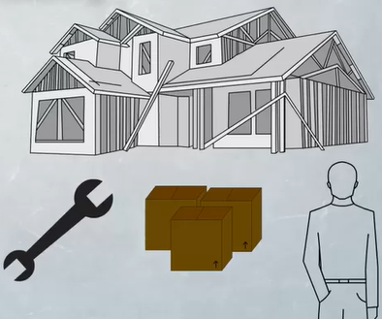
Construction and Production
Typical construction and production issues that need to be addressed and monitored:
availability of production tools and equipment;
material availability (lead times);
human resources;
availability of skill sets (including any training);
process control;
inspection and test.

Slide 23
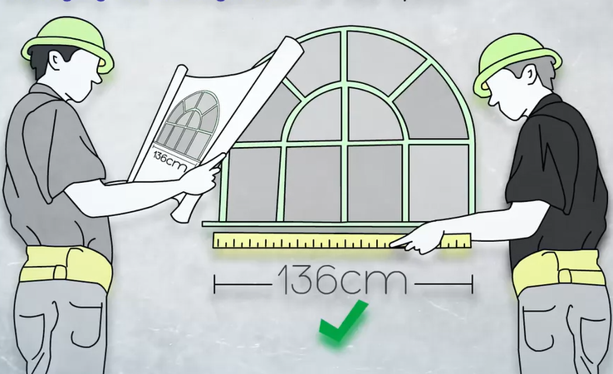
Construction and Production
During the production and construction stage, the system will be subjected to a number of important system management activities, including acceptance tests and configuration audits.
The acceptance tests aim at confirming the ability of the system to satisfy the original requirements.
The configuration audits are conducted to ensure that the system has been built in accordance with the approved specifications.
the functional configuration audit
the physical configuration audit

Slide 24
Agenda for today
Preliminary Design
Detailed Design
Construction and Production
Utilization Phase
Retirement
System Management
Project Management

Slide 25
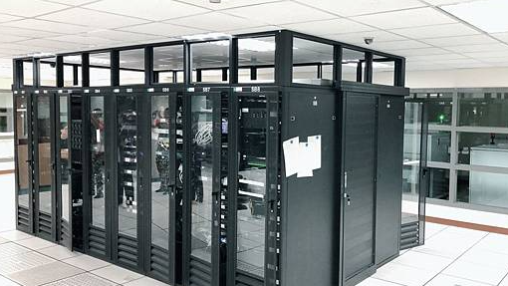
Utilization Phase
Once the system has passed the necessary testing and audits, it is ready to enter the Utilization Phase that includes operational use, maintenance and modifications.
Modifications may be needed to
address changes in requirements and environments
enhance supportability

Slide 26
Agenda for today
Preliminary Design
Detailed Design
Construction and Production
Utilization Phase
Retirement
System Management
Project Management

Slide 27
Retirement
Either the original need disappears or the system we have developed is no longer viable to operate and support. Retirement is required.
Potential disposal methods:
Sold as a second-hand item
Use in a different role
Destroy, scrap and recycle
Can be expensive because of things like hazardous materials, sensitive content, environmental constraints/laws.
Once a system is being disposed of, the life cycle of that system for that role has ended.

Slide 28
Agenda for today
Preliminary Design
Detailed Design
Construction and Production
Utilization Phase
Retirement
System Management
Project Management

Slide 29
System Management
System management is responsible for ensuring that the system delivers the expected outcomes without exposing parties to excessive risk.
Key system management issues include:
Verification and Validation
Managing the configuration of the system
Managing technical risk

Slide 30
Verification and validation
verify against the documentation produced during the design process
validate against the original needs, goals and objectives
built the system right (verify)
built the right system (validate)

Slide 31
Verification and validation
Developmental test and evaluation (DT&E): involves progressively checking the system as it passes through the design, development, production and delivery.
Acceptance test and evaluation (AT&E): aims to confirm that the built system meets specified requirements.
Operational test and evaluation (OT&E): is conducted for a period of time following acceptance of the system.

Slide 32
Configuration management
The configuration management is the act of controlling and managing the configuration items (physical or functional) that comprise the system. It is about maintaining version control of the established system.
The main aims of configuration management are to control changes to characteristics of selected system components; and to record and report on the change processing and implementation status.

Slide 33
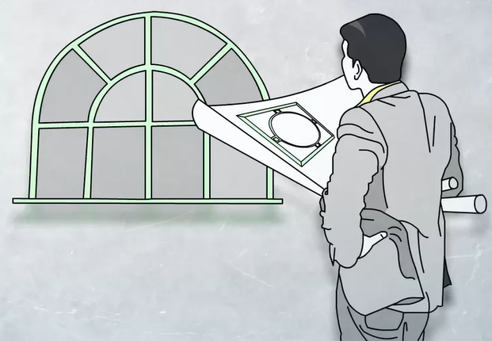
Configuration management
Different designs of windows could happen if changes have been made to the documents without involving all of the parties in the change process.

Slide 34
Configuration management
Managing the configuration of the system
We start by identifying what we are going to place under control.
We then establish and maintain an accurate picture of the configuration of all of those items
We also establish a means of formally considering change proposals to the configuration of those items. We ensure that changes to configuration items can be conducted in an effective, systematic, measurable, and documented change management process.
Configuration management also involves periodically auditing the process to make sure it’s working properly.
Check that everyone is using the agreed documentation in performing their work. Confirm that the material being used and the construction process being employed is in accordance with the design documentation.

Slide 35
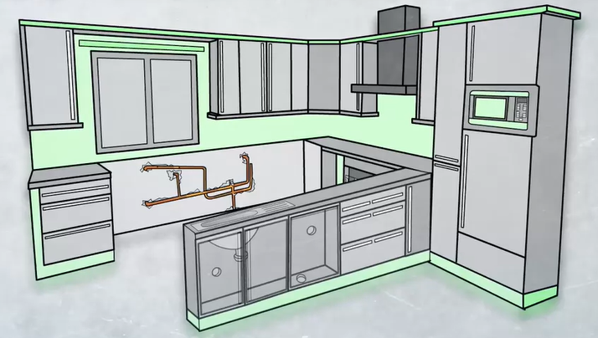
Configuration management
Changes without informed and agreed by all the involved parties would be a disaster.
The documentation should be updated in a timely manner and provided to all parties.

Slide 36
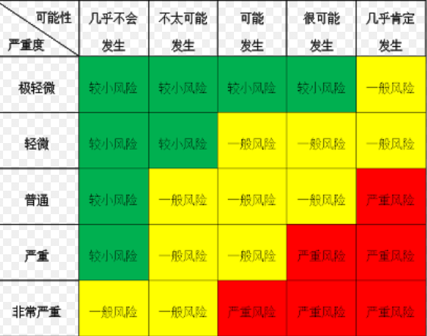
Risk Management
Risk is the chance of something happening that will impact on us achieving the objectives.
Risks are normally thought as a function of both likelihood of the risk and the impact it occur. Based on likelihood and impact, we determine severity.

Slide 37
Risk Management
Establish Criteria
Risk identification
Risk assessment
Risk treatment
Progressively Review
Different Scenario different criteria

Slide 38
Risk Treatment
Managing technical risk
The most severe risks need to be managed by
Avoiding them
Reducing them (likelihood and/or impact)
Transferring them
not to proceed with the activity that introduced the unacceptable risk, choosing an alternative more acceptable activity.
implementing a strategy that is designed to reduce the likelihood or consequence of the risk to an acceptable level.
implementing a strategy that shares or transfers the risk to another, such as outsourcing the management, developing contracts with insuring against the risk. The third-party accepting the risk should be aware of and agree to accept this obligation.

Slide 39
Progressively Review
Progressively reviewing the technical program
conduct reviews at logical points in the design and development process.
try to pick up problems, conflicts and errors in the design and development effort as early as possible.
The earlier we detect issues, the cheaper and easier they are to fix.

Slide 40
Agenda for today
Preliminary Design
Detailed Design
Construction and Production
Utilization Phase
Retirement
System Management
Project Management

Slide 41
Project Management
Time Management
Cost Management
Risk Management
Quality Management

Slide 42
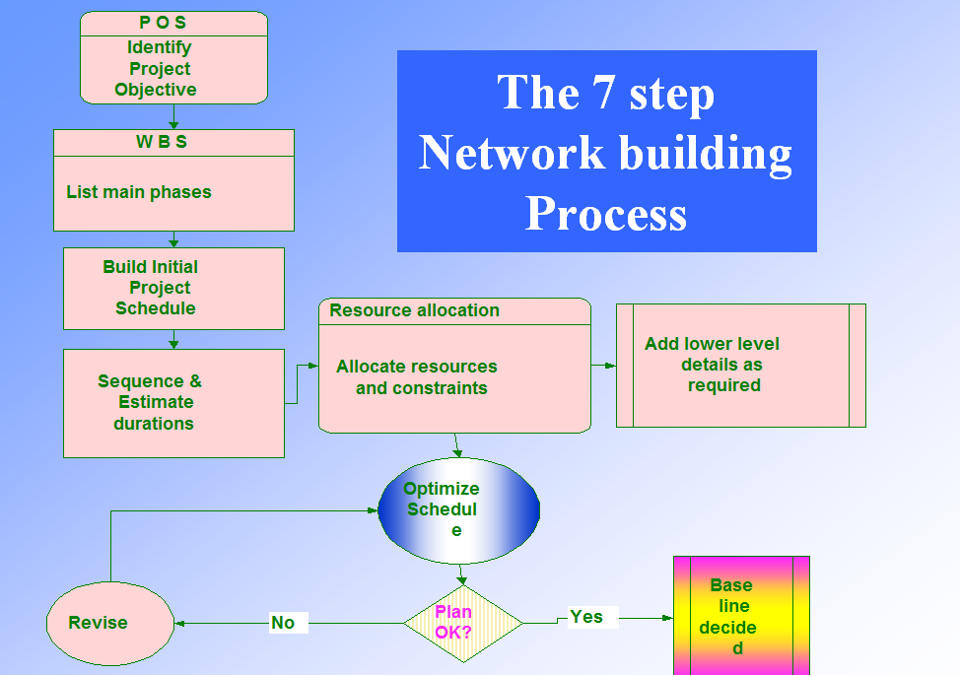
Time Management
Time Management ensures the timely completion of the project.
❑ Define Activities  Estimate Activity Durations  Develop Schedule  Control Schedule

Slide 43
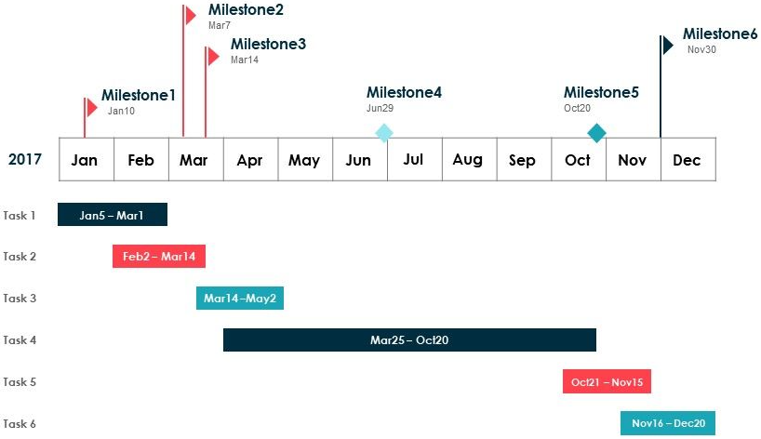
Time Management
Time Management ensures the timely completion of the project.
✓ Schedule once finalized is set as a baseline ✓ Progress of work are tracked against the baseline ✓ Analysis and forecasting is done in progress reports.

Slide 44
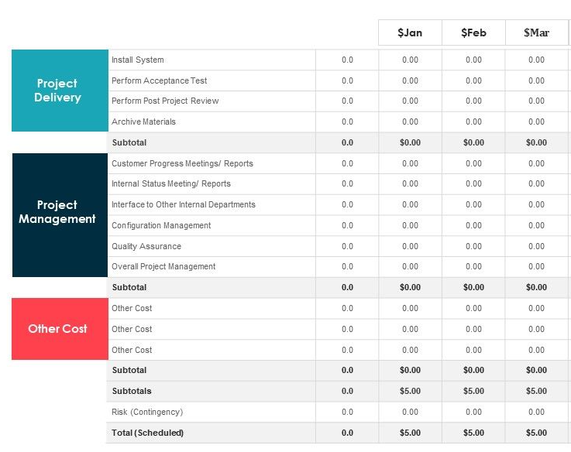
Cost Management
Cost Management includes the processes involved in estimating, budgeting, and controlling costs so that the project can be completed within the approved budget.
Estimate cost
Convert it into budget
Load the cost into schedule
Control cost

Slide 45
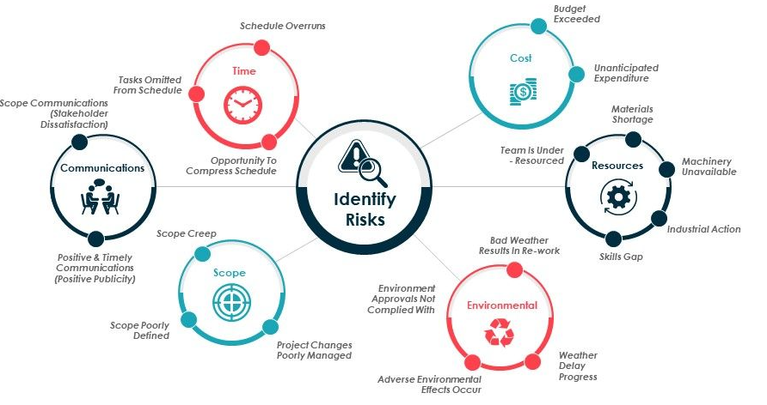
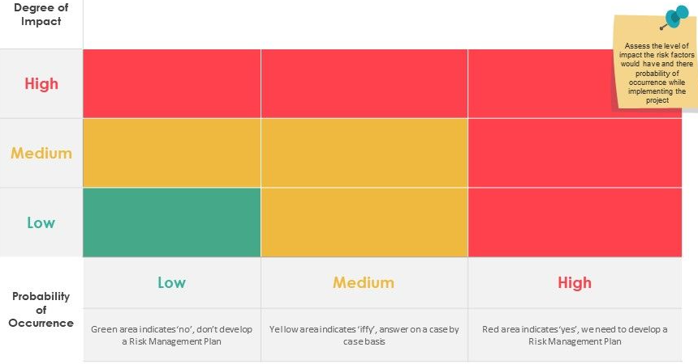
Risk Management
Risk Management is concerned with identifying, analyzing and responding to project risks.
Identify Risks Perform Risk Analysis Plan Risk responses Monitor and Control Risks

Slide 46
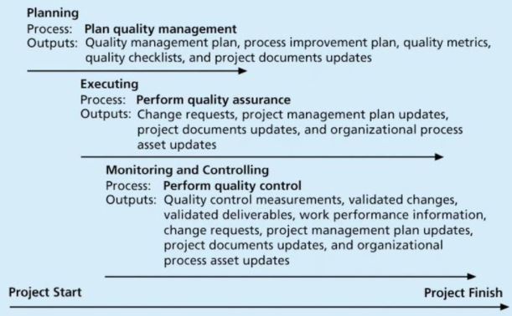
Quality Management
Project Quality Management ensures the project will satisfy NEEDS for which it was undertaken. The project’s processes and products meet written specifications.
Planning quality management: Identifying which quality standards are relevant to the project and how to satisfy them; a metric is a standard of measurement. Performing quality assurance: Periodically evaluating overall project performance to ensure the project will satisfy the relevant quality standards. Performing quality control: Monitoring specific project results to ensure that they comply with the relevant quality standards.

Slide 47
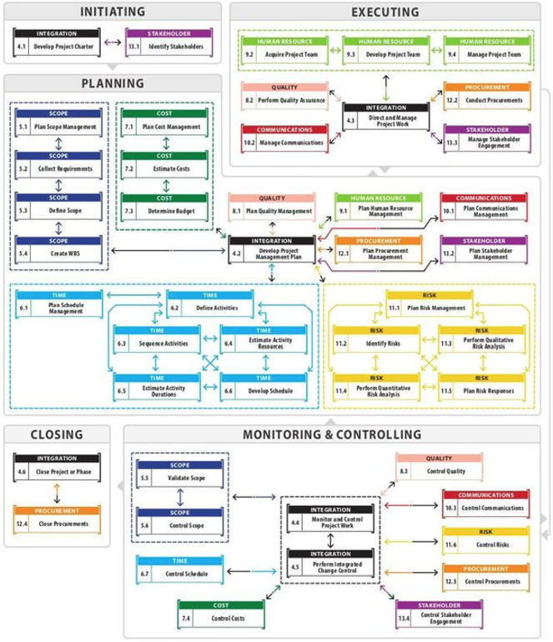
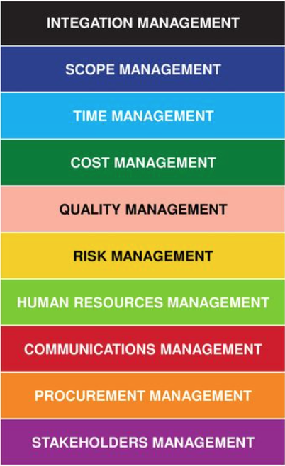
PM Knowledge Areas

Slide 48
Agenda for today
Preliminary Design
Detailed Design
Construction and Production
Utilization Phase
Retirement
System Management
Project Management

