Slide 1

Business Analytics: System development
Dimitrios Saltsoglidis,
Johannes Schmid and
Philip Eßwein

Slide 2
Agenda
Starting point
Program
Backend
Frontend & Demo
Monitoring tool & Demo
Lessons learned

Slide 3
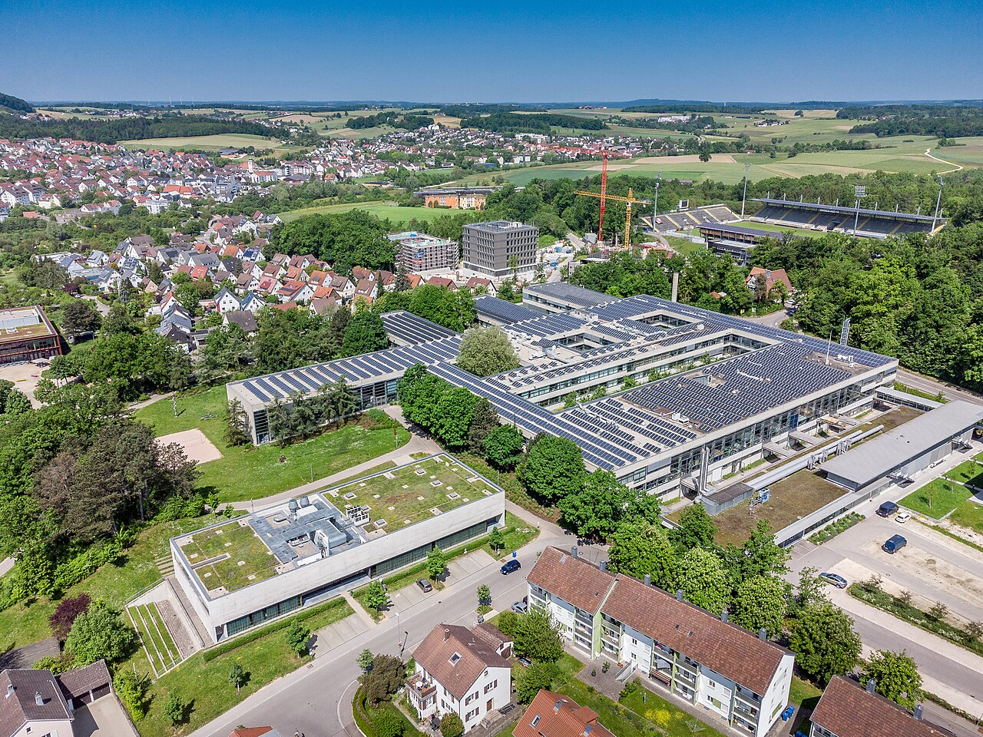
Starting point
Input student data
Input exam data
Input grade data
Monitoring Tool
https://de.wikipedia.org/wiki/Hochschule_Aalen#/media/Datei:HochschuleAalenHauptgebaeude.jpg

Slide 4
Backend
Python Backend & Data Storage
- PostgreSQL database as central data storage
- Management of students, exams, and grades
- Focus on correct data types and data integrity
Notes:
The goal of the backend was to create a stable and consistent data foundation for the entire project. A key focus was the conscious selection of data types to ensure valid and reliable data.

Slide 5
Database Structure
matno
grade
exam_date
pnr
firstname
title
student
has
exam
lastname
degree
date_of_birth
semester
Table 1 (students)
Table 2 (grades)
Table 3 (exams)
Notes:
The database is structured into three main tables. This separation helps avoid redundant data and ensures a clear relationship between students, exams, and grades.

Slide 6




Numeric Data Types
Grades stored as decimal
Decimal
Semester stored as integer
Integer
Normal textfields for anything
Text field
VARCHAR for course of study
VARCHAR
Notes:
On this slide, I want to explain why we carefully selected different data types for our database fields.
Grades are stored as decimal values, because in academic grading systems grades are not always whole numbers. For example, values like 1.3 or 2.7 must be stored precisely. Using a decimal data type avoids rounding errors and ensures accurate calculations.
The semester is stored as an integer, since it always represents a whole number. Allowing decimal values would not make sense in this context and could lead to invalid data.
For general textual information, such as names, we use standard text fields. These are flexible and well-suited for free-form input where no strict length limitation is required.
However, for fields like the course of study, we use VARCHAR with a defined length. This allows us to control the maximum input size, prevent unrealistic entries, and ensure consistent data quality across the database.
Overall, choosing the correct data types helps us maintain data integrity and reduces the risk of invalid or inconsistent data.

Slide 7


Tabs vs multiple windows
Multiple windows
Tabs
Navigation
Tab 1
Tab 2
Tab 3
Tab 1
Tab 2
Tab 3
Application Tab 1
Application
window 1
Application
window 2
Application
window 3
Easy to follow
One window for all processes
Additional window (UX-friction)
Initial window is not always the desired one

Slide 8
Frontend (Tabs)
matno
grade
exam_date
pnr
firstname
title
student
has
exam
lastname
degree
date_of_birth
semester
Tab 1 (students)
Tab 2 (grades)
Tab 3 (exams)

Slide 9
Frontend (UX design)
Version 1
Version 2
Create
Update/ delete
Create
Treelist (e.g. grades)
Treelist (e.g. grades)
Update/ delete

Slide 10
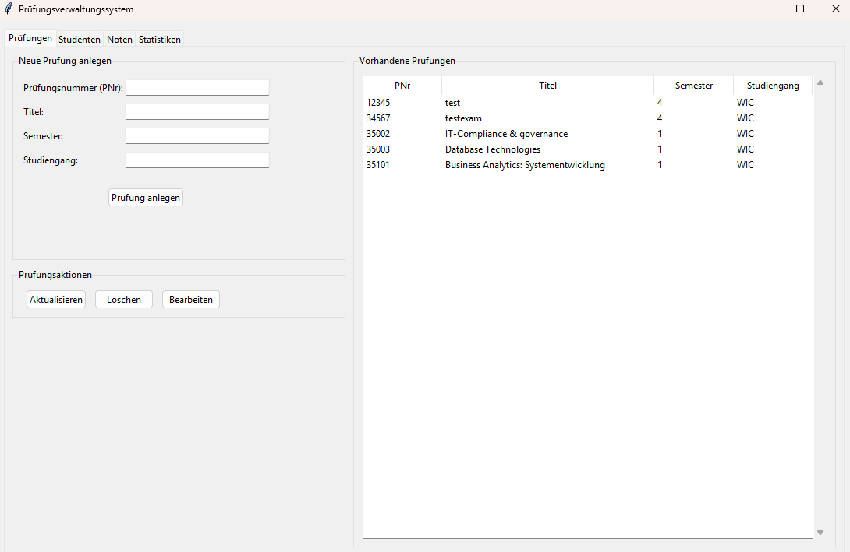
Demo

Slide 11
User roles
Student service
Exam office
lecturer
Input student
Input exam
Input grade

Slide 12

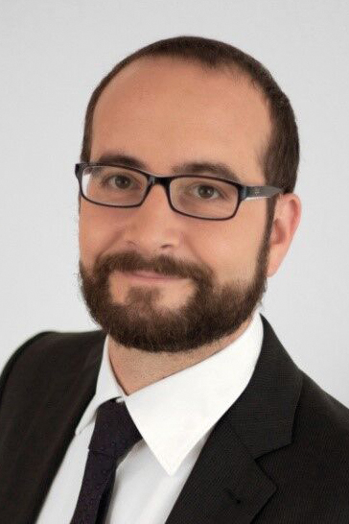
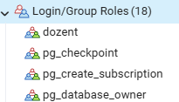

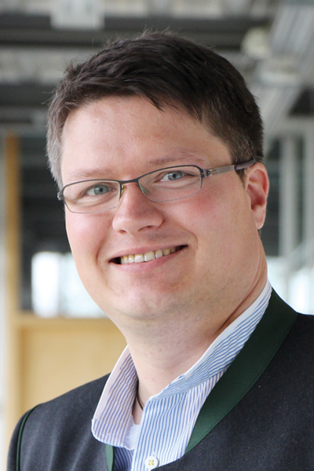
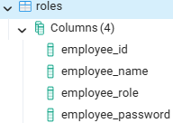

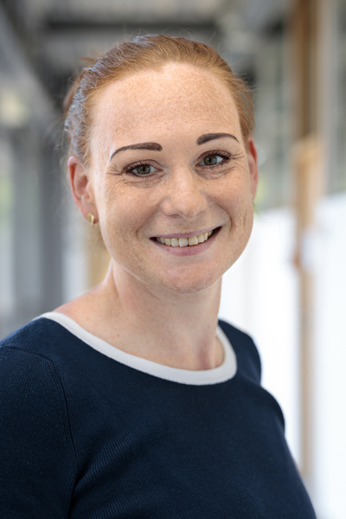
User roles
USER
Prof. Dr. Fernandes
role
(professor)
USER
Kai Elser
role
(admin_exam)
USER
Britta Seitz
role
(admin_student)

Slide 13
Folder Structure
shinyApp
global.R
server.R
ui.R
Shared Initialization and Data
Logic and Reactivity
User Interface

Slide 14
global.R
Executed once when the app starts
Global initialization for all users
Loads required R packages
shiny, DBI, Rpostgres, ggplot2
Establishes a central PostgreSQL database connection
global.R
Packages & DB-connection
ui.R
Interface
server.R
Logic

Slide 15
server.R
Processes user inputs from the UI
Executes dynamic SQL queries
Renders tables and plots
Creates a separate server session for each user
Closes the database connection when the session ends
global.R
Packages & DB-connection
ui.R
Interface
server.R
Logic

Slide 16
ui.R
Defines the complete user interface of the Shiny app
Contains title, layout, and visual structure
Filter bar with dropdowns for student and exam selection
Tab navigation: Student, Exam, Statistics
Defines output placeholders (tableOutput, plotOutput, textOutput)
Contains no calculations and no database logic
global.R
Packages & DB-connection
ui.R
Interface
server.R
Logic

Slide 17



Lessons learned
Fixing a Database in retrospective is always harder – think thrice, act once
Designing the application before programming it minimizes coding time
Continuous team communication is key for a good backend-frontend relationship

Slide 18
Thank you for listening!
Feel free to ask questions!

