Slide 1
Report by Philip
June 29, 2021
Final Report – The Battle of Neighborhoods
Finding a Better Place in Downtown Toronto, Toronto
1) Introduction:
The goal of this project is to assist people in discovering better amenities in their area. It will assist individuals in making informed and efficient decisions on which great neighbourhood to choose from among the many in Downtown Toronto, Toronto.
Many individuals are travelling to different parts of Canada, and they need to do a lot of research to find affordable housing and a place which is closer to their workplace. This project is for folks who want to live in a more desirable neighbourhood and near to IT companies. For easy access to cafes, schools, supermarkets, medical and food stores, malls, theatres, hospitals, and like-minded people, among other things.
This project aims to produce a feature analysis for people migrating to Downtown Toronto in order to find the best area by comparing communities. The features include median housing price and proximity to a nearby workplace based on ratings, local crime rates, road connectivity, weather conditions, emergency management, water resources (both fresh and waste water), sewage sys- tems, and recreational amenities.
It will assist people in becoming familiar with the area and community before relocating to a new city, state, nation, or location for job or to begin a new life.
2) Data and API:
Link: https://en.wikipedia.org/wiki/List_of_postal_codes_of_Canada:_M
We’re going to use the Downtown Toronto dataset, which we scraped from Wikipedia in Week 3. Latitude and longitude, as well as zip codes, make up this dataset.
We’ll require information on various venues throughout that borough’s various neighbourhoods. We’ll use “Foursquare” locational information to get that information. Foursquare is a location data provider that provides information about a variety of locations and activities in a given area. Names of venues, their locations, menus, and even images are examples of this type of informa- tion. As a result, the foursquare location platform will serve as the single data source, as the API provides access to all of the essential data.
We next connect to the Foursquare API to obtain information about venues inside each neighbour- hood after finding the list of neighbourhoods. The radius for each neighbourhood has been set at

Slide 2
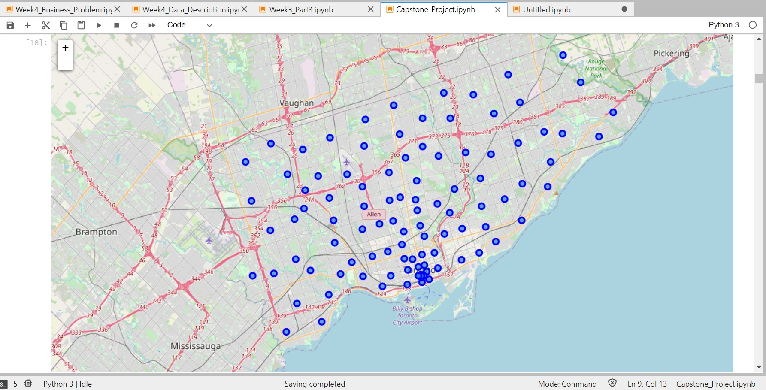
100 metres.
The Foursquare data comprised information on venues within a certain distance of the postcodes’ longitude and latitude. The following is the information received for each venue:
Name of the venue e.g. the name of a store or restaurant 2.Neighborhood
3.Neighborhood Latitude 4.Neighborhood Longitude 5.Venue
6.Venue Category 7.Venue Latitude 8.Venue Longitude
1.1.3 Map of Downtown Toronto
1.1.4 3) Methodology
Clustering approach To examine the similarities of two cities, we opted to look for similar neigh- bourhoods in big cities like New York and Toronto by exploring neighbourhoods, segmenting them, and grouping them into clusters. To do so, we must cluster data using the k-means cluster- ing algorithm, which is a type of unsupervised machine learning.

Slide 3
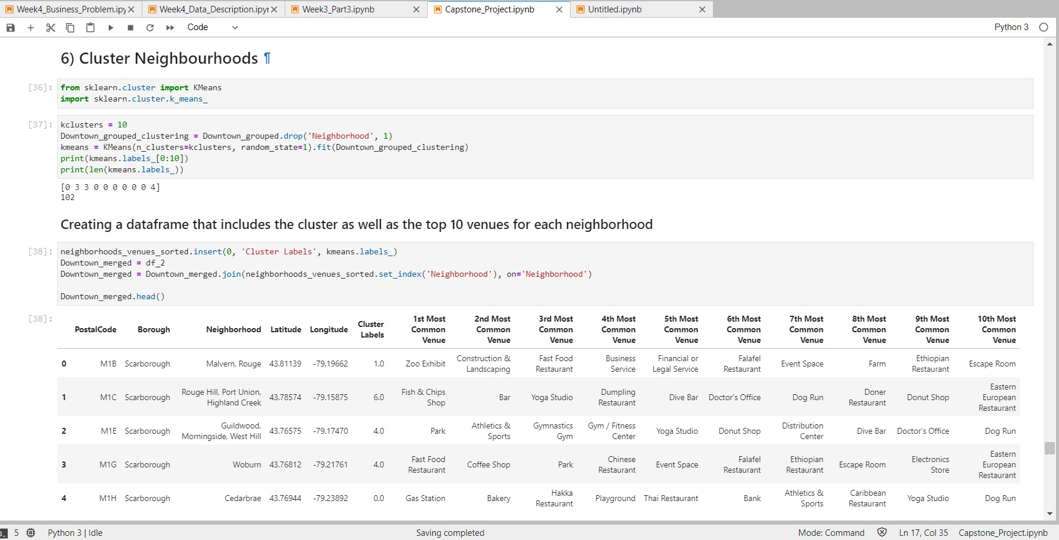
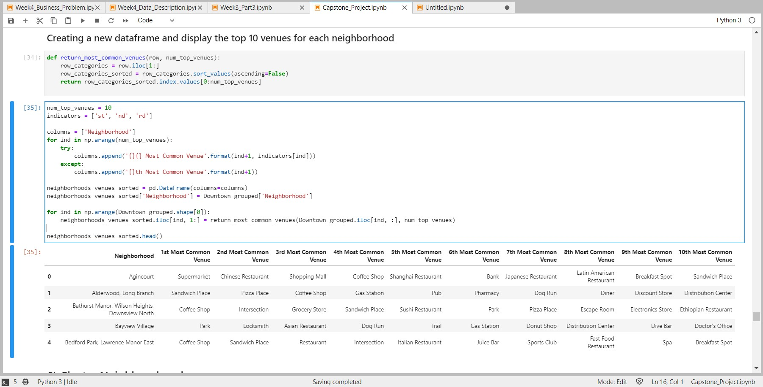
1.2 K-Means Clustering
1.3 Most Common venues near Neighborhood
Workflow The attributes of nearby sites in the neighbourhoods would be mined using Foursquare API credentials. Due to http request constraints, the radius parameter should be ad- justed to 500 and the number of places per neighbourhood parameter should be set to 100.

Slide 4
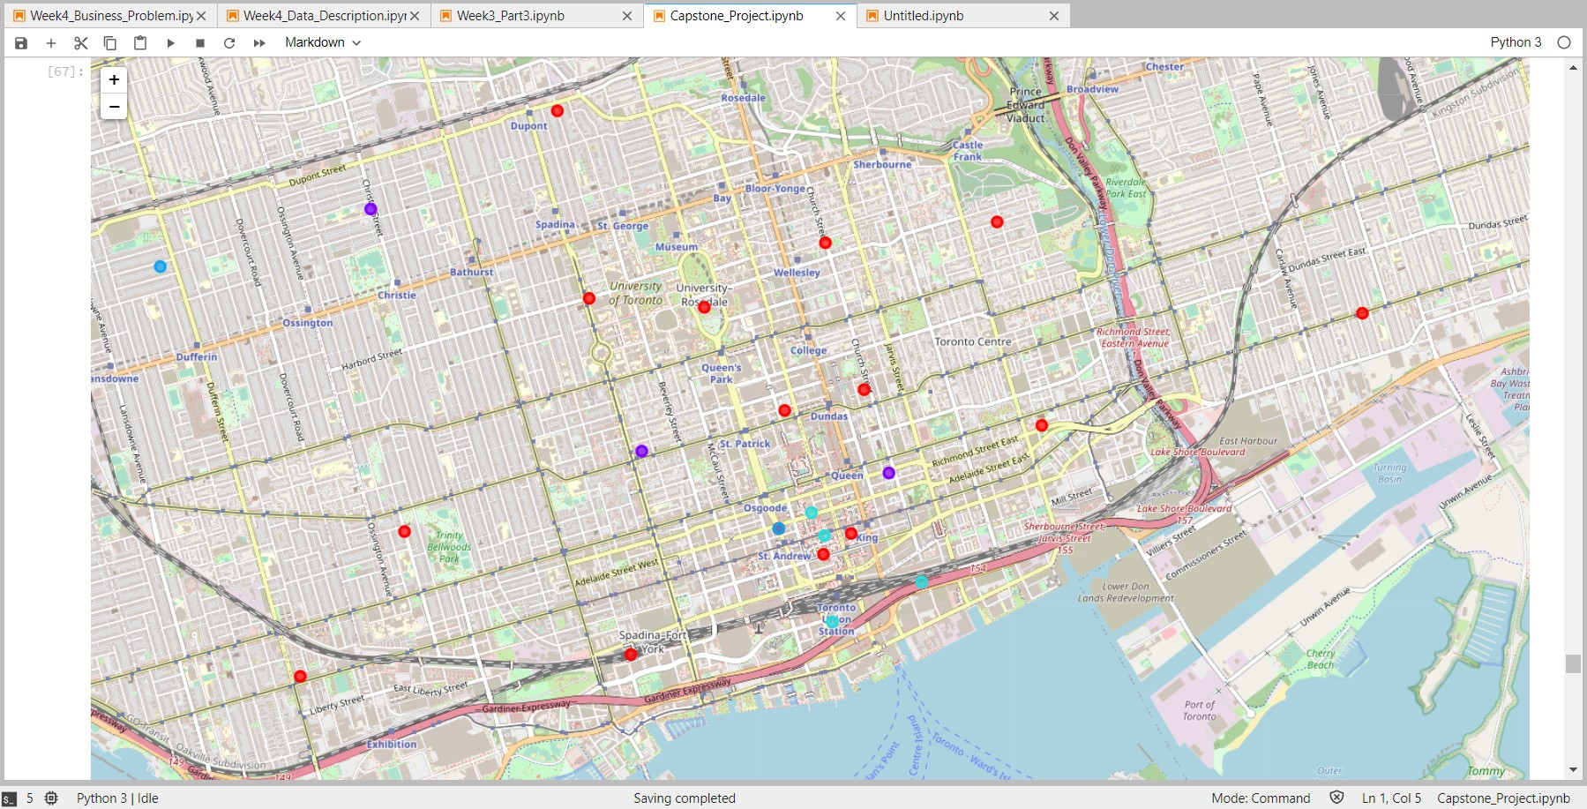
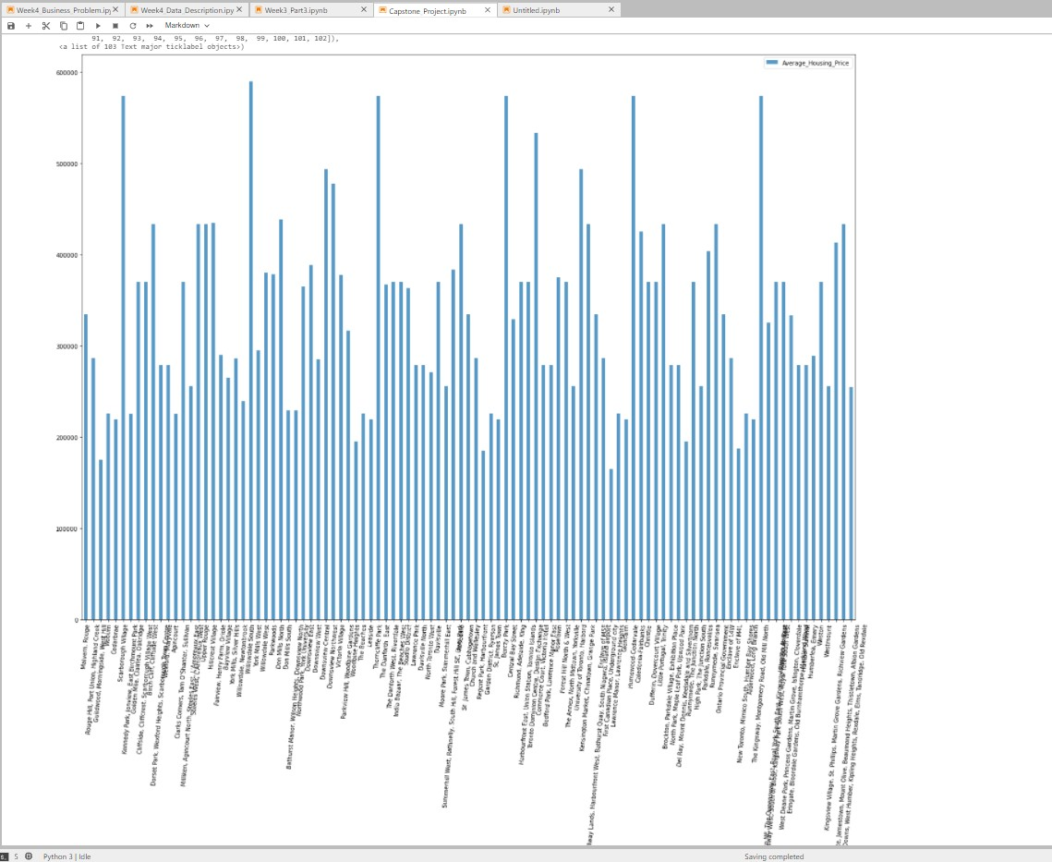
1.3.1 4) Results
1.4 Map of clusters in Downtown Toronto
1.5 Average Housing Price by Clusters in Downtown Toronto

Slide 5
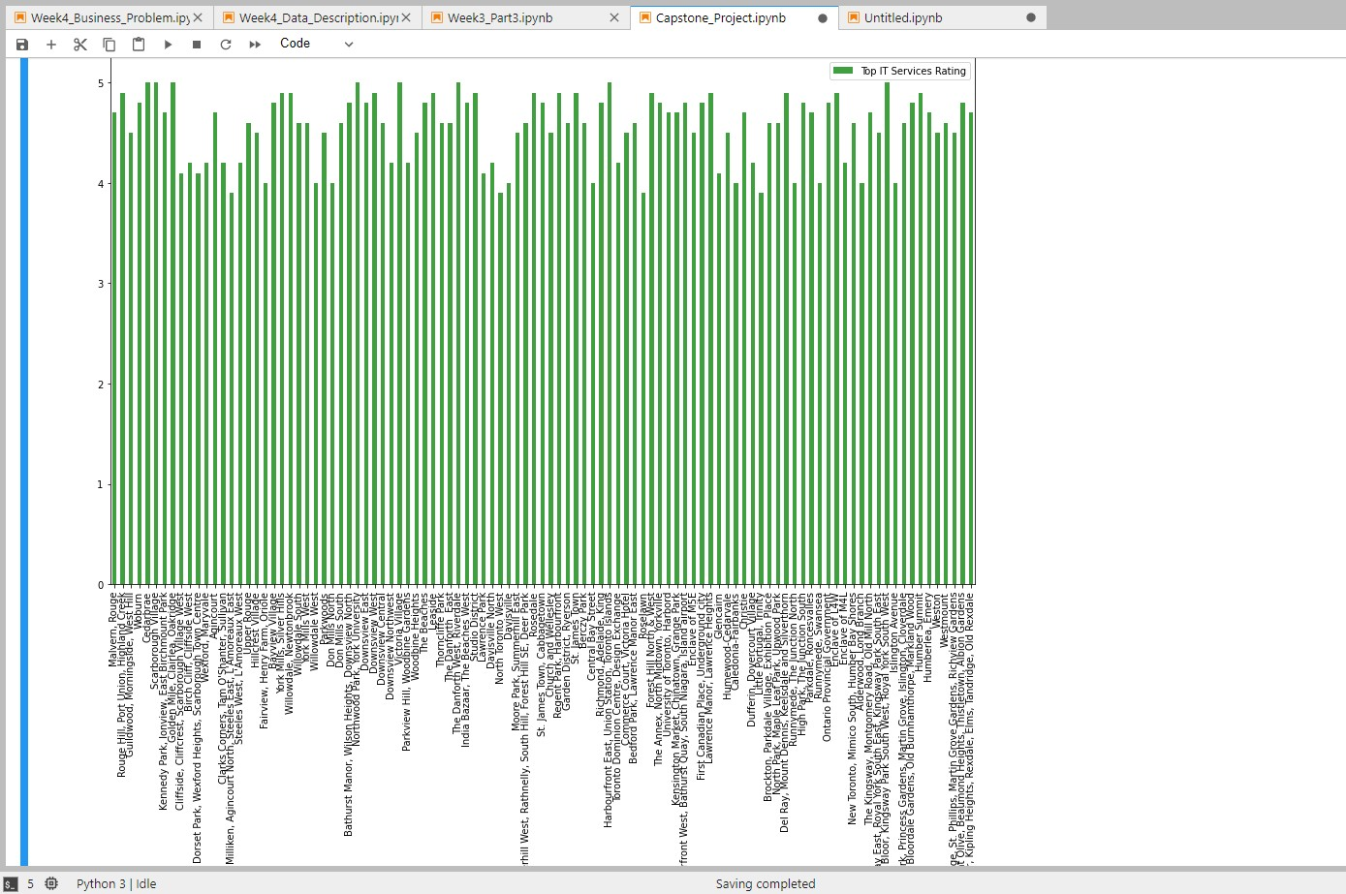
1.6 IT Companies Ratings by Clusters in Downtown Toronto
Location Downtown Toronto is the main central business district of Toronto, Ontario, Canada. It is also the home of the municipal government of Toronto and the Government of Ontario. The area is made up of Canada’s largest concentration of skyscrapers and businesses that form Toronto’s skyline.
Foursquare API This project would use the Four-square API as its primary data source because it contains a database of millions of locations, particularly their places API, which allows users to search for, share, and learn about businesses.
5) Discussion
The primary goal of this project is to recommend a better neighbourhood in a new city to those who are relocating there. Access to the airport, bus station, town centre, markets, and other neces- sities in the area.
Sorted list of houses in ascending or descending order by housing prices.
A list of IT Services that has been sorted by location, fees, rating, and reviews.
6) Conclusion
In this project, I used the k-means cluster algorithm to divide the neighbourhood into 10 differ- ent clusters and for 103 different latitude and longitude from a dataset with fairly comparable neighbourhoods. The above charts were used to deliver findings to a specific community based on typical house prices and school ratings.

Slide 6
Future Works: This project can be continued to improve the accuracy of finding the best property in Downtown Toronto. Best refers to the most efficient use of all available resources, as well as the most cost-effective use of those resources.
The following libraries were used to develop the project:
Requests: Library to handle HTTP requests.
Beautiful Soup: Library to parse HTML and XML documents.
JSON: Library to handle JSON files.
XML: To separate data from presentation and XML stores data in plain text format.
Pandas: For creating and manipulating dataframes.
Geocoder: To retrieve Location Data.
Matplotlib: Python Plotting Module.
Folium: Python visualization library would be used to visualize the neighborhoods cluster distribution of using interactive leaflet map.
Scikit Learn: For importing k-means clustering.
Thank you, Philip
[ ]:

