Slide 1
Presentation Title (Verdana 20pt) - maximum 2 lines

Slide 2
Agenda
Write your first topic here
Write your second topic here
Highlight your topics by using bold font (change manually)
Write your fourth topic here
If you need further details
Choose the second text layer

Slide 3
Architecture Differences
 | RL 4 Self Repair | ML Control
Prediction Goal | Fix order | Fix order
Fix failure | Possible | Never
Fix order based on | max(E[P_{success}] * E_{π}[R]) | max(E_{π}[R])
Issue loading | Batch | „Stream“
Actual Reward | Zero or inferred from table | mRubis

Slide 4
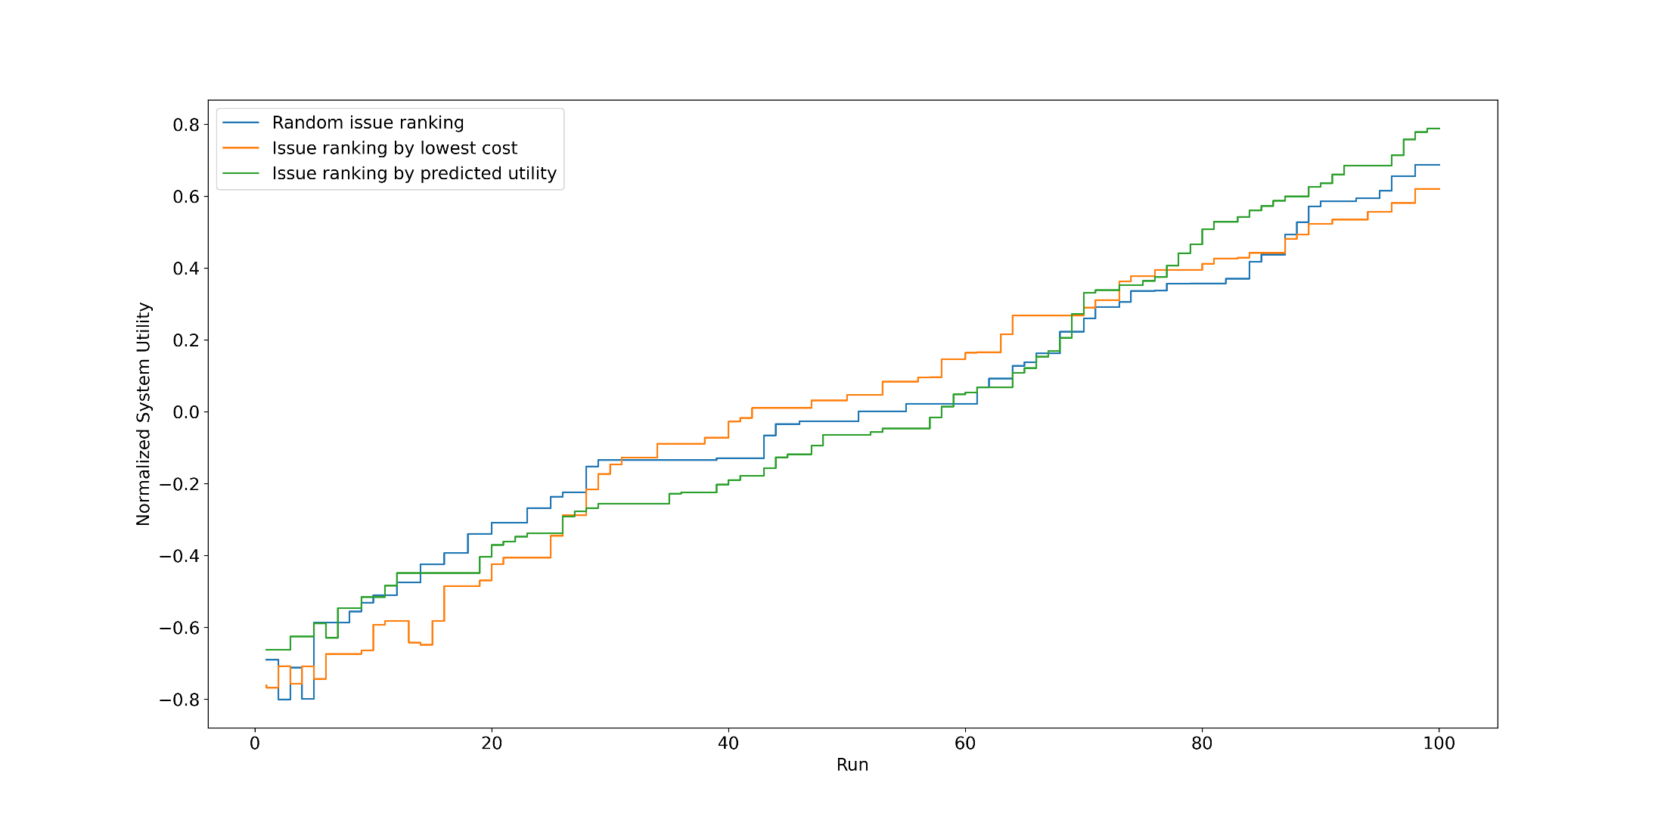
Issue ranking – multiple runs

Slide 5
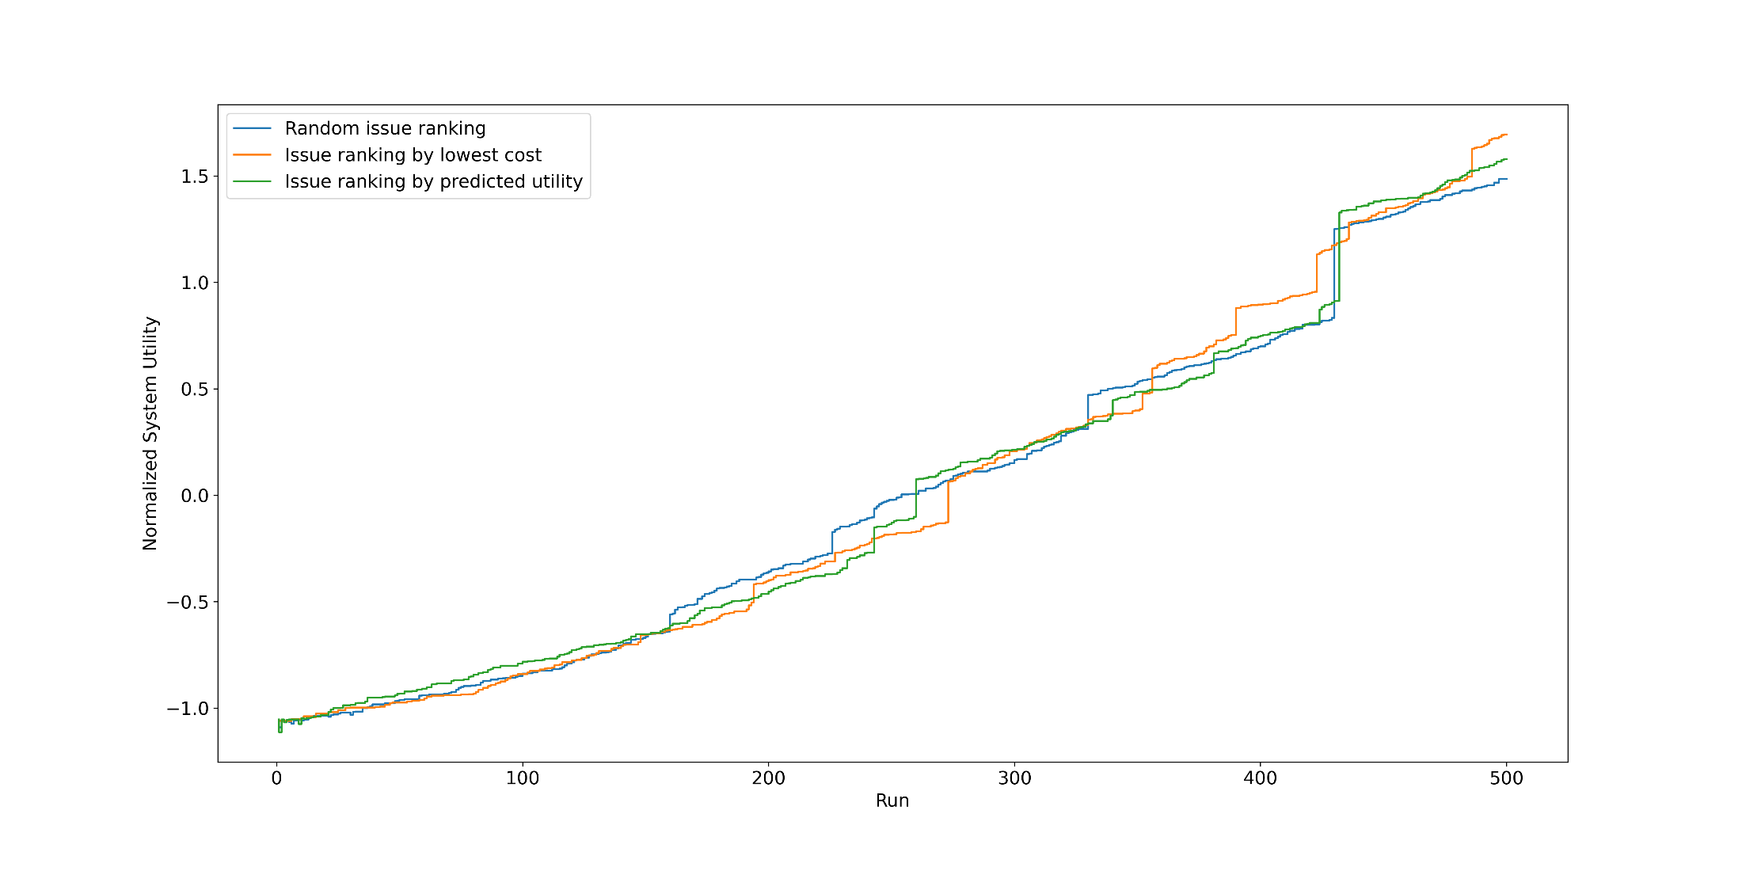
Issue ranking – multiple runs

Slide 6
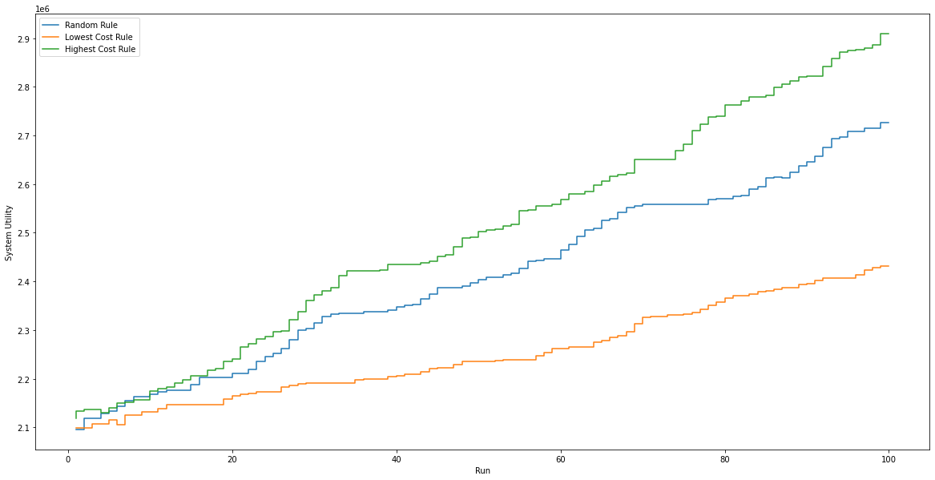
Action picking – multiple runs

Slide 7
Past-Learned Action Failing Probabilities – Transition Matrix

Slide 8
Research Questions
RQ1
Are the two approaches compatible?
RQ2
Is the decision-making significantly worse when using incorrect reward penalties?
RQ3
Assuming that the failing probabilities were correct: What is the theoretical lost utility?

Slide 9
Discussion
Currently a lot of functions with side effects
=> Harder to understand data-transformations
mRubis wants „execution plan“ but ignores it ☺

Slide 10
Disscussion - mRubis and Python
Current
Proposal
python controller
mRubis
python controller
mRubis
get #shops
get all issues
#shops
all issues
for each shop
get info of shop
Send sorted list of fixes
system utility
info of shop
get #issues
= 2 messages
#issues
for each issue
request each issue seperately
issue
for each issue
send fix for each issue seperately
20-40 messages
send actual fix order

Slide 11
Thank you for your attention!
Speaker
Job Description
Institute

Slide 12


Slide 13


Slide 14


Slide 15
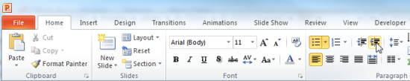
Explanations - Text layers
First text layer for running text.
Second level for bullet points
Third level for bullet points
Fourth level for bullet points
Fifth level for numberings
Sixth level for listings
Seventh text layer for Core Messages
In this template, we pre-formatted different text layers (as you can see on the right side). You don’t have to generate bullet points manually. By the way: Please avoid this!
To change from one text layer to the next, use the Increase / Decrease List Level buttons:

Slide 16
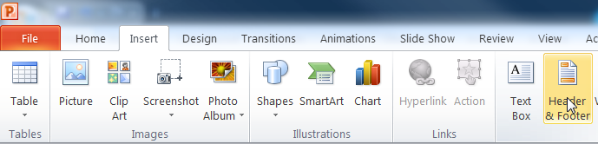
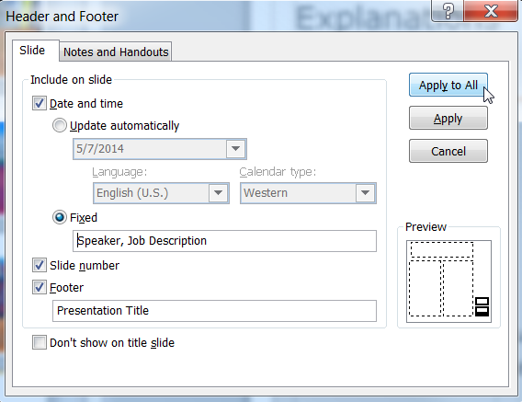
Explanations - Footer
You can insert or change your presentation‘s footer. Click on the Insert-tab | Header and Footer | After filling in your descriptions click on Apply to All.
Descriptions:
Activate date and time and write in:Speaker, Job Description
Activate the slide number.
Activate the footer and write in: Presentation Title
Don‘t use the template without the complete footer.

Slide 17
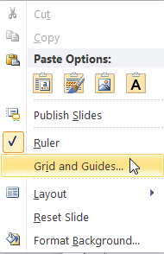
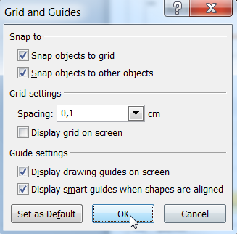
Explanations - Drawing guides
You can enable your guide-lines to align objects on the slide (View | Show | Select the option „Guides“)
Or hit the right mouse button outside the slide and go at „Grid and Guides…“

Slide 18
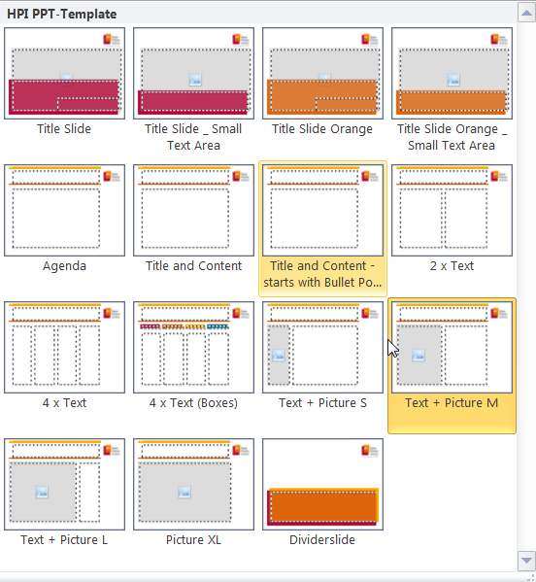
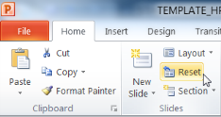
Explanations - Slide layouts
You can choose between different slide layouts. These pre-defined layouts gives you the oportunity to use text and visualisations just the right way.
To use these layouts:
Click on the Home-tab | New Slide or Layout | and choose one out of the layouts
Click „Reset“ to reset to the predefined slide layout.

