Slide 1
Advanced Encryption Standard (AES)
Ghenea Claudiu-Florentin

Slide 2
Introduction
Also known as Rijndael algorithm, AES is a symmetric block cipher that can process data blocks of 128 bits (16 bytes), using keys of various lengths (128, 192 and 256 bits).
AES uses a private key, that must be known by both parties (shared secret key) as it is a symmetric encryption algorithm.

Slide 3
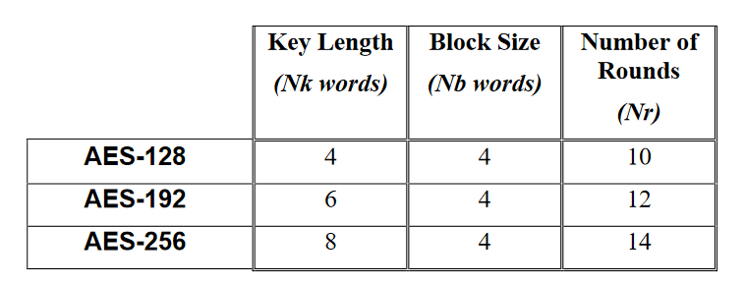
Algorithm Specifications
Nk – Number of 32-bit words comprising the Cipher Key.
Nb – Number of columns (32-bit words) comprising the State.
Nr – Number of rounds, which is a function of Nk and Nb.

Slide 4
Some definitions
Key Expansion - Routine used to generate a series of Round Keys from the Cipher Key.
Plaintext - Data input to the Cipher or output from the Inverse Cipher.
Round Key - Round keys are values derived from the Cipher Key using the Key Expansion routine;
S-box - Non-linear substitution table used in several byte substitution transformations

Slide 5
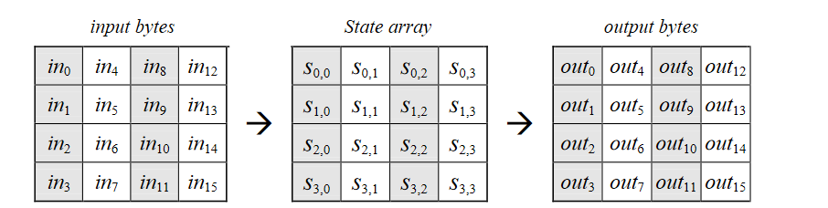
The state matrix
All AES operations are performed on a two dimensional array that it’s called State. It is formed of the input bytes (128 bits – 16 bytes) and it will contain the output of the encryption function.

Slide 6
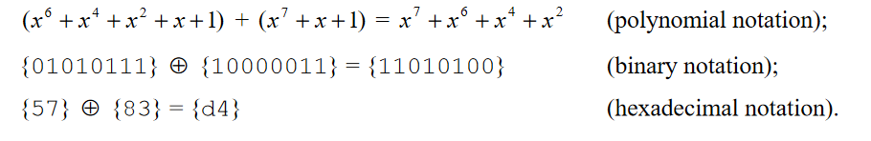
Mathematical Preliminaries
All operations, such as multiplication and addition are interpreted and performed in a finite field, thus addition is represented by the xor operation in modulo 2.
Example:

Slide 7

Mathematical Preliminaries
Multiplication, in the polynomial representation is denoted by • and corresponds with the multiplication of polynomials modulo an irreducible polynomial of degree 8, in our case in GF(2^8) – (Galois Field) and the selected irreducible polynomial is – .

Slide 8
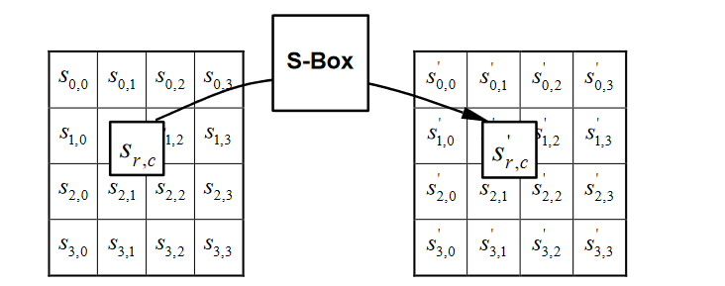
SubBytes Transformation
It grants diffusion as it uses look-up tables to scatter each plaintext bit to multiple ciphertext bits. The look-up table used it’s S-Box. For this implementation the S-Box is precomputed and used as a lookup table.

Slide 9
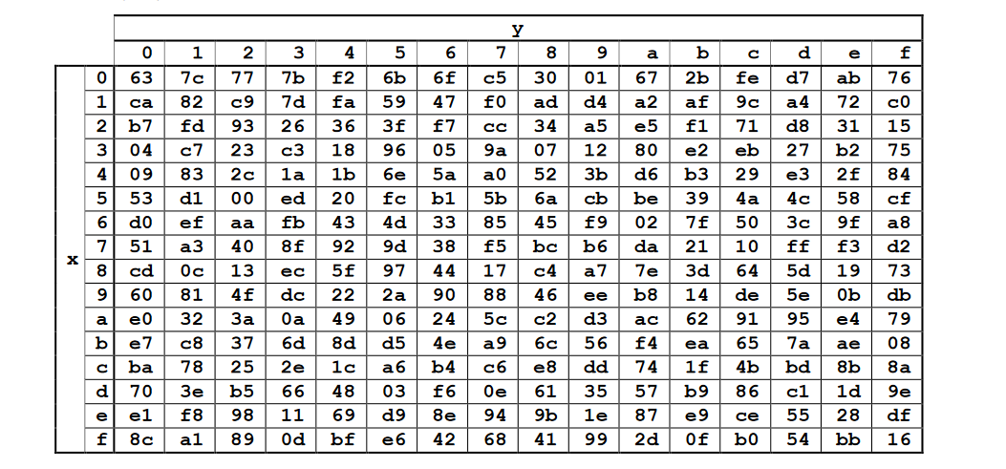
SubBytes Example
If S1,1 = {53} then S’1,1 = {ed}. Given Sx,y of form {x,y}.

Slide 10
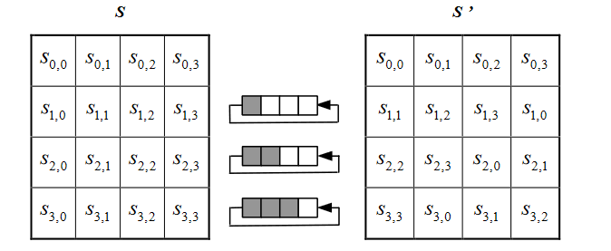
ShiftRows Transformation
In the ShiftRows transformation, the bytes in the last three rows of the State are cyclically shifted over different numbers of bytes (positions).

Slide 11
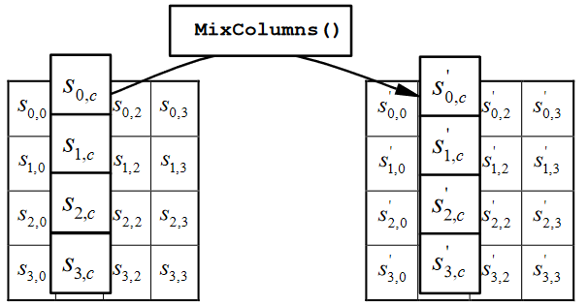
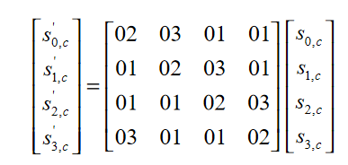
MixColumns Transformation
In this transformation each column of the State matrix is considered a polynomial over GF(2^8) and multiplied modulo . The fixed polynomial that will be multiplied is fixed – a(x). The whole operation can be written as:

Slide 12
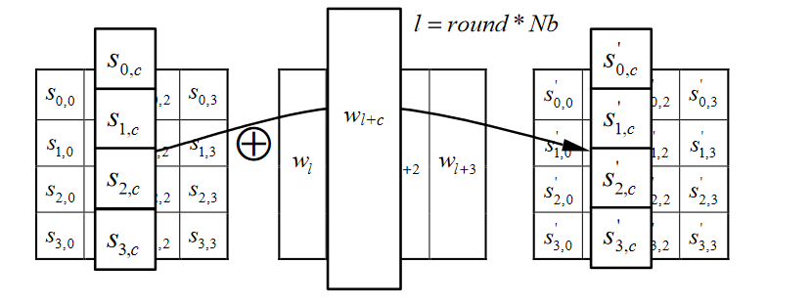
AddRoundKey Transformation
For the AddRoundKey transformation step, a Round Key is added to the State by a simple bitwise XOR operation.
This step provides confusion by combining the key schedule with the State.

Slide 13
Key Expansion
The provided Cipher Key K is used to perform a Key Expansion Routine that generated a key schedule (that is used in AddRoundKey).
The pseudocode for this step is presented in the next slide.

Slide 14
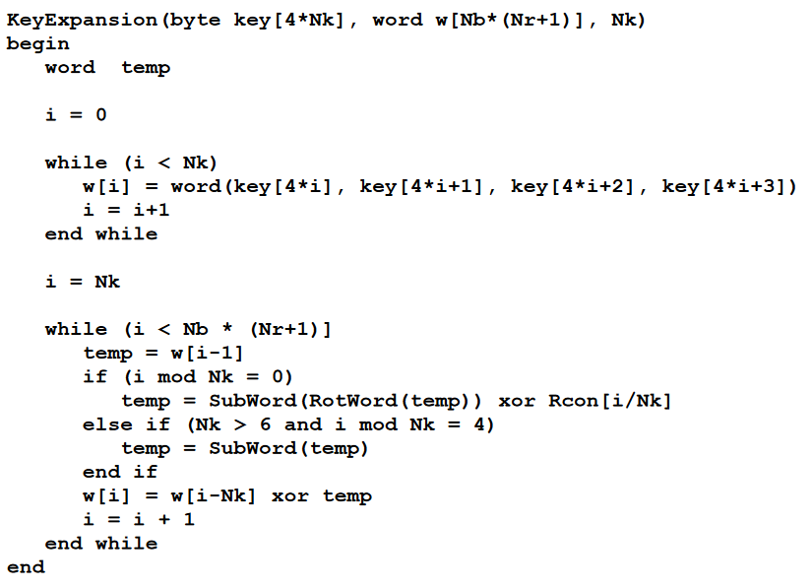

Slide 15
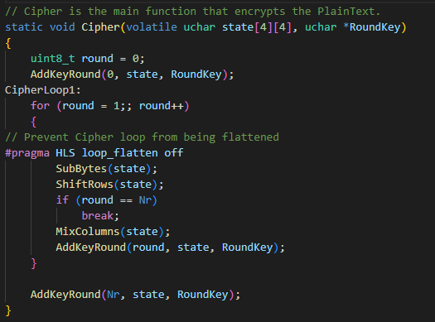
Cipher Algorithm

Slide 16
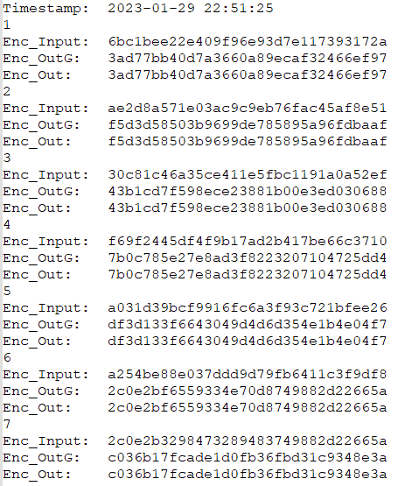
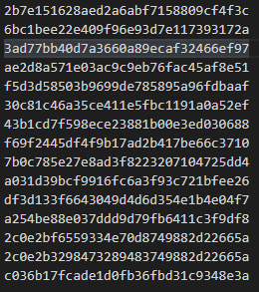
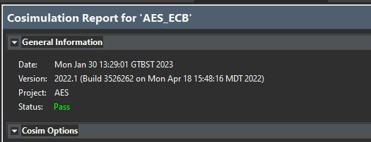
Vitis HSL Implementation and Results
GoldenValues.txt
debugFile.txt
Cosimulation

Slide 17
Bibliography
https://tsapps.nist.gov/publication/get_pdf.cfm?pub_id=901427
https://github.com/Xilinx/Vitis-Tutorials
https://docs.xilinx.com/r/en-US/ug1399-vitis-hls
Project can be found here - https://github.com/Phineas09/FPGA_AES

