Slide 1

UNIVERSITY OF MINES AND TECHNOLOGY (UMaT)
FACULTY OF GEOSCIENCES & ENVIRONMENTAL STUDIES
DEPARTMENT OF ENVIRONMENTAL AND SAFETY ENGINEERING
TOPIC:
Human Factor Contributions To Heavy Mining Equipment Damages and Its Impact on Production: A Case Study of a Ghanaian Mining Contractor
BY: SAGOE ISAAC
SUPERVISOR: DR. ERIC STEMN
13TH June, 2025

Slide 2
OUTLINE
Introduction
Objectives of the Study
Methods Used
Facilities and Resources Used
Results and Discussion
Conclusions
References

Slide 3
INTRODUCTION
The mining industry has witnessed an increasing reliance on heavy mobile equipment to meet the rising demands of production, particularly within the Ghanaian gold mining sector (Stemn et al., 2022).
The industry regardless of its contribution to socioeconomic development is undoubtedly considered as a safety–critical industry due to the hazardous nature of its activities, the working environment and the equipment used (Gyekye SA., 2003).

Slide 4
INTRODUCTION CONT’D
There exists a prevalent belief that accidents and equipment failures are primarily caused by the unpredictable behavior of individuals referred to as the “Bad Apple Theory” (Dekker, 2006) .
Since Industrialization, Human Error has significantly impacted mining operations by causing equipment failures, reduced productivity and increase in costs (Reason, 1990)
There’s the need for application of system approach in incident investigation, shifting from active failures (human errors) to latent systemic factors/failure (Dekker, 2002).

Slide 5
INTRODUTION CONT’D
Human factors encompass the interactions between operators, the equipment, and the work environment, and are increasingly recognized as a key element influencing industrial accidents (Reason, 1990).
Human-Induced errors as major contributor to operational and maintenance failures in machinery, are often overlooked despite their significant impact (Dhillon,2014)
However, understanding and mitigating the influence of human factors is essential for improving safety, reducing errors, enhancing productivity, and increasing the overall efficiency of mining operations (Simpson & Horberry, 2018).

Slide 6
OBJECTIVES OF THE STUDY
The objectives for this study are to ;
To Identify Human Factor contributions to equipment damages.
To Investigate the Relationship between Equipment Damages and Production.

Slide 7
METHODS USED
The study involved a;
Thematic and quantitative analysis on secondary data from the Ghanaian mining contractor using Microsoft excel
Correlation analysis using R-studio programming software
Wilcoxon rank sum exact test was used to test the hypothesis formed using R-studio programming software.

Slide 8
FACILITIES AND RESOURCES USED
Incident Data on Equipment Damages, Equipment Downtimes and Production Figures from a Ghanaian Mining Contractor
Library and internet facilities from the University of Mines and Technology (UMaT)
A personal laptop with Microsoft Office Suite (Word, Excel and Power Point)
R-Studio programming Software

Slide 9
RESULTS AND DISCUSSIONS
OVERALL SUMMARY
year | total cost of damaged component | total mean time to repair | total equipment downtime | total production revenue lost | total incident | equipment downtime per incident | revenue lost per hour of downtime | average revenue lost per incident | mean time to repair per incident
2019 | 178000.00 | 60.00 | 816.00 | 1570552.04 | 2 | 408.00 | 1924.70 | 785276.02 | 30.00
2020 | 172100.00 | 221.20 | 1222.50 | 258541.94 | 12 | 101.88 | 211.49 | 21545.16 | 18.43
2021 | 133000.00 | 104.00 | 647.40 | 324090.66 | 14 | 46.24 | 500.60 | 23149.33 | 7.43
2022 | 96860.00 | 80.00 | 314.40 | 764644.83 | 15 | 20.96 | 2432.08 | 50976.32 | 5.33
2023 | 32750.71 | 25.00 | 96.60 | 130815.14 | 4 | 24.15 | 1354.19 | 32703.79 | 6.25
2024 | 2460.00 | 9.00 | 30.00 | 3281.04 | 2 | 15.00 | 109.37 | 1640.52 | 4.50
2019 -2024 | 615170.71 | 499.20 | 3126.90 | 3051925.65 | 49 | 63.81 | 976.02 | 47825.12 | 10.19

Slide 10
RESULTS AND DISCUSSIONS CONT’D
CATEGORIZATION BASED ON CAUSE
Category | Number of Incidents | Percentage | TDT (HOUR) | TMTR (HOUR) | TRL ($)
Human Factor | 20 | 40.82 | 2068.40 | 318.20 | 2145740.00
Non-human Factors | 29 | 59.18 | 1058.50 | 181.00 | 906185.65
Total | 49 |  | 3126.90 | 499.20 | 3051925.65
CATEGORIZATION BASED ON OPERATOR EXPERIENCE
Category | Number of Incidents | Human Factor | TDT (HOUR) | TMTR (HOUR) | TRL ($)
0 - 2 YEARS | 6 | 2 | 41.90 | 24.30 | 88957.08
3 - 5 YEARS | 14 | 4 | 1082.70 | 127.90 | 707264.33
6 - 10 YEARS | 24 | 11 | 1182.70 | 270.00 | 448450.72
11 - 15 YEARS | 5 | 3 | 819.60 | 77.00 | 1807243.52
15 + YEARS
TOTAL | 49 | 20 | 3126.90 | 499.20 | 3051915.65

Slide 11
RESULTS AND DISCUSSIONS CONT’D
CATEGORIZATION BASED ON EQUIPMENT TYPE
Category | Number of Incidents | Human Factor | TDT (HOUR) | TMTR (HOUR) | TRL ($)
DUMP TRUCK | 24 | 12 | 1908.30 | 308.20 | 266841.28
EXCAVATOR | 14 | 7 | 1066.70 | 127.00 | 2552029.15
ARTICULATED DUMP TRUCK | 1 | 0 | 10.00 | 6.00 | 1455.00
LOADER | 3 | 0 | 23.00 | 15.00 | 5298.58
DRILL RIG | 3 | 1 | 40.40 | 20.00 | 135879.74
DOZER | 2 | 0 | 56.50 | 11.00 | 84557.60
MULTI EQUIPMENT | 2 | 0 | 22.00 | 12.00 | 5864.30
TOTAL | 49 | 20 | 3126.90 | 499.20 | 3051925.65
CATEGORIZATION BASED ON SEVERITY
Category | Number of Incidents | Human Factor | TDT (HOUR) | TMTR (HOUR) | TRL ($)
Insignificant (RL <$1k)) | 10 | 2 | 27.00 | 11.00 | 7009.28
Minor ( $1k < RL <$10k) | 21 | 7 | 525.00 | 172.20 | 80382.13
Moderate ( $10 < RL <$100k) | 14 | 9 | 1622.90 | 235.00 | 612760.53
Major ( $100k < $1M) | 3 | 1 | 278.80 | 57.00 | 788855.76
Catastrophic ( RL > $1M) | 1 | 1 | 673.20 | 24.00 | 1562917.95
Total | 49.00 | 20 | 3126.90 | 499.20 | 3051925.65

Slide 12
RESULTS AND DISCUSSIONS CONT’D
CATEGORIZATION BASED ON AFFECTED SYSTEM
Category | Number of Incidents | Human Factor | TDT (HOUR) | TMTR (HOUR) | TRL ($)
Mechanical | 8 | 1 | 232.70 | 53.20 | 198545.86
Hydraulic | 2 | 1 | 684.60 | 30.00 | 1564362.95
Electrical | 4 | 0 | 224.60 | 52.00 | 249408.14
Structural | 19 | 10 | 456.10 | 104.40 | 812494.81
Undercarriage | 2 | 1 | 31.00 | 12.40 | 4441.61
Cabin/Interface | 8 | 4 | 1054.80 | 165.00 | 153829.93
multiple-damages | 6 | 3 | 443.10 | 82.20 | 68842.35
Total | 49 | 20 | 3126.90 | 499.20 | 3051925.65
CATEGORIZATION BASED ON SHIFT
Category | Number of Incidents | Human Factor | TDT (HOUR) | TMTR (HOUR) | TRL ($)
NIGHT SHIFT | 29 | 10 | 2372.30 | 264.00 | 2673393.49
DAY SHIFT | 20 | 10 | 754.60 | 235.20 | 378532.16
TOTAL | 49 | 20 | 3126.90 | 499.20 | 3051925.65

Slide 13
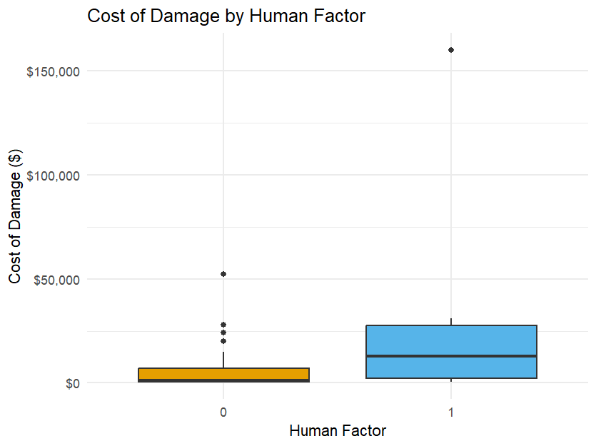
RESULTS AND DISCUSSIONS CONT’D

Slide 14
RESULTS AND DISCUSSIONS CONT’D
To determine whether the observed difference is statistically significant, a hypothesis test was conducted;
A non-parametric test (Wilcoxon rank-sum test) was employed due to the skewed distribution and presence of outliers in the data.

Slide 15
RESULTS AND DISCUSSIONS CONT’D
HYPOTHESIS TEST
Let H₀: be the null hypothesis and H₁: be the alternative hypothesis.
H₀: There is no difference in the distribution of cost of damage components between incidents with and without human factor involvement
H₁: There is a difference in the distribution of cost of damage components between incidents with and without human factor involvement

Slide 16
RESULTS AND DISCUSSIONS CONT’D
Based on the Wilcoxon rank sum test, a p-value of 0.007449 was obtained at a 95% confidence level.
Since the p-value is less than the significance level of 0.05, we reject the null hypothesis at the 5% level of significance.
We conclude that there is a statistically significant difference in cost of damaged components between incidents that involved a human factor and those that did not.
This result provides statistical evidence suggesting that human factors may be associated with cost of damaged components and hence increasing financial loss.

Slide 17
RESULTS AND DISCUSSIONS CONT’D
AVERAGE REVENUE LOSS BY HUMAN FACTOR
Human Factor | Number of Incidents | Average Revenue Loss
0 | 29 | 31,247.80
1 | 20 | 107,287.00
To determine whether the observed difference is statistically significant, a hypothesis test was conducted;
A non-parametric test (Wilcoxon rank-sum test) was employed due to the skewed distribution and presence of outliers in the data.

Slide 18
RESULTS AND DISCUSSIONS CONT’D
HYPOTHESIS TEST
Let H₀: be the null hypothesis and H₁: be the alternative hypothesis.
H₀: There is no difference in the distribution of revenue loss between incidents with and without human factor involvement
H₁: There is a difference in the distribution of revenue loss between incidents with and without human factor involvement

Slide 19
RESULTS AND DISCUSSIONS CONT’D
Based on the Wilcoxon rank sum test, a p-value of 0.0124 was obtained at a 95% confidence level.
Since the p-value is less than the significance level of 0.05, we reject the null hypothesis at the 5% level of significance.
We conclude that there is a statistically significant difference in revenue loss between incidents that involved a human factor and those that did not.
This result provides statistical evidence suggesting that human factors may be associated with increased production and financial loss.

Slide 20
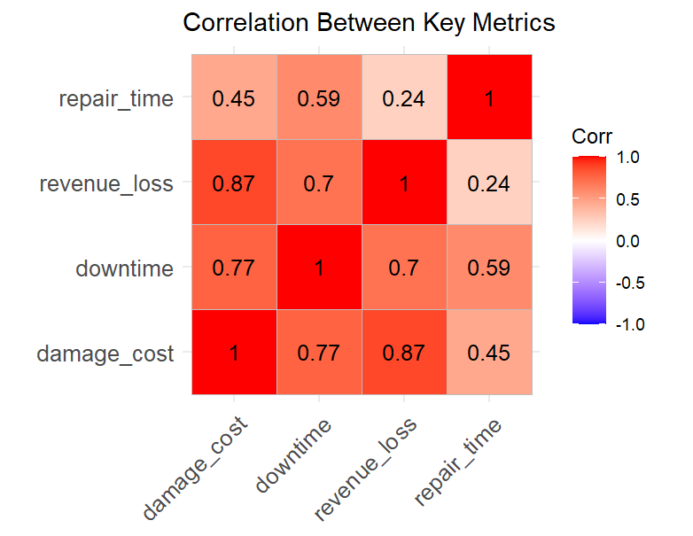
RESULTS AND DISCUSSIONS CONT’D

Slide 21
CONCLUSIONS
The study revealed that human factors significantly contribute to equipment damages in the operations of the Ghanaian mining contractor.
These damages have a direct negative impact on equipment availability, productivity, and overall production performance.
Statistical analysis confirmed a significant relationship between human-induced errors and equipment downtimes, reinforcing the need for targeted human factor interventions.

Slide 22
CONCLUSIONS
Enhancing operator training, supervision, safety culture, and human-machine interface designs can help reduce these errors.
Managing human error is essential not just for improving equipment reliability, but also for boosting operational efficiency and ensuring workplace safety.

Slide 23
REFERENCES
Bevilacqua, M., and Ciarapica, F. E., (2018), “Human factor risk management in the process industry: A case study”, Reliability Engineering and System Safety, Vol. 16, No. 9, pp. 149–159
Dhillon, B. (2014). “Human Error in Maintenance: An Investigative Study for the Factories of the Future”, IOP Conf. Ser. Mater. Sci. Eng, Vol. 65, No.1, pp. 20-31.
Dekker, S.W., (2006), “The Field Guide to Understanding Human Error”, pp. 62-67.
Gyekye SA (2003) Causal attributions of Ghanaian industrial workers for accident occurrence: Miners and non-miners perspective. J Safety Res 34:533–538

Slide 24
REFERENCES CONT’D
Reason, J. (1990), “Human Error” Cambridge University Press, New York Cambridge, pp. 56-60.
Reason, J. (2000), “Human Errors, models and management, education and Debate”, pp.768770
Simpson, G. and Horberry, T., (2018), “Understanding human error in mine safety”, CRC Press, pp. 175
Stemn, E., Benyarku, C. A., & Buabeng, A. (2022). Human factor issues associated with mobile mining equipment-related injuries in the Ghanaian Surface Gold Mines. Journal of Mining Safety, 32(4), 320-330

Slide 25
THANK YOU

