Slide 1
Examining Ambiguities in the Automatic Packet Reporting System
Kenneth W. Finnegan, W6KWF
December 12, 2014

Slide 2
Overview
Introduction to APRS and its capabilities
Highlight many of the issues with APRS identified while working on this thesis
  Bell 202 modulation
  KISS modem interface
  AX.25 addressing and routing
  Tracker beaconing behaviors
Questions and hopefully answers

Slide 3
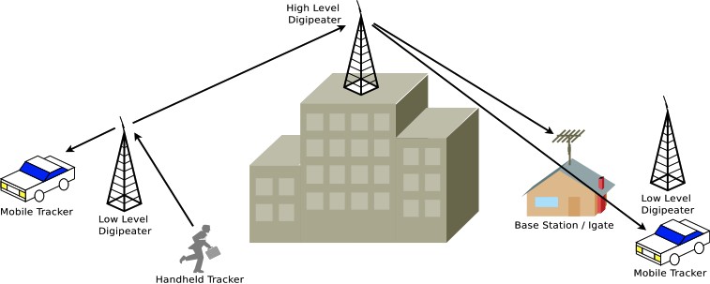
What is APRS?
An ad-hoc message passing network
for short pieces of information

Slide 4
What is APRS?
GPS Positions (Automatic Vehicle Location)
Weather station readings
Short (67 char) text messages
Arbitrary system telemetry (i.e. battery voltage)
Bulletins and announcements
Remote command and control (i.e. turn light on)

Slide 5
The Three Types of APRS Nodes
Trackers – Mobile APRS stations, often installed in cars, which feed most of the traffic into the network
Digipeaters (Digis) – Digital repeaters which operate by storing and immediately forwarding packets on the APRS simplex channel
Internet Gateways (I-gates) – Internet-connected APRS stations which feed local APRS traffic into the world-wide APRS-Internet System network

Slide 6
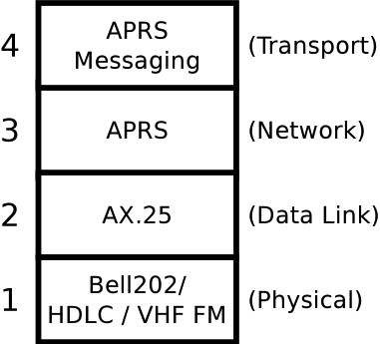
APRS Network Stack

Slide 7
Amateur Bell 202
1200bps modem developed in the early 1980s
AT&T Bell 202 audio modems ordinarily used over telephone lines
HDLC framing protocol as used under X.25
Transmitted over VHF FM voice radios

Slide 8
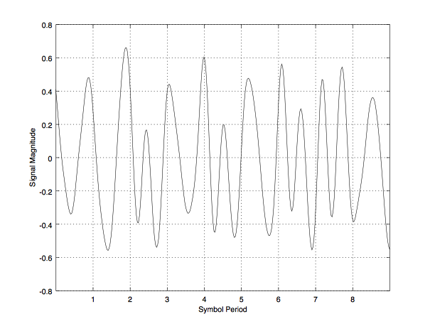
Amateur Bell 202
(ASCII letter A - 0x41)

Slide 9
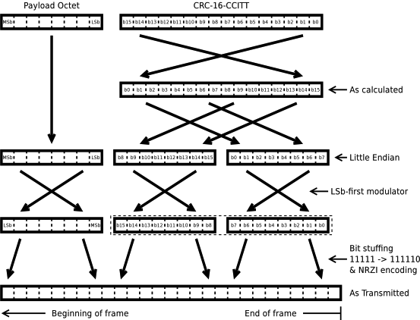
CRC-16-CCITT

Slide 10
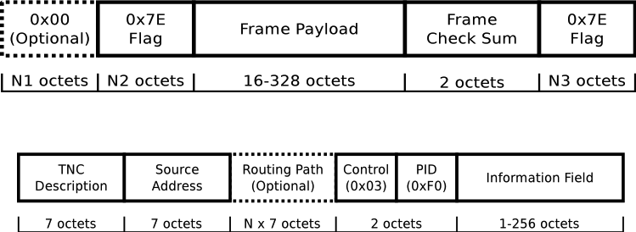
Frame and AX.25 Format

Slide 11
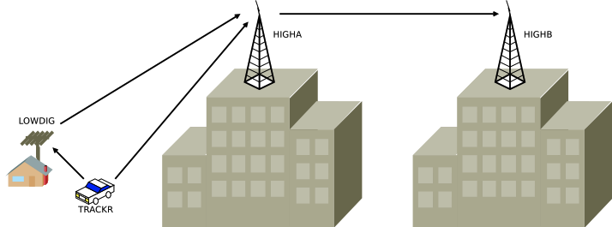
Digipeater Aliases
WIDEn-N
n – Hops originally requested
N – Hops left to be consumed

Slide 12
(Actual) Digipeater Aliases
WIDEn-N
n – All digipeaters if =1, else only high level
N – Hops left to be consumed

Slide 13
Beaconing Algorithms
Fixed intervals
Time slots
Nice interval skipping
Fixed interval with dithering
SmartBeaconing

Slide 14
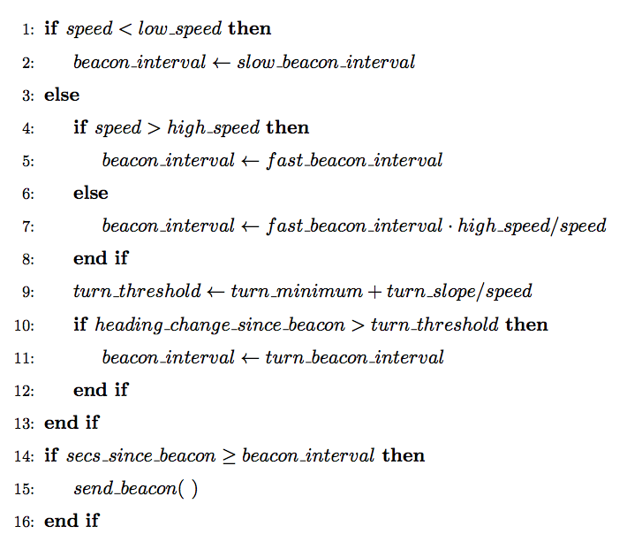
SmartBeaconing

Slide 15
Recommended Paths
Mobile: “WIDE1-1,WIDE2-1”
Fixed: Literal digi paths, or “WIDE2-1”
Airborne: EMPTY
“Proportional pathing”

Slide 16
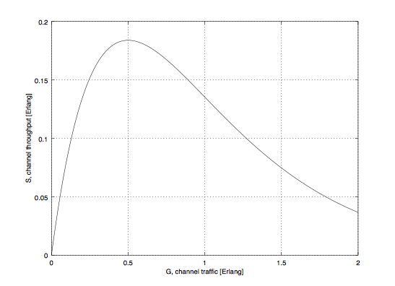
RF Channel Capacity Model
1200bps channel bandwidth, but less than that in channel throughput

Slide 17
Questions?
Kenneth W. Finnegan, W6KWF
KennethFinnegan2007@gmail.com
http://blog.thelifeofkenneth.com/

