Slide 1
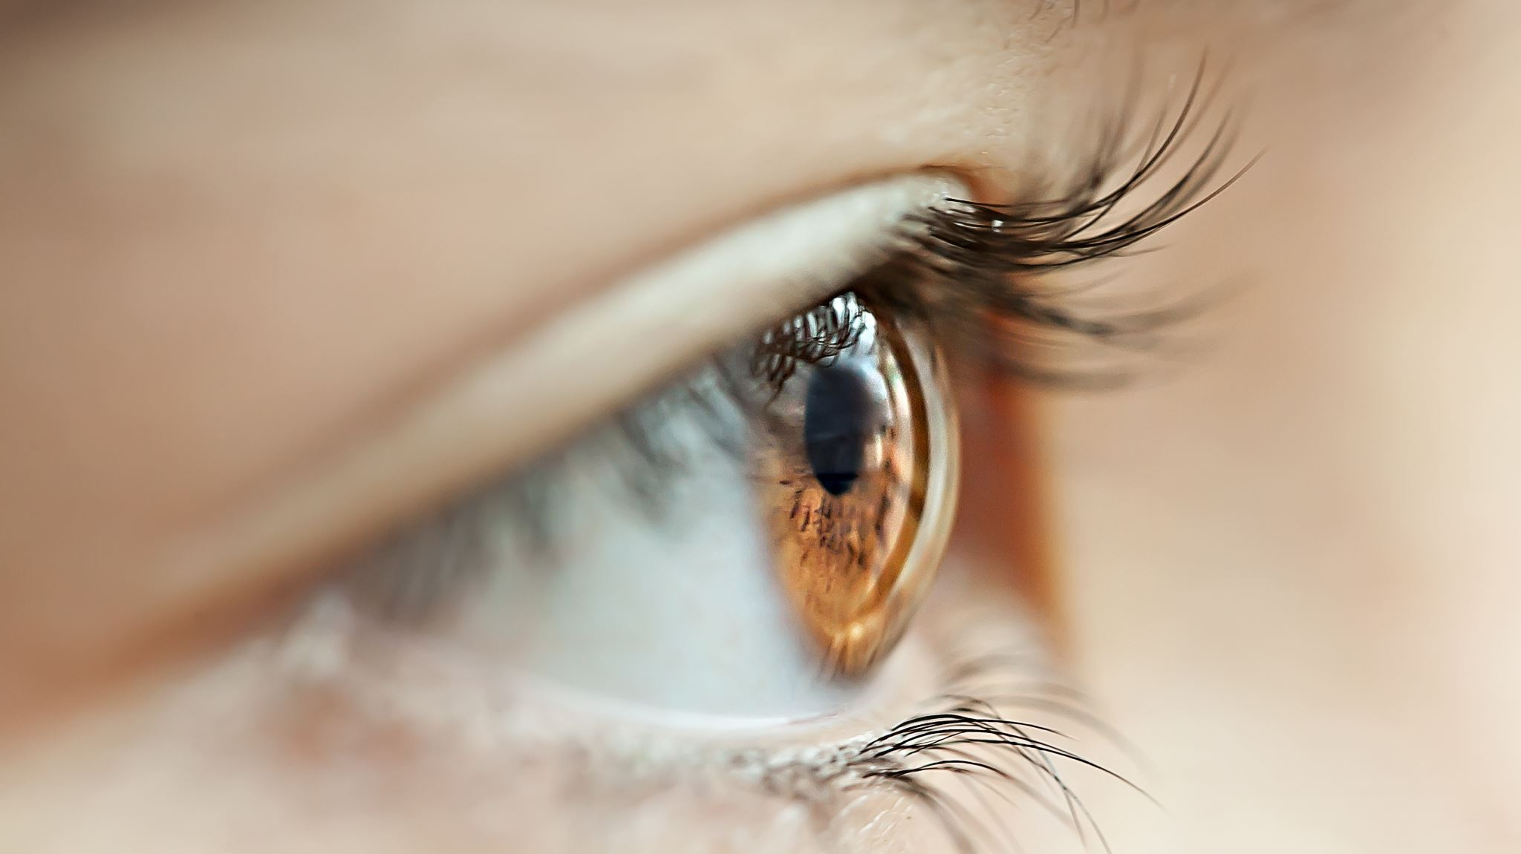
ViTal‑Eye: Transformer-Driven Retina Screening Study
Adekola O. Okunola
Texas A&M University College of Engineering
Department of Electrical and Computer Engineering
ECEN 642 – 600,700 Digital Image Processing & Computer Vision

Slide 2

Content
1: Project Overview and Motivation
2: Related Work and Approach
3: Methodology
4: Results and Insights
5: Conclusion and Future Work

Slide 3
Project Overview and Motivation
Problem: Diabetic Retinopathy (DR) is a leading cause of preventable blindness, especially in under-resourced areas.
Need: DR detection is labor-intensive, and early screening is critical but infeasible at scale in many regions.
Goal: Build and evaluate an interpretable, efficient AI "second reader" for DR screening using Vision Transformer (ViT) and ResNet.
Datasets: EyePACS and APTOS (publicly available on Kaggle)

Slide 4
Related Work and Approach
CNNs in DR Detection:
ResNet, Inception used extensively.
Strong performance but limited interpretability and robustness.
ViT for Vision Tasks:
Less inductive bias; global attention.
Strong performance with large-scale pretraining.
What’s New:
Head-to-head comparison of ViT-Base/16 vs ResNet-50.
Evaluation on robustness, interpretability, and clinical applicability.

Slide 5
Methodology
Preprocessing:
512×512 resizing, cropping around optic disc.
Stratified splits for train/val/test (80/10/10).
Augmentations: flips, rotation, color jitter, blur.
Models:
ViT-Base/16: Partially frozen, mixed precision fine-tuning.
ResNet-50: Standard baseline with Grad-CAM support.
Training:
15 epochs, AdamW, cosine schedule, weighted cross-entropy.
Evaluation:
Accuracy, AUC, quadratic kappa, sensitivity@95% specificity.

Slide 6
Results and Insights
Performance Metrics:
Best Val AUC: 0.8228 (ViT @ Epoch 6).
Test AUC: 0.8203, Kappa: 0.5399, Accuracy: 77.5%.
Interpretability:
ViT: Attention rollout clearly highlights pathologies.
ResNet: Grad-CAM often focuses on non-diagnostic features.
Robustness:
Under blur/brightness perturbations:
ViT AUC ≈ 0.74–0.77.
ResNet AUC ≈ 0.000–0.002.

Slide 7
Conclusion and Future Work
Conclusion:
ViT achieves competitive accuracy with better interpretability and robustness than ResNet.
Demonstrated potential as a lightweight, explainable second-reader system.
Significance:
Effective for early DR screening in clinics lacking specialists.
Future Work:
Extend to semi/self-supervised ViT pretraining.
Explore real-world deployment, mobile edge adaptation, federated learning.

