Slide 1

PROGRESS
INTERNAL STATUS UPDATE · 11 SEPTEMBER 2026
✓
Windows OS & namespaces
aiDAPTIV+ Middleware Integration
✓
Middleware installed
✓
4 apps integrated
✓
KV cache offload verified
Setup complete, middleware integrated with LibreChat, Onyx, OpenWebUI and Obsidian, and KV cache offloading verified.
1
Benchmark with / without
2
Doc upload & web search
Model under test: gemma-4-26B-A4B-it-UD-Q4_K_M.gguf · aiDAPTIV+ build NXWVB306.1

Slide 2

STATUS AT A GLANCE
Setup & integration done — benchmarking next
COMPLETED 5 tasks
UPCOMING 4 tasks
✓
Windows OS installed
Clean Windows 11 install on the test laptop
1
Benchmark basic functionality
Same workload with vs. without aiDAPTIV+
✓
NVMe namespaces allocated
Boot drive (C:) + dedicated aiDAPTIV namespace (D:)
2
Document upload feature
Add to all four apps
✓
aiDAPTIV+ middleware installed
Build NXWVB306.1 · environment check passing
3
Web search feature
Add to all four apps
✓
4 apps integrated, with & without aiDAPTIV+
LibreChat · Onyx · OpenWebUI · Obsidian
4
Verify functionality
End-to-end checks, with & without aiDAPTIV+
✓
KV cache offload verified
Cache file on D: grew 16.5× during a live session
MiPhi · aiDAPTIV+ Integration — Internal Status Update · 11 September 2026
2

Slide 3
SETUP · OVERVIEW
What we set up on the test machine
1
2
3
4
Install Windows OS
Allocate namespaces
Install middleware
Integrate apps
• Windows 11 (x64) installed on the test laptop
• Remote access via TeamViewer for the team
• NVMe split into two namespaces
• Boot drive (C:) for OS & apps
• aiDAPTIV namespace (D:) for KV cache
• aiDAPTIV+ build NXWVB306.1 (x64)
• llama-server Launcher v0.0.1
• Dry-run environment check OK
• LibreChat · Onyx · OpenWebUI · Obsidian
• Each wired to both backends: with and without aiDAPTIV+
✓ DONE
✓ DONE
✓ DONE
✓ DONE
Outcome: one machine, one model, two backends — ready for a like-for-like with / without aiDAPTIV+ comparison.
MiPhi · aiDAPTIV+ Integration — Internal Status Update · 11 September 2026
3

Slide 4
SETUP · STEPS 1–2
Windows OS and NVMe namespace allocation
NVMe AI SSD · one physical drive, two namespaces
WHAT WAS DONE
Windows 11 installed
Fresh OS install on the test laptop; remote access via TeamViewer.
NAMESPACE 1
Boot drive · C:
Windows 11 OS · applications · aiDAPTIV+ launcher & llama-server
Boot namespace created
Holds the OS, the client apps and the aiDAPTIV+ binaries.
aiDAPTIV namespace created
Mounted as D: (“New Volume”) and reserved for the middleware.
NAMESPACE 2
aiDAPTIV namespace · D:
Dedicated AI SSD region for KV cache offload
--offload-path D:\nvme0
Offload path pointed at D:
Middleware creates its cache directory D:\nvme0\inference on first run.
MiPhi · aiDAPTIV+ Integration — Internal Status Update · 11 September 2026
4

Slide 5
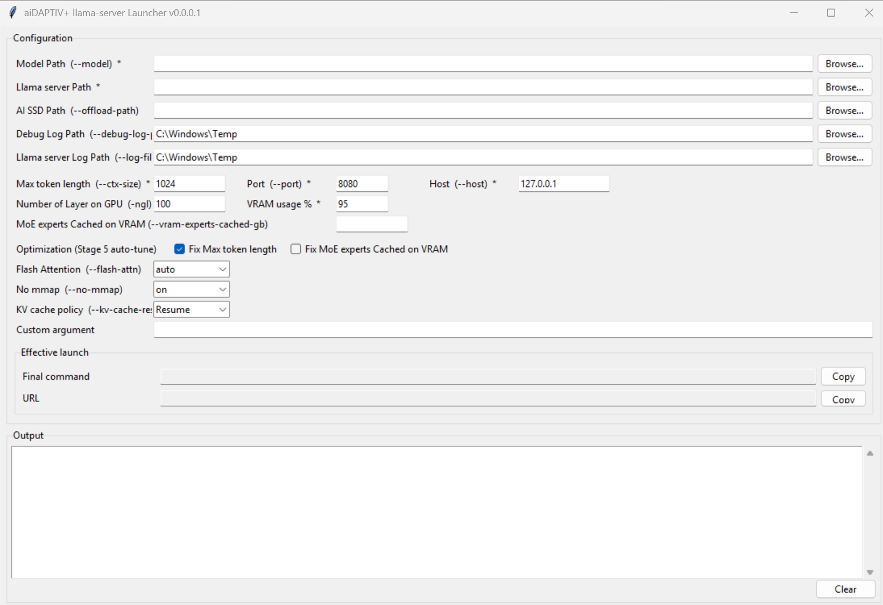
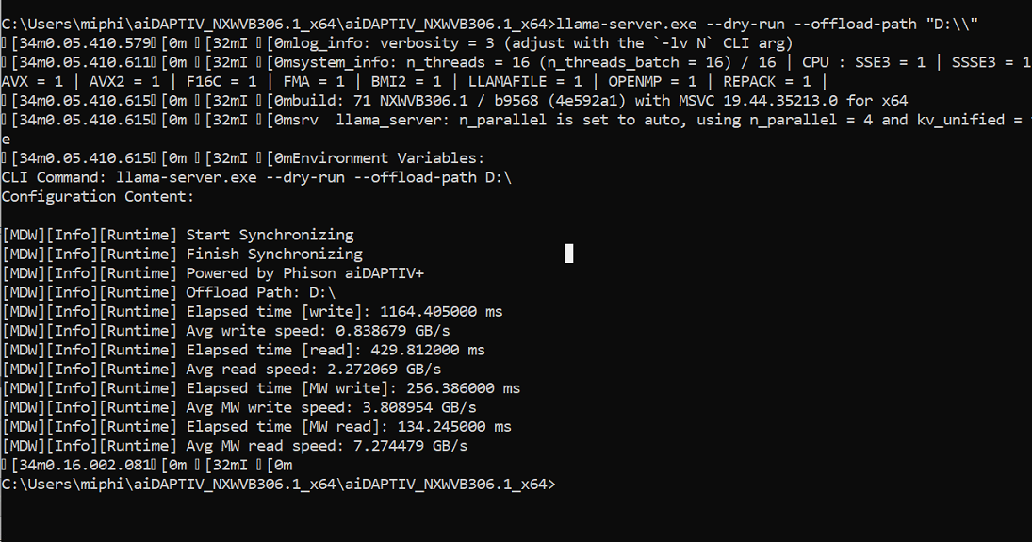
SETUP · STEP 3
Middleware installed — environment check passing
Dry run: middleware synchronizes with the AI SSD — “Powered by Phison aiDAPTIV+”
llama-server Launcher v0.0.1 — offload path, KV cache policy (Resume), GPU layers
NXWVB306.1
3.81 GB/s
7.27 GB/s
middleware build (x64)
MW write · 4.5× baseline
MW read · 3.2× baseline
MiPhi · aiDAPTIV+ Integration — Internal Status Update · 11 September 2026
5

Slide 6
SETUP · STEP 4
Apps integrated with and without aiDAPTIV+
CLIENT APPS
BACKENDS (SAME MODEL)
WHERE THE KV CACHE LIVES
LibreChat web chat
WITHOUT aiDAPTIV+
Standard llama-server
KV cache in GPU VRAM / DRAM only
GPU VRAM + DRAM
Model layers, hot KV
Onyx AI chat & search
OpenWebUI web chat
WITH aiDAPTIV+
aiDAPTIV+ llama-server
Middleware offloads KV cache to the AI SSD
AI SSD · D:
aiDAPTIV namespace
D:\nvme0\inference
Obsidian Copilot plugin
MiPhi · aiDAPTIV+ Integration — Internal Status Update · 11 September 2026
6

Slide 7
ACCOMPLISHED · INTEGRATION
Middleware integrated with four apps
App | Type | Without aiDAPTIV+ | With aiDAPTIV+ | Proof
LibreChat | Web chat UI | ✓ | ✓ | Slide 8
Onyx | AI chat & enterprise search | ✓ | ✓ | Slide 9
OpenWebUI | Web chat UI | ✓ | ✓ | Slide 10
Obsidian | Notes app · Copilot plugin | ✓ | ✓ | Slide 11
KV cache offload | Verified on the aiDAPTIV namespace (D:) | — | ✓ | Slides 12–13
All apps use the same model gemma-4-26B-A4B-it-UD-Q4_K_M.gguf so results are comparable across apps and backends.
MiPhi · aiDAPTIV+ Integration — Internal Status Update · 11 September 2026
7

Slide 8
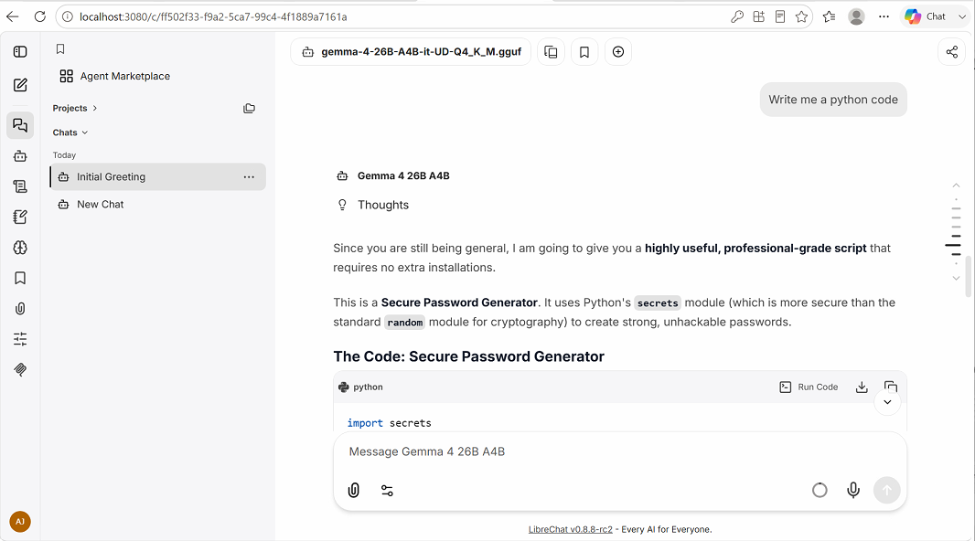
PROOF · LIBRECHAT
LibreChat running on the aiDAPTIV+ backend
✓ INTEGRATED
Setup
aiDAPTIV+ llama-server added as LibreChat’s model endpoint (plus baseline endpoint).
Version
LibreChat v0.8.8-rc2 at localhost:3080.
Model
Gemma 4 26B A4B · Q4_K_M GGUF.
Check
Reasoning (“Thoughts”) and a full code-generation answer streamed successfully.
MiPhi · aiDAPTIV+ Integration — Internal Status Update · 11 September 2026
8

Slide 9
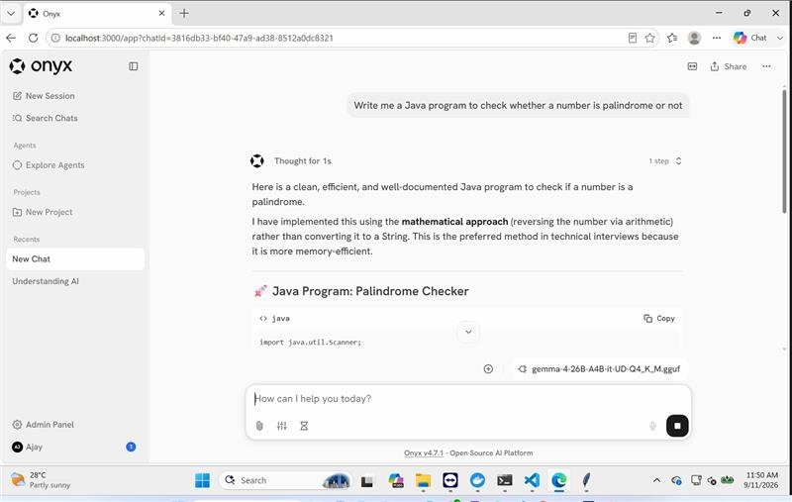
PROOF · ONYX
Onyx running on the aiDAPTIV+ backend
SCREENSHOT PENDING
Insert proof screenshot here
Onyx chat session answered by the aiDAPTIV+ backend
✓ INTEGRATED
Setup
aiDAPTIV+ llama-server added as Onyx’s LLM provider (plus baseline endpoint).
App
Onyx — open-source AI chat & enterprise search.
Model
Gemma 4 26B A4B · Q4_K_M GGUF.
Check
Chat response served through the aiDAPTIV+ backend.
MiPhi · aiDAPTIV+ Integration — Internal Status Update · 11 September 2026
9

Slide 10
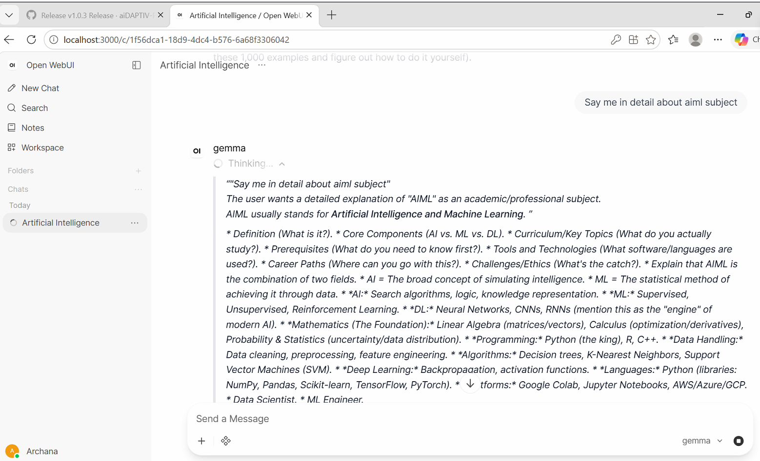
PROOF · OPENWEBUI
OpenWebUI running on the aiDAPTIV+ backend
SCREENSHOT PENDING
Insert proof screenshot here
OpenWebUI chat session answered by the aiDAPTIV+ backend
✓ INTEGRATED
Setup
aiDAPTIV+ llama-server added as an OpenWebUI connection (plus baseline endpoint).
App
OpenWebUI — self-hosted web chat UI.
Model
Gemma 4 26B A4B · Q4_K_M GGUF.
Check
Chat response served through the aiDAPTIV+ backend.
MiPhi · aiDAPTIV+ Integration — Internal Status Update · 11 September 2026
10

Slide 11
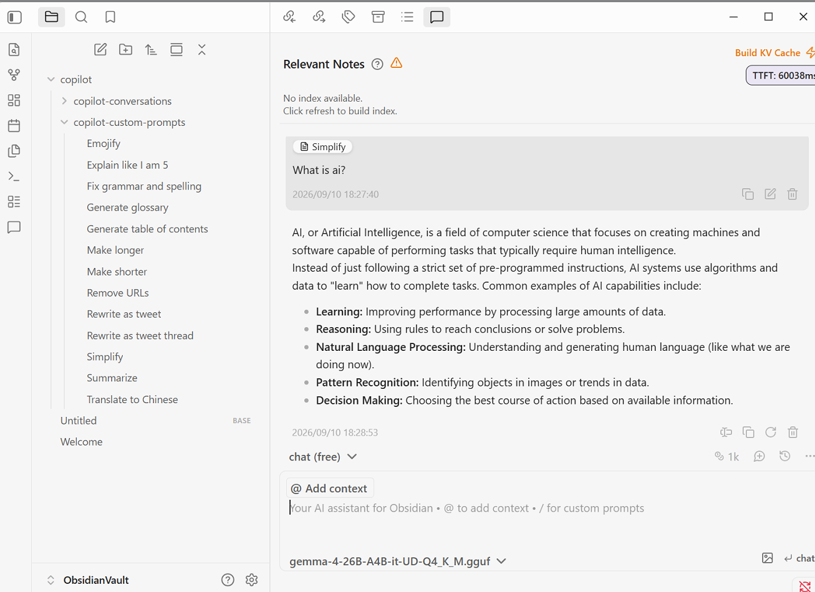
PROOF · OBSIDIAN
Obsidian Copilot running on the aiDAPTIV+ backend
✓ INTEGRATED
Setup
Obsidian Copilot plugin pointed at the aiDAPTIV+ endpoint (plus baseline endpoint).
Build KV Cache
One-click action in the chat panel to pre-build the KV cache.
Model
gemma-4-26B-A4B-it-UD-Q4_K_M.gguf.
Check
Prompt answered end-to-end inside the vault (2026-09-10, 18:27).
MiPhi · aiDAPTIV+ Integration — Internal Status Update · 11 September 2026
11

Slide 12
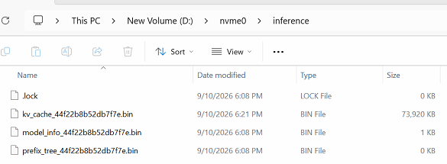
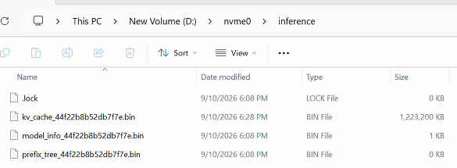
ACCOMPLISHED · KV CACHE OFFLOAD
Verified: KV cache is offloading to the AI SSD
6:21 PM
kv_cache_…bin = 73,920 KB
6:28 PM
kv_cache_…bin = 1,223,200 KB
16.5×
growth
≈ 72 MB · early in session
≈ 1.17 GB · seven minutes later
D:\nvme0\inference cache directory on the aiDAPTIV namespace
kv_cache_<id>.bin
Offloaded KV cache — grows as tokens are processed
prefix_tree_<id>.bin
Prefix index used for cache reuse
model_info_<id>.bin
Model metadata for the cached session
.lock
Guards the cache directory while the server runs
Captured live: the launcher reported “Server is ready (llama-server is still running)” while the KV cache kept growing on the SSD.
MiPhi · aiDAPTIV+ Integration — Internal Status Update · 11 September 2026
12

Slide 13
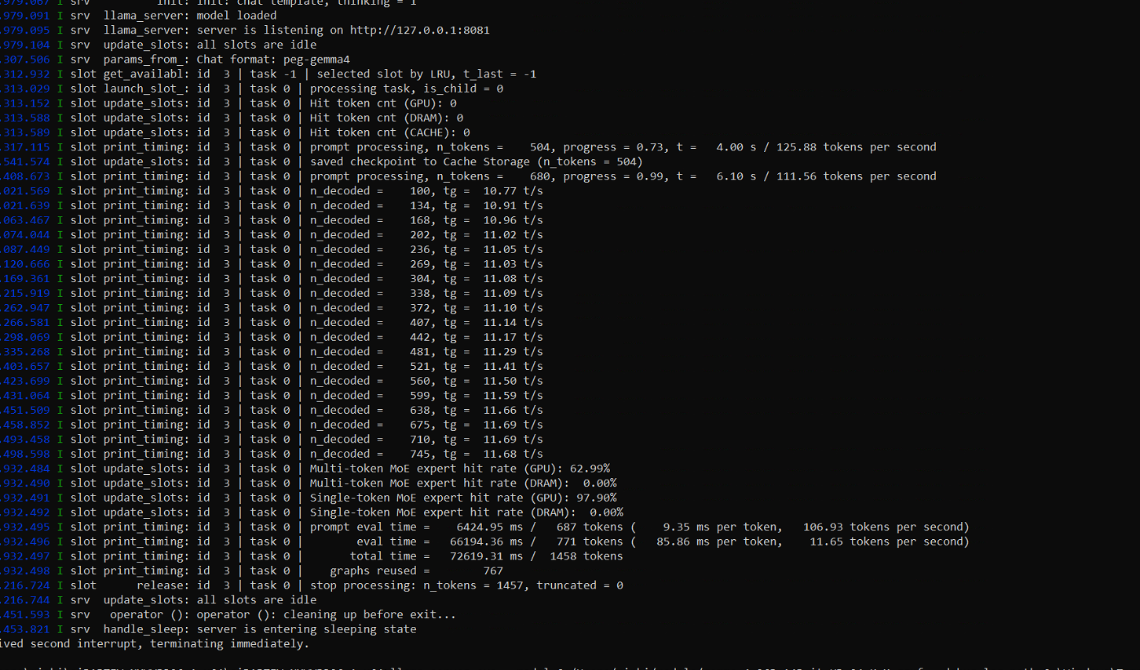
ACCOMPLISHED · KV CACHE OFFLOAD
Server log confirms checkpoints saved to Cache Storage
MiPhi · aiDAPTIV+ Integration — Internal Status Update · 11 September 2026
13

Slide 14
UPCOMING
Next tasks
1
2
3
4
Benchmark with vs. without aiDAPTIV+
Document upload feature
Web search feature
Verify functionality
• Same basic chat workload on both backends
• Planned metrics: TTFT, prompt & generation tok/s, max context, VRAM use
• Add document upload to LibreChat, Onyx, OpenWebUI and Obsidian
• Answers grounded in uploaded files
• Add web search to all four apps
• Responses served through the aiDAPTIV+ backend
• End-to-end checks of chat, document upload and web search
• On each app, with and without aiDAPTIV+
UPCOMING
UPCOMING
UPCOMING
UPCOMING
Order: benchmark first to set the baseline, then add document upload and web search, then verify each feature on every app.
MiPhi · aiDAPTIV+ Integration — Internal Status Update · 11 September 2026
14

