Slide 1

14 — 18 SEPTEMBER
WEEKLY UPDATE · 18 SEPTEMBER 2026
✓
Reuse verified after restart
KV Cache Reuse on aiDAPTIV+
✓
Benchmarked vs. no aiDAPTIV+
✓
Onyx cache_prompt wired in
✓
Document upload verified
KV cache reuse verified on the middleware API, then wired into Onyx - an uploaded document now comes back from the AI SSD instead of being re-computed.
1
RAG retrieval benchamarking
2
LibreChat integration
Model under test: gemma-4-26B-A4B-it-UD-Q4_K_M.gguf · aiDAPTIV+ build NXWVB306.1

Slide 2

RECAP · BEFORE 14 SEP
Where we were, and what this week adds
LAST WEEK · COMPLETED
14–16 SEP · FOCUS
Four apps integrated on the aiDAPTIV+ stack
From offload to reuse
✓ OpenWebUI
✓ Obsidian
• Prove the offloaded cache can be read back after a restart
✓ Onyx
✓ LibreChat
• Benchmark it against the same prompt without aiDAPTIV+
• Middleware installed — build NXWVB306.1, checks passing
• Plan the Onyx integration that makes reuse work from the app
• Each app tested with and without aiDAPTIV+
Result: 10,272 of 10,274 tokens restored after a restart
• KV cache offload verified — cache file on D: grew 16.5×
In short: last week we showed the KV cache is written to the AI SSD. This week we show it is read back and what that saves.
MiPhi · aiDAPTIV+ Integration — Weekly Update · 18 September 2026
2

Slide 3
SUMMARY
The week at a glance
WHAT WE DID
10,272
2
1
Went through the aiDAPTIV+ middleware API stack documentation
tokens restored
from aiDAPTIV+ storage
tokens re-computed
out of 10,274
2
Prefilled a ~10K-token prompt with POST 127.0.0.1:8080/completions
3
Restarted llama-server so nothing survived in GPU VRAM or DRAM
99×
9.4 GB
4
Replayed the same prompt — 10,272 tokens came from the drive
faster prefill
91.2 s → 0.92 s
VRAM saved
MoE experts on the AI SSD
5
Repeated the run without aiDAPTIV+ for a like-for-like comparison
Then 17–18 Sep: cache_prompt wired into Onyx - an uploaded document comes back from the drive as 10,968 cached tokens.
In this deck: 14–16 Sep - reuse verified and benchmarked · 17–18 Sep - Onyx integration, document upload, tokens saved · upcoming tasks
MiPhi · aiDAPTIV+ Integration — Weekly Update · 18 September 2026
3

Slide 4
SECTION 1
Middleware API: proving the cache can be reused
• Read the API stack docs and prefilled ~10K tokens through POST /completions
14 – 16 SEP
• Restarted the server, replayed the prompt — 10,272 of 10,274 tokens came back
KV cache reuse on the middleware API
• Benchmarked the same prompt without aiDAPTIV+ for comparison
• Planned the Onyx integration
Outcome: KV cache reuse works at the API level - 114× faster prefill on a ~10K-token prompt after a full server restart.
MiPhi · aiDAPTIV+ Integration — Weekly Update · 18 September 2026
4

Slide 5
14–16 SEP · KV CACHE REUSE
Verified KV cache reuse from the AI SSD across a restart
1
2
3
4
Read the API stack docs
Prefill via /completions
Restart the server
Replay the same prompt
• Went through the aiDAPTIV+ middleware API stack documentation
• llama-server exposes its endpoints on 127.0.0.1:8080
• POST /completions on 127.0.0.1:8080
• Prompt of approx. 10K tokens sent
• KV cache offloaded to D:\nvme0 (folder 'doc1')
• llama-server restarted so nothing survives in GPU VRAM or DRAM
• Run with --kv-cache-resume-policy 1
• Identical prompt re-sent to /completions
• Log shows Hit token cnt (CACHE): 10272 — served from aiDAPTIV+ storage
✓ DONE
✓ DONE
✓ DONE
✓ DONE
Result: a ~10K-token prompt posted to http://127.0.0.1:8080/completions survived a full server restart - 10,272 of the 10,274 tokens came back from aiDAPTIV+ storage, only 2 had to be re-computed.
MiPhi · aiDAPTIV+ Integration — Weekly Update · 18 September 2026
5

Slide 6
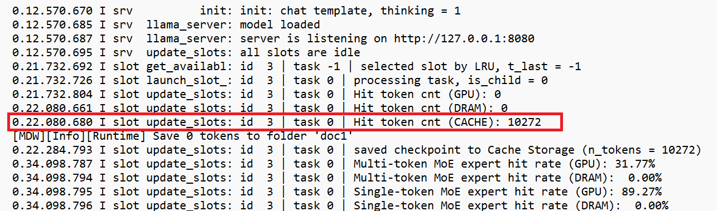
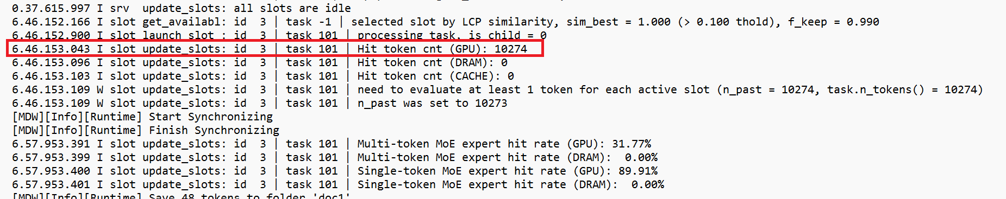
14–16 SEP · PROOF
Log evidence: where the prompt tokens came from
RUN 2 · AFTER RESTART
Served from the drive
GPU and DRAM caches are empty after the restart, yet Hit token cnt (CACHE) = 10272: the prefix is read back from the aiDAPTIV namespace on D:.
Only 2 of 10,274 tokens went through prefill.
Run 2 — first request after the restart
RUN 3 · SAME SESSION
Served from VRAM
Without a restart the prompt is matched by LCP similarity (sim_best = 1.000) and answered from the GPU: Hit token cnt (GPU) = 10274.
Run 3 — same prompt again, server left running
MiPhi · aiDAPTIV+ Integration — Weekly Update · 18 September 2026
6

Slide 7
14–16 SEP · BENCHMARK
Findings from the aiDAPTIV+ server log
10,272
2
99.98%
KEY LOG LINES
[MDW] Trying to resume KV cache...
[MDW] KV cache resume completed
[MDW] Resume subfolder: doc1
Hit token cnt (GPU): 0
Hit token cnt (DRAM): 0
Hit token cnt (CACHE): 10272
saved checkpoint to Cache
Storage (n_tokens = 10272)
prompt eval time = 917.98 ms
/ 2 tokens
eval time = 11041.72 ms
/ 100 tokens (9.06 t/s)
total time = 11959.70 ms
/ 102 tokens
graphs reused = 99
tokens restored
from aiDAPTIV+ storage
tokens re-computed
out of 10,274 in the prompt
of the prompt reused
after a full server restart
416 ms
9.06 t/s
89.27%
cache lookup + restore
log 25.517 s → 25.933 s
generation
100 tokens in 11.04 s
MoE expert hit (GPU)
single-token · DRAM 0.00%
Reading: prefill collapsed from ~10K tokens to 2 tokens, so time-to-first-token is set by a ~0.4 s cache restore instead of a full prefill.
Source: C:\Windows\Temp\2026-09-15_17-55-49_llama_server.log · task 0, slot 3
MiPhi · aiDAPTIV+ Integration — Weekly Update · 18 September 2026
7

Slide 8
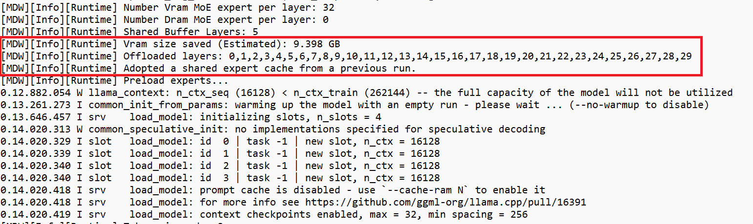
14–16 SEP · RUN DETAIL
Run configuration and MoE expert offload
9.398 GB
VRAM saved (est.)
reported by the middleware
30
Same run — the middleware reports the expert offload it applied at model load
layers offloaded
layers 0–29 · 32 VRAM experts/layer
RUN CONFIGURATION
• gemma-4-26B-A4B-it-UD-Q4_K_M.gguf · aiDAPTIV+ build NXWVB306.1 (b9568)
• --ctx-size 16000 · -ngl 100 · --flash-attn auto · --no-mmap · --vram-experts-cached-gb 4
• --kv-cache-resume-policy 1 · --offload-path D:/nvme0 · resume subfolder 'doc1'
• Intel Core Ultra 7 356H · Vulkan0 Intel Graphics 18,268 MiB · n_parallel 4
14.1 s
cold start
launch to “model loaded”
Together: the AI SSD holds both the offloaded experts and the KV cache and 9.4 GB of VRAM saved on this run.
MiPhi · aiDAPTIV+ Integration — Weekly Update · 18 September 2026
8

Slide 9
14–16 SEP · PERFORMANCE
Measured difference, side by side
Metric | Without aiDAPTIV+ | With aiDAPTIV+ | Difference
Prompt tokens in the request | 10,793 | 10,274 | similar ~10K prompt
Cache hit (GPU / DRAM / CACHE) | 0 / 0 / 0 | 0 / 0 / 10,272 | prefix served from drive
Prompt tokens re-computed | 10,793 (all) | 2 | − 99.98 %
Prompt eval (prefill) time | 105381 ms | 917.98 ms | 114× faster · 104s saved
Generation throughput * | 7.63 tok/s (683 tok) | 9.06 tok/s (100 tok) | not like-for-like
MiPhi · aiDAPTIV+ Integration — Weekly Update · 18 September 2026
9

Slide 10
14–16 SEP · PLAN
Making KV cache reuse work inside Onyx
1
2
3
What we assume
Approach
How we verify
• Reuse is proven at the API level, but not yet through Onyx
• The middleware only reuses a cache entry when the leading tokens match
• We assume Onyx's code has to be modified before that prefix stays stable
• Take the OpenWebUI integration code as the base and its request path already works against the aiDAPTIV+ endpoint
• Integrate that handling into Onyx's LLM provider layer
• Keep system prompt and document context byte-identical across turns
• Repeat this week's test through Onyx: prefill → restart → replay
• Expect Hit token cnt (CACHE) > 0 in the server log, not a 91 s prefill
• Document upload lands with this work and an uploaded file becomes the reusable prefix
ASSUMPTION
PLANNED
PLANNED
Next: integrate and verify KV cache reuse through Onyx. Document upload comes with that integration, then the same path is rolled out to the other apps.
MiPhi · aiDAPTIV+ Integration — Weekly Update · 18 September 2026
10

Slide 11
SECTION 2
Onyx: making the same reuse work from the app
• Added cache_prompt and offload_folder_name to Onyx's docker-compose
17 – 18 SEP
• Checked recomputation in Onyx across a server restart
KV cache reuse inside Onyx
• Uploaded a document and verified the context is served from the cache
• Logged the prefix the middleware wrote to the drive - 9,496 tokens
Outcome: after a restart Onyx re-uses the uploaded document's prefix - Hit token cnt (CACHE): 10,968 instead of a fresh prefill.
MiPhi · aiDAPTIV+ Integration — Weekly Update · 18 September 2026
11

Slide 12
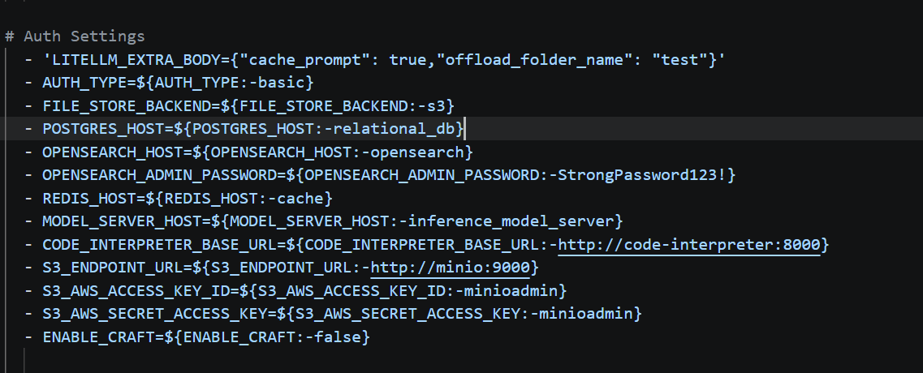
17–18 SEP · ONYX CONFIGURATION
Turning on KV cache reuse inside Onyx
WHAT WE CHANGED
Onyx was reaching the model without ever asking for cache reuse.
Added one LLM extra-body line to the api_server service in docker-compose.yml - no application code was touched.
"cache_prompt": true
Asks the middleware to reuse a matching prompt prefix.
"offload_folder_name": "test"
Names the folder on the AI SSD that holds the cache.
docker-compose.yml · api_server → environment
Outcome — every Onyx request now carries the reuse flags, so prompts are cached to and served from aiDAPTIV+ storage.
MiPhi · aiDAPTIV+ Integration — Weekly Update · 18 September 2026
12

Slide 13
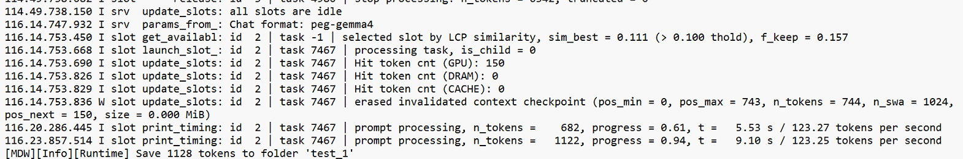
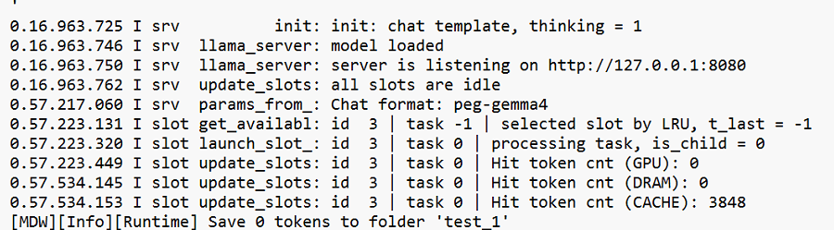
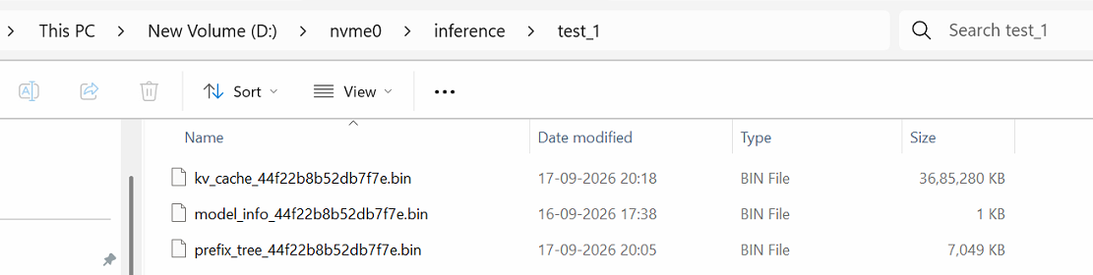
17–18 SEP · REUSE VERIFIED IN ONYX
The same prompt after a restart is served from the SSD
1
FIRST RUN · CACHE WRITTEN
HOW WE TESTED
Sent a prompt through Onyx; the middleware wrote the KV cache to the aiDAPTIV+ folder.
Restarted llama-server so nothing could survive in GPU memory.
Re-sent the identical prompt from Onyx.
2
SECOND RUN · AFTER SERVER RESTART
CACHE FILE ON THE AI SSD
Result — 3,848 tokens came back from CACHE and 0 tokens were re-saved: nothing was recomputed.
MiPhi · aiDAPTIV+ Integration — Weekly Update · 18 September 2026
13

Slide 14
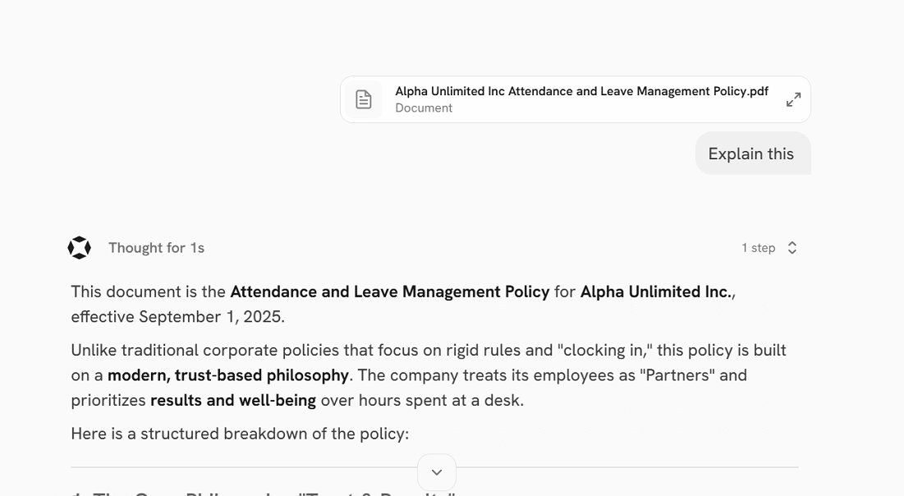
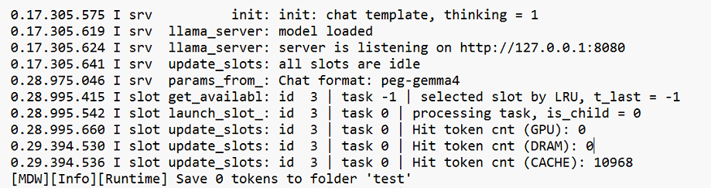
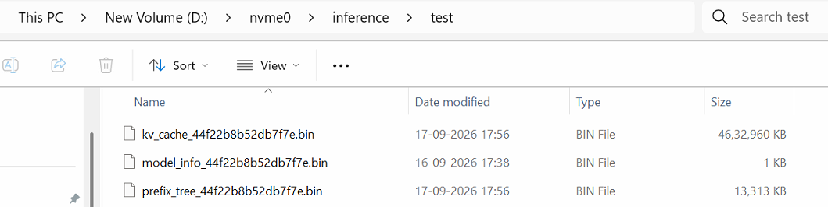
17–18 SEP · DOCUMENT UPLOAD
Uploaded document context is reused as well
1
KVCACHE REUSE OF UPLOADED DOCUMENT
DOCUMENT UPLOADED TO ONYX
CACHE FILE ON THE AI SSD
Result — 10,968 document tokens were served from CACHE; the uploaded file was not re-read or re-processed.
MiPhi · aiDAPTIV+ Integration — Weekly Update · 18 September 2026
14

Slide 15
NEXT · UPCOMING
Upcoming tasks
1
2
Validate RAG retrieval
Integrate LibreChat
• Validate the RAG retrieval in Onyx with various context lengths
• After validating Onyx, integrate LibreChat
• Confirm that the relevant context is correctly identified and retrieved
• Same path: cache_prompt plus an offload folder on the AI SSD
• Benchmark the results with and without aiDAPTIV+
PLANNED
PLANNED
Order: validate and benchmark retrieval inside Onyx first, then bring LibreChat onto the same reuse path and roll it out to the remaining apps.
MiPhi · aiDAPTIV+ Integration — Weekly Update · 18 September 2026
16

