Slide 1

Lecture 10: Building production ready CUDA libraries
A computer architecture aware programming perspective
Oscar Amoros Huguet

Slide 2

About me
BSC
UB
Teaching assistant 9 years teaching OpenCL/CUDA and other CS topics
2 papers (OpenCL)
First OpenSource library: SimpleOpenCL
StreamHPC
Porting Boost Compute (OpenCL) to HSA and HAS-IL
AutomaticTV 2016 – Today
AutomaticTV: soft real time, C++ and CUDA
New OpenSource libraries cvGPUSpeedup and the Fused Kernel library -> paper on the way!
3D convolutions in OpenCL, CUDA and OmpSs

Slide 3
Lecture overview
Summary of already seen concepts
Main story: why would a “CUDA ninja” want to create libraries?
Use cases:
GPU communication utility
GPU kernel libraries

Slide 4

Summary of already seen concepts
cudaMemcpyAsync -> D2H, H2D, D2D
GPU DRAM latencies and latency hiding
Memory bound and Compute bound Kernels
Kernel Fusion: Vertical
CUDA Streams

Slide 5

Lecture overview
Summary of already seen concepts
Main story: libraries
Use cases:
GPU communication utility
GPU kernel libraries

Slide 6

Main story: 2008 approach
CPU application
GPU application

Slide 7


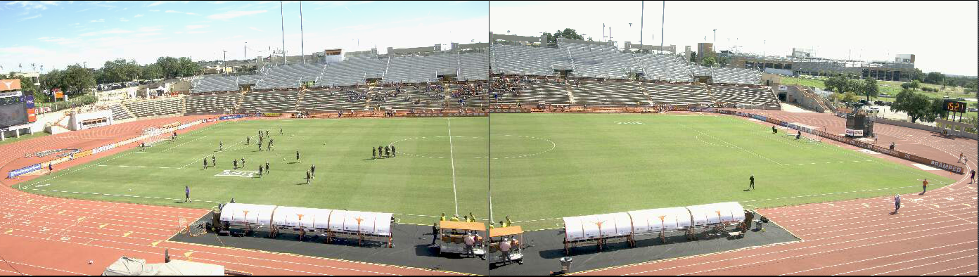

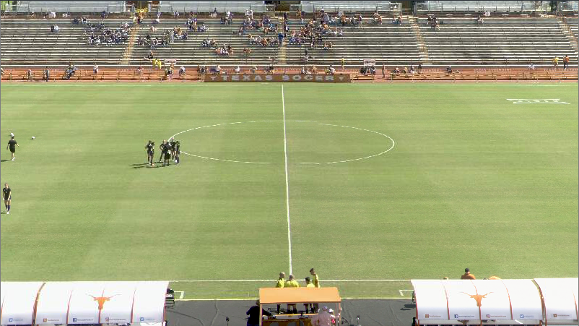
Main story: most of my C++/CUDA exp.
4K
4K
https://automatic.tv/
FullHD
Notes:
Been working for 8 years
Soft real time application
AutomaticTV -> Automatic sports production
All code is C++

Slide 8
Main story: ideal project organization
Design phase
Code flexibility
No CUDA knowledge
Performance Optimizations
QA phase

Slide 9

Main story: reality
Performance QA
Some optimizations
QA phase
Design phase
Code flexibility
No CUDA knowledge
Performance Optimizations
More optimizations
Notes:
I was doing repetitive work under the clock.
I realized I had to put my knowledge in the shape of utilities/libraries, that the rest of the team can use, without knowing CUDA.

Slide 10
Main story: problem
AI
Notes:
3 Main IDEAS:
1 Fast CPU scheduling, wait at the end of the iteration
2 Make this work on multi GPU!! -> communication
3 Most kernels are heavily memory bound

Slide 11

Main story: tough balance
Abstraction
Performance
Notes:
The more abstraction usually less performance
The more performance usually less abstraction

Slide 12

Main story: user requirements
Abstraction
Performance
Notes:
Which is the level of abstraction your target users want/need?
Which API’s are they using?
Which concepts do they know?
What level of performance do they need?
What is acceptable, and what is painful fo them?

Slide 13


Main story: what users care about
Learning curve
API
Notes:
You defined a great abstraction, but programmers don’t want to use it, because it’s very different from what they already know.

Slide 14
Main story: libraries challenges

Slide 15
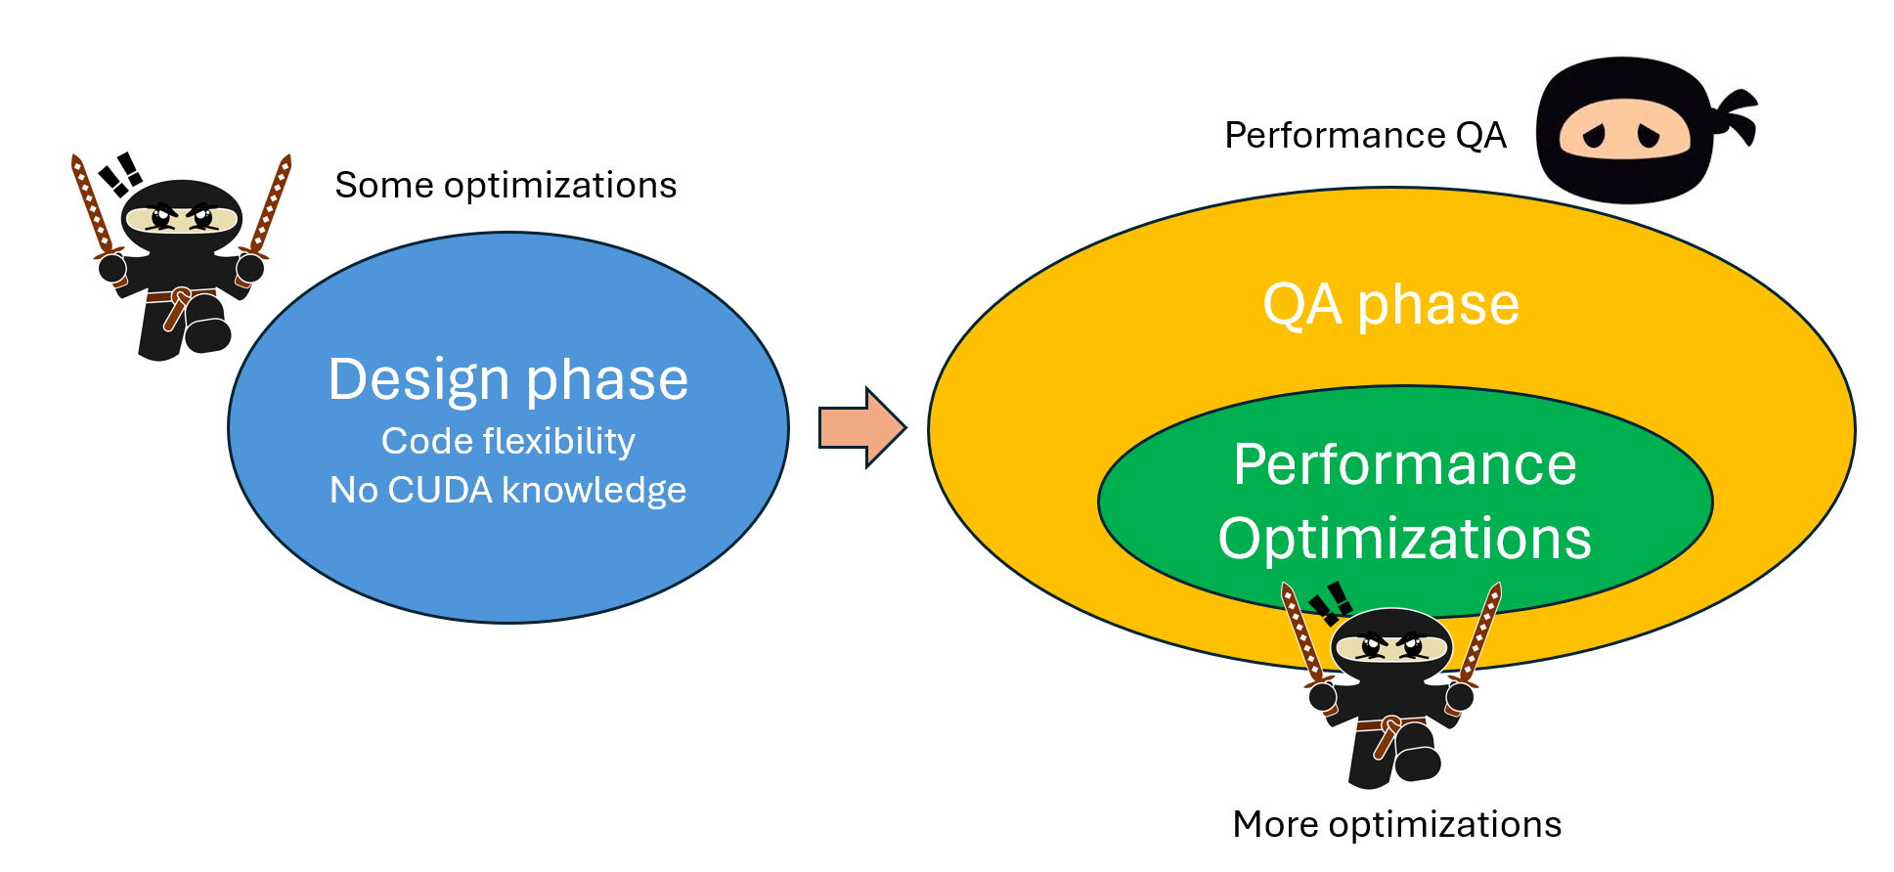
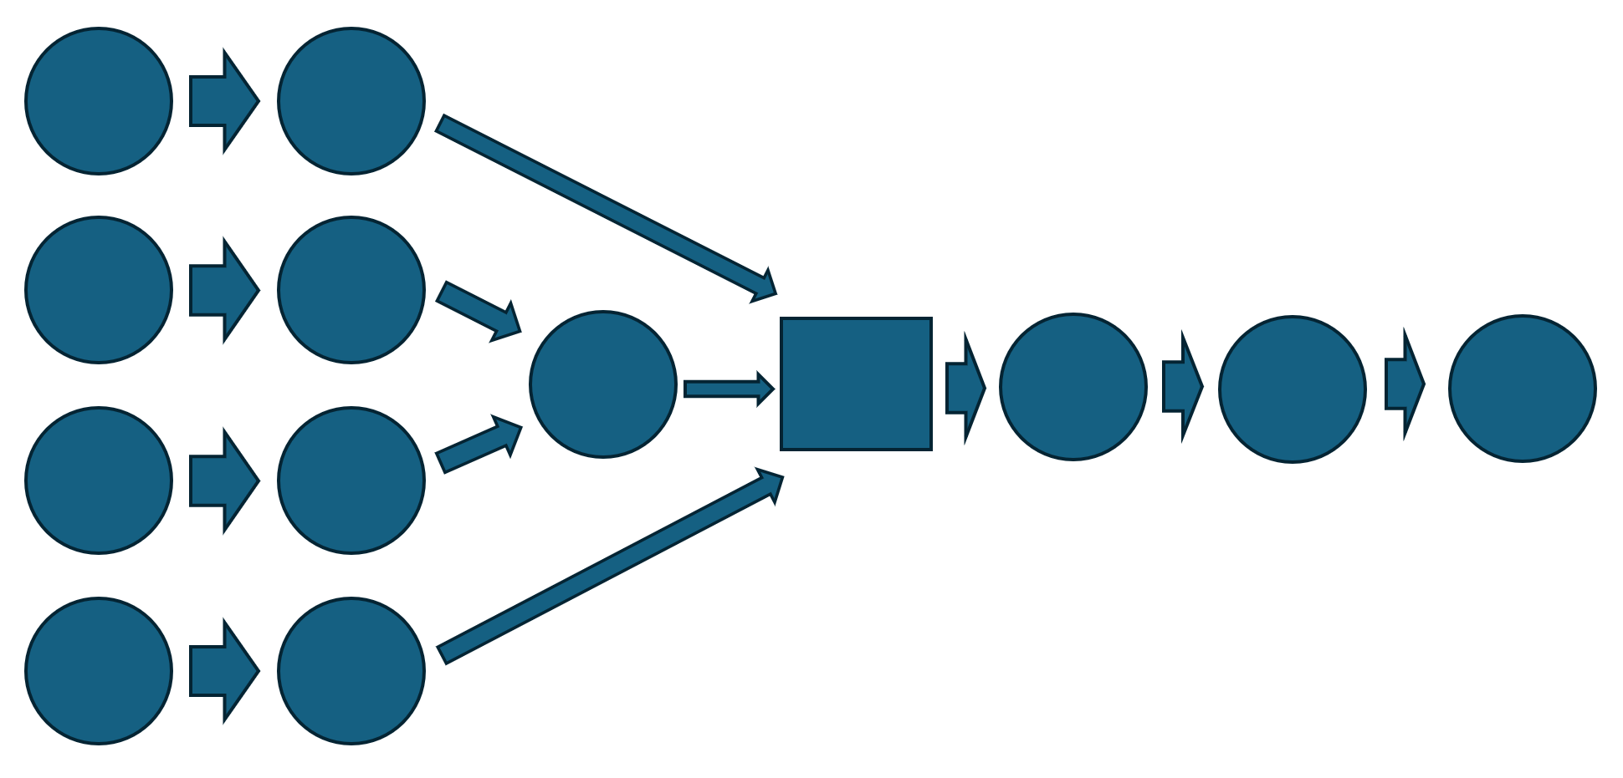
Main story: summary
Motivation
Problem to solve
Challenges
Notes:
Motivation: provide utilities/libraries, so the final user can modify the code, and always get the best performance
Problem to solve: we discussed the kind of problems that the specific application has
Challenges: discussed the typical challenges when creating utilities and libraries

Slide 16
Lecture overview
Summary of already seen concepts
Main story: libraries
Use cases:
GPU communication utility
GPU kernel libraries

Slide 17
GPU communication utility
Source Memory Space
Destination Memory Space

Slide 18
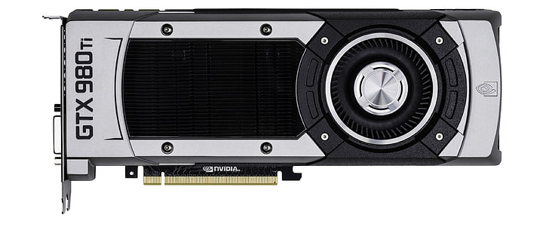

GPU communication utility
GPU
Memory Space Types
CPU Pinned
CPU

Slide 19
GPU communication utility
Pre-allocate all your memory

Slide 20
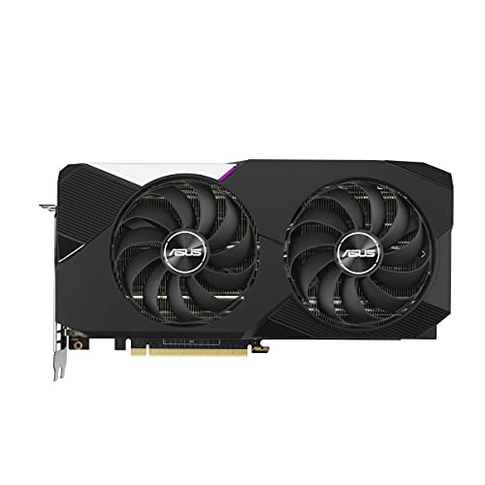
GPU communication utility
Source Memory Space
Destination Memory Space
!=
Manager.manage(sourcePtr, destinationPtr);
Source Memory Space
Destination Memory Space
==
Notes:
For a given spot in the code, memory spaces Source and Destination can change, according to the system where the code is executed.
Same line of code should work for any configuration

Slide 21
GPU communication utility
Source MS Type | Destination MS Type | Number of copies
CPU | CPU | 0
CPU | CPU Pinned | 1
CPU | GPU | 2 CPU -> Pinned -> GPU
CPU Pinned | CPU | 1
CPU Pinned | CPU Pinned | 0
CPU Pinned | GPU | 1
GPU | CPU | 2 GPU -> Pinned -> CPU
GPU | CPU Pinned | 1
GPU | GPU | 0
GPU | Peer GPU | 1
GPU | Fake Peer GPU | 2 GPU -> Pinned -> GPU
Multi GPU
cudaMemcpyPeerAsync
cudaMemcpyPeerAsync

Slide 22
GPU communication utility
Problem: serial execution (GPU to Fake Peer GPU)
GPU 1PU
Kernel A
Copy D2HPN
Copy HPN2D
GPU 2U
Kernel B
Time
Goal: parallel execution
GPU 1PU
Kernel A
Copy D2HPN
Copy HPN2D
Kernel B
Kernel B
GPU 2U
GPU 2U
Time
Time

Slide 23
GPU communication utility
Buffer
DATA
PTR
Producer
PTR
Consumer
PTR
PTR
DATA
PTR
ProducerConsumerBuffer buffer;
CPU THREAD 1
ptrToProduce = buffer.getPointerToProduce();
doProduce(ptrToProduce); // Modifying the data
buffer.setPointerAsProduced(producedData);
CPU THREAD 2
ptrToConsume = buffer.getPointerToConsume();
doConsume(ptrToConsume); // Reading the data
buffer.setPointerAsConsumed(producedData);
Notes:
Model Producer Consumer
We have a Producer Thread, a Consumer Thread and a Producer-Consumer Buffer

Slide 24
GPU communication utility
GPU 1PU
Buffer
Producer Kernel
PTR
PTR
Copy D2HPN
CPU PU
Buffer
PTR
PTR
Copy HPN2D
GPU 2PU
Buffer
PTR
Consumer Kernel
PTR

Slide 25
GPU communication utility
Producer Kernel
GPU 1PU
Copy D2HPN
CPU PU
2
1
0
Iteration:
3
Copy HPN2D
END
GPU 2PU
Consumer Kernel

Slide 26
GPU communication utility
Iterative Memory Manager
Producer Kernel
GPU 1PU
Copy D2HPN
CPU PU
Copy HPN2D
GPU 2PU
Consumer Kernel

Slide 27
GPU communication utility
Write
Read
Single CPU Thread
T0
T1
T2
T3
T4
T5
T6
Delay Buffer

Slide 28
GPU communication utility
Memory manager: minimum delay possible
Delay Buffer
Memory Manager .
COPY
GPU 1PU
Copy D2HPN
CPU PU
Copy HPN2D
GPU 2PU
Consumer Kernel

Slide 29
GPU communication utility
Memory manager: minimum copies and delay possible
Delay Buffer
GPU 1PU
Memory Manager .
Copy D2HPN
CPU PU
Copy HPN2D
GPU 2PU
Consumer Kernel
Notes:
More complexirty but: implement once, and forget about it
Benefits:
Skip a copy
Allocate less memory

Slide 30
GPU communication utility
Producer
Consumer
DATA
Provider
Taker
POINTER

Slide 31


GPU communication utility
Taker
Provider
TAKE
Dear manager, I want you to provide me with a pointer that you own (allocated long ago when the application started).
Please, do not use this pointer during this iteration, because I’m going to use it.
After this iteration, you can do whatever you need with it.
During this iteration, do your stuff with other pointers.
Outside the Manager
Iterative
Memory
Manager

Slide 32
GPU communication utility
Provider
Taker
PROVIDE
Dear manager, here is a pointer that I own (allocated long ago when the application started).
I assure you can safely use it during this iteration, because no one else is going to read or write it.
Please, give it back when the iteration finishes.
Outside the Manager
Iterative
Memory
Manager

Slide 33
GPU communication utility
Producer Memory Space | Consumer Memory Space
ProducerTakes | ConsumerTakes
ProducerProvides | ConsumerTakes
ProducerTakes | ConsumerProvides
ProducerProvides | ConsumerProvides

Slide 34
GPU communication utility
Source MS | Destination MS | Flag | Number of copies
CPU | CPU | HPG2HPG | 0
CPU | CPU Pinned | HPG2HPN | 1
CPU | GPU | HPG2D | 2 CPU -> Pinned -> GPU
CPU Pinned | CPU | HPN2HPG | 1
CPU Pinned | CPU Pinned | HPN2HPN | 0
CPU Pinned | GPU | HPN2D | 1
GPU | CPU | D2HPG | 2
GPU | CPU Pinned | D2HPN | 1
GPU | GPU | D2D | 0
GPU | Peer GPU | D2PD | 1
GPU | Fake Peer GPU | D2FPD | 2 GPU -> Pinned -> GPU
Producer MS | Consumer MS
Take | Take
Provide | Take
Take | Provide
Provide | Provide

Slide 35
GPU communication utility
struct DataInfo {
int numElements;
int elemSizeInBytes;
MemorySpace memSpace;
};
DataInfo producerDataInfo{1024, 4, HostPageable};
DataInfo consumerDataInfo{1024, 4, Device_1};
Data ptrToProduce(producerDataInfo);
Data ptrToConsume(consumerDataInfo);
enum Actions { ProducerProvides, ProducerTakes, ConsumerProvides, ConsumerTakes};

Slide 36
GPU communication utility
//Initialization
MemoryManager<ProducerProvides, ConsumerProvides> manager(producerDataInfo, consumerDataInfo);
int delay = manager.getTotalDelay(); // Query delay generated by the manager
manager.manage(ptrToProduce, ptrToConsume); // Usage

Slide 37
GPU communication utility
// Initialization
MemoryManager<ProducerTakes, ConsumerTakes> manager(producerDataInfo, consumerDataInfo);
auto [ptrToProduce, ptrToConsume] = manager.manage(); // Usage

Slide 38
GPU communication utility
// Initialization
MemoryManager<ProducerTakes, ConsumerProvides> manager(producerDataInfo, consumerDataInfo);
ptrToProduce = manager.manage(ptrToConsume); // Usage

Slide 39
GPU communication utility
// Initialization
MemoryManager<ProducerProvides, ProducerTakes> manager(producerDataInfo, consumerDataInfo);
ptrToConsume = manager.manage(ptrToProduce); // Usage

Slide 40
GPU communication utility
GPU1
Compute
M
Delay Buffer
M
Compute
M
Delay Buffer
M
Compute
No copy
No copy
No copy
No copy
MemoryManager< ProducerTakes, ConsumerProvides>
MemoryManager<ProducerProvides, ConsumerTakes>
MemoryManager<ProducerTakes, ConsumerProvides>
MemoryManager<ProducerProvides, ConsumerTakes>

Slide 41
GPU communication utility
GPU1
Compute
Compute
M
Delay Buffer
M
Compute
M
M
No copy
No copy
CPU
Delay Buffer
Two copies
Two copies

Slide 42
GPU communication utility
GPU1
Compute
M
M
Compute
Compute
Time

Slide 43
GPU communication utility
GPU1
Compute
M
CPU
Delay Buffer
M
GPU2
Compute
M
Delay Buffer
M
GPU3
Compute

Slide 44
GPU communication utility
GPU1
Compute
Download
GPU2
Compute
Upload
Peer
GPU3
Compute
Time

Slide 45

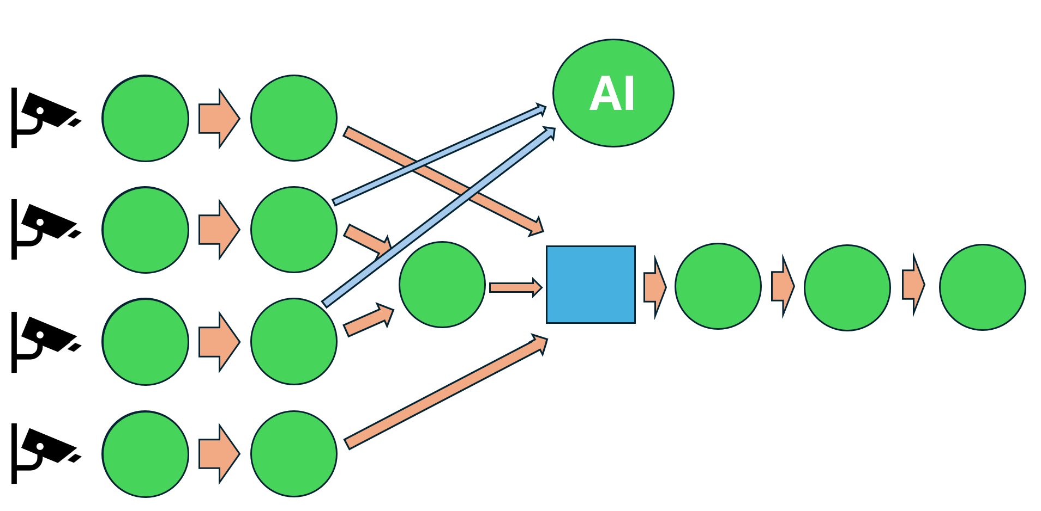
GPU communication utility
GPU 0 TCC
GPU 1 TCC
GPU 2 WDDM
GPU 1
GPU 0
GPU 2
Notes:
Nsight Systems timeline

Slide 46
GPU communication utility
Libraries that provide solutions to similar problems
Image processing graphs:
DeepStream SDK | NVIDIA Developer | NVIDIA Developer
Multi-gpu and multi-node CUDA programs (training DNNs and more):
NVIDIA Collective Communications Library (NCCL) | NVIDIA Developer

Slide 47
GPU communication utility
Providing this pointer: ProducerProvides
Buffer
GPU 1PU
I
Memory Manager .
Copy D2HPN
CPU PU
Copy HPN2D
GPU 2PU
Kernel B
O
Taking this pointer: ConsumerTakes

Slide 48
GPU communication utility
Taking this pointer: ProducerTakes
Memory Manager .
Kernel A
GPU 1PU
I
Copy D2HPN
CPU PU
Copy HPN2D
GPU 2PU
O
Buffer
Providing this pointer: ConsumerProvides

Slide 49
GPU communication utility
Providing this pointer: ProducerProvides
Buffer
GPU 1PU
I
Memory Manager .
Copy D2HPN
CPU PU
Copy HPN2D
GPU 2PU
O
Buffer
Providing this pointer: ConsumerProvides

Slide 50
GPU communication utility
Zero copy case
Providing this pointer: ProducerProvides
Buffer
GPU 1PU
Memory Manager
Kernel B
I and O
Taking this pointer: ConsumerTakes

Slide 51
GPU communication utility
Rules to know when to use Provide:
If the Producer code it’s a Delay Buffer.
Equivalent to saying: if the Producer code does not modify the data during this iteration.
Then Producer must Provide: ProducerProvides
If the Consumer code it’s a Delay Buffer.
Equivalent to saying: if the Consumer code does not modify the data during this iteration.
Then Consumer must Provide: ConsumerProvides

Slide 52
GPU communication utility
Rules to know when to use Take:
If the Producer code it’s a Kernel or asynchronous CPU code.
Equivalent to saying: if the Producer code does modify the data during this iteration.
Then Producer must Take: ProducerTakes
If the Consumer code it’s a Kernel or asynchronous CPU code.
Equivalent to saying: if the Consumer code does modify the data during this iteration.
Then Consumer must Take: ConsumerTakes

Slide 53
Lecture overview
Summary of already seen concepts
Main story: libraries
Use cases:
GPU communication utility
GPU kernel libraries

Slide 54

GPU kernel libraries
OpenSource personal project:
morousg/cvGPUSpeedup: A faster implementation of OpenCV-CUDA that uses OpenCV objects, and more! (github.com)

Slide 55
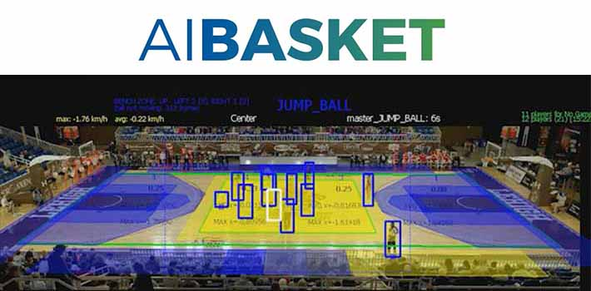
GPU kernel libraries
The inference image preprocessing
The image processing pipeline

Slide 56
GPU kernel libraries:
AI team uses OpenCV-CUDA -> extremely memory bound kernels
Many small independent and dependent kernels

Slide 57
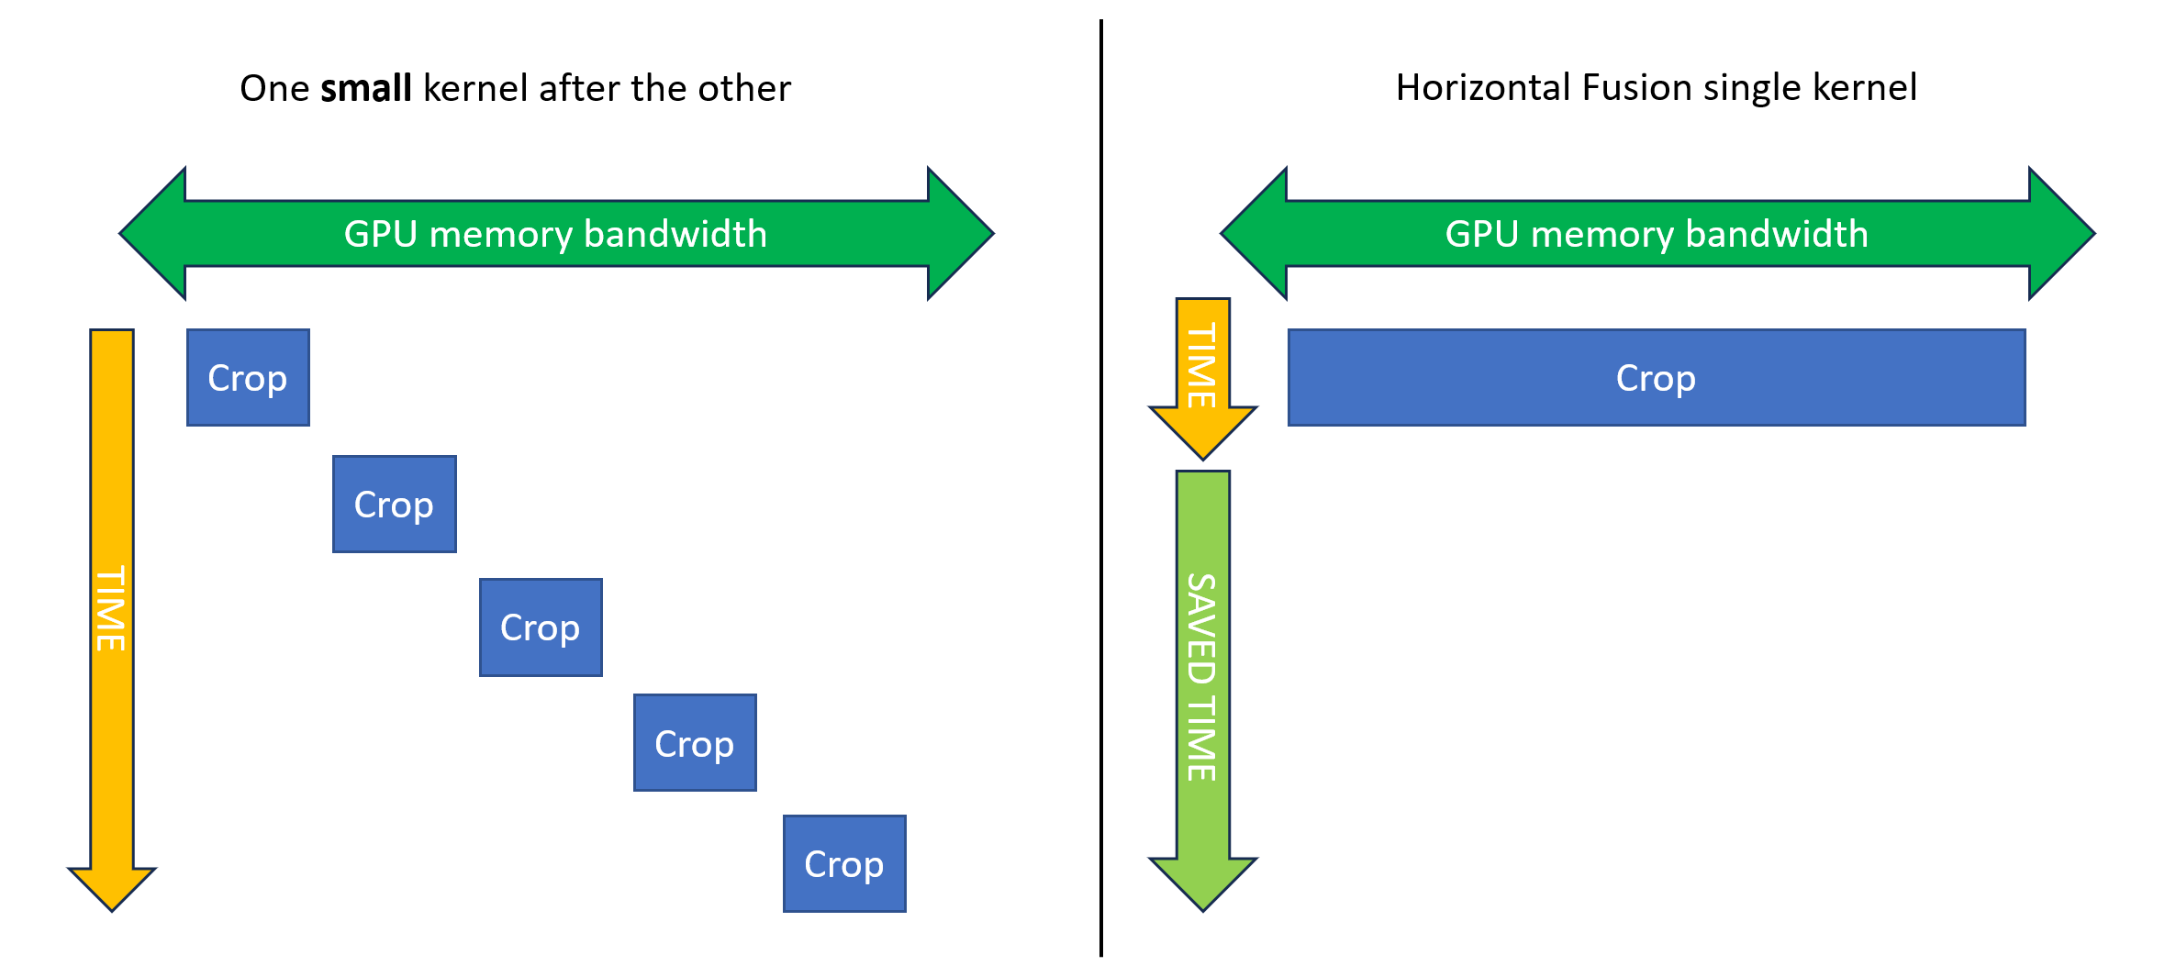
GPU kernel libraries: Horizontal Fusion

Slide 58
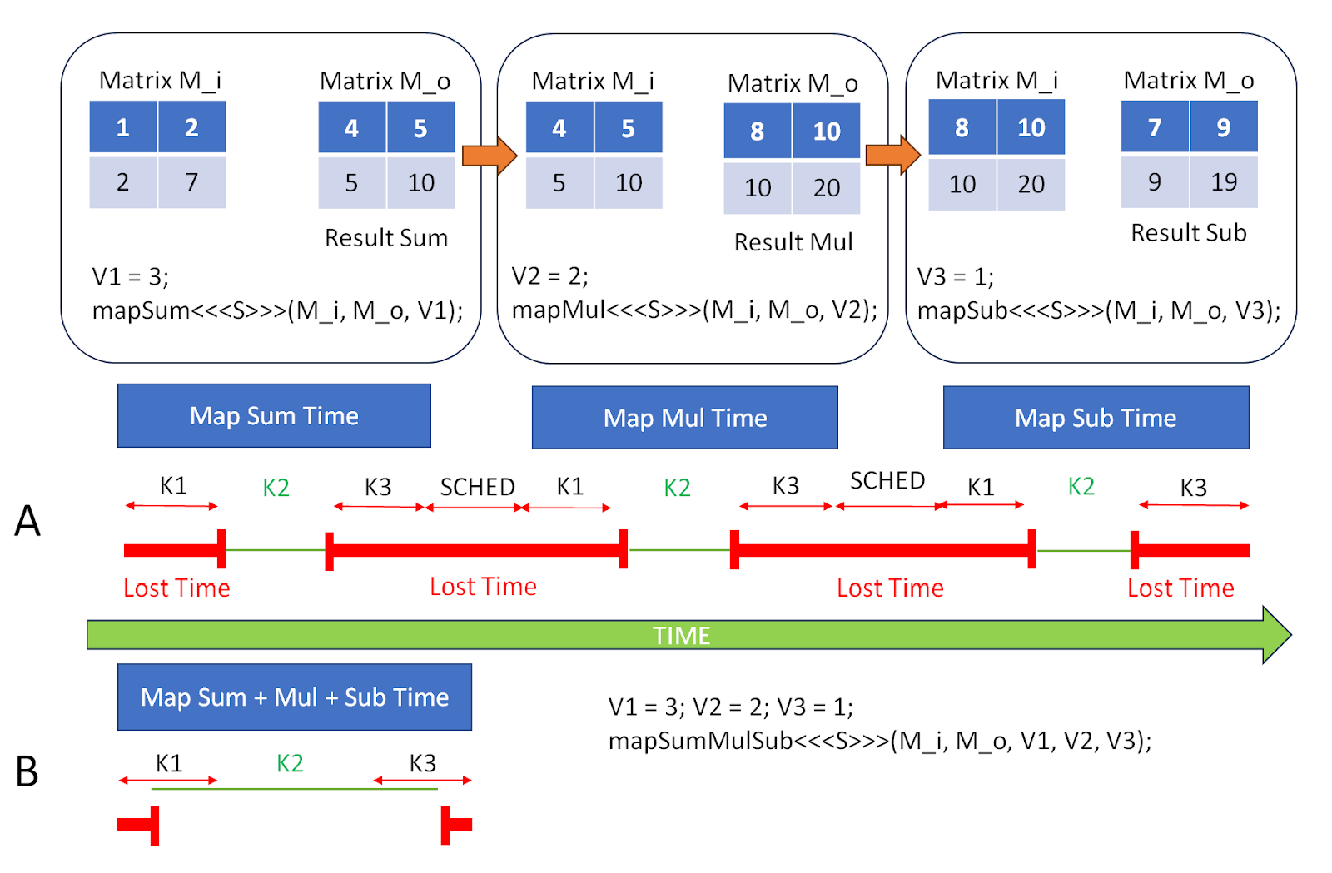
GPU kernel libraries: Vertical Fusion

Slide 59

GPU kernel libraries: Fusion
Vertical Fusion for Data Dependent Kernels
Horizontal Fusion for Data Independent Kernels

Slide 60

GPU kernel libraries: novel concepts implemented in cvGPUSpeedup library
Generic Vertical Fusion (GVF)
Divergent Horizontal Fusion (DHF)
Backwards Generic Vertical Fusion (BGVF)
Automatic Thread Coarsening (ATC)

Slide 61

GPU kernel libraries
Typical approach for Vertical Fusion:
Library defines a set of Vertically Fused Kernels (__global__ functions)
Explicitly chosen by the user
Implicitly chosen by a runtime
Our proposal:
The library provides a set of fusionable __device__ functions
The final user, defines the chain of functions that go into the kernel, without knowing it.
We call this Generic Vertical Fusion

Slide 62
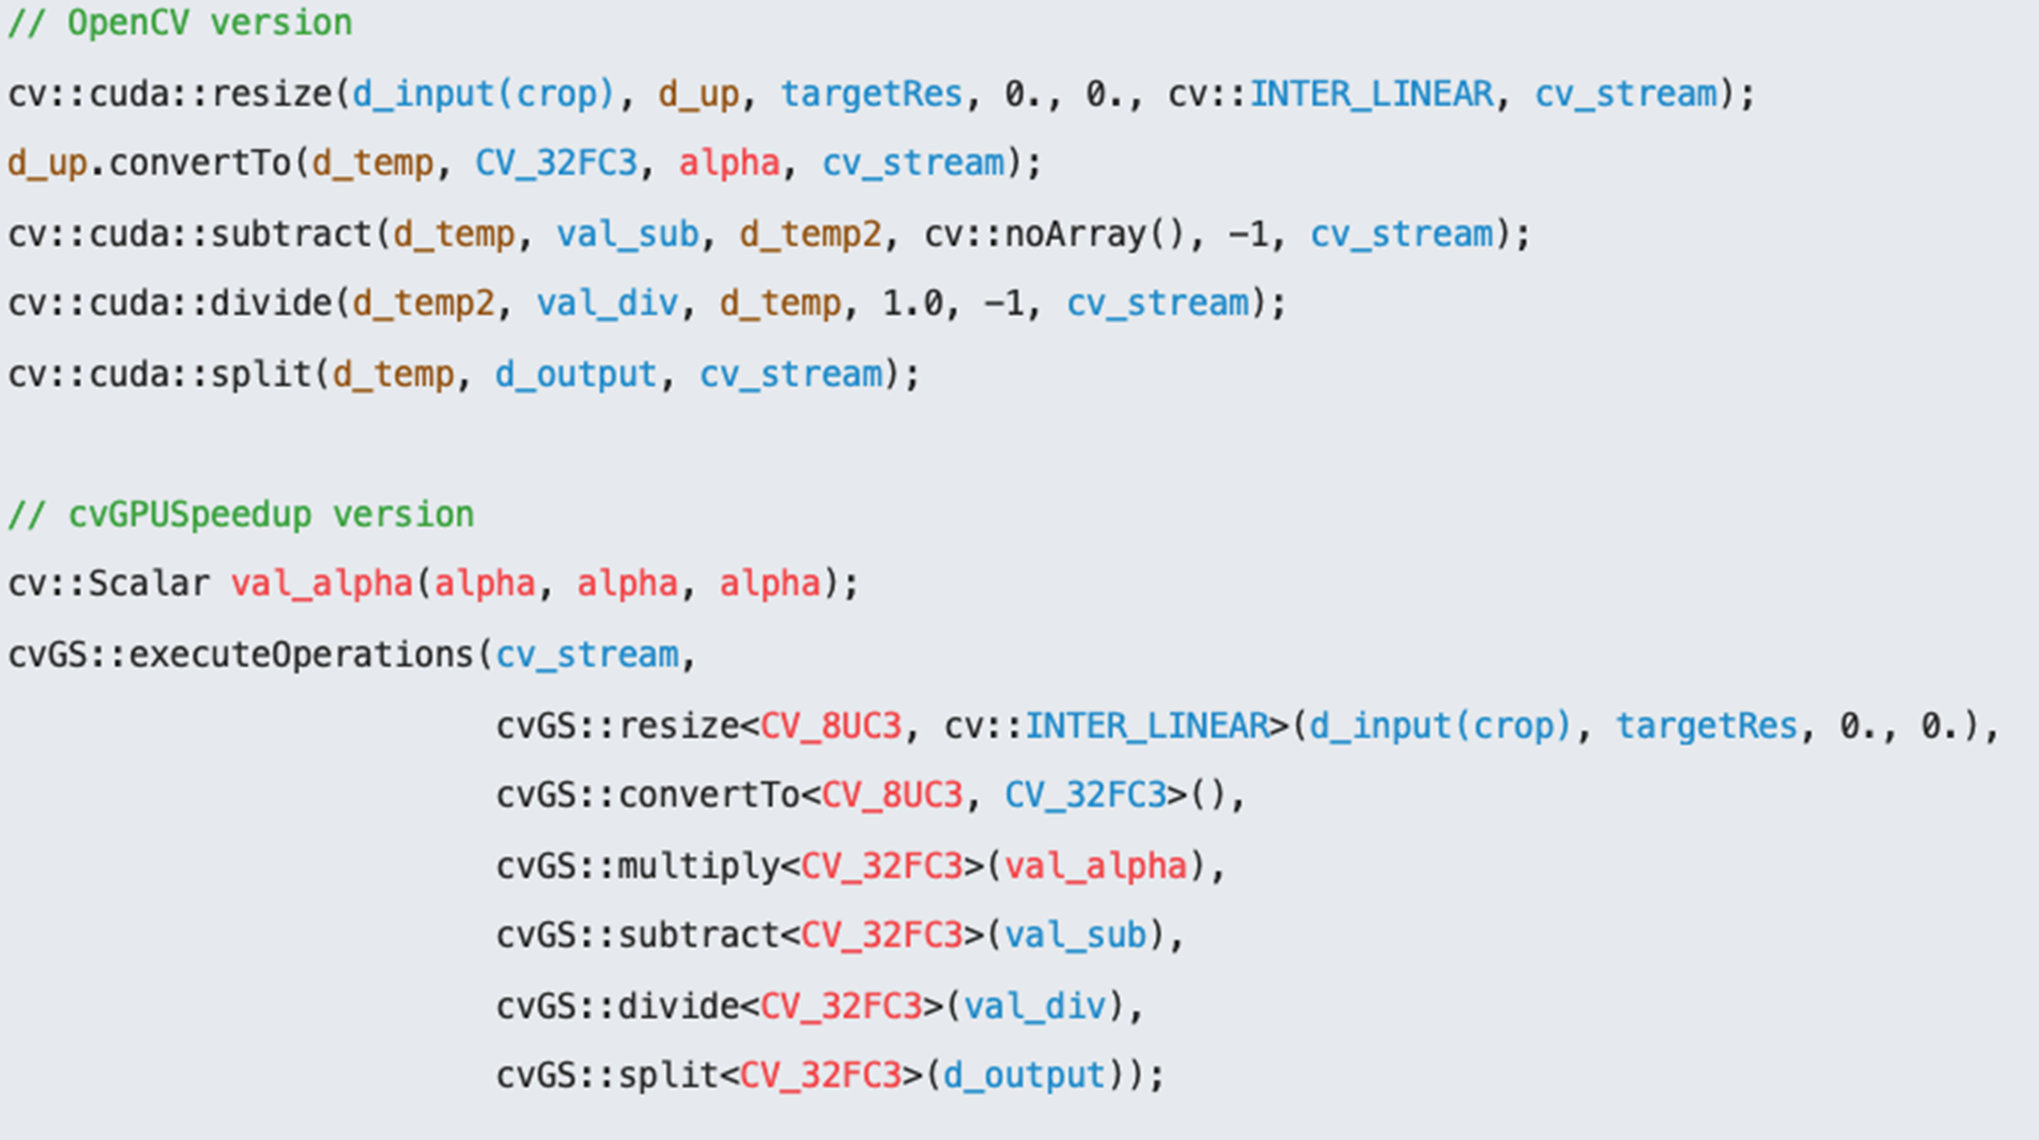
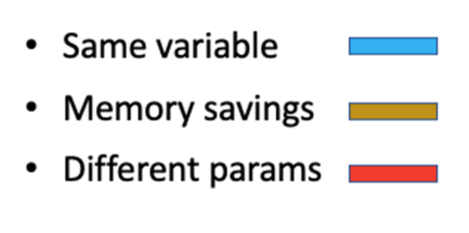
GPU kernel libraries: Generic Vertical Fusion
No Fusion
GVF

Slide 63
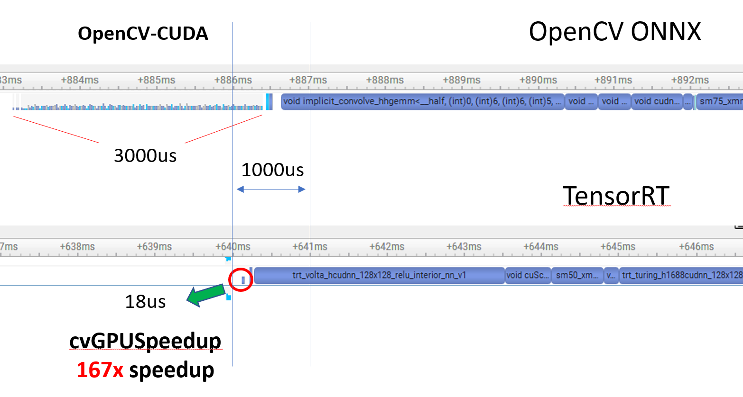
GPU kernel libraries: Cr,Res,Nor for 50 Crops

Slide 64
GPU kernel libraries: CircularTensor
cvGS::CircularTensor<InputCVType, CircularTensorCVType, NUM_CHANNELS, BATCH, cvGS::CircularTensorOrder::NewestFirst> myTensor(WIDTH, HEIGHT);
myTensor.update(cv_stream,
cvGS::resize<…>(newImage, …),
cvGS::convertTo<…>(…),
cvGS::split<…>(myTensor.ptr().data)); // We may look for a way to avoid this
// Now you can send the raw data to inference
network.forward(myTensor.ptr().data, cv_stream);

Slide 65

New image
Sub Grid Pattern
Interpolate
CircularTensor
Using: GVF + DHF
Normalize
MidWrite
Write
Sub Grid Pattern
PerThreadRead
Newest
PerThreadWrite
Fused Kernel
5
4
4
TIME
TIME
Sub Grid Pattern
3
5
PerThreadRead
1
2
Newest
Oldest
PerThreadWrite
2
Oldest
TIME
Sub Grid Pattern
3
PerThreadRead
PerThreadWrite

Slide 66
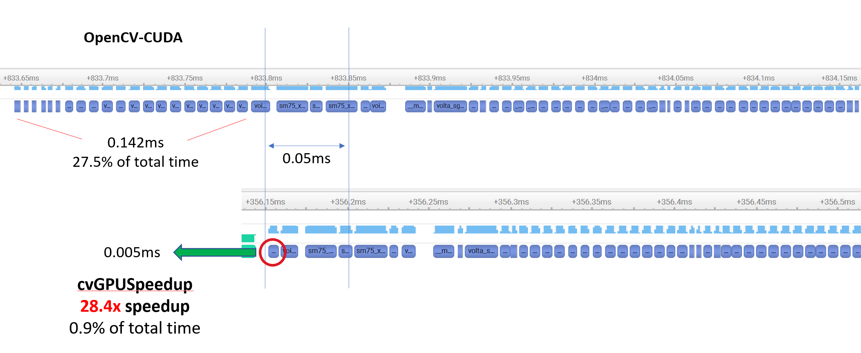
GPU kernel libraries

Slide 67
GPU kernel libraries: image processing
Hand made kernels
Mostly memory bound -> repetitive optimizations
Read uchar4, process float4, store uchar4 -> loss of image quality

Slide 68
GPU kernel libraries: graph total fusion
using HowToReadAPixel = Binary<ReadYUV<NV12>, ConvertYUVToRGB<NV12, Full, bt709, AddAlpha, float4>, ImageProcA<float4>>;
HowToReadAPixel readDF;
get_params<0>(readDF) = d_nv12Image; // Source 8K image (ReadYUV Device Function)
get_params<2>(readDF) = imgProcAParams; // Parameters required by the ImageProcA Device Function.
// Applying Backwards Generic Vertical Fussion (BGVF)
auto howToInterpolateAPixelDF = resize<HowToReadAPixel, INTER_LINEAR>(readDF.params,
Size(d_nv12Image.dims().width, d_nv12Image.dims().height),
Size(targetWidth, targeHeight));
// Not present in the OpenSource library, approximated code, more BGVF
auto howToTransformAPixelDF = geometryFuntionBuilder(howToInterpolateAPixelDF, stitchParams);
auto generateOutputImageWithScoreBoardDF = scoreBoardFunctionBuilder(howToTransformAPixelDF, scoreBoardParams);
// Launch a single CUDA kernel, that does everything
executeOperations(stream, generateOutputImageWithScoreBoardDF, // Generic Vertical Fusion after the BGVF
Binary<ConvertRGBAToYUV<…>>{},
Write<ChromaSubSampling<NV12>,…>>{d_outputImage});

Slide 69
GPU kernel libraries: graph total fussion
Source Image
DRAM
SRAM
SRAM
SRAM
ScoreBoard
SRAM
SRAM
Output Image
DRAM
4K RGBA
8K NV12
4K RGBA
4K RGBA
FHD
FHD
FHD
FHD NV12
SRAM
RGBA 2 NV12
Interpolate + Geometry
NV12 2 RGBA
ImageProcA
Backwards Device Functions
BDF
4x less pixels processed than non fused kernels, thanks to BGVF
Pixels behind the ScoreBoard will not be processed by BDFs, thanks to BGVF
Forwards Device Functions
FDF

Slide 70

GPU kernel libraries: graph total fussion
Any one imagined a fused neural network with the previous slide?
It will require extra work, but yes, we have many ideas on how to get there, (including reductions, MMA etc…)

Slide 71
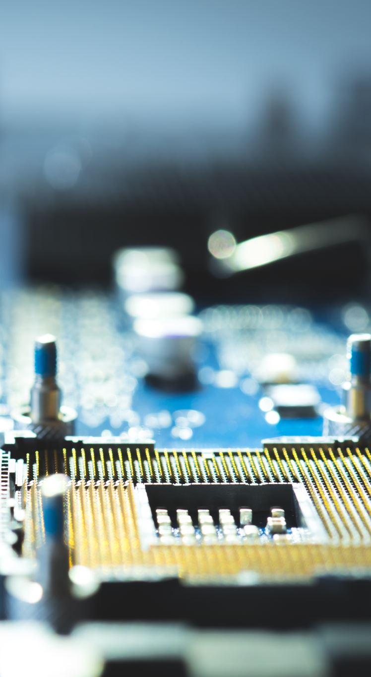
GPU kernel libraries
Automatic Thread Coarsening:
Compile time detection of the possibility/convenience to apply it or not.
Requires zero user intervention (non CUDA programmers)
Requires CUDA ninjas to include it or not in their Read and Write Device Functions
Around 2x speedups for very memory bound kernels
Currently only active for 1 or 2 Byte data types:
Bigger types do not seem to give any speedup.
Further analysis will look into it.

